Slide 1
California and Northwest Tribal Epidemiology Center Overview
Vanesscia Cresci, MSW, MPA
Acting Epidemiology Manager, California Tribal Epidemiology Center
Director, Research & Public Health Department
California Rural Indian Health Board, Inc.
Victoria Warren-Mears, PhD, RDN, FAND
Director, Northwest Tribal Epidemiology Center
Northwest Portland Area Indian Health Board

Slide 2
Tribal Epidemiology Centers (TEC)
Established via Indian Health Care improvement Act (IHCIA)
Four TECs were started in 1996, now 12 TECs
TECs function independently, but also as part of a national group called TEC-Consortium

Slide 3
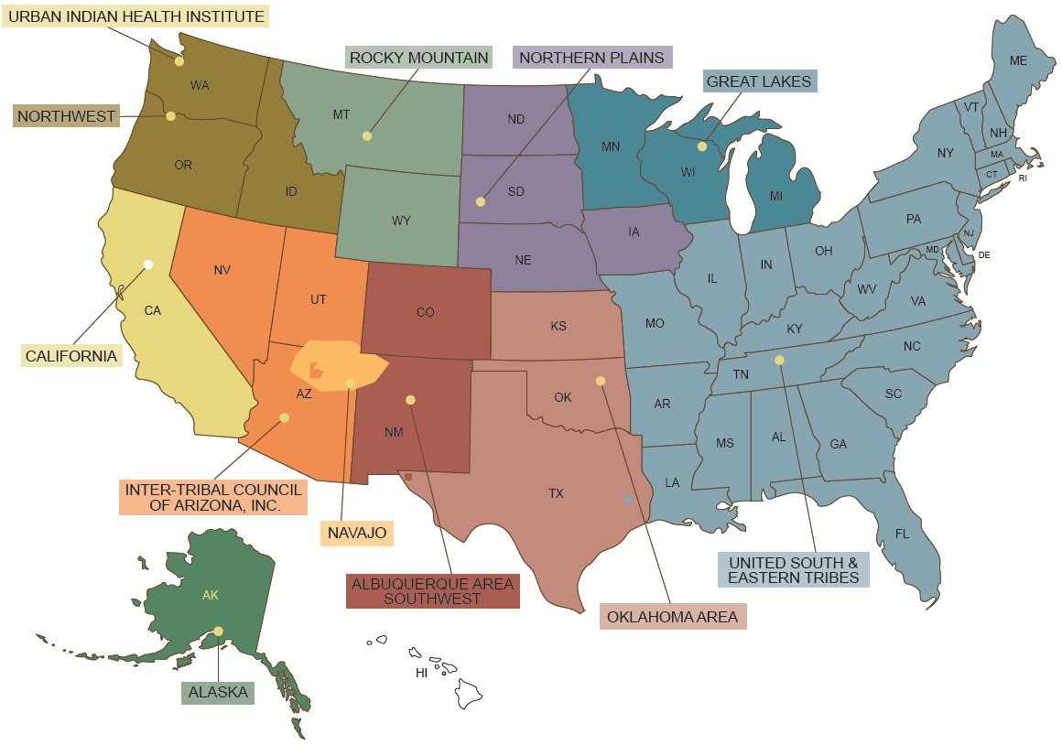

Slide 4
TECs as Public Health Authorities
Established through permanent reauthorization of the Indian Health Care Improvement Act (IHCIA) as part of the Patient Protection and Affordable Care Act (2010)
Health and Human Services (HHS) directive gives TECs access to HHS data systems and protected health information
Centers for Disease Control and Prevention must provide TECs technical assistance
Each Indian Health Service (IHS) Area must have TEC access
The Secretary “shall grant to each epidemiology center… access to use of the data, data sets, monitoring systems, delivery systems, and other protected health information in the possession of the Secretary.”
25 U.S.C.A. § 1621m(c)

Slide 5
California Tribal Epidemiology Center
Formed in 2005
Housed within the California Rural Indian Health Board’s Research and Public Health Department
Guided by an Advisory Council, but reports to CRIHB Board of Directors
Staff by 6 Epidemiologists, 4 Program Evaluators, 2 Project Coordinators, 1 Research Associate, and 1 Outreach Coordinator

Slide 6
Northwest Tribal Epidemiology Center
Formed in1996
Tribal leaders had approved the concept and function of a tribal research and epidemiology center prior to this time.
Housed within the Northwest Portland Area Indian Health Board
Guided by the Public Health Committee of the NPAIHB, and report to the NPAIHB Board
Functions as a departmental designation with oversight of over 30 employees

Slide 7
7 Core Functions
Collect data
Provide disease surveillance
Evaluate data and programs
Identify health priorities
Health service needs
Provide technical assistance
Improve healthcare delivery systems
Collect data
Evaluate data and programs
Identify health priorities with Tribes
Make recommendations for health service needs
Make recommendations for improving health care delivery systems
Provide epidemiologic technical assistance to Tribes and Tribal organizations
Provide disease surveillance to Tribes

Slide 8
Mutual Areas of Focus
Project Focus | California TEC | Northwest TEC
Technical Assistance
Workforce Development
Trainings
Data Access and Analysis
Grant Writing Training/Support
Publications
Partnerships
Community Health Assessments
Communities of Practice
Data Management Systems
Subawardee Projects
Public Health Priority Settings

Slide 9
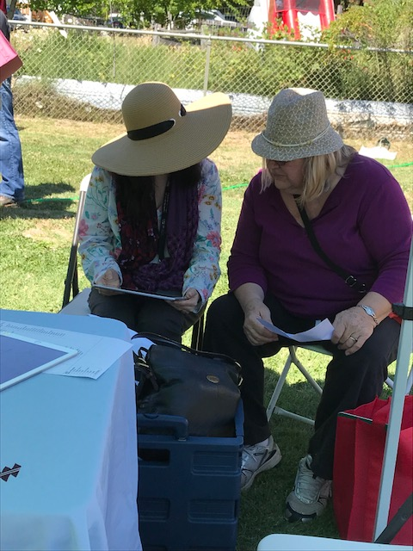
1. Collect Data
Tribal Behavioral Risk Factor Survey (adult and youth)
Community Health Assessments
California Health Interview Survey: AIAN oversample
Health Priorities Survey
Oral Health Needs Assessment
California Tribal Opioid Strategic Plan

Slide 10
Collect Data
NWTEC does data linkage work with the Northwest Tribal Registry to correct misclassification of individuals in State and Regional data systems, who are not correctly identified as AI/AN.
NWTEC collects original data from surveys and projects
NWTEC collects both numeric and story based data

Slide 11
2. Evaluate Data and Programs
Good Health and Wellness in Indian Country
MSPI/DVPI Technical Assistance Provider
California Tribal Comprehensive Cancer Control Program
Tribal Personal Responsibility and Education Program
Native Connections
Building Public Health Infrastructure in Indian Community
Tribal Public Health Capacity Building
Project Pathway
Tribal Opioid Response
Dental Transformation Initiative
Provide specialized evaluation to Tribal projects upon request

Slide 12
Evaluate Data and Programs
NWTEC evaluates behavioral health programs in our region
NWTEC evaluates Good Health and Wellness activities
Conduct internal evaluation on all of our programs
Provide specialized evaluation to tribal projects upon request

Slide 13
3. Identify Health Priorities
Diabetes
Alcohol/substance abuse
Obesity
Health Priorities Survey: Statewide to community, 2017
Annual Health Priorities Survey: THP/UIHP Directors
Multi-site THP priorities reports
Mental/emotional health
High blood pressure
Limited access to medical care
Chronic pain
Other
Heart disease
Suicide

Slide 14
Identify Health Priorities with Tribes
NWTEC conducts an annual health priorities survey with regional tribal leadership and health directors
NWTEC staff scan the environment for emerging public health topics.
NWTEC collaborates with the Portland Area Office of Indian Health Service to identify priority health concerns.

Slide 15
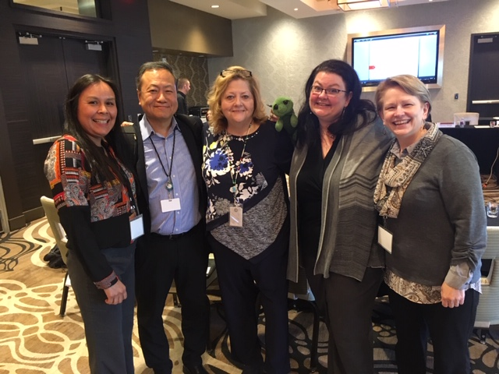
4. Make Recommendations for Health Service Needs
Provide feedback and data for Tribal consultations
Serve as a resource for federal agency Tribal Advisory Committees’ California delegates
Develop and publish data reports

Slide 16
Make Recommendations for Health Service Needs
NWTEC publishes data to inform the decision making processes around health service needs.
NWTEC provides data to support regional consultation and budget development for HHS programs.
Provide technical assistance for advocacy.

Slide 17
5. Improving Healthcare Delivery Systems
Collaborate with Medical Director/Medical Epidemiologist and Public Health Nurse on projects
Summer Research Assistant Program
Annual Data, Evaluation, and Grant Writing training
Tribal Adverse Childhood Experiences pilot project

Slide 18
Improving Health Care Delivery Systems
NWTEC staff has created communities of practice for Hepatitis C, Opioid treatment and Diabetes.
More communities of practice are on the horizon to assist communities with treatment of complex disease cases.
Have provided opportunities for other health boards to develop these services.
Conduct data analysis for SDPI programs within our area
Conduct various trainings regionally and nationally to improve care

Slide 19
6. Provide Technical Assistance
Access to data
Data collection
Data interpretation and dissemination
Program evaluation
Survey development
Evaluation plan development
Focus groups
Key Informant Interviews
Community health assessments
Community Readiness Model
Outbreak response
Surveillance
Data management and use

Slide 20
Provide Epidemiologic TA
NWTEC offers training in a variety of topics, including health data literacy to assist tribes in understanding and using data.
Provide access to linkage corrected data to both States and Tribes.
Provide technical assistance across all of our program areas for health promotion and disease prevention.
Staff include a Centers for Disease Control and Prevention Epidemic Intelligence Service Officer (EISO) and Public Health Associate Program Staff.
House the Portland Area Office IHS medical epidemiologist to ensure close collaboration to benefit Area tribes.

Slide 21
7. Provide Disease Surveillance and Promotion of Public Health
Development of a Disease Outbreak Response Protocol
Development of a Disease Surveillance Protocol
Monitor infectious diseases
Disseminated information regarding Zika and Measles outbreak
Emergency Preparedness staff capacity development

Slide 22
7. Provide Disease Surveillance and Promotion of Public Health: Opioid Surveillance
Implement a Tribal Opioid Surveillance Assessment
Assess Tribal-specific capacity and gaps
Partner with Tribes and Stakeholders to improve opioid surveillance
Partner with California Department of Public Health to improve AIAN reporting via California Opioid Surveillance Dashboard
Address and improve data issues related to racial classification across data systems
Partner with 2 Tribal Health Programs to link AIAN data with death vital statistics to assess racial misclassification
Improve non-fatal overdose data collection
Work with 2 Tribal Health Programs and hospitals to assess data issues and improve data sharing
Partner with a Tribe to pilot ODMAP use
Improve fatal overdose data collection
Develop partnerships with medical examiners, coroners, funeral directors

Slide 23
Provide Disease Surveillance and Promotion of Public Health
NWTEC has provided a Public Health Emergency Preparedness conference, annually over the last 13 years to enhance jurisdictional collaboration during an emergency.
NWTEC provides assistance with tasks related to Public Health Accreditation preparation.
Assists with MOU development for medical countermeasures and disease investigation
Staff assisted States of Washington and Oregon with recent measles outbreak

Slide 24
Questions
Vanesscia Cresci, MSW, MPA
Acting Epidemiology Manager, California Tribal Epidemiology Center
Director, Research & Public Health Department
California Rural Indian Health Board, Inc.
vcresci@crihb.org
(916) 929-9761 x1500
http://www.crihb.org/ctec

Slide 25
Questions
Victoria Warren-Mears, PhD, RDN, FAND
Director, Northwest Tribal Epidemiology Center
Northwest Portland Area Indian Health Board
vwarrenmears@npaihb.org
(503)416-3283 or (503)998-6063
http://www.npaihb.org/epicenter/

