Slide 1
NPAIHB Legislative & Policy Update
Quarterly Board Meeting
April 17, 2019
Hosted by: Swinomish Indian Tribal Community

Slide 2
Report Overview
Hot Topics
Legislation
Future IHS Appropriations & Budget Formulation
New & Pending Federal Policies
Litigation
6. Upcoming National/Regional Meetings

Slide 3
Hot Topics

Slide 4
Hot Topics
Threat to the Affordable Care Act and Indian Health Care Improvement Act
SDPI Reauthorization and Funding
CMS Work Requirements
AI/AN Health Resource Advisory Committee
Eric Miller confirmed to U.S. Ninth Circuit Court of Appeals by Senate Judiciary Committee on 2/26/19.
Hill Visits- Recent and Future

Slide 5
Legislation

Slide 6
Consolidated Appropriations Act, 2019 (“Omnibus”) (H.J.R. 31)
The President signed the FY 2019 Omnibus on February 15, 2019 which averted another government shutdown (Senate 83-16; House 300-128)
7 spending bills; 5 previously passed
$328 billion spending package
For the Indian Health Service (IHS) $5.8 billion
$4.98 billion for IHS for services and facilities ($162 million or 3.4%)
$822 million for mandatory contract support costs

Slide 7
Omnibus FY 2019 IHS Appropriations Cont’d
Clinical Services $136m increase above FY 2018 level
Hospitals and Clinics $102m or 5% 
Dental Services $9.4m or 4.8% 
Mental Health $5.4m or 5.4% 
Alcohol and Substance Abuse $17.8m or 7.8% 
Purchased and Referred Care $2.1m or .2% - includes a mandate by Congress as to allocation of future increases
No new funding for Indian Health Care Improvement Fund

Slide 8
Omnibus FY 2019 IHS Appropriations Cont’d
Preventative Health $4.8m increase above FY 2018 enacted level
Public Health Nursing $4.1m or 4.8% 
Health Education $697k or 3.5% 
Community Health Representatives- level, no increase
Other Services $9.2m increase above FY 2018 enacted level
Urban health $2m or 4.1% 
Indian Health Professions $8m or 16.2% 
Tribal Management - level, no increase
Direct Operations- -$800k transferred to Dental Services
Self Governance- level, no increase

Slide 9
Omnibus FY 2019 IHS Appropriations Cont’d
Facilities $11.3m increase over FY 2018 enacted level
Maintenance & improvement –level, no increase
Sanitation Facilities – level, no increase
Health Care Facilities Construction –level, no increase
Includes $15m for small ambulatory grant program
Facilities & Environmental Support - $11.3m or 4.7% 
Equipment – level, no increase
Contract Support Costs $822m, indefinite appropriation

Slide 10
Omnibus FY 2019 Other IHS Authorities and Reports to Congress
Opioid Grants- $10m increase to create special behavioral health pilot program
Maternal and Child Health – IHS’s top priority is to hire a National Maternal/Child Health Coordinator with report to Congress within 90 days of hiring position
Health Care Facilities – IHS is directed to publish the gap analysis required under H.R. 115-238 within 180 days
IHCIA Demonstration Authorities – IHS is directed to identify criteria for ranking projects funded through IHCIA demonstration authorities should funds become available in the future within 180 days

Slide 11
PrEP Assistance Program Act (H.R. 1643)
Introduced by Rep. Bonnie Watson-Coleman (D-NJ) on 3/8/19.
Establishes a Grant Program under HHS to provide grants to tribes, states and territories for pre-exposure prophylaxis (PrEP) programs.
Status: In Committee

Slide 12
Violence Against Women’s Act of 2019 (H.R. 1585)
Introduced by Rep. Karen Bass (D-CA) on 2/14/19.
Reauthorizes the Violence against Women’s Act of 1994
Status: 4/4/19- Passed House (263-158)

Slide 13
Department of Veterans Affairs Tribal Advisory Committee of 2019 (S.524)
Introduced by Sen. Jon Tester (D-MT) on 2/14/19 and referred to Committee on Veterans’ Affairs.
Establishes a Department of Veterans Affairs (VA) Tribal Advisory Committee (TAC).
Status: In Committee

Slide 14
Assessment of the Indian Health Service Act of 2019 (S. 498)
Introduced by Sen. Mike Rounds (R-SD) on 2/14/19 and referred to Committee on Indian Affairs.
Calls for the Secretary of HHS to contract an assessment of IHS’ health care delivery systems and financial management process of IHS facilities to improve care for patients.
Status: In Committee

Slide 15
Native American Suicide Prevention Act of 2019 (S. 467 & H.R. 1191)
S. 467 introduced by Sen. Elizabeth Warren (D-MA) on 2/13/19 and referred to HELP Committee.
H.R. 1191 introduced by Rep. Raul Grijalva (D-AZ) on 2/13/19 and referred to Energy and Commerce Committee.
Amends section 520E of the Public Health Service Act to require States and their designees receiving grants for development and implementation of statewide suicide early intervention and prevention strategies to collaborate with each Federally recognized Indian tribe, tribal organization, urban Indian organization, and Native Hawaiian health care system in the State.
Status: In House and Senate Committees.

Slide 16
Advanced Appropriations Bills for BIA/BIE/IHS and IHS only
S. 229 & H.R. 1122 – Advanced Appropriations for BIA and BIE at DOI and IHS at HHS.
Senate Bill introduced by Sen. Tom Udall (D-NM) on 1/25/19.
House Bill introduced by Introduced by Rep. Betty McCollum (D-MN-4) on 2/8/19.
Status: Both referred to respective House and Senate Committees.
H.R. 1135 –Advanced Appropriations for IHS.
House Bill introduced by Rep. Don Young (R-AK- At Large) on 2/8/19; referred to Committees.
Senate Bill anticipated to be introduced.
Status: In House Committees.

Slide 17
Tribal HUD-VASH Act of 2019 (S. 257)
Introduced by Sen. Jon Tester (D-MT) on 1/29/19.
Provides rental assistance for homeless or at-risk Indian veterans, and for other purposes.
Status: 3/28/19- Placed on Senate Legislative Calendar under General Orders; Indian Affairs-Reported by Sen. Hoeven without amendment

Slide 18
PROGRESS for Indian Tribes Act (S.209)
Introduced by Sen. John Hoeven (R-ND) on 1/24/19 and referred to Indian Affairs Committee.
Amends the Indian Self-Determination and Education Assistance Act (ISDEAA) to establish and further self-governance by Indian Tribes under DOI.
Status: 1/29/19- Reported through Indian Affairs.

Slide 19
Community and Public Health Programs Extension Act (S.192)
Introduced by Sen. Lamar Alexander (R-TN) and referred to Senate HELP Committee on 1/18/19.
Provides for funding extensions through 2024 for:
Special Diabetes Program,
Community Health Centers,
National Health Service Corps, and
Teaching Health Centers that operate GME programs.
Status: In Committee

Slide 20
Pay Our Doctors Act of 2019 (H.R. 195)
Introduced Rep. Markwayne Mullin (R-OK) and referred to Appropriations Committee on 1/3/19.
Provides full-year appropriations for the Indian Health Service in the event of a partial lapse in appropriations and for other purposes
Status: In Committee

Slide 21
Future IHS Appropriations & Budget Formulation

Slide 22
FY 2020 IHS Appropriations
National Tribal Budget Formulation Workgroup recommended over $7 billion for IHS for FY 2020 (36% increase over FY 2017 enacted level).
Available at: https://www.nihb.org/legislative/budget_formulation.php
House Interior, Environment and Related Agencies Appropriations Subcommittee Public Witness Hearings – March 6 and 7
Andy Joseph, Jr., Chairman testified
House hearings on IHS appropriations – week of April 8.
Senate – no hearings announced yet.

Slide 23
FY 2020 President’s Recommendations for IHS
On March 11, 2019, the President released the FY 2020 for IHS.
Congressional Justification (CJ) for FY 2020 with detail released on March 25, 2019.
Per our annual analysis of President’s Budget:
President’s budget and CJ use 2019 annualized CR level, not FY 2019 enacted level.
Only recommends an $82.6m increase above FY 2019 for services and facilities (1.7%) above FY 2019 enacted level.

Slide 24
FY 2020 President’s Recommendations for IHS
Cuts included:
Zero funding for Health Education and Tribal Management Grants
$39 m cut to Community Health Representative program
$2.5 m cut to urban health programs
$14 m cut to Indian Health Professions
$1 m to Self-Governance
$78m cut to Health Care Facilities Construction
$647k cut to Facilities & Environmental Support

Slide 25
FY 2020 President’s Recommendations for IHS
Recommendations for FY 2020 include:
$2 m for quality and oversight
$8 m for recruitment and retention
$20 m for expansion of the Community Health Aide Program (CHAP)
At budget formulation meeting, tribes clearly expressed that should not be at expense of CHR program.
$25 m for establishing an Eliminating Hepatitis C and HIV/AIDS in Indian Country initiative
New line item: $25 m for an initial investment in modernizing the Electronic Health Record System

Slide 26
FY 2021 IHS Budget Formulation
National Tribal Budget Formulation Workgroup met on March 14-15, 2019 in Washington D.C. and recommended full funding for IHS at $37.61 billion to be phased in over 12 years.
For FY 2021, a total of $9.1 billion for IHS is requested. Includes:
$257 m for full funding of current services
$413 m for binding fiscal obligations
$2.7 b for program increases (46% above FY 2019 enacted level)
And more!

Slide 27
FY 2021 IHS Budget Formulation Cont’d
Other recommendations for IHS:
Support preservation of Medicaid, IHCIA and Indian-specific provisions of the ACA.
Fund critical infrastructure investments (Health IT/HCFC)
Exempt Tribes from Sequestration
Support Advance Appropriations
Allow federally-operated health facilities and IHS headquarters to use federal dollars efficiently and adjust programmatic funds flexibly across accounts at the local level
Support funding of tribes outside of grants based system.
Permanently authorize SDPI and increase funding to $200 m per year plus annual inflationary increases.
Take a adequate steps to fully address 105(l) leasing obligations and work proactively with Congress to ensure its full payment as an indefinite appropriation.
Available at: https://www.nihb.org/legislative/budget_formulation.php

Slide 28
New & Pending Federal Policies

Slide 29
HHS Office of National Coordinator (ONC) 21st Century Cures Act Interoperability, Information Blocking and the ONC Health IT Certification Program
Comments Due: 5/3/19
Federal Notice Issued: 3/4/19
Proposes adoption of standardized application programming interfaces (APIs) to allow patients to securely and easily access electronic health information.
ONC requests clear and concise proposals that include data and specific examples.

Slide 30
Pending Responses from HHS
HHS RFI on National HIV/AIDS Strategy and National Viral Hepatitis Action Plan; issued 2/8/19; comments submitted.
HHS Initiative: Ending the HIV Epidemic; announced 2/5/19; comments submitted.
HHS Pain Management Best Practices Inter-Agency Task Force Draft Report on Pain Management Best Practices; issued 12/31/18.
HHS Tribal Consultation Policy; DTLL 10/22/18; comments submitted.
HHS Draft Strategy to Reduce Regulatory and Administrative Burden of Health IT and EHRs

Slide 31
Proposed Rule on CMS Medicaid, Medicare Programs and Qualified Health Plans-- Interoperability and Patient Access
Comments Due: 5/3/19
Federal Register Notice: 3/4/19
Requires covered plans to implement, test, monitor and maintain patient health information (PHI) through Application Program Interfaces (APIs) to:
Make patient claims and other PHI available to patients through third-party applications and developers.
Simplify and increase the ease and access for patients to transition between insurance plans and providers by facilitating the flow of PHI.
I/T/U exemption to be requested.

Slide 32
CMS Request for Information (RFI) on Increasing Consumer Choice through the Sale of Individual Health Insurance Coverage Across State Lines Through Health Care Choice Compacts
Comments Due: 5/6/ 19
Federal Register Notice: 3/11/19
CMS is interested in feedback on how states can take advantage of Section 1333 of the ACA, which provides for the establishment of a regulatory framework that allows two or more states to enter into a Health Care Choice Compact to facilitate the sale of health insurance coverage across state lines.

Slide 33
CMS New Guidance on State Implementation of Home and Community Based Services Regulation Issued in 2014
Issued: 3/22/19
Provides updated guidance to State Medicaid Directors on the 2014 Home and Community Based (HCBS) regulation, which impacts older adults and adults with disabilities eligible for Medicaid.
Available at: www.medicaid.gov/federal-policy-guidance/downloads/smd19001.pdf

Slide 34
Pending Responses and/or Ongoing Issues with CMS
CMS Medicaid and CHIP Managed Care Proposed Rule - comments submitted 1/28/19.
CMS Work Requirements
CMS Four Walls Limitation- FAQs

Slide 35
Recent IHS DTLLs
Automated Tool for Electronically Submitting CHEF Requests and Training Schedule; DTLL on 3/15/19.
Tribal Consultation on Long and Short Term Options for Meeting ISDEAA 105(l) Requirements; DTLL on 3/12/19; Comments Due 5/3/19.
Final IHS Strategic Plan FY 2018-2022 Released; DTLL on 2/27/19.
IHS and HRSA announce availability of new funding of $15 million through the National Health Service Corps; DTLL on 1/16/19.

Slide 36
IHS Health IT Modernization Project
PURPOSE: Evaluate the current state of HIT across the I/T/U and identify alternatives to aid future HIT decisions.
SEPTEMBER 2019: Final IT Roadmap Strategy and recommendations will be provided.
DATA CALL: https://redcap.uits.iu.edu/surveys/index.php?s=DYKDTEJXHC
PLANNED SITE VISITS:
1) Cow Creek Health & Wellness Center,
2) Colville Service Unit,
3) Port Gamble S’Klallam Tribe,
4) Puyallup, and
5) Warm Springs Service Unit.

Slide 37
NPAIHB EHR Survey Responses Snapshot

Slide 38
Pending IHS Responses
IHS notice about IHS Headquarters Reorganization; DTLL 12/20/18.
Update on the Mechanism to Distribute Behavioral Health Initiative Funding; DTLL on 12/11/18; comments submitted.
Tribal Consultation on PRC implications for the entire State of Arizona if identified as a PRCDA/CHSDA; DTLL on 11/20/18; comments submitted.

Slide 39
Pending IHS Responses Cont’d
Special Diabetes Program for Indians funding distribution for FY 2019; DTLL issued 7/12/18; comments submitted.
Follow-up: Stated that RADM Weahkee to ask Area Directors to meet with tribal leaders to discuss the Area’s proposed budget for its share of the SDPI FY 2019 data infrastructure fund.
IHS Sanitation Deficiency System (SDS); DTLL on 7/2/18; comments submitted.

Slide 40
Pending IHS Responses Cont’d
IHS Manual, PRC Chapter Revisions; DTLL on 5/18/18; comments submitted.
Contract Support Costs – Indian Health Manual, Chapter 3 CSC, rescission of 97/3 split language; DTLL 4/13/18; comments submitted.
CHEF Regulation – comments submitted.
Redding Rancheria case update

Slide 41
Office of National Drug Control Policy Releases 2019 National Drug Control Strategy Report
Issued: 1/19
The Office of National Drug Control Policy coordinate drug control and response efforts across all federal agencies.
Report establishes parity between state, tribal and local government agencies and the need for coordinated response efforts.
Includes a strategic objective to strengthen the capacity of state, local, and tribal communities to identify and prevent substance abuse.

Slide 42
HRSA Shortage Designation Modernization Project (SDMP) Updates
HRSA SDMP will update existing Auto-HPSA designations in Summer 2019.
New Auto-HPSA scores will be applicable to the 2020 National Health Service Corp application cycle.
Clinics will be able to update their HPSA score in the online portal after the national rollout.
Clinics should collect and submit facility-specific data and supplemental data to increase scores in replacement of the ACS data.
April 30 at 11AM PT: HRSA Shortage Designation Modernization Project Webinar

Slide 43
VA Updates
VA and SAMHSA Mayor’s Challenge to prevent suicide among service members, veterans and their families.
Goal to eliminate suicide by promoting comprehensive public health approach to empower communities to take action.
June 2019 VA Community Care Program implementation..
Veterans will be able to access urgent, non-emergency care for non-life-threatening conditions in VA’s network of community providers.
VA on track to cure 100,000 veterans of hepatitis C virus.

Slide 44
Litigation

Slide 45
Brackeen v. Bernhardt Challenge to ICWA
On 10/5/18, Judge Reed O’Conner (USDC ND Texas) ruled that ICWA is unconstitutional in Brackeen v. Zinke.
Found that Morton v. Mancari rule does not apply because ICWA extends to Indians who are not members of tribes.
ICWA struck down in violation of equal protection.
Appealed to USCA for the Fifth Circuit and now titled, Brackeen v. Bernhardt.
Many tribes and tribal organizations (including NPAIHB) joined the amicus brief.
On March 13, 2019, oral argument occurred before a panel of 3 judges.
Decision pending in Fifth Circuit.

Slide 46
Texas v. United States Challenge to Affordable Care Act
On December 14, 2018, Judge Reed O’Conner (USDC ND Texas) found that Congress’ 2017 elimination of the ACA individual tax penalty for non-compliance with not having health insurance resulted in the mandate invalid.
Reasoning:
In the absence of a tax, Congress has no authority to issue a mandate.
Individual mandate essential to the rest of the ACA, not “severable”
If ACA struck down, then ICHIA could also be struck down.
Appealed to USCA for the the Fifth Circuit.
Tribes and tribal organizations(including NPAIHB) joined an amicus brief.
On March 25, 2019, a coalition of states intervened in the case in order to defend the ACA while Department of Justice filed a two-sentence letter with the court announcing that the U.S. had changed its position in the litigation.
Decision pending in the Fifth Circuit.

Slide 47
Opioid Litigation
All federal court lawsuits have been combined in multi-district litigation under Federal District Judge Dan A. Polster (USDC-ND Ohio)
Over 100 tribes and tribal organizations joined 1,000 state and local governmental plaintiffs in the litigation.
Tribal Amicus Brief: 448 tribes and tribal organizations signed on and provided statements of interest (NPAIHB, ATNI, NCAI, and NIHB).
Status: Two Tribal Cases selected as bellweather cases ---Muscokee (Creek) Nation and Blackfeet Tribe. On April 1, 2019, Magistrate Judge released his Report and Recommendations that Judge Polster permit most of the tribal claims to proceed. Judge Polster’s decision on tribal bellweather cases anticipated in May.

Slide 48
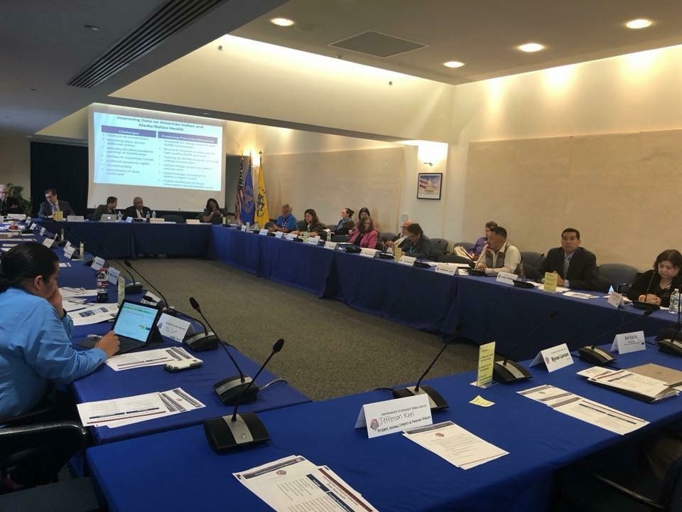
Upcoming National/Regional Meetings
Joint Tribal Advisory Committee Meeting, Washington, DC

Slide 49
April-May 2019
HHS Annual Tribal Budget Consultation, April 23-24, 2019, Washington, D.C.
IHS TSGAC Meeting, April 24-25, 2019, Washington, D.C.
IHS Information Systems Advisory Committee Semi-Annual Meeting, April 26, 2019, Rockville, MD
Secretary’s Tribal Advisory Committee Meeting, May 8-9, Tuscon, Arizona
NIHB National Tribal Public Health Summit, May 13-15, 2019, Albuquerque, NM
NIHB AI/AN National Behavioral Health Conference, May 15-17, 2019, Albuquerque, NM

Slide 50
May-July 2019
IHS Purchased and Referred Care Meeting, May 16-17, 2019, Phoenix, AZ
ATNI Mid-Year Meeting, May 20-23, 2019, Spokane, WA
DSTAC Quarterly Meeting, May 29-30, 2019, Rapid City, SD
NCAI Mid-Year Conference & Marketplace, June 23-26, 2019, Reno, NV
IHS Budget Formulation Evaluation FY 2021/Planning FY 2022, June 26-28, Reno, NV
Region 10 HHS Tribal Consultation, July 9-11, 2019, Spokane, WA
NPAIHB/CRIHB Joint QBM, July 15-19, 2019, Sacramento, CA

Slide 51
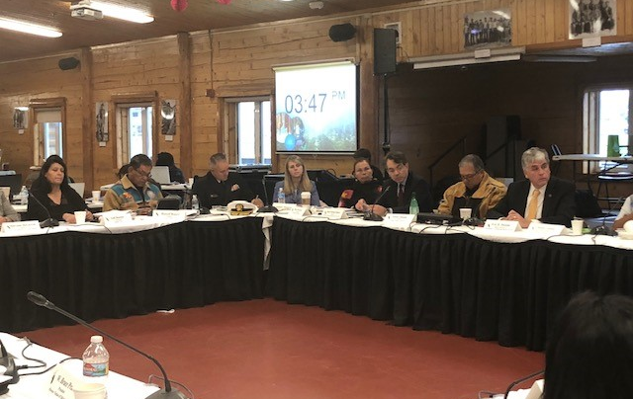
Discussion and Questions
HHS Secretary’s Tribal Advisory Committee Meeting, Fairbanks, AK

