Slide 1
DISCLOSURES
This activity is jointly provided by Northwest Portland Area Indian Health Board and Cardea
Cardea Services is approved as a provider of continuing nursing education by Montana Nurses Association, an accredited approver with distinction by the American Nurses Credentialing Center’s Commission on Accreditation.
This activity has been planned and implemented in accordance with the accreditation requirements and policies of the Institute for Medical Quality/California Medical Association (IMQ/CMA) through the joint providership of Cardea and Northwest Portland Area Indian Health Board. Cardea is accredited by the IMQ/CMA to provide continuing medical education for physicians.
Cardea designates this live training for a maximum of 8.25 AMA PRA Category 1 Credit(s)TM. Physicians should claim credit commensurate with the extent of their participation in the activity.

Slide 2
DISCLOSURES
COMPLETING THIS ACTIVITY
Upon successful completion of this activity 8.25 contact hours will be awarded
Successful completion of this continuing education activity includes the following:
Attending the entire CE activity;
Completing the online evaluation;
Submitting an online CE request.
Your certificate will be sent via email If you have any questions about this CE activity, contact Michelle Daugherty at mdaugherty@cardeaservices.org or (206) 447-9538

Slide 3
CONFLICT OF INTEREST
None of the planners or presenters of this CE activity have any relevant financial relationships with any commercial entities pertaining to this activity.

Slide 4
Starting to provide Mat at a tribal health clinic
Whitney Essex, MSN, BSN, APRN-CNP
Jorge Mera, MD, FACP
Cherokee Nation Health Services

Slide 5
Outline
Who?
Why Not?
Why?
What If?
The Truth

Slide 6
Who?
Our perception:
“I don’t know anyone who is addicted to opiates”
They hide it well – Because they don’t want you to know…
In 2015, Oklahoma providers wrote 101.7 opioid prescriptions per 100 persons (3.97 million prescriptions).
In the same year, the average U.S. rate was 70 opioid prescriptions per 100 persons
In 2016, there were 444 opioid-related overdose deaths­­­ in Oklahoma—a rate of 11.6 deaths per 100,000 persons
Since 2012, heroin overdose deaths have more than doubled from 26 deaths to 53 deaths in 2016

Slide 7
Why Not?
“I don’t have time.”
“None of my patients need it.”
“It’s cumbersome.”

Slide 8
Why? – Why did we, an ID Team, Decide to do this?
“I love Torture”
“I am bored”
The real reasons:
“I can’t do nothing”
Treating related infections is only treating a symptom of the real issue
Notes:
33 y.o. female presents to my office on referral for positive hcv test. IVDU is the most likely route of transmission, but states “I don’t do that no more” since she found out about the Hep C. She says “I used to shoot heroin or pills”. I ask her how she was able to stop. “Oh. I still take pills. If I don’t, I get so sick”. She says “Now I do it because I have to. I can’t tell you the last time I actually felt good or high after taking them”. She goes on to tell me that she started abusing opiates after they were prescribed to her for a broken foot almost 10 years ago. Since that time, she has gotten divorced, had all 3 of her children removed from her home, jumps from odd job to odd job, and is now living with her grandmother who is unknowingly supporting her addiction. When asked if she had ever overdosed she had a simple answer. “Twice.” I ask if she has ever been on methadone or Suboxone and she hasn’t. She has heard of them, but never tried them. So I make a referral to a provider who can treat her with suboxone. The response – “I can’t take any more patients. I’m at my cap”. So I refer out to another provider - they can see the patient in 2 months. And I send her away that day knowing that she is going to the street to treat this disease herself as she has been doing for quite some time…

Slide 9
What If…
We let them leave the clinic without treating their Opioid Use Disorder?

Slide 10
The Truth…A Few things we have learned
MAT is Extremely rewarding
All the resources you need already exist
Once the patient is stable with their dosing, the visits are uncomplicated
Some patients are not ready

Slide 11
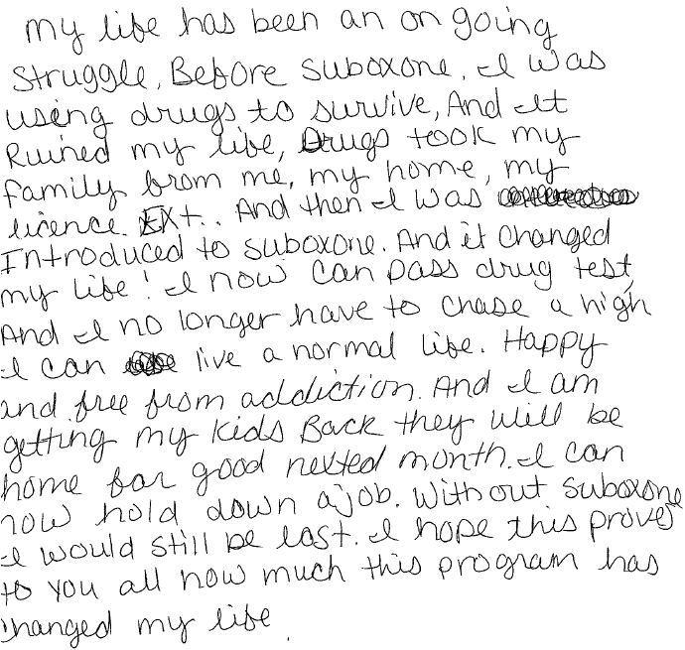

Slide 12
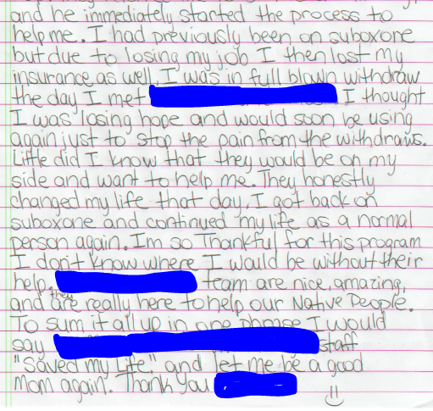
the Infectious Disease team
All of the
The buprenorphine provider and
Cherokee Nation

Slide 13
The End

