Slide 1


DISCLOSURES
This activity is jointly provided by Northwest Portland Area Indian Health Board and Cardea
Cardea Services is approved as a provider of continuing nursing education by Montana Nurses Association, an accredited approver with distinction by the American Nurses Credentialing Center’s Commission on Accreditation.
This activity has been planned and implemented in accordance with the accreditation requirements and policies of the Institute for Medical Quality/California Medical Association (IMQ/CMA) through the joint providership of Cardea and Northwest Portland Area Indian Health Board. Cardea is accredited by the IMQ/CMA to provide continuing medical education for physicians.
Cardea designates this live training for a maximum of 8.25 AMA PRA Category 1 Credit(s)TM. Physicians should claim credit commensurate with the extent of their participation in the activity.

Slide 2
DISCLOSURES
COMPLETING THIS ACTIVITY
Upon successful completion of this activity 8.25 contact hours will be awarded
Successful completion of this continuing education activity includes the following:
Attending the entire CE activity;
Completing the online evaluation;
Submitting an online CE request.
Your certificate will be sent via email If you have any questions about this CE activity, contact Michelle Daugherty at mdaugherty@cardeaservices.org or (206) 447-9538

Slide 3
CONFLICT OF INTEREST
None of the planners or presenters of this CE activity have any relevant financial relationships with any commercial entities pertaining to this activity.

Slide 4


Neurobiology and Diagnosis of SUDs
Jessica Gregg, MD, PhD
OHSU Addiction Medicine Section

Slide 5
Objectives
1. Review the diagnostic criteria for substance use disorders
2. Understand how and why substance use disorders develop
3. Discuss the gray zone between opioid use disorder and pain

Slide 6
Objective 1
Review the Diagnostic Criteria for Substance Use Disorders
Notes:
What makes use of a substance an addiction?

Slide 7
Not Just Use
Notes:
Not just use. Not having a drink or a cigarette or smoking marijuana or even smoking heroin, even 5 times.

Slide 8
Disordered Use
Notes:
It is disordered use. Or use that is pathological. . I imagine that some among you might say that using heroin once, certainly more than once pathological. Ok. But ultimately that is an opinion, not a diagnosis. In medicine, we diagnose SUDS w

Slide 9
DSM V
Diagnostic and Statistical Manual of Mental Disorders
Notes:
The DSM V. American Psychiatric Association's (APA) classification and diagnostic tool and it provides a standardized way to understand substance disorders and mental illness

Slide 10
DSM V: Substance Use Disorder
11 criteria
Notes:
According to the DSM V there are 11 critieria that determine whether use is disordered

Slide 11
DSM V: Substance Use Disorder
Craving / Compulsion
Notes:
First couple themes are craving and compulsion

Slide 12
DSM V: Substance Use Disorder
Taking in larger amounts or for longer than intended
Unsuccessful efforts to cut down
Spending a lot of time obtaining the substance
Craving or a strong desire to use the substance
Notes:
Maps to the first four criteria

Slide 13
DSM V: Substance Use Disorder
Consequences
Loss of Control

Slide 14
DSM V: Substance Use Disorder
Continued use despite recurring social or interpersonal problems due to use
Important activities given up or reduced
Recurrent use in physically hazardous situations
Persistent / Recurrent physical or psychological difficulties from use
Recurrent use resulting in a failure to fulfill major role obligations
Notes:
Consequences, and using the substance repeatedly despite those consequences. Loss of control.

Slide 15
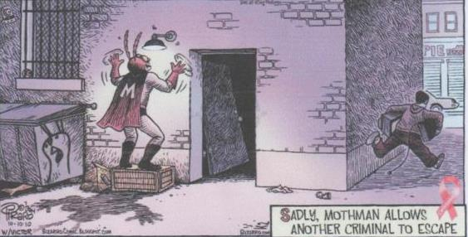
Notes:
The first 9 criteria are pretty much summed up here. Craving compulsion consequence loss of control

Slide 16
DSM V: Substance Use Disorder
Tolerance*
Withdrawal*
Notes:
Some substances, when used appropriately, still lead to tolerance and withdrawal. In those cases, these two critieria don’t count.

Slide 17
Substance Use Disorder
2—3
4—5
6+
mild disorder
moderate disorder
severe disorder
Notes:
Knowing those 11 criteria, it possible to diagnose.

Slide 18
Craving
Compulsion
Consequences
Loss of Control
Notes:
Let’s look at why this happens

Slide 19
Objective 2
Understand how and why substance use disorders develop

Slide 20
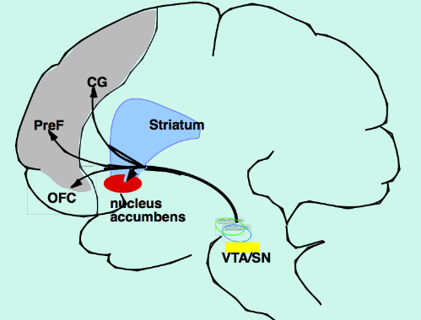
Notes:
Mesolimbic dopamine system: This track is where addiciton does its work. This red area, the nucleus accumbens, is at the center of all of it.

Slide 21
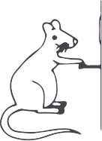
Notes:
Scientists in the 1950s found that if implanted electrodes in NA and send a current through ithose electrodes whenever a lever was pressed, rats will enjoy the stimulation so much they will hit the lever up to 2,000/hr.

Slide 22
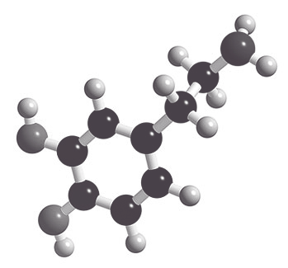
Dopamine
Notes:
In the 1970s scientists discovered that dopamine was the neurotransmitter responsible for pleasurable sensations that the rats experienced. Pushing the lever caused dopamine to be released in the NA.

Slide 23
Desire, Drive, Motivation
Notes:
Later work clarified that the DA release was responsible for the feeling of desires, for drive and motivation in the face potential reward

Slide 24
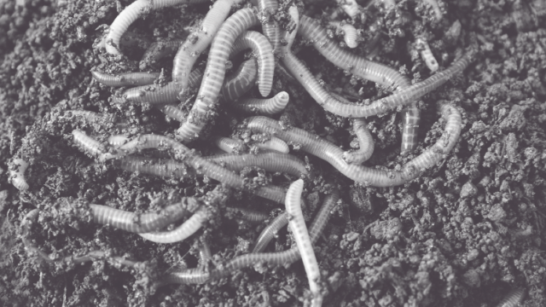
DSM V
Diagnostic and Statistical Manual of Mental Disorders
Notes:
The use of dopamine neurons to shape responses to rewards is seen in simple organisms like worms and flies. It evolved millions of years ago. Dopaminergic impulses tell organisims to move toward reward – toward warmth, toward food, toward moisture. In humans, those dopaminergic impulses travel through the NAC

Slide 25
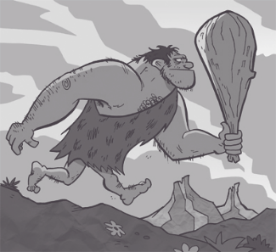
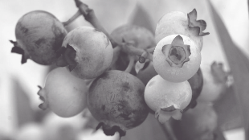

Mediate responses to food, sex, social interactions
Connects with memory and emotional centers
Notes:
In humans, it mediates responses to food, sex, and social interactions. When we seem something rewarding, dopaminergic projections from the VTA to the NAc, release dopamine and tell the NAC to go for it. Activation of the pathway also connects with memory and emotional centers in the brain so that an individual will pay particular attention to all features of that rewarding experience, so it can be repeated in the future. So, when hungry OGG eats a berry and it is sweet and its pleasurable and he doesn’t starve, the brain pays very very close attention to what he had to do to get that berry. When he sees the kind of plant that grows the berry, more likely to remember the berry, think about looking for berry, to potentially crave the berry, find the berry and to stay alive.

Slide 26
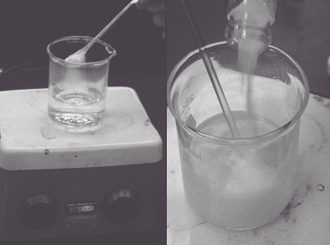

Craving
All addictive drugs activate this pathway
Drug experience is deeply linked to memory and emotion
People, places, things associated with drug use can trigger cravings
Notes:
All addictive drugs activate that pathway Drug experience is also then deeply linked to memory and emotion. As a result, when a person addicted to a drug tries to quit, all things associated with the drug (the neighborhood, the spoon, the cooker, the boyfriend) activate the pathway. It is just like seeing the bush associated with the berries – but this time it isn’t necessary for survival. It just feels like it is. Studies have even found when images associated with drug use (a cooker, a syringe) are flashed in front of a drug user too rapidly to be consciously processed, the brain ”sees” those images anyway, and the persons cravings are triggered.

Slide 27
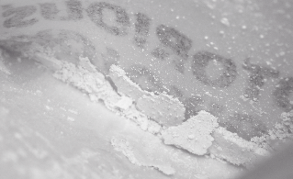

Liking
Opioids: Activate DA receptors
Also activate opioid receptors in NA and produce feeling of satiety, soothing, comfort.
Notes:
So part of addiction is craving. Another part is liking. Opioids are particularly good at activating these feelings. Yes, they increase the activity of the dopamine-containing neurons of the VTA (craving) to the NA. But they also act DIRECTLY on a dfiferent set of receptors, opioid receptors, in the nucleus accumbens and produce feeling of satiety, soothing, comfort. So a lot of addiction involves craving and and some also involves lliking and it all involves desire.

Slide 28

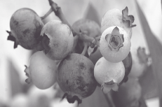

Dysregulation: impaired ability of the front of the brain, to regulate what is going on in the older regions of the brain.
Prefrontal cortex helps him determine the risks and benefits of behaviors and make rational choices.
Repeated activation of the VTA to NAC track slowly strengthens those connections and weakens the connections between the front and the back.
Dysregulation
Notes:
Finally, addiction also involves dysregulation, specifically, impaired ability of the front, or newer part of the brain, to regulate what is going on in the older regions of the brain. Regulation of entire system is the responsibility of the prefrontal cortex, which is charged with keeping the rest of the brain apprised of the consequences of harmful actions. So to go back to OG... Benefits and drawbacks Prefrontal cortex: determine the risks and benefits of behaviors and make rational choices. Here is what is tricky: the prefrontal cortex is newer and more complicated than these older regions. So it needs a little time to weigh in. BUT Repeated activation of the VTA to NAC track slowly strengthens those connections and actually weakens the connections between the front and the back.

Slide 29

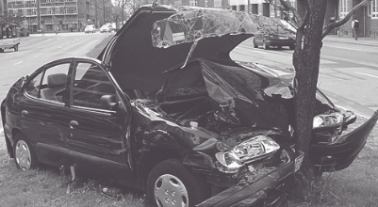
Habits get hard wired, fast and automatic
Connections to the prefrontal cortex slow down
Decreased ability to inhibit disadvantageous behaviors
http://wfae.org/people/amy-rogers
Notes:
The habits: the berry picking: get hard wired the more we do them and the more often they make us feel good. Fire fast and automatically. And connection between front and the back actually slows down. There is decreased ability to inhibit any disadvantageous behavior. Keep picking the berries even if some days it doesn’t seem like a very good idea. Nora Volkow, the head of NIDA has said the for people addicted to drugs it is like stepping on brakes of car barreling down a hill only to discover that brakes, while there, have been disconnected. In this case, no brakes means that someone who is habituated to drug use is unable to tell herself quickly enough that what she is about to do is a really, really bad idea.

Slide 30
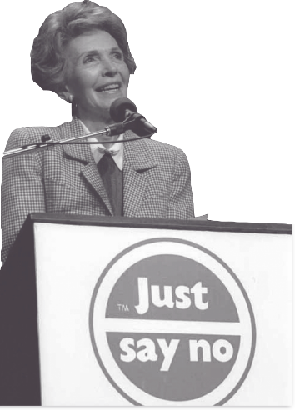
Notes:
That is why THIS didn’t work. Why when we tell patients if they do X then Y, they might die, or be asked to leave, or both. Doesn’t stop. Devstating

Slide 31
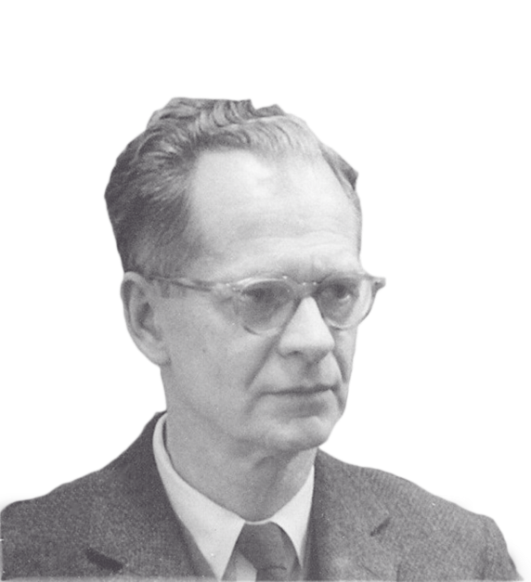
BF Skinner
Notes:
Ok, so we’ve talked about diagnosing addiction, what addiction is doing in the brain, and how that can play out in terms of behavior. Now lets talk about the role of context in the development and treatment of addiction.
Drug use is particularly well learned because of the reinforcing context in which it is learned. In the 1950’s a psychologist named bf skinner did a series of experiments that showed how rewards and punishments affect behavior. Would give rats pellets to run through a maze and press a lever. If they made it to the end of the maze and pressed the lever, they were given a treat.

Slide 32
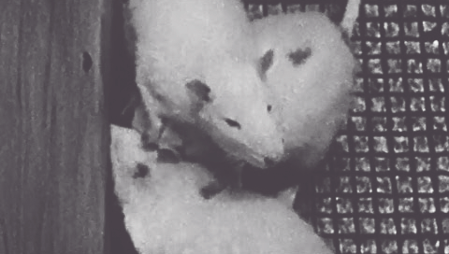
Notes:
One day he was running out of treats and to save treats, didn’t give every time they made it to the lever. Found that this was more actually more reinforcing than giving the rats treats each time. Rats were MORE likely to run the maze and hit lever if they weren’t sure whether the treat would be there or not. Later studies found that the most effective schedule of reinforcment to hook animals (including humans) on a behavior pattern in the most unpredictable.

Slide 33

Notes:
See that with gambling. People can become compulsively engaged. Or social media. So we get a dopamine surge hit the jackpot, see the “like”
Illicit drug use is a chancy thing. Will you have enough heroin, cocaine, meth? Will it be potent. It is an extremely reinforcing context in which to learn a habit

Slide 34


Slide 35
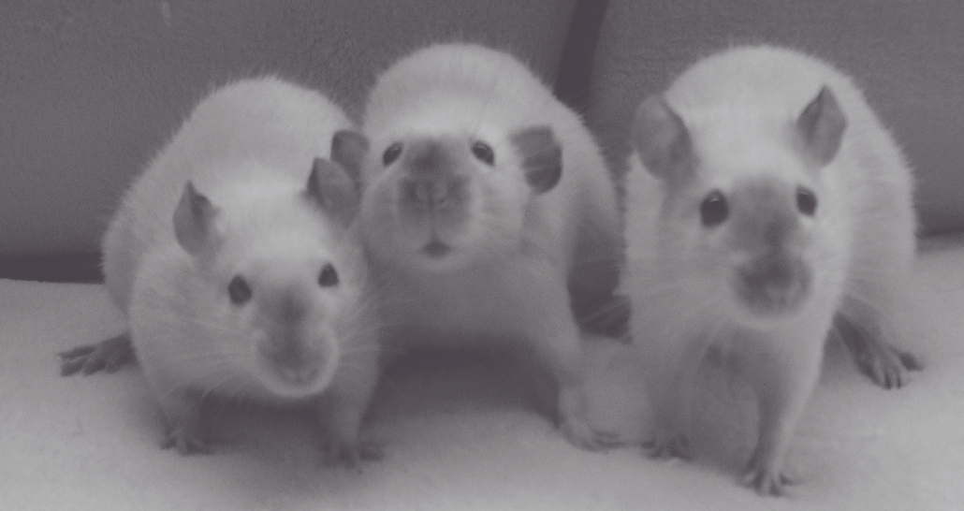
Notes:
Compelling. What doesn’t tell you is that rats in those experiments had food and water withheld before they were placed alone in a small cage with nothing else to do. It also doesn’t tell you about other experiments that showed that just giving a cocaine-injecting rat a solution of sugar water decreased the injection rate (Carroll et al., 1989); and so did maintaining rats on an adequate diet (Carroll et al., 1979).

Slide 36
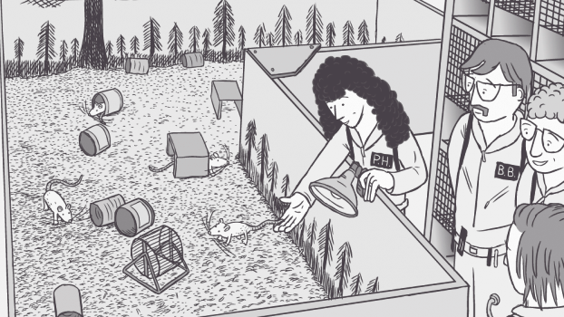
Notes:
AND when rats were placed in a rat park, with other rats, wheels, and tunnels, rates of injection plummeted. In one experiment, caged rates took 19 times more morphine than rats in rat park. Even when all of the rats were made physically dependent and taught that drinking could relieve withdrawal symptoms, Rat Park rats had significanly decreased injection rates. They had other stuff going on.

Slide 37
Notes:
Similarly, in 1974 sociologist Lee Robins’ did landmark study of soldiers who were addicted to heroin in Vietnam.

Slide 38
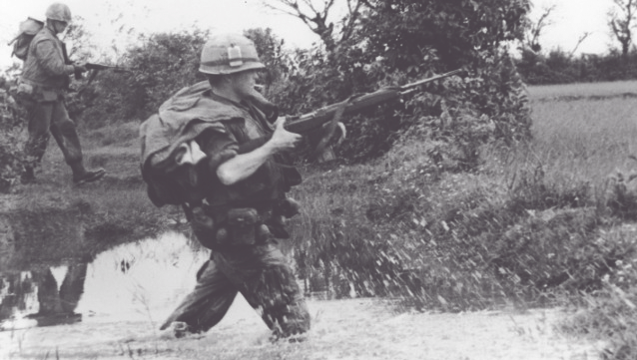
Notes:
She found that approximattely 75% of the soldiers who were addicted to heroin quit when they returned home, without any treatment at all. In essence, their treatment was leaving battle and a war torn country.

Slide 39
?
Notes:
How does this square with the idea that addiction changes the brain, that there is a car that can’t stop?

Slide 40
Notes:
Bear with me here. Let’s just briefly go back to the brain and chemicals. Here is a different view of the same brain pathways we were talking about before .The blue is the area where dopamine does its work. But there are actually several kinds of dopamine receptors and two there are particularly important to this topic.

Slide 41
D1: Activate the nucleus accumbens, cause us to act
Responsive to big pleasure surges.
D2: Slow down decision making, allow the frontal cortex to step in. Responsive to smaller pleasures.
Notes:
D1 receptors , these are the receptors that respond to the big surges in pleasure.
And D2 receptors, that tell us to slow down, hold on a minute.

Slide 42
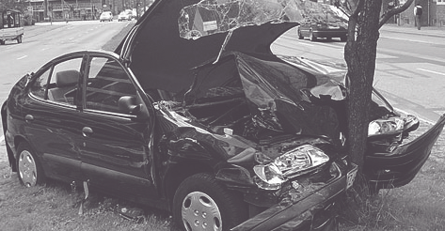
Notes:
But big dopamine surges, like what you get with drug use, actually cause the D2 receptors, the slow down receptors, to be reabsorbed. That is why the brakes don’t work. So with repeated drug use, you speed up the Go! In the nucleus accumbens and inhibits the stop impulses. So it is terrible situation.

Slide 43

Notes:
BUT little pleasures like family, friends, jobs well done, task accomplished, provide just enough dopamine to activate the D2 receptors and strengthen the impulses that slow things down.So, we need just enough DA to activate D2 receptors but not too much. So the thinking is that the soldiers got the surges when returned home, saw their kids, started their jobs, got their lives back.
This has some implications for hospital care that our team has been exploring

Slide 44
Objective 3
Discuss gray zone between opioid use disorder and pain
Notes:
Reviewed how to diagnose, how SUDs develop, let’s get specific and discuss the overlap between opioid use disorder and pain, which can be so challenging to disentangle in the hospital

Slide 45
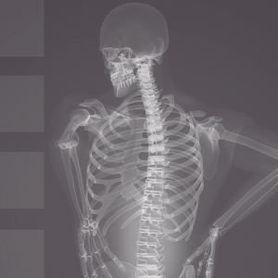
Notes:
A lot of what pain looks like in the brain is not that different from what addiction looks like in the brain

Slide 46
Notes:
Let’s say I have terrible back pain. I want to know what will make me feel better soon. The NA, the area that helps me find rewards, is very motivated to help me pursue opportunities for relief. I get a nice dopamine bolus when my pain is relieved. And if I get an opioid and the pain goes away, I get a big dopamine surge. I want that more. As we know, over time, chronic firing of reward circuits shapes them. D1 receptors excited by DA surge. D2 receptors are reabsorbed. Eventually, I crave the opioids when I have pain even if they aren’t providing much pain relief. Pain is my trigger. And separately from that, I become dependent, so if I try to stop, I experience withdrawal symptoms, which cause more pain and stimulate greater craving for opioids.

Slide 47
Notes:
Terrible conundrum. This is especially problematic because in addition to generally not working well for chronic pain, the opioids we prescribe and that some of our patients now crave, have played a role in our current opioid crisis.

Slide 48
Notes:
Largely because of this, the CDC has now given us guidelines recommending caution at dosages above 50 morphine eq per day and recommending against opioid dosages above 90meq morphine. So for many reasons there is a great deal pressure on providers to taper.

Slide 49
Notes:
Here is why this is critically important. In the haste to taper, it important to drill down on the current data. Any opioid overdose death is the green line. The purple is morphine, codeine, oxycodone. Prescription opioids. Those prescriptions have increased slightly in the last years but have largely plateaued. Blue is heroin, orange is mostly fentanyl. They are sky rocketing.

Slide 50
Notes:
Close up. Drug deaths from heroin have quadrupled since 2010, Deaths from fentanyl increased 72 percent in one year alone, between 2014 and 2015. There is no sign of slowing. There is heated debate about whether the increases in heroin and fentanyl are a result of decreased access to prescription opioids or whether we were headed there anyway. Either way, the death rate is astonishing and as our patients taper some will join the ranks of those using heroin and fentanyl unless we can offer them treatment.

Slide 51

Thank You

Slide 52
Questions?

Slide 53
Administration on Aging and Substance Abuse and Mental Health Services Administration. (2012). Older Americans behavioral health–Issue brief 5: Prescription medication misuse and abuse among older adults. Retrieved from https://www.acl.gov/sites/de- fault/files/programs/2016-11/Issue%20Brief%205%20 Prescription%20Med%20Misuse%20Abuse.pdf
Agency for Healthcare Research and Quality. (2014). Patient characteristics of opioid-related inpatient stays and emergency department visits nationally and by state. Retrieved from https:// www.hcup-us.ahrq.gov/reports/statbriefs/sb224- Patient-Characteristics-Opioid-Hospital-Stays-ED- Visits-by-State.pdf
Alexander, BK ‘Addiction: The View from the Rat Park,” www.brucekalexander.com/articles-speeches/rat-park/148-addition-the-view-from-rat-park.
Centers for Disease Control and Prevention, National Center for Injury and Prevention Control, Division of Unintentional Injury Prevention. ”Opioid Overdose”
Childress AR et al. Prelude to Passion: Limbic Activation by “Unseen” Drug and Sexual Cues January 30, 2008 PLoS ONE 3(1): e1506.
CMS (Centers for Medicare & Medicaid Services). January 5, 2017. Opioid Misuse Strategy.
Coffin PO et al. Nonrandomized Intervention Study of Naloxone Coprescription for Primary Care Patients Receiving Long-Term Opioid Therapy for Pain. Ann Intern Med 2016 Aug 16; 165(4): 245-52.
Comer, SD, et al. Injectable, Sustained-release Naltrexone for the Treatment of Opioid Dependence. Arch Gen Psychiatry 2006.
Dowell D, Haegerich TM, Chou R. CDC Guideline for Prescribing Opioids for Chronic Pain — United States, 2016. MMWR Recomm Rep 2016;65(No. RR-1):1–49. DOI: http://dx.doi.org/10.15585/mmwr.rr6501e1
Frenk et al., 2015). Larney, S., Bohnert, A.S., Ganoczy, D., Ilgen, M.A., Hickman, M., Blow, F.C. and Degenhardt, L., 2015. Mortality among older adults with opioid use disorders in the Veteran's Health Administration, 2000–2011. Drug and Alcohol Dependence, 147, pp.32-37.
Koob GF, Volkow ND. Neurocircuitry of Addiction. Neuropsychopharmacology. 2010;35(1):217-238.

Slide 54
Krupitisky, e. et al. Injectable Extended-release Naltrexone for Opioid Dependence: A Double-blind, Placebo-controlled, Multicenter Randomized Trial. Lancet 2011
Lee JD et al. Extended-Release Naltrexone to Prevent Opioid Relapse in Criminal Justice Offenders NEJM 2016; 374:1232-1242
Lee Jd, et al. Comparative Effectivenes sof Extended-Release Naltrexone versus Buprenorphine-naloxone for Opioid Relaspse Prevention. The Lancet 2017
Lewis, M. The Biology of Desire: Why Addiction is Not A Disease Public Affairs: New York 2015.
Robins, LN et al. How Permanent Was Vietnam Drug Addiction? Am J Public Health. 1974 December; 64(12 Suppl): 38–43.
Mattson, M., Lipari, R. N., Hays, C., et al. (2017). A day in the life of older adults: Substance use facts. The CBHSQ Report. Substance Abuse and Mental Health Services Administration. Retrieved from https://www.samhsa.gov/data/sites/default/files/ report_2792/ShortReport-2792.html
Sordo L. eta l. Mortality Risk during and after Opioid Substitution Treatment: Systematic Review and Meta-analysis of Cohort Studies. BMJ 2017
Szalavitz, M. Unbroken Brain: A Revolutionary New Way of Understanding Addiction St. Martin's Press (April 5, 2016)
Tanum, L et al. The Effectiveness of injectable extended-release naltrexone vs daily buprenorphine-naloxone for opioid dependence: a randomized clinical non-inferiority trial. JAMA Psychiatry 2017
Trafton, Jodi New Concepts in the Neurobiology of Pain and Addiction. Lecture at CSAM Addiction Medicine State of the Art Conference October 23, 2015 San Francisco
Substance Abuse and Mental Health Services Administration. (2017). Opioid misuse increases among older adults. The CBHSQ Report. Retrieved from https://www.samhsa.gov/data/sites/default/ files/report_3186/Spotlight-3186.html
Substance Abuse and Mental Health Services Administration. (2017). Resources List. Opioid Use in the Older Population. Retrieved from https://www.samhsa.gov/capt/sites/default/files/resources/resources-opiod-use-older-adult-pop.pdf

Slide 55
U.S. Office of the Inspector General. (2017). Opioids in Medicare Part D: Concerns about extreme use and questionable prescribing. Retrieved from https://oig.hhs.gov/oei/reports/oei-02-17-00250.asp
Walley, AY et al. Opioid overdose rates and implementation of overdose education and nasal naloxone distribution in Massachusetts: interrupted time series analysis BMJ 2013; 346 doi: https://doi.org/10.1136/bmj.f174
Weiss A.J., Bailey M.K., O’Malley L., Barrett M.L., Elixhauser A., Steiner C.A., Patient Characteristics of Opioid-Related Inpatient Stays and Emergency Department Visits Nationally and by State, 2014. HCUP Statistical Brief #224. June 2017. Agency for Healthcare Research and Quality.

