Slide 1
DISCLOSURES
This activity is jointly provided by Northwest Portland Area Indian Health Board and Cardea
Cardea Services is approved as a provider of continuing nursing education by Montana Nurses Association, an accredited approver with distinction by the American Nurses Credentialing Center’s Commission on Accreditation.
This activity has been planned and implemented in accordance with the accreditation requirements and policies of the Institute for Medical Quality/California Medical Association (IMQ/CMA) through the joint providership of Cardea and Northwest Portland Area Indian Health Board. Cardea is accredited by the IMQ/CMA to provide continuing medical education for physicians.
Cardea designates this live training for a maximum of 8.25 AMA PRA Category 1 Credit(s)TM. Physicians should claim credit commensurate with the extent of their participation in the activity.

Slide 2
DISCLOSURES
COMPLETING THIS ACTIVITY
Upon successful completion of this activity 8.25 contact hours will be awarded
Successful completion of this continuing education activity includes the following:
Attending the entire CE activity;
Completing the online evaluation;
Submitting an online CE request.
Your certificate will be sent via email If you have any questions about this CE activity, contact Michelle Daugherty at mdaugherty@cardeaservices.org or (206) 447-9538

Slide 3
CONFLICT OF INTEREST
None of the planners or presenters of this CE activity have any relevant financial relationships with any commercial entities pertaining to this activity.

Slide 4
Assessing and Treating Co-occurring Mental Illness and SUD
Joshua Boverman M.D.
Medical Director, Wallowa Valley Center for Wellness
Consulting Psychiatrist, Winding Waters Clinic
Affiliate Assistant Professor of Psychiatry, OHSU

Slide 5
Joshua Boverman MD
CONFLICTS OF INTEREST: No
No conflicts of interest/financial relationships to disclose
DISCUSSION OF OFF LABEL USE OF MEDICATIONS: Yes
I will be discussing off label use of the following medications: clonidine, prazosin, gabapentin, clonazepam, and the food supplement N-Acetylcysteine

Slide 6
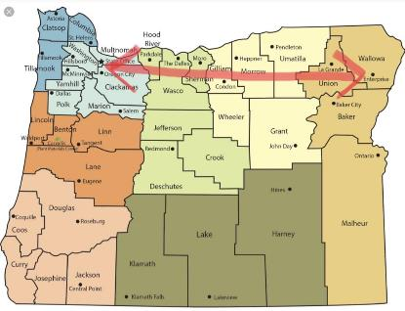
Joshua Boverman MD: Current work

Slide 7
My first job as an doctor

Slide 8
OBJECTIVES:
Understand the relationship between mental disorder and Opioid Use Disorder
Understand the relationship between PTSD symptoms and Opioid Use Disorder
Understand MAT’s effects on PTSD and to some degree other mental illnesses
Be familiar with risks/benefits of co-prescribing certain medications along with buprenorphine or methadone MAT:
Risks associated with prescribing benzodiazepines, gabapentin, and other sedatives with MAT
How to adjust antidepressants, alpha blockers, antipsychotics and mood stabilizers in MAT

Slide 9
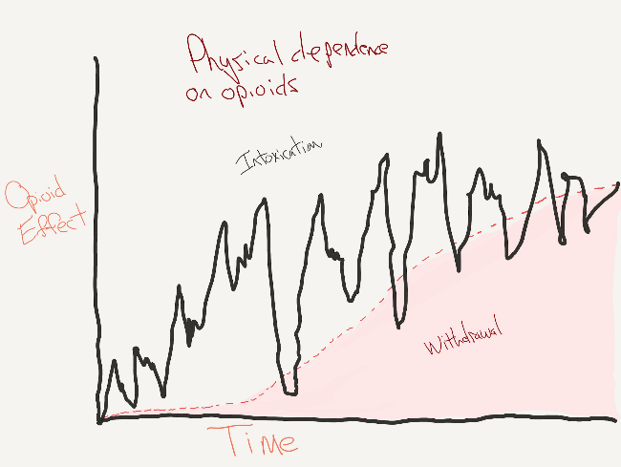

Slide 10
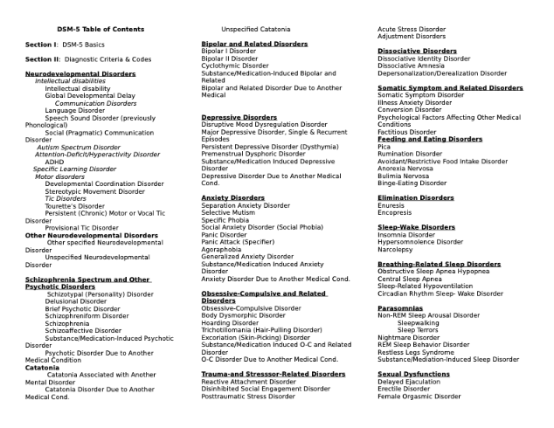
All DSM 5
Disorders

Slide 11
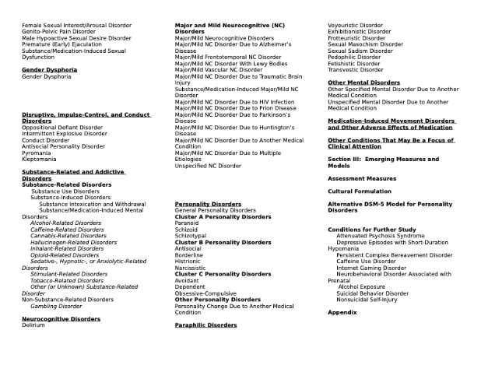
All DSM 5
Disorders (cont)
(too many disorders)

Slide 13
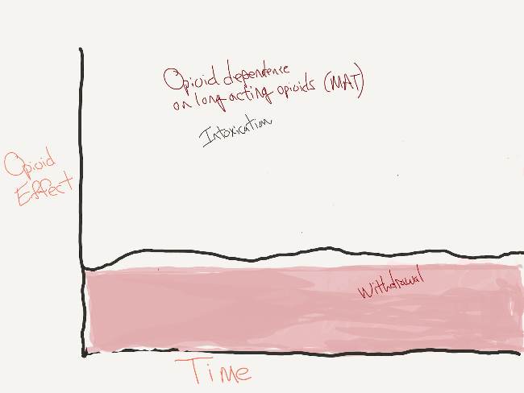
Notes:
Modest effects on PTSD symptoms:
Mills KL, Teesson M, Ross J, Darke S. The impact of post-traumatic stress disorder on treatment outcomes for heroin depen- dence. Addiction 2007; 102:447–54.
Schiff M, Levit S, Cohen-Moreno R. Child- hood sexual abuse, post-traumatic stress disorder, and use of heroin among fe- male clients in Israeli methadone main- tenance treatment programs (MMTPS). Soc Work Health Care 2010; 49(9): 799–813.
Trafton JA, Minkel J, Humphreys K. Opioid substitution treatment reduces substance use equivalently in patients with and with- out posttraumatic stress disorder. J Stud Al- cohol 2006; 67(2):228–35.
And
Observational Evidence for Buprenorphine’s Impact on Posttraumatic Stress Symptoms in Veterans With Chronic Pain and Opioid Use Disorder
Karen H. Seal, MD, MPH; Shira Maguen, PhD; Daniel Bertenthal, MPH; Steven L. Batki, MD; Joan Striebel, MD; Murray B. Stein, MD; Erin Madden, MPH; and Thomas C. Neylan, MD
J Clin Psychiatry 2016;77(9):1182–1188

Slide 14
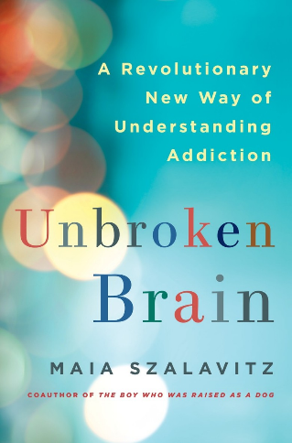
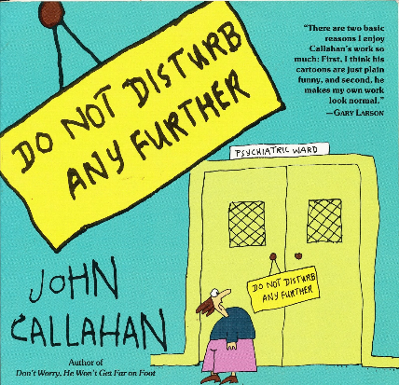
This Talk

Slide 15
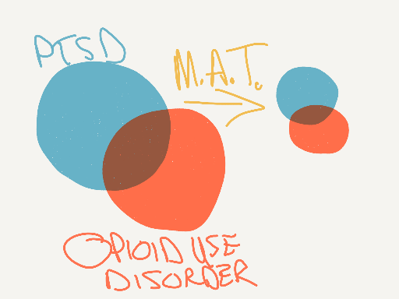
Narrowing the focus a bit . ..

Slide 16
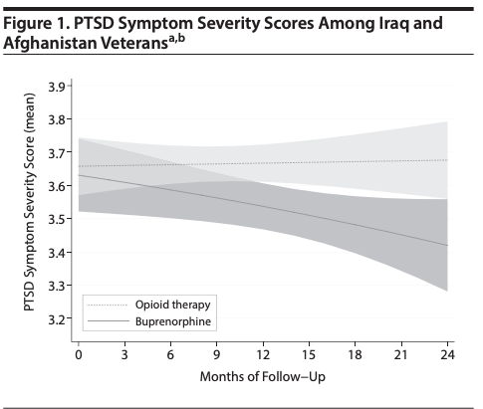

Slide 17
Mental Illness and MAT: what can you do
Good MAT!
Careful mental health assessment and referral
PTSD:
Counseling
Medications: SSRIs, alpha blockers
Other disorders:
May prescribe (OR STOP):
mood stabilizers
benzodiazepines
antipsychotic medications
N-acetylcysteine
gabapentin

Slide 18
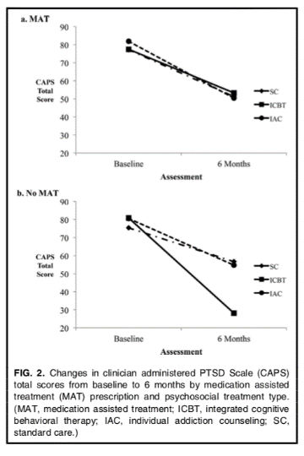
Counseling .. . .

Slide 19
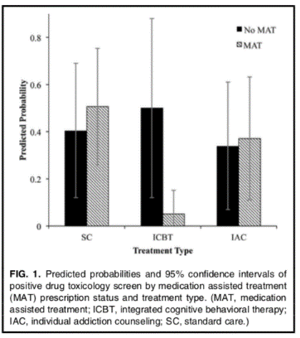
Counseling .. . .

Slide 20
Benzodiazepines
The risk/benefit of chronic benzodiazepines is in question for all groups. It is especially poor in individuals with addictive disorders
Practitioners and patients cannot distinguish between endogenous anxiety symptoms and those caused by drug use disorder
Co-prescribing benzodiazepines places the patient at risk of overdose, deepened or compound drug dependence, temptation to divert
Avoid co-prescribing, except in certain circumstances as a taper
Your patients will thank you

Slide 22
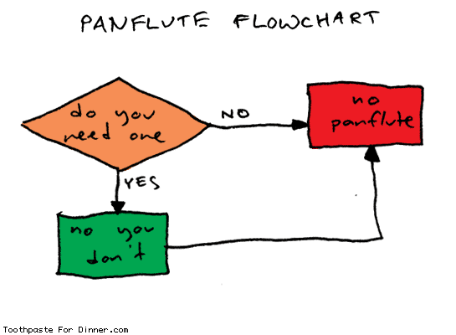
(Used by permission)

Slide 23
Medications for PTSD: no major adjustments
SSRIS - mainstay of therapy. A slow, modest improvement in anxiety symptoms.
Example: fluoxetine 10 mg daily. Increase to 20 as tolerated.
Alpha blockers - helpful adjuncts to treat startle, “fight or flight” sensation, interrupted sleep, nightmares.
Example: prazosin 1 hs. Increase to 3 hs. Consider adding a morning dose. Hold for orthostatic symptoms
No adjustment necessary in MAT

Slide 24
N-Acetylcysteine (NAC)
Glutamate modulator
Current medical use as a detoxification agent for acetaminophen and as a mucolytic
Available as a food supplement. Inexpensive. Well tolerated
Preliminary studies suggest efficacy for a wide range of disorders (autism, dementia, cannabis dependence, trichotillomania , skin picking) but no strong data for its use in any disorder
Cannabis dependence: some studies support but best trial to date is negative
Notes:
Gray, K. M., Sonne, S. C., McClure, E. A., Ghitza, U. E., Matthews, A. G., McRae-Clark, A. L., ... & Hasson, A. (2017). A randomized placebo-controlled trial of N-acetylcysteine for cannabis use disorder in adults. Drug and alcohol dependence, 177, 249-257.
Costa, D. L., Diniz, J. B., Requena, G., Joaquim, M. A., Pittenger, C., Bloch, M. H., ... & Shavitt, R. G. (2017). Randomized, Double-Blind, Placebo-Controlled Trial of N-Acetylcysteine Augmentation for Treatment-Resistant Obsessive-Compulsive Disorder. The Journal of clinical psychiatry, 78(7), e766-e773.

Slide 25
Gabapentin
Benefits:
FDA approved for:
Neuropathic pain (post-herpetic neuralgia)
Strong support for:
Alcohol dependence
Some evidence for use in:
PTSD, cannabis use disorder, as adjunct for opioid use d/o
RISKS
Abuse and dependence - some risk
Overdose. Low risk as sole agent in overdose but use correlates with opioid overdose
Notes:
Addiction. 2017 Sep;112(9):1580-1589. doi: 10.1111/add.13843. Epub 2017 May 15. Risk to heroin users of polydrug use of pregabalin or gabapentin. Lyndon A1, Audrey S2, Wells C3, Burnell ES1, Ingle S2, Hill R1, Hickman M2, Henderson G1.

Slide 26
Abuse of Psychiatric Medications
Benzodiazepines: avoid because of abuse potential, severe physical dependence syndrome, and overdose risk
Gabapentin: sometimes abused
Wellbutrin: sometimes abused . When taken orally: noradrenergic. When snorted: dopaminergic/noradrenergic
Stimulants: carry strong abuse potential
However, may be reasonable to co-prescribe with MAT in selected and carefully monitored cases
Mood stabilizers and all sedating medications may be over-used

Slide 27
OBJECTIVES:
Understand the relationship between mental disorder and Opioid Use Disorder
Understand the relationship between PTSD symptoms and Opioid Use Disorder
Understand MAT’s effects on PTSD and to some degree other mental illnesses
Be familiar with risks/benefits of co-prescribing certain medications along with buprenorphine or methadone MAT:
Risks associated with prescribing benzodiazepines, gabapentin, and other sedatives with MAT
How to adjust antidepressants, alpha blockers, antipsychotics and mood stabilizers in MAT

