Slide 1
DISCLOSURES
This activity is jointly provided by Northwest Portland Area Indian Health Board and Cardea
Cardea Services is approved as a provider of continuing nursing education by Montana Nurses Association, an accredited approver with distinction by the American Nurses Credentialing Center’s Commission on Accreditation.
This activity has been planned and implemented in accordance with the accreditation requirements and policies of the Institute for Medical Quality/California Medical Association (IMQ/CMA) through the joint providership of Cardea and Northwest Portland Area Indian Health Board. Cardea is accredited by the IMQ/CMA to provide continuing medical education for physicians.
Cardea designates this in-person training for a maximum of 7 AMA PRA Category 1 Credit(s)TM. Physicians should claim credit commensurate with the extent of their participation in the activity.

Slide 2
DISCLOSURES
COMPLETING THIS ACTIVITY
Upon successful completion of this activity 7 contact hours will be awarded
Successful completion of this continuing education activity includes the following:
Attending the entire CE activity;
Completing the online evaluation;
Submitting an online CE request.
Your certificate will be sent via email If you have any questions about this CE activity, contact Michelle Daugherty at mdaugherty@cardeaservices.org or (206) 447-9538

Slide 3
CONFLICT OF INTEREST
None of the planners or presenters of this CE activity have any relevant financial relationships with any commercial entities pertaining to this activity.

Slide 4
Acknowledgement
This event is funded in part by:
The Indian Health Service HIV Program
and
The Secretary’s Minority AIDS Initiative Fund

Slide 5
Objectives
By the end of this learning event participants will be able to:
Discuss the current state of Medicaid access in WA State for Hep C medications
Describe strategies for successfully accessing HCV meds for AI/AN patients

Slide 6
Accessing HCV Medications
Jessica Rienstra RN
Hepatitis C Project Coordinator
Lummi Tribal Health Center
jessicar@lummi-nsn.gov
360.312.2426

Slide 7
Identify HCV Database
Compile list of all patients with a HCV AB and HCV RNA
Notes:
Identify Database
Review what ICD 10 codes are used for POV for HCV patients (current and historic)

Slide 8
Identify Insurance and Eligibility
Notes:
Within our HCV database and Care Cascade we also have identified each patient’s insurance and current status. Updating this information has increased priority as several times during the prior authorization process a patient’s insurance has “termed” and therefore caused an unnecessary denial of medication. This is not a permanent issue, but does make the process more time consuming as many more phone calls are then required and at time a new PA submission.
Chart Audit Database for Insurance Coverage
~90% of our 366 HCV Database have Medicaid

Slide 9
Obtaining Treatment Approvals
Notes:
This takes a TEAM APPROACH. Tribal Assisters, Pharmacists, Lab, Receptionist, MDs and Nursing staff, are all a HUGE part of our ability to get patient’s treatment to them successfully and in a timely manner.
Another reason for this insurance screening is an effort to minimize return visits for the patient. Each insurance company has slightly different requirements for their prior authorization, including different lab values and screening points.

Slide 10
MEDICAID
Washington State Health Care Authority will approves coverage for all patients with chronic HCV infection regardless of fibrosis scoring.
Notes:
Some differences to note from different insurance companies.
If using fibrosure for fibrosis stating, ensure not fibrometer (washington state specific)
Medicaid aligns closely to the ECHO form, with the exception of requiring an INR within the last 6 months and
Often times this will be sent back with addional questions, and 7 days to respond before denial. Don’t give up, respond anyway and reopen the case and you can still receive your approval.
When filling out this prior auth we have the MD order the medication which signals the pharmacy to fill out the 13-835 which is the cover sheet to the 13-830A.
LEARN THE GUIDELINES (Medicaid can change with out notice ((ie mavyret preferencevs harvoni)) and can be inconsistent with approvals, but having full knowledge of policy gives solid backing to prior auth requests.)

Slide 11
MEDICAID
Chronic infection:
Fibrosis ≥ F1 and HCV RNA ≥ 15 IU/mL within the last 12 months
OR
Fibrosis < F1 AND
HCV AB + at least 6 months and HCV RNA + 6 months after date of HCV AB +; OR
Two detectable HCV RNA tests at least 6 months apart

Slide 12
Medicaid Required Documentation
HCV AB test (at least 6 months prior to treatment request)
HCV Genotype
Current HCV RNA Viral Load
Fibrosis Staging (within last 2 years)
Documenation of Decompensation if F4 or cirrhotic
Documentation of treatment experienced status
Notes:
Prescriber must be participating and consulting with Project ECHO or with specialist ( requires consulation note or documentation of phone call.)

Slide 13
Transmission Risk Factors and Time Frames
CrCl, APRI, Albumin, total Bilirubin, INR (within last 6 months)
https://www.hca.wa.gov/assets/billers-and-providers/13-835.pdf
https://www.hca.wa.gov/assets/billers-and-providers/13-830A.pdf

Slide 14
Molina
Stage 3 fibrosis needed for Prior Authorization
Aetna
Requires SVR labs to be submitted. (others by request only)
http://www.aetna.com/pharmacy-insurance/healthcare-professional/documents/HepC-MedicationPrecertificationRequest.pdf
Cigna
More specific cirrhosis screening for ALL patients. (APRI, FIB-4 and Abd US not enough for non cirrhotic screening.)
https://www.cigna.com/assets/docs/pharmacy/Pharmacy_hepatitis_c.pdf
Notes:
When sending these PA’s ensure that the patient

Slide 15
Insurance Phone Numbers Medicaid 1-800-562-3022 ext 15483 for pharmacy authorization Kaiser Permanente 1-800-729-1174 for Pharmacy Drug Benefit Help Desk Cigna 1-888-992-4462 1-800-351-3606 for Specialty Pharmacy Services 800-244-6224 for physician for prior authorizations Aetna 1-866-503-0857 for Precertification Notification HMA 1-877-408-9742 option #5 for Caremark Specialty Pharmacy
Notes:
Important phone numbers, find these for your area and make them visible to everyone on your team

Slide 16
CREATE A TEMPLATE
Inclusive of all the Prior Authorization requirements from each Insurance company in your area and the ECHO presentation form.

Slide 17
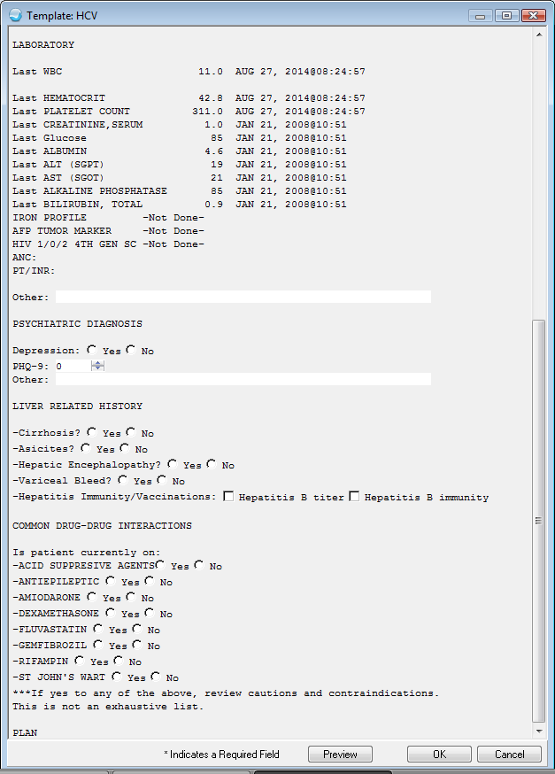
Notes:
This is an example of one of our earlier templates, based off of ECHO screening guidelines and medicaid and HMA guidelines. This really helps streamline and add structure to the screening process. It is not uncommon for one of our patients to have a change of insurance during the screening process, which is why I try to screen inclusive of all requirements. This visit can be referenced when preparing a case for ECHO presentation or preparing a Prior Authorization for medication coverage.
(Template just guides the visit but is not the entire documenation)
(opened on a “demo patient” file)

Slide 18
Other Options
Gilead Support Path
http://www.mysupportpath.com/
Specialty Pharmacies
CMOP
Notes:
Depending on your clinic and pharmacy set up and available support staff it may be easier/necessary to use outside pharmacy. Many specialty pharmacies are very helpful and very motivated to connect the patients to care.
The benefit of treating patient’s in house for us, is that with a 340b pharmacy we can be reimbursed for our medicaid patients at a profit, so that we can have funding to provide care for the patient’s who do not meet coverage

Slide 19
Patient Assistance Programs can be difficult to navigate but are helpful for motivated patients.
Cigna and Kaiser Permanente both assisted patient’s with payment plans. Offering a RX card that allowed patient’s to get the medication for $5.00.
HMA insurance connected patients to CVA Caremark Pharmacies that offer each 28 tablets of medication for a $20.00 co-pay.
Notes:
In OUR experience. In Washington state.

Slide 20
Case Management
Home visits
Transportation
Weekly phone calls
Med Drop offs
Flexible Lab Visits
Client Oriented plan of treatment
Help address other needs and priorities
Notes:
Frequency of RF’s and visit schedule.
Previous commitments? Drug Court, OTP, court ordered counseling? Collate with those schedules!!!
Get EVERYONE’s number. And potential address changes and addresses of closest relatives.
Get friendly with Local Jails and DOC’s in your area. Open communication with Health Departments in your state. Become very aquainted with your patient’s network of contacts.
Keep consistent contact people when possible. I have found that with patients that I triage and that see the same provider the level or report is built up and they are more likely to be forthcoming about life changes and usage habits then those patients who see a wider variety of staff.

Slide 21
Resources
Washington State Health Care Authority Medical Policy No. 12.35.30-99
Notes:
Resources:

