Slide 1
Portland Area Health Priorities
CAPT Thomas Weiser, MD, MPH
Medical Epidemiologist
Portland Area Budget Formulation Meeting
Portland, November 30, 2017

Slide 2
Overview
Brief History of Hepatitis C
Hepatitis C → Liver Disease → Leading Causes of Death (Mortality)
Hepatitis C → Liver Disease → Leading Causes of Hospitalization (Morbidity)
Hepatitis C → Liver Disease → Years of Potential Life Lost (YPLL)

Slide 3
Brief History of Hepatitis C
Mortality, Morbidity and Years of Potential Life Lost

Slide 4
Brief History of Hepatitis C
1975: A virus capable of causing hepatitis that was not hepatitis A or hepatitis B was discovered (“non-A, non-B hepatitis”)
1989: The non-A, non-B hepatitis virus is isolated: hepatitis C virus
1990: Testing of US blood supply for Hepatitis C
1991: First treatment regimen developed, interferon alfa 2b
1992: Improved sensitivity test adopted for US blood supply
1998: Ribavirin plus interferon treatment
2001: Pegylated interferon

Slide 5
Brief History of Hepatitis C
2010: Rapid antibody test developed
2013: First direct-acting antiviral (DAA) medications allows treatment without interferon
2015-present: New DAAs with increased rates of cure for most genotypes, with fewer doses and shorter treatment durations for many patients

Slide 6
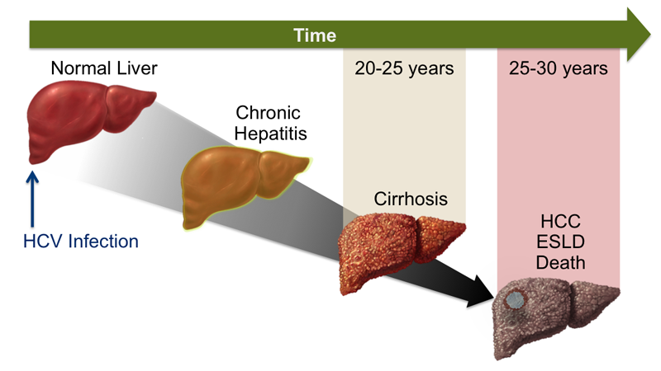
Natural History of Hepatitis C
15%-25% of HCV infections will resolve
without treatment depending on age, sex, race, severity of initial infection , immune status and host genotype
Copyright © 2018 Hepatitis C Online - AWS
Notes:
Age: 70% of infections in those aged 20 or less appear to resolve spontaneously. 45% of children infected through contaminated blood transfusions resolved the infections without treatment
Sex: In 2 large retrospective analyses involving more than 1600 women who received contaminated Rh immune globulin, the chronicity rate was only 55%, a rate significantly lower than the 75 to 85% typically reported. In contrast, cross sectional studies have not reported gender differences.
Race: In a prospective cohort study involving 1667 injection-drug users, African Americans were more likely to develop chronic infection than other races (91% versus 64%).
Severity of infection: Studies of the women infected with hepatitis C virus through contaminated Rh immune globulin, only 45 to 50% of people who developed jaundice become chronically infected.
Immune Status: HCV persisted in 95% of those coinfected with HIV.
Genotype: Those with CC allele on IL28B gene which codes for interleukin 28 (interferon lambda) resolve their infection about 50% of the time.

Slide 7
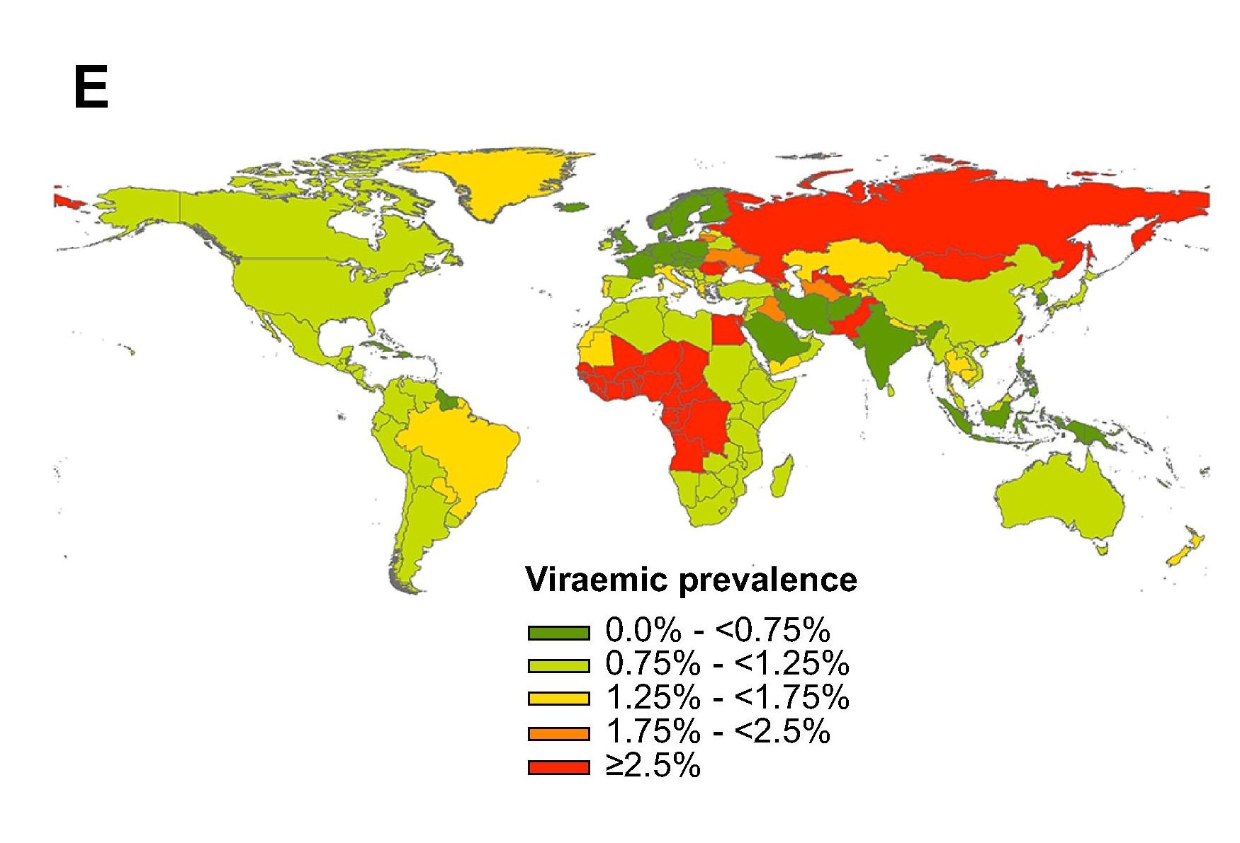
Global Distribution of HCV
Estimated and reported HCV viremic disease
  Highest in West Africa, Egypt, Russia, and parts of Central Asia and Eastern Europe
  Data quality is poor in many of these areas
Absolute numbers of people infected are highest in China, India, Nigeria, Egypt, US, Brazil, Russia
J Hepatology Volume 61(1), Supp, 2014 (Nov): S45-S57

Slide 8
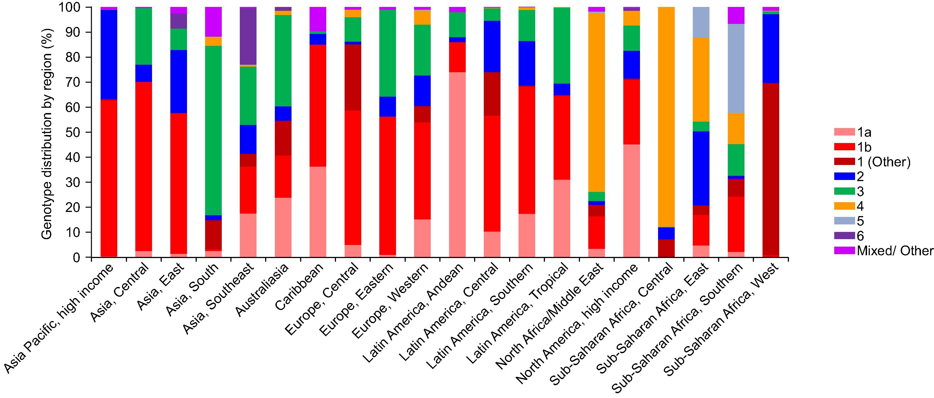
Total global viremic HCV infections
Estimated at 80 (64–103) million infections.
Genotype distribution:
  genotype 1 (G1) (46%)
  G3 (22%)
  G2 (13%)
  G4 (13%)
J Hepatology Volume 61(1), Supp, 2014 (Nov): S45-S57
Notes:
Type 1 is most common, shown in shades of red at the base of each bar. It makes up 46% of infections worldwide and is the most common genotype in each region except in South Asia, North Africa/Middle East, Central, East and Southern Africa.
Type 3, shown in green is the next most common accounting for 22% of infections worldwide, primarily because of the large number of infections in Southern Asia.
Type 2, shown in blue and type 4 shown in gold each account for 13% infections. Type 2 is seen more commonly in Asian Pacific countries and West Africa whereas type 4 is seen more commonly in North Africa and the Middle East and in Central and East Africa.

Slide 9
Impact Measures
Mortality, Morbidity and Years of Potential Life Lost for AI/AN in the Western Region and NW States

Slide 10
Notes:
The next few slides are data from the National Center for Health Statistics and include data from <CLICK> the Western states.

Slide 11
Top 10 Causes of Death, Men
American Indian/Alaska Native Western Region, 2010-2015
Data Source: | National Center for Health Statistics (NCHS) Vital Statistics System.
Notes:
This Table shows the leading causes of death for AI/AN Men in the Western Region, as described on the previous map, by age groups from 2010-2015. Liver disease from all causes is outlined in yellow and is the 2nd through 4th leading cause of death for men 25-64 years of age <CLICK>.
The fact that liver disease was not the leading cause of death among men <CLICK> is that from Age 1-54, the leading cause of death was unintentional injury, shown in red. From 10-34, suicide, shown in green, was the second leading cause. While these are from all categories of unintentional injury and suicide, we mustn’t forget the role that substance abuse plays in these deaths, including the present crises of opioids and methamphetamine, along with the much more persistent impact of alcohol.

Slide 12
Top 10 Causes of Death, Women
American Indian/Alaska Native Western Region, 2010-2015
Data Source: | National Center for Health Statistics (NCHS) Vital Statistics System.
Notes:
Liver disease mortality is even greater among women where it was the 2nd leading cause of death for women 25-44, and 55-64 and the leading cause of death for women 45-54. Again we also see the importance of unintentional injury and suicide as number 1 and 2 leading causes of death.

Slide 13
Leading Causes of AI/AN Hospitalization, Washington, 2011
Males
< 1 Year | 1 - 14 | 15 - 24 | 25 - 39 | 40 - 64 | 65 + | Overall
Perinatal | Respiratory | Injury & Poisoning | Injury & Poisoning | Circulatory | Circulatory | Perinatal
Respiratory | Injury & Poisoning | Digestive | Digestive | Digestive | Respiratory | Digestive
Congenital Anomalies | Digestive | Endocrine/Immun. | Skin & Soft Tissue | Injury & Poisoning | Digestive | Injury & Poisoning
Females
Perinatal | Respiratory | Pregnancy & Childbirth | Pregnancy & Childbirth | Digestive | Circulatory | Pregnancy & Childbirth
Respiratory | Injury & Poisoning | Digestive | Digestive | Respiratory | Respiratory | Digestive
Congenital Anomalies | Digestive | Injury & Poisoning | Injury & Poisoning | Circulatory | Digestive | Perinatal
Produced by: Northwest Portland Area Indian Health Board Improving Data & Enhancing Access - Northwest (IDEA-NW) Project
Data Source: Washington Comprehensive Hospital Abstract Reporting System (CHARS) 2011
Notes:
This chart looks at Hospitalizations in Washington State in 2011. For men, digestive disorders, which includes Hepatitis C related hospitalizations, made up the second leading cause of hospitalizations in the middle decades and overall. For women it is similar but for those 40-64, digestive disorders were the leading cause of hospitalization in Washington State.

Slide 14
Leading Causes of AI/AN Hospitalization, Oregon, 2011
Males
< 1 Year | 1 - 14 | 15 - 24 | 25 - 39 | 40 - 64 | 65 + | Overall
Perinatal | Respiratory | Injury & Poisoning | Digestive | Circulatory | Circulatory | Perinatal
Respiratory | Digestive | Mental Illness | Mental Illness | Digestive | Respiratory | Circulatory
Congenital Anomalies | Injury & Poisoning | Digestive | Injury & Poisoning | Injury & Poisoning | Musculoskeletal | Digestive
Females
Perinatal | Respiratory | Pregnancy & Childbirth | Pregnancy & Childbirth | Digestive | Circulatory | Pregnancy & Childbirth
Respiratory | Digestive | Digestive | Genitourinary | Musculoskeletal | Respiratory | Perinatal
Congenital Anomalies | Injury & Poisoning | Mental Illness | Digestive | Circulatory | Digestive | Digestive
Produced by: Northwest Portland Area Indian Health Board Improving Data & Enhancing Access - Northwest (IDEA-NW) Project
Data Source: Oregon Association of Hospitals & Health Systems, 2010-2011
Notes:
In Oregon we again see that digestive disorders is one of the top 3 leading causes of hospitalization for almost every age group

Slide 15
Years of Potential Life Lost, American Indian/Alaska Native, West Region 2010-2015
Data Source: | National Center for Health Statistics (NCHS) Vital Statistics System.
Notes:
We have looked at mortality and hospitalization. Years of Potential Life Lost, known as YPLL, is another way of measuring the impact of disease on a population. Those who die from conditions at a younger age have lost a greater number of potential years of life, so the combination of a high rate of mortality and an early onset has the greatest impact. In this graph we see Liver Disease as the second highest condition for years of potential life lost for women in the western region from 2010-2015, measuring 28,442 years, behind unintentional injuries as number one, which at 55,984 is more than twice that of Liver Disease.
For men, Liver Disease is slightly higher in magnitude, 33477 years, but is ranked as the fourth leading cause. The leading cause is also Unintentional Injury, which has nearly 4 times the years of potential life lost as for Liver Disease.

Slide 16
HCV-Specific Data

Slide 17
Age-adjusted Hepatitis C-related Mortality – Northwest, 2006–2012
Northwest
Rate Ratio (95% Confidence Interval) AI/AN : NHW | 3.33 (2.96, 3.75) | 3.22 (1.85, 5.62) | 2.52 (2.04, 3.11) | 3.88 (3.34, 4.50)
Notes:
We looked at age-adjusted mortality related to hepatitis C among AI/AN and Non-Hispanic whites in the Northwest- Idaho, Oregon and Washington, from 2006-2012.
AI/AN mortality rate per 100,000 is shown in gold for the combined and each state separately; non-Hispanic is shown in grey. The rate ration compares AI/AN to Non-Hispanic white and measured 3.33 for all 3 states combined with a range of state-specific rates of 2.52 to 3.88.

Slide 18
Age-Adjusted HCV-Related Mortality, 2006–2012
AI/AN
NHW
Notes:
This is a plot of age-adjusted HCV mortality rates overtime for AI/AN in orange and NHW in grey.
Over time, rates appear to remain relatively stable for NHW, and appear to increase for AI/AN, although rate estimates are imprecise for this population.
However, the disparity in age-adjusted HCV mortality between AI/AN and NHW is persists over time.

Slide 19
Analysis of IHS HCV Diagnoses, 2005-2015
Journal of Community Health, May 28, 2018 https://doi.org/10.1007/s10900-018-0528-7
Notes:
Another analysis that was just published, looked at ICD coded visits to IHS, Tribal and Urban facilities reported in the National Patient Information Reporting System (NPIRS) from 2005-2015. These visits and diagnoses do not include lab-verified HCV infections. This table shows basic demographic information. The number and rate is slightly higher for males compared to females and increases with age until the oldest age group, 55 and over.

Slide 20
Analysis of IHS HCV Diagnoses, 2005-2015
Journal of Community Health, May 28, 2018 https://doi.org/10.1007/s10900-018-0528-7
Notes:
When we look at cohorts- those born in the baby boom era vs those born before, those born before have about 20% of the HCV diagnosis prevalence compared to the baby-boomers.
There are also differences by region with the highest rates of HCV diagnoses seen in the West, Northern Plains West, and Southern Plains. The lowest rates are seen in the Southwest. At this point, we are not able to conform these diagnoses in this data system because it does not include laboratory values. But in the near future, we expect to be able to have that information which will help improve the accuracy of these estimates.

Slide 21
Conclusion
Hepatitis C has a large impact on AI/AN populations as a cause of mortality and as an important contributor to high rates of hospitalization and years of potential life lost from liver disease.
The mortality disparity, approximately 3.3 times that of non-Hispanic whites likely reflects a number of disparities such as higher risks of exposure, earlier age of exposure, less access to testing and less access to treatment.
The ongoing epidemic of injection opioid and meth use is an important contributor to increased risk of acute hepatitis C infection.

Slide 22
Thank You

