Slide 1
SYRINGE SERVICES AND HCV TREATMENT PROGRAMS AT A TRIBAL HEALTH CENTER
Jessica Rienstra, RN
Hepatitis C Project Coordinator
JessicaR@Lummi-nsn.gov

Slide 2
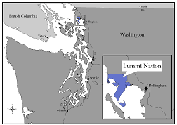
The Lummi Tribal Health Center is located in Bellingham, Washington on the Lummi Nation.
Established in 1978, LTHC serves close to 6,500 patients. The Lummi Nation operates an ambulatory direct care facility under a Self-Governance Compact with the IHS. The center offers general comprehensive medical and dental, mental health and substance abuse counseling, WIC, family planning, community health outreach (CHR) and health education. 60% of LTHC employees are community members.
Notes:
Primary care, Suboxone program, Dental, PT, Mental health and chemical dependency services, and community health outreach services.

Slide 3
Overview
In 2012 40% of new HCV cases in Whatcom county were Native American while accounting for only 3.2% of The county’s total population.
Notes:
Where all this stems from and to give a little bit of background..

Slide 4
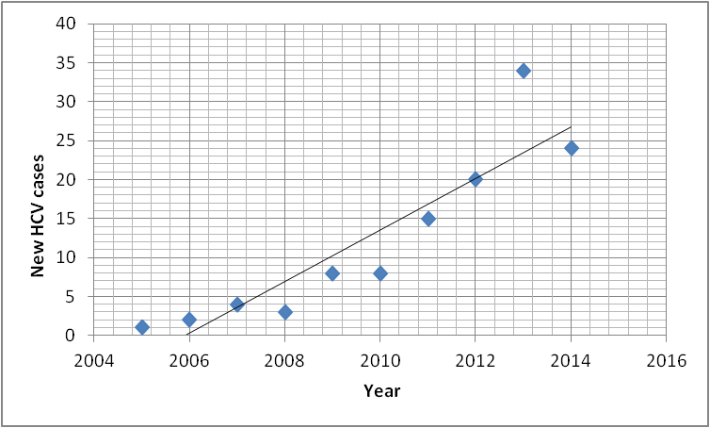
HCV at LTHC
Notes:
This is a snapshot of new cases per year at Lummi Clinic. Clearly a growing concern and a rapidly growing one.

Slide 5
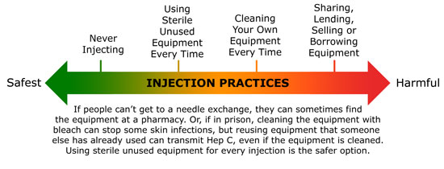
Lummi Tribal Health Center (LTHC) offers a Primary Integrated Care Syringe Service Program that allows patients to access harm reduction materials while maintaining anonymity.
LTHC offers screening and treatment for Hepatitis C through Primary Care Providers participating in ECHO sessions.
Offering HCV treatment to all patients, including those actively or intermittently injecting, requires an optimization of a syringe program to minimize any future exposures.
Notes:
In the past we have had a needle exchange program that operated outside the clinic for one hour a week, and while initially there was success with this model, the patients expressed concern at the lack of privacy and the amount of onlookers and many patients stopped attending.
With the syringe program integrated into the primary care visits the patient has a chance to express their needs privately in a secure environment.
Not every patient will ask for supplies, but it is something that everyone here can offer. For the patient that comes in with repeated abcesses, do you need a sharps container, how many times are you injecting each day, do you use alone or with others?. Making a point to ask the uncomfortable questions to better meet the patients need.

Slide 6
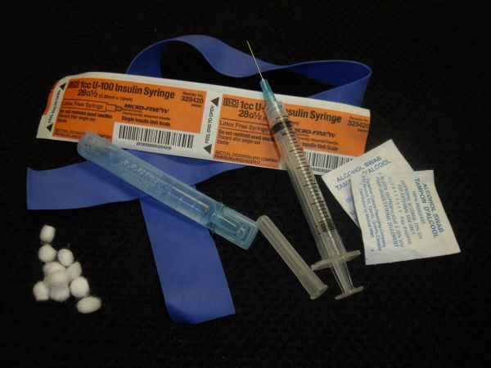
Supplies:
-Sterile syringes
-Alcohol prep pads
-Cookers
-Cotton filters
-Sterile water
-Bandages
-Condoms
-Tourniquet
-Narcan
https://nasen.org/
Notes:
Vanish point, need based vs one to one
These may include but are not limited to the following prevention items:
Nasen.org

Slide 7
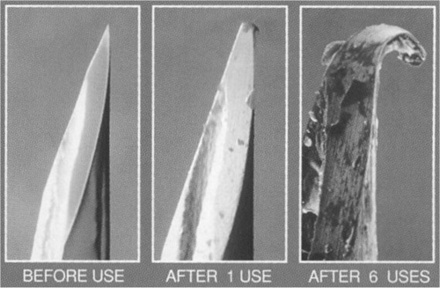
Notes:
A big part of the syringe program is education of our patients. Decreasing abscesses for patients who reuse their own needles. Preventing transmission in patients who previously shared needles.

Slide 8
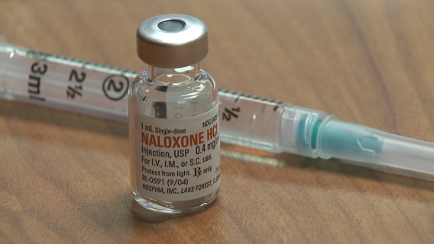
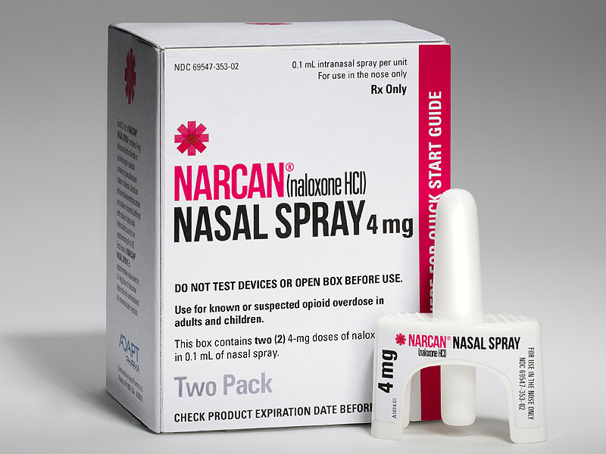
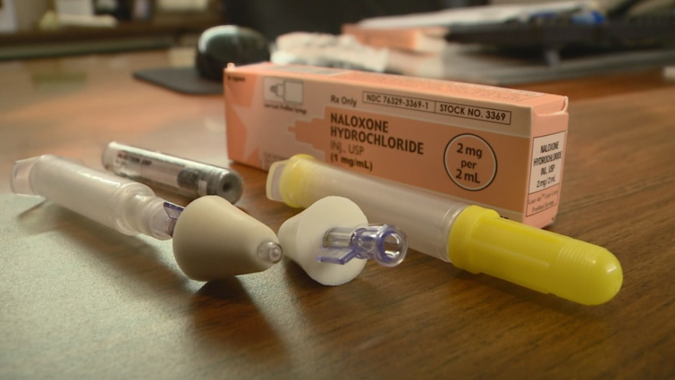
Easy and safe access to Narcan
Notes:
Another big focus is Narcan Distribution
Presently we only give our Narcan through MD prescription. However looking at the health departments methods and with WA states liberal rules surrounding Narcan distribution we are working on easier access to narcan through any trained clinic employee.
This must include Overdose prevention and Narcan training for each new patient.
Discuss Training Highlights. (reviewing s/sxs of overdose, both from stimulants and depressants. Identify risk factors. Disspell common myths.

Slide 9
Principles of Harm Reduction
Harm reduction incorporates a spectrum of strategies from safer use, to managed use to abstinence to meet people who inject “where they’re at,” addressing conditions of use along with the use itself. Because harm reduction demands that interventions and policies designed to serve users reflect specific individual and community needs, there is no universal definition of or formula for implementing harm reduction.
http://harmreduction.org/about-us/principles-of-harm-reduction/
Notes:
http://harmreduction.org/about-us/principles-of-harm-reduction/
Importance of meeting people where they are at as well as addressing the CONDITIONS of use along with the use itself.
Harm reduction will look different in each state, in each clinic and it looks different for each patient.

Slide 10
Basic Harm Reduction Principles
-Accepts, for better and or worse, that licit and illicit drug use is part of our world and chooses to work to minimize its harmful effects rather than simply ignore or condemn them.
-Understands drug use as a complex, multi-faceted phenomenon that encompasses a continuum of behaviors from severe abuse to total abstinence, and acknowledges that some ways of using drugs are clearly safer than others.
-Establishes quality of individual and community life and well-being–not necessarily cessation of all drug use–as the criteria for successful interventions and policies.
-Recognizes that the realities of poverty, class, racism, social isolation, past trauma, sex-based discrimination and other social inequalities affect both people’s vulnerability to and capacity for effectively dealing with drug-related harm.
-Does not attempt to minimize or ignore the real and tragic harm and danger associated with licit and illicit drug use.
Notes:
Basic Harm Reduction Principles from harmreduction.org
For future reading. I have found that these basic principles have been helpful talking points with those around me who hold different views on syringe services. It has opened up discussion with co-workers, community members and patients.

Slide 11
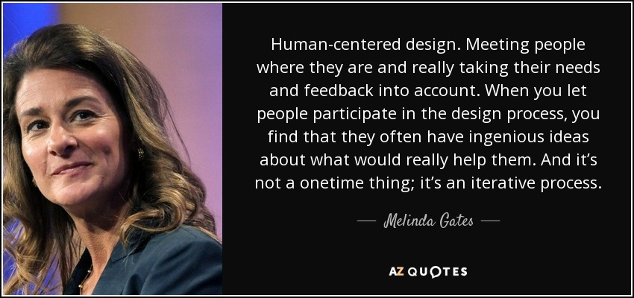
Notes:
This is key as we try to format a program with structure around HCV treatment. If it is not something that fits into the individuals life style or priority list, we will not be successful.

Slide 12
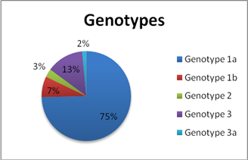
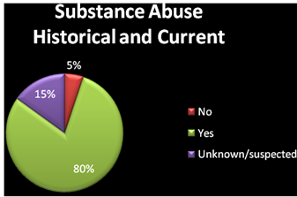
So, Where Are They At?...
Notes:
So, we can all agree that we need to meet our patient’s where they are and have their input drive the care plan we create together…So where are our patients?
Create pathways tailored to each patient’s need, where they are at.
Screen for homelessness, integrated care teams that include members of BH, CD, Medical meet once weekly to develop unique care plans for our people who have higher needs to access multiple care providers.

Slide 13
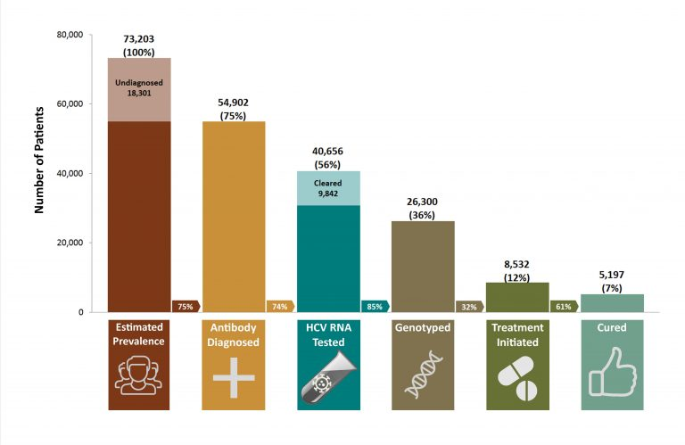
Cascade of Care
Example from the University of BC
Notes:
This is just an example from the Univeristy of British Columbia, but I like the simplicity. It is easy to model a database after, and to identify categories and trends. The goal of course being to reverse the chart, move the diagnosed patient population to the cured population. We have been attempting this by increasing Screening, community education, and we are working on developing more specific plans tailored to patients with less stable lifestyles.
Again remembering what works for one patient could be impossible to for another patient to adhere to

Slide 14
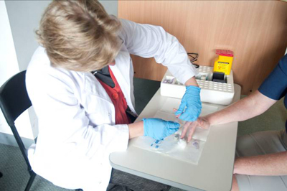
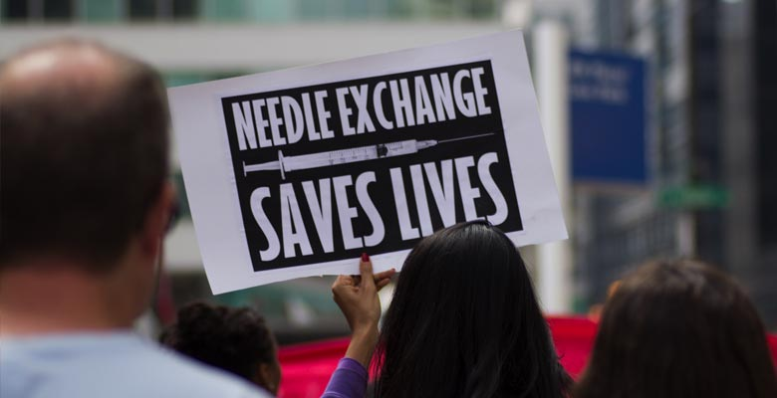
INCREASE SCREENING!
-Community Events POCT
-Flyers
-Patient Education
COLLABORATE WITH LOCAL RESOURCES!
-Health Department
-Local Hospitals
-Dental Office
-County Jail
-CDC
STRENGTHEN YOUR HARM REDUCTION EFFORTS!
DON’T GIVE UP!
Notes:
Treating HCV with the goal of elimination reduces risk for everyone.
Offer POC HCV antibody testing at unique locations. Educate the community via flyers/presentations/presence at community events. We are in the process of offering screening events at more locations, where we can also offer educational resources succeed at reaching SVR.
Again remembering what works for one patient could be impossible to use for another.

Slide 15
“They’ll Never Succeed”
SUCCESS STORIES
Untreated schizophrenia
Struggling with homelessness
Incarcerated
Poor Health Insurance Coverage
Everyone Deserves Treatment
Notes:
We can make treatment plans to fit each patient, but it requires asking questions, listening to the need, and willingness to think outside the box. There are barriers and challenges, but there are no excuses. Everyone deserves access to HCV treatment. By increasing access to harm reduction supplies and offering all patients HCV treatment, we reduce the risk of HCV for everyone.
This was made possible by our Syringe Service Program. Developing this relationship with patients who were previously too ashamed to use the clinic for health care, has allowed this population to receive a higher level of health care and increase their overall health.

Slide 16
HARM REDUCTION
Is a practical strategy that attempts to reduce negative consequences of drug use and other activities.
Accepts that some will engage in dangerous activities, but does not attempt to minimize the harm or dangers involved.
Focuses on the individual and their health and wellness needs.
Places individuals in the greater social context.
Places a value on drug users having a voice in the creation of programs and policies designed to serve them.

Slide 17
Prevention of injection-related wounds
Prevention of secondary infections (endocarditis, cotton fever)
Safer injection technique
Alternatives to injecting
Overdose prevention and response
Immunization
STI testing
Safer sex supplies
Case management
Addiction treatment
Allows patients access to Primary Care that they previously did not seek out
Connects patients to Recovery and Treatment options

Slide 18
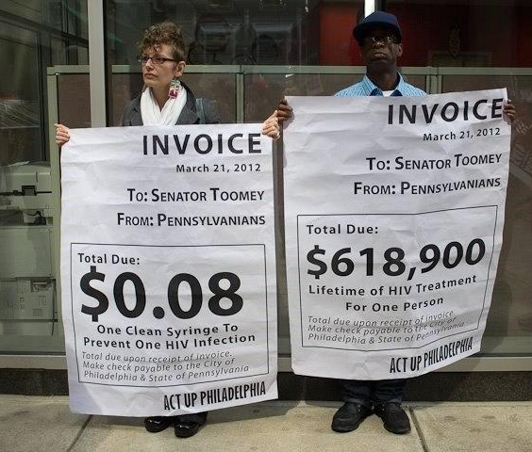
Harm Reduction is Cost Effective
Every dollar invested in SSPs results in
$7 in savings
just by preventing new HIV infections.¹
Notes:
¹Nguyen, T. Q., Weir, B. W., Pinkerton, S. D., Des Jarlais, D.C., & Holtgrave, D. (2014). Syringe Exchange in the United States: A National Level Economic Evaluation of Hypothetical Increases in Investment, AIDS and Behavior November 2014, Volume 18, Issue 11, pp 2144-2155; abstract: http://link.springer.com/article/10.1007/s10461-014-0789-9

Slide 19
What is Addiction?
Addiction is defined as a chronic, relapsing brain disease that is characterized b y compulsive drug seeking and use, despite harmful consequences. It is considered a brain disease because drugs change the brain—they change its structure and how it works. These brain changes can be long-lasting, and lead to the harmful behaviors seen in people who abuse drugs.

Slide 20
Resources
www.Harmreduction.org
http://stopoverdose.org/
https://nasen.org/
Local County Health Departments
Good Days Foundation : https://www.mygooddays.org/for-patients/patient-assistance/
Mary Beth Levin “Why Should Anyone Care” Harm Reduction
Notes:
Questions? Review resources.

