Slide 1
Cherokee Nation Health Services HCV Elimination Program
Jorge Mera, MD, FACP
Whitney Essex, ARNP
Dwayne David, Pharm D

Slide 2
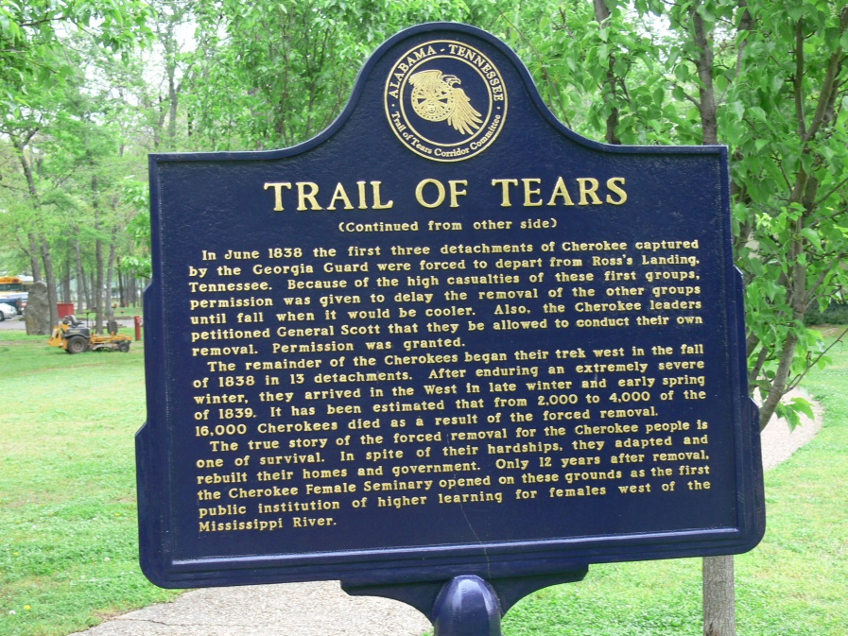
HCV in the CNHS: Historical Trauma and Cultural Disconnection
HCV in the CNHS: Historical Trauma and Cultural Disconnection

Slide 3
Linkage to Care
Screening
Quality of Care
HCV
Unsafe Medical Practices
IVDU
Harm Reduction Strategies
Poverty
Domestic Violence
Mental Illness
Historical Trauma*
Cultural
Disconnection
others
Prevention
*Maria Yellow Horse Brave Heart
Journal of Psychoactive Drugs Vol. 35, Iss. 1, 2003

Slide 4
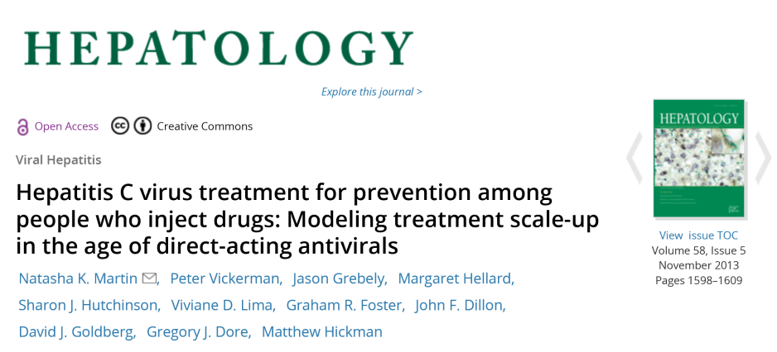
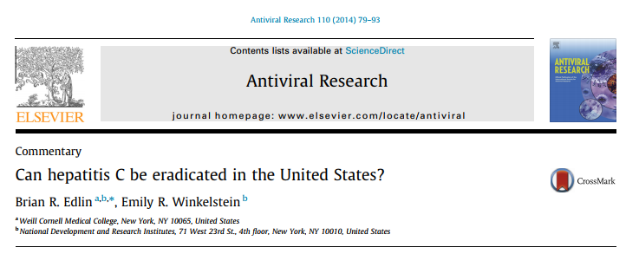
CDC :“Do you think the CNHS can pursue an HCV elimination goal?”

Slide 5
Key Concepts to Guide HCV Elimination
Treat the HCV infected population to decrease the burden of liver disease (Decrease Prevalence)
Mainly target birth cohort (patients born between 1945-1965)
Prevent Transmission (Decrease Incidence and prevalence)
Mainly target the younger population who are PWID
Treatment as prevention (HCV + PWID, HIV/HCV coinfection)
Establish or expand MAT
Establish or expand needle and syringe services
MAT: Medication Assisted Treatment
PWID: People Who Inject Drugs

Slide 6
Impact of Treatment as Prevention on HCV Prevalence
(Mathematical Modeling)
NTT: Number Needed To Treat.
PWID: People Who Inject Drugs
Adapted from NK Martin, et al. Hepatology 2013:58(5):1598-1609

Slide 7
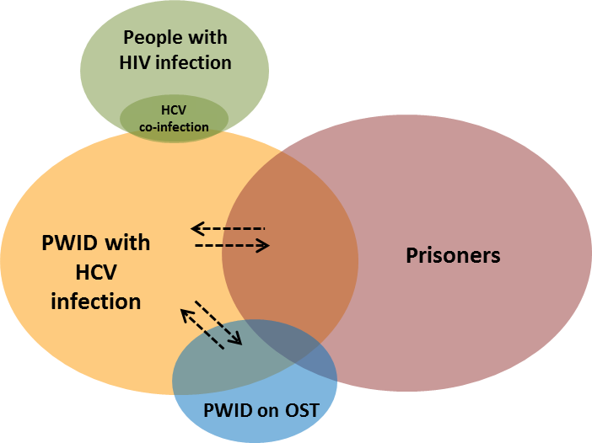
Where Can We Find and Treat HCV (+) PWID?
People who access the health system
Not Available in the Cherokee Nation
NSEP
ED: Emergency Department, UC: Urgent Care
Adapted from Hajarizadeh B et al. The Lancet Gastroenterol Hepatol 2016;1:317-27

Slide 8
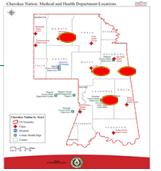
How did we get from this point……
CNHS HCV Cascade of Care: July 2015
HCV Clinics
100%
Number of Patients
21%
77%
21%
16%
67%
11%
Adapted from: Mera J, Vellozzi C, Hariri S, et al. Identification and Clinical Management of Persons with Chronic Hepatitis C Virus Infection — Cherokee Nation, 2012–2015. MMWR Morb Mortal Wkly Rep 2016;65:461–466.

Slide 9
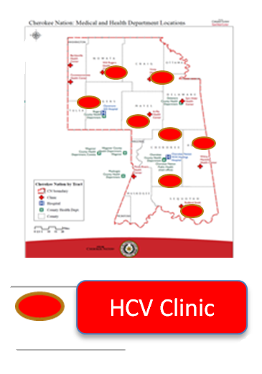
……to this point?
CNHS HCV Cascade of Care: December 2017
100%
Number of Patients
74%
55%
74%
39%
75%
71%
Cherokee Nation Health Services 2018

Slide 10
CNHS HCV Elimination Program 8/2015 – 10/2018
Secure political commitment for HCV elimination
Expand the HCV screening program
Establish robust programs to link to care, treat, and cure patients
Reduce the incidence of new HCV infections

Slide 11
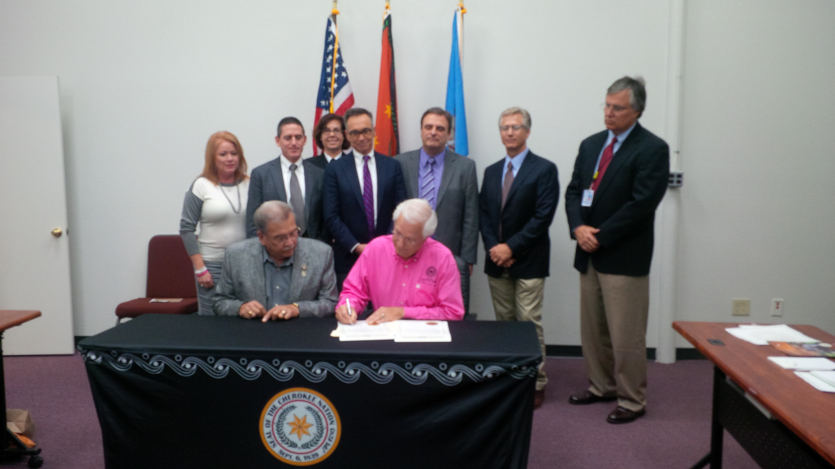
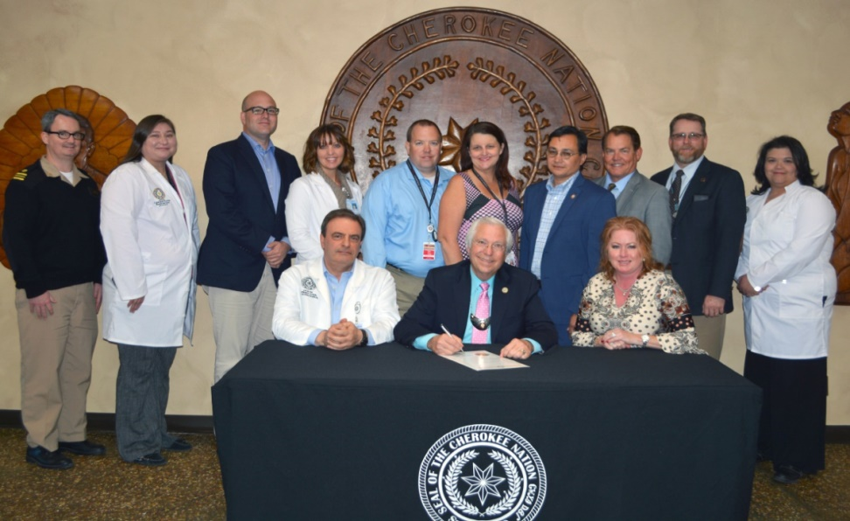
Goal #1: Secure Political Commitment
HCV Awareness Day
October 31,2015
HCV Elimination Awareness Day
October 31, 2017
“As Native people and as Cherokee Nation citizens, we must keep striving to eliminate hepatitis C from our population.” Chief Bill John Baker
1. https://www.cdc.gov/hepatitis/statistics/2015surveillance/index.htm Accessed February 12, 2018
2. Source: CDC, National Notifiable Diseases Surveillance System (NNDSS)
3. Ly KN, et al. Clin Infect Dis 2016 May 15;62(10):1287-1288

Slide 12
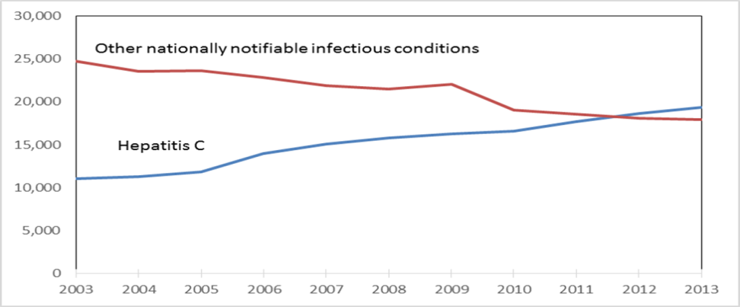
What were the “talking points” for HCV Elimination?
AI/AN have the highest
Mortality¹
Incidence²
Incidence of Acute Hepatitis C Stratified by Ethnicity: USA 2010-2013
HCV Deaths and Deaths from Other Nationally
Notifiable Infectious Diseases, USA 2003- 2013³
1. https://www.cdc.gov/hepatitis/statistics/2015surveillance/index.htm Accessed February 12, 2018
2. Source: CDC, National Notifiable Diseases Surveillance System (NNDSS)
3. Ly KN, et al. Clin Infect Dis 2016 May 15;62(10):1287-1288

Slide 13
Expand the Screening Program
People who access the health system
Not Available in the Cherokee Nation
NSEP
ED: Emergency Department, UC: Urgent Care
Adapted from Hajarizadeh B et al. The Lancet Gastroenterol Hepatol 2016;1:317-27

Slide 14
Goal #2: Expanding the Screening Program
Medical Assisted Therapy
80,928 AI/AN Ages 20-69
that access the CNHS
Prison
HCV + with history of IDU
or other risk factors
Needle and Syringe Services
HCV (+) PWID
Transmitting the Infection
130,000nAI/AN Population that CNHS Serves
Universal Screening

Slide 15
Goal #2: Expand Screening Program
Universal Screening
Ages 20-69
Non-Traditional Screening Sites
Emergency Department
Urgent Care
Dental Clinics
Behavioral Health
OBGYN
Screen 85%
of Target Population
(80,928 AI/AN)
Screening Modalities
EHR Reminders
Point of care antibody test
Lab Triggered screening
Cherokee Nation Health Services 2018

Slide 16
HCV Screening in the CNHS: 10/2012 – 12/2017
Pre-elimination Period (10/2012-7/2015) 16,772 patients screened
Post-elimination Period (08/2015-12/2017) 38,591 patients screened
Primary Care
>55 % of the Target Population Has been Screened
Urgent Care/Emergency/
Obstetrics/Dental/
Behavioral health
Universal Screening
Ages 20-69
Primary Care
Birth Cohort + Risk
*preliminary data
Cherokee Nation Health Services 2018

Slide 17
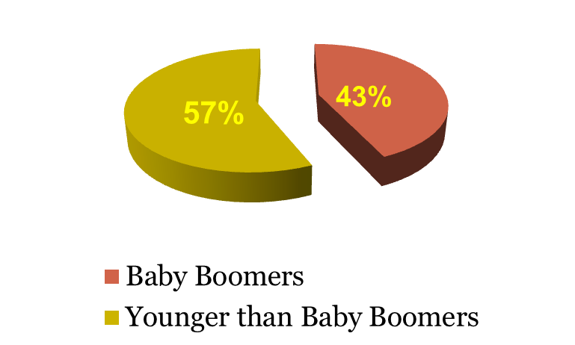
HCV Prevalence, Gender and Age Distribution*: 8/2015 – 12/2017
Prevalence
Age Distribution of HCV Ab (+)
38,591 patients screened
1,328 HCV antibody positive
Overall Prevalence ~ 3.4%
Male 4.5%
Female 2.7%
Baby boomers
3.9% (12,540)
Younger than Baby Boomers
3.2% (18,319)
55%
Baby Boomers
Younger than Baby Boomers
*preliminary data
Cherokee Nation Health Services 2018

Slide 18
CNHS: HCV Screening* 8/2015 – 12/2017
Expanded Age Targeted Screening (Ages 20-69)
Lab Triggered
Screening discontinued
Lab Triggered
Screening Initiated
Cherokee Nation Health Services 2018
*preliminary data

Slide 19
Lab Triggered Screening: Screening location
97 patients with new positive HCV antibody screen at WW Hastings Hospital
Cherokee Nation Health Services 2018

Slide 20
Goal # 3: Link to Care, Treat, and Cure
Evaluate 85%
Treat 85%
Cure 85%
Expand Clinical Capacity
ProjectECHO
Expand Case Management Capacity
Patient navigator
Case manager for antiviral procurement
Clinical Case Manager
Pharmacy managed follow up
Cherokee Nation Health Services 2018

Slide 21
Patient and Medical Provider Support
Before HCV Evaluation
Patient Navigator contacts patient to make sure and appointment is secured
If the patient cant be reached a Public Health Nurse is sent to the patients home
During Evaluation
Most patients are evaluated by a drug and alcohol counselor,
If substance use disorder is detected, referral to a behavioral health specialist
After Treatment Initiated
Clinical case manager, pharmacist and a community health worker will assist with adherence follow-up and treatment (including DOT)
DOT: Direct Observed Therapy
Cherokee Nation Health Services 2018

Slide 22
CNHS HCV Program: Clinical Capacity Expansion: 1/2014 – 12/2017
HCV ProjectECHO
Introduced
HCV Elimination
7 Providers
1 Specialist
24 Providers
Providers included 1 Specialist, 8 Physicians, 8 Pharmacists and 7 Nurse Practitioners
Cherokee Nation Health Services 2018

Slide 23
Goal #4: Reduce the incidence of new HCV infections
Decrease Incidence
Public and Provider Awareness
Contact Tracing
Acute HCV
PWID
Harm Reduction
Treatment as Prevention
OST
NSEP
Public Campaign
Provider Training
CNHS HCV Elimination Program Strategies and Goals, 8/2015-10/2018
CNHS: Cherokee Nation Health Services. PWID: People Who Inject Drugs, OST: Opioid Substitution Therapy, NSEP: Needle and Syringe Exchange Program

Slide 24
Moving Forward
Increase public awareness and intensify HCV screening in “hot spots” and out in the community
Improve engagement in care of PWID
Expand Medication Assisted Treatment
Advocate for needle and syringe service
Identify networks of transmission trough the Global Health Outbreak Surveillance Technology (GHOST) program
Treat, treat and treat patients with HCV!!!!!!!
Define measures to monitor program outcomes
90 % reduction in incidence by the year 2030
65 % reduction in mortality by the year 2030

Slide 25
What is a Syringe Service Program (SSP)?

Slide 26
PWID and SSPs
Number of life time PWID – 6.6 million
Number of persons injecting in past year - 775,000
334,000 (43%) living with HCV infection
270 syringe service programs (SSP) in operation (early 2017)
Approximately 2,200 additional programs needed for proximal access to syringe services
39 states/counties approved to redirect USG funds to support SSPs (as of April 3)
Only 20% of persons 15-29 yrs. with HCV, live within 10 miles of a syringe service program.
Syringe Service Program
1 dot = 1 person
HCV Cases: LabCorp and Quest
commercial laboratories
SSPs: SSPs: North American Syringe Exchange Network
Canary L, CID, 2017; CDC unpublished data

Slide 27
Myths and misconceptions of SSPs
SSPs increase high-risk practices
SSPs promote syringes in the community
SSPs enable drug use
SSPs increase crime

Slide 28
Do SSPs increase high risk practices?
For every 2-fold increase in SSP coverage, participants . . .
Outcome variable | aPR | 95% CI | p-value
Receptively shared syringes | 0.96 | 0.93-0.99 | 0.021
Receptively shared syringes with ≥2 people | 0.94 | 0.89-0.99 | 0.012
Shared other injection equipment (e.g., cookers, filter, water) | 1.00 | 0.98-1.03 | 0.954
Models control for age, gender, race/ethnicity, homelessness, and peer network size
Slide courtesy of Dr. Dita Broz, NHBS Team
Notes:
Using data from CDC’s National HIV Behavioral Surveillance system, which monitors HIV infection, risk behaviors and HIV testing and use of prevention services in 3 key populations: men who have sex with men, persons who inject drugs and heterosexuals at increased risk for HIV infection.
NHBS is implemented in annual rotating cycles such that each population is surveyed every 3 years. This analysis uses data from the latest NHBS cycle among PWID conducted in 2015.
Assess the impact of SSP coverage in 20 geographically diverse cities in the US on HIV risk and protective behaviors among PWID
The SSP coverage is determined by annual syringes per PWID in one year and it is not based on NHBS data. This estimate is based on the number of syringes distributed by all programs operating in each city (our staff collected the data during formative directly from the programs) and the estimated population size estimate of PWID in that city/MSA So our first question was whether higher SSP coverage at the city level was associated with increases in high risk practices.
They used binary log transformation for the SSP coverage variable, so the interpretation of the model prevalence ratios is for every 2-fold increase in SSP coverage. In this case, for every 2-fold increase in SSP coverage, participants were less likely to receptively share syringes, that is used a syringe that someone else already injected with, and they were also less likely to do so with 2 or more people.
Although the adjusted PRs might suggest small differences, because we are measuring mean probabilities of the outcome in the population, even small differences could affect many people at the population level.
There were no differences in sharing other injection equipment, such as cookers.

Slide 29
Do SSPs promote syringes in the community?
For each 2-fold increase in SSP coverage, participants . . .
Outcome variable | aPR | 95% CI | p-value
Safely disposed of used syringes | 1.20 | 1.07-1.34 | 0.001
Models control for age, gender, race/ethnicity, homelessness, and peer network size
Slide courtesy of Dr. Dita Broz, NHBS Team
Notes:
For each 2-fold increase in SSP coverage at the city level, participants were more likely to safely dispose of their used syringes.

Slide 30
Do SSPs increase risky behavior?
For each 2-fold increase in SSP coverage, participants were . . .
Outcome variable | aPR | 95% CI | p-value
Have sex without a condom with a casual partner | 0.97 | 0.94-0.99 | 0.037
Models control for age, gender, race/ethnicity, homelessness, and peer network size
Slide courtesy of Dr. Dita Broz, NHBS Team
Notes:
And they were less likely to have sex without a condom with casual partners, that is partners they are not close to or do not know well.

Slide 31
Do SSPs increase crime?
No evidence of increased illegal drug use or crime.
As many as 1 in every 3 officers may be stuck by a used needle during his or her career.
Needle stick injuries are among the most concerning and stressful events experienced by law officers and have been ranked as equivalent to a knife or gunshot wound.
SSPs help to protect the public and first responders by providing safe syringe disposal and reducing community presence of syringes
Lorentz et al, Am J. Preventative Medicine, 2000; Davis et al, DAD; 2014 Cepada et al, J. Urban Health, 2017

Slide 32
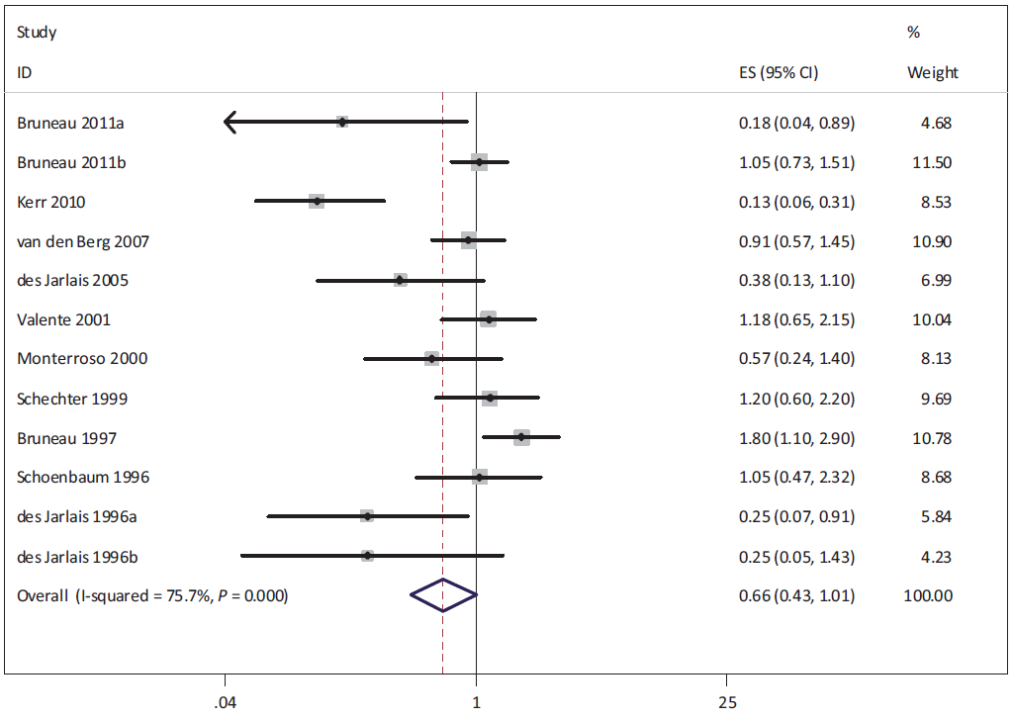
SSPs Reduce HIV Transmission
56% reduction in risk of HIV infection
Aspinall E J et al., Int J Epidemiol 2014, Courtesy of Richard Needle
Notes:
There are more than 60 published studies that show effectiveness of the programs that provide access to sterile needles, syringes, and other safe injection equipment.

Slide 33
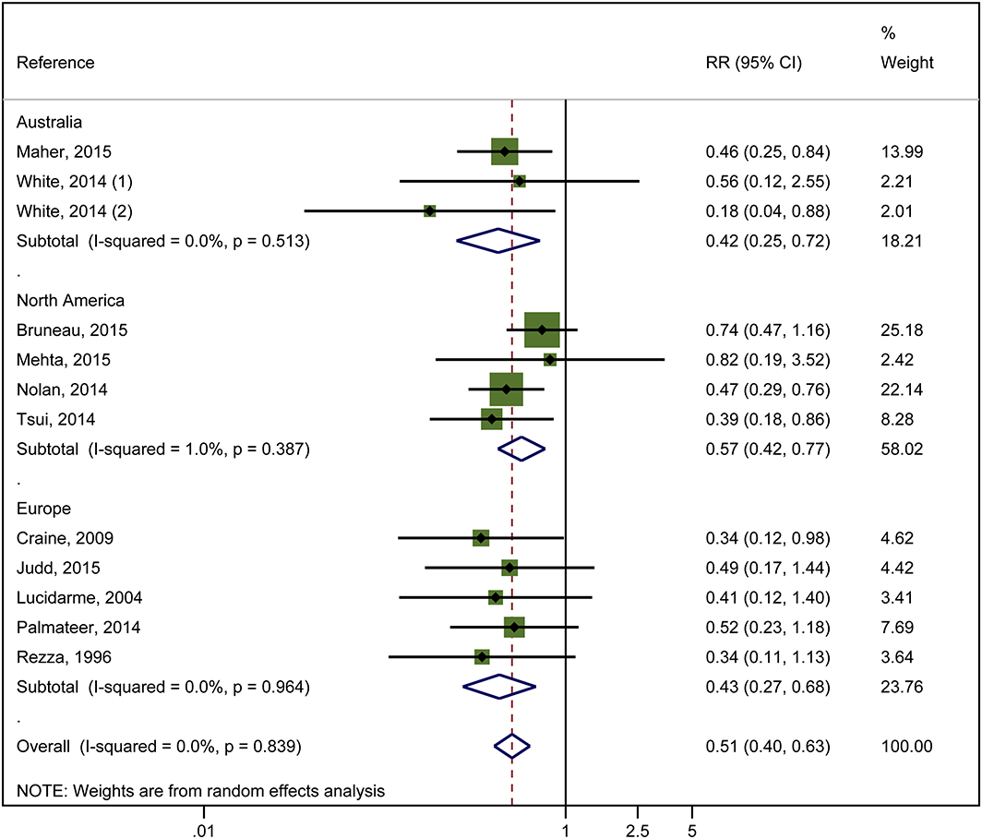
SSPs play an essential role in reducing HCV transmission
Combined use of OST and high coverage of NSP associated with a 74% risk reduction in HCV acquisition
RR = 0.26
I²=80%
P= 0.007
Platt, et al, Addiction, 2017
Notes:
For people who don’t want, or can’t access MAT, SSPs can provide access to sterile injection equipment, education and referrals to care. While MAT alone reduces risk of hepatitis C transmission, it is strengthened in combination with SSPs, resulting in a 74% decrease in the risk of HCV transmission. There is weaker evidence for the impact of SSPs alone, although stronger evidence that high coverage, meaning that PWID are able to access sufficient sterile equipment for each injection, and adequate geographic spread of SSPs, is associated with reduced risk in Europe. High NSP with OST
4 studies
3356 participants
518 HCV cases Reduced HCV by 71%
moderate heterogeneity
Low NSP with OST
3 studies
3071 participants
449 HCV cases,
Reduced HCV by 24%
GRADE: low evidence

Slide 34
Unmet Opioid Treatment Need
In 2014, opioid injection accounted for 360,707 admissions for drug treatment
22.3% of all admissions
In 2015, nearly 2.4 million Americans had an opioid use disorder
Close to 80% of these individuals did not receive treatment.
SAMHSA, TEDS-A, 2014; SAMHSA, NSDUH, 2015; SAMHSA, MAT Pocket Guide, 2016

Slide 35
SSPs facilitate entrance to substance use treatment
PWID who used SSPs were 2.8 times more likely to reduce the amount they injected compared to those who didn’t use the programs
New users of SSPs were 5 times more likely to enter drug treatment than those who didn’t use the programs.
PWID who used SSPs were 3.5 times more likely to stop injecting compared to those who didn’t use the programs.
Hagan H et al J. of Substance Abuse Treatment, 2000; Latkin et al, Substance Use and Misuse, 2006

Slide 36
Role of Syringe Services Program
Access to sterile injecting equipment and disposal
Risk reduction education
Opportunity to engage in care
Access to primary care
More likely to connect with primary care when meet a health care provider on the street
Testing/screening services
Patient navigation and case management
Naloxone distribution
HAV/HBV vaccine
Access to mental health, social services
Reproductive health
Islam, et al, J. Primary Care Comm Health, 2010, Des Jarlais, et al, MMWR, 2015;
Islam, et al, J. of Substance Use Tx, 2012

Slide 37
Meeting PWID demand

Slide 38
The growth of SSPs

Slide 39
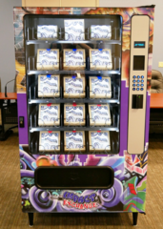
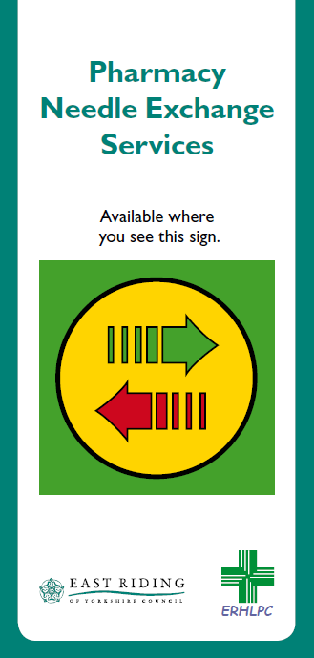
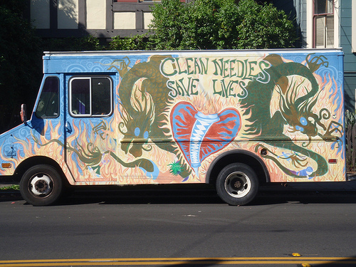
Innovations and Creativity in SSP delivery
Pharmacy sales
Mobile services
Vending machines
Web-based mail order supply
Peer to Peer delivery

Slide 40
Special Thanks to Alice Asher, Dita Broz and John Brooks for slides, panel preparation support and review

Slide 41
Thank you
Questions:
AAsher@cdc.gov

