Slide 1
Treatment of HCV
Jorge Mera, MD, FACP
Director, Infectious Diseases
Cherokee Nation

Slide 2
objectives
Treatment
Rationale and goals for the universal need of HCV treatment
Describe FDA approved antivirals used in HCV treatment, their strengths and weaknesses
Interpret decision trees to determine treatment options

Slide 3
Goal of treatment
“The goal of treatment of HCV-infected persons is to reduce all-cause mortality and liver-related health adverse consequences, including end-stage liver disease and hepatocellular carcinoma, by the achievement of virologic cure as evidenced by an SVR”
SVR: sustained virological response hcvguidelines.org

Slide 4
SVR Was Associated With Reduced Long-Term Risk of All-Cause Mortality in an International, Multicenter Study
Treatment
All-Cause Mortality
Percent
Time (years)
International, multicenter, long-term follow-up study from 5 large tertiary care hospitals in Europe and Canada. Patients with chronic HCV infection started an interferon-based treatment regimen between 1990 and 2003 (n=530).
van der Meer AJ, et al. JAMA. 2012;308:2584-2593.

Slide 5
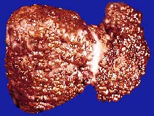
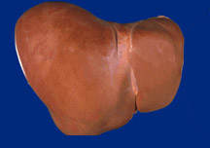
Why do we need to treat HCV
Treatment
SVR (cure) of HCV is associated with:
  70% Reduction of Liver Cancer
  50% Reduction in All-cause Mortality
  90% Reduction in Liver Failure
Lok A. NEJM 2012; Ghany M. Hepatol 2009; Van der Meer AJ. JAMA 2012

Slide 6
HCV-Associated Disease Burden (2015–2050)
Treatment
50–70% reduction in HCV-associated disease burden
Chhatwal et al. AASLD 2015 Abstract 104
Notes:
With the availability of DAAs, the disease burden would further reduce. For instance, 260,000 deaths would be averted because of the availability of DAAs (in comparison with pre DAA era).
60-70% reduction in the advanced HCV outcomes

Slide 7
Impact of Treatment compared to other common diseases
Treatment
HCV cirrhosis risk = 40% over 30 years
Hepatocellular carcinoma (HCC) risk in HCV Cirrhosis = 17% over 5 years
When we cure 30 patients with HCV we will prevent:
  12 cases of HCV related cirrhosis
  2 case of HCV related HCC
If we treat 104 patients with hypercholesterolemia with statins (For 5 years), we will prevent 1 first time heart attack and ¾ of a stroke
www.thennt.com

Slide 8
Direct Acting Antiviral Agents (DAAs):
Keeping them Straight
Treatment
Non-Enzyme Target
Protease
Polymerase
Core
E1
E2
p7
NS2
NS3
NS4A
NS4B
NS5A
NS5B
Ribavirin
NS3
Protease Inhibitors
NS5A
Replication Complex Inhibitors
NS5B
NUC Inhibitors
NS5B
Non-NUC Inhibitors
Boceprevir (BOC)
Telaprevir (TVR)
Simeprevir (SMV)
Paritaprevir (PTV)
Grazoprevir (GRZ)
Daclatasvir (DCV)
Ledipasvir (LDV)
Ombitasvir (OMV)
Elbasvir (ELB)
Velpatasvir (VEL)
Sofosbuvir
(SOF)
Dasabuvir
(DSV)

Slide 9
HCV Therapies - DAAs
Treatment
Medication | NS5B | NS5A Inh | NS3 PI | Other
Sovaldi® | sofosbuvir
Harvoni® | sofosbuvir | ledipasvir
Epclusa® | sofosbuvir | velpatasvir
Zepatier® |  | elbasvir | grazoprevir
Viekira Pak® | dasabuvir | ombitasvir | paritaprevir | ritonavir
Daklinza® |  | daclatasvir
Olysio® |  |  | simeprevir
Ribavirin |  |  |  | ribavirin

Slide 10
HCV Treatment by Genotype
Medication | GT1 | GT2 | GT3 | GT4
Sovaldi® | X | X | X | X
Harvoni® | X |  |  | X
Epclusa® | X | X | X | X
Zepatier® | X |  |  | X
Viekira Pak® | X
Daklinza® | X | X | X | X
Olysio® | X
Ribavirin | X | X | X | X

Slide 11
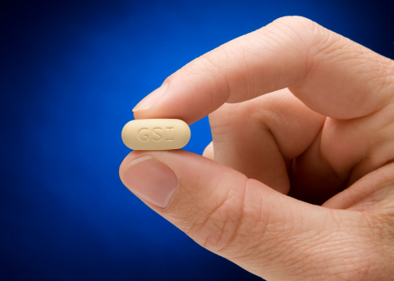
sofosbuvir (Sovaldi®)
Treatment
NS5B nucleotide inhibitor
Few drug interactions
Genotypes 1,2,3,4
Contraindicated in patients with GFR < 30
Most common reported SE
  Headache
  Fatigue (with ribavirin)
Pangenic in combination
  Not used as monotherapy
SE: Side Effects
Sovaldi® [package insert]. Gilead Sciences, Foster City, CA
Notes:
Pangenic b/c sofosbuvir looks like uridine… which is part of the base pair for the HCV RNA virus… SOF subs in and makes the HCV viral RNA fall apart

Slide 12

ledipasvir/sofosbuvir (Harvoni®)
Treatment
Once daily single oral tablet
Genotype 1 and 4
Minimal DDIs, no food effect
8 week treatment available
  Naïve/Non cirrhotic/VL < 6 million
Do not use in patients with GFR < 30
Avoid use with anti acids
  May use with 20 mg of omeprazole
  if necessary
LDV
NS5A
inhibitor
SOF - NS5B
nucleotide polymerase inhibitor
Approved: Oct 10, 2014
DDI: Drug-Drug Interactions
Harvoni® [package insert]. Gilead Sciences, Foster City, CA
Notes:
LedipASivr and daclatASvir – AS: Assembly interference… prevent virus from reconstructing in our bodies

Slide 13
velpatasvir/sofosbuvir
(Epclusa®)
Treatment
Once daily single oral tablet
Minimal DDIs, no food effect
Genotype 1,2,3,4
Do not co-administer with PPI
  If medically necessary, take Epclusa with food 4 hours before omeprazole 20 mg
Do not use in patients with GF<30
Approved: June 28, 2016
VEL
NS5A
inhibitor
SOF - NS5B
nucleotide polymerase inhibitor
DDI: Drug-Drug Interactions
Epclusa® [package insert]. Gilead Sciences, Foster City, CA
Notes:
LedipASivr and daclatASvir – AS: Assembly interference… prevent virus from reconstructing in our bodies

Slide 14
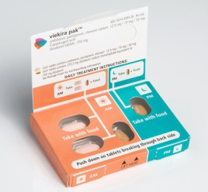
OBV/PTV/r and DSV
(Viekira Pak)
Treatment
Includes 3 direct acting antivirals and ritonavir, triple therapy or PrOD
  Ombitasvir, paritaprevir, dasabuvir
Ritonavir (No HCV activity)
  Used to boost the paritaprevir
Genotype 1 and 4
Administer orally twice a day with food
Many pharmacological interactions
GT1a requires addition of RBV
May use with GFR < 30
2 tablets of ombitasvir/paritaprevir/ ritonavir
(12.5/75/50 mg) combination tablet every am
1 dasabuvir 250 mg tablet every am and pm
FDA approval Dec 19, 2014
VIEKIRA PAK [package insert]. North Chicago, IL: AbbVie Inc.
Notes:
Ombitasvir (NS5A inhibitor)
Paritaprevir (NS3/4A protease inhibitor)
Dasabuvir (Non-nucleoside NS5B polymerase inhibitor)

Slide 15
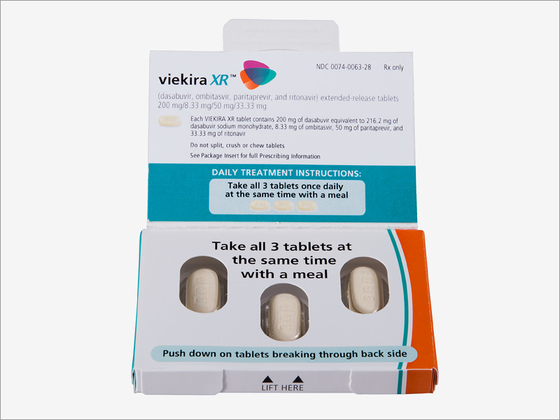
OBV/PTV/r and DSV XR
(Viekira XR)
Treatment
Extended Release
  All 3 tablets at the same time
  Take with food
  Same precautions as Viekira Pak
  Do not split, crush or chew
  Alcohol should not be consumed within 4 hours of taking VIEKIRA XR

Slide 16
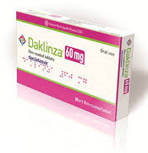
daclatasvir (Daklinza)
Treatment
NS5A inhibitor
High barrier to resistance
Once daily oral tablet
  In combination with sofosbuvir
With or without food
Genotype 1,2,3,4
May use with antiacids
No DDIs: 60 mg once daily
DDIs with strong CYP3A inhibitors: 30 mg once daily
DDIs with moderate CYP3A inducers: 90 mg once daily
DDI: Drug-Drug Interaction
Daklinza [package insert]. Princeton, NJ: Bristol-Myers Squibb Company
Notes:
Examples of inducers: carbamazepine, oxcarbamazepine, phenytoin, rifampin, rifabutin, St. John’s Wort
Examples of inhibitors: keto/itra/voriconazole, ritonavir, amiodarone, clarithro/erythromycin
Daklinza [package insert]. Princeton, NJ: Bristol-Myers Squibb Company

Slide 17
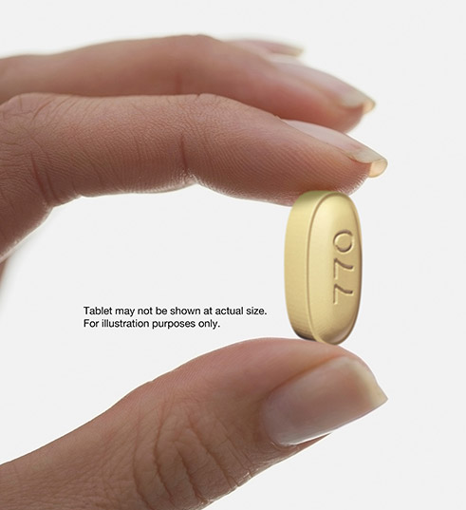
elbasvir/grazoprevir
Zepatier
Treatment
Genotypes 1 and 4
Elbasvir/Grazoprevir
  NS5A inhibitor - NS3/4A protease inhibitor
Oral and once daily
Must perform resistance
testing in genotype 1A
  If resistance present must add Ribavirin and extend therapy from 12 to 16 weeks
DO NOT use in advanced liver disease (Child Pugh B or C
May use with GFR < 30 ml/min
May use in Dialysis
May use with PPI
FDA-approved Jan 28, 2016

Slide 18
Clinical Case #1
Treatment
55 year old HCV positive male with a hx of IVDU 10 years ago
Genotype 1a
VL 2.4 million/ML
Treatment naïve
Fibrosis Stage F0-F1
Labs: GFR of 65 ml/min, Hg 13 Platelets 245
Other medical conditions
  HTN on amlodipine
What are your options?

Slide 19
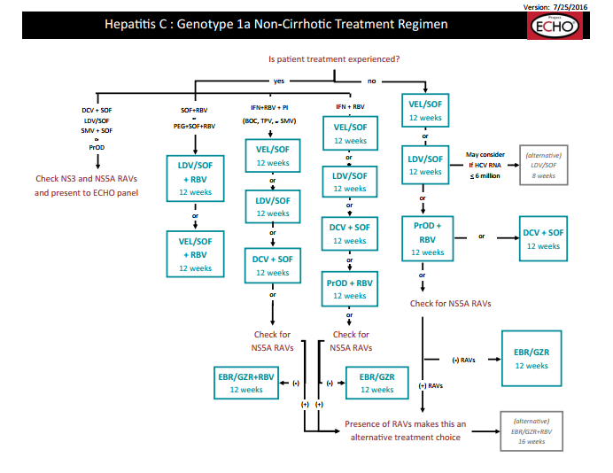

Slide 20
Sofosbuvir/ledipasvir (harvoni) and Acid Suppressing Agents
Treatment
Antacids
  aluminum hydroxide
  magnesium hydroxide
Separate administration by four hours
H₂RAs
  famotidine
  ranitidine
Administer concurrently or 12 hours apart
Not to exceed doses >40 mg famotidine twice daily
Harvoni® [package insert]. Gilead Sciences, Foster City, CA

Slide 21
Sofosbuvir/ledipasvir (harvoni) and Proton PumP Inhibitors
Treatment
  Consider discontinuation of acid suppression therapy if patient is able to tolerate
    Reduce PPI by 50% per week to lowest dose, then discontinue to minimize rebound acid hypersecretion
  If you have to use a PPI and Harvoni is the best option
    Administer simultaneously on an empty stomach
    Only doses < omeprazole 20 mg
    Pantoprazole mg ≠ omeprazole mg
Harvoni® [package insert]. Gilead Sciences, Foster City, CA

Slide 22

Treatment

Slide 23
Clinical Case # 2
Treatment
65 year old HCV positive female with a hx of a post partum blood transfusion 40 years ago
Genotype 1a
VL 8.8million/ML
Treatment naïve
  Fibrosis Stage F3-F4
  No history of
    Esophageal varices/ encephalopathy or ascitis
  Labs: GFR of 28 ml/min, Hg 13 Platelets 109
  Other medical conditions
    Barrett's esophagus (on omeprazole 40 mg once a day)
What are your options?

Slide 24
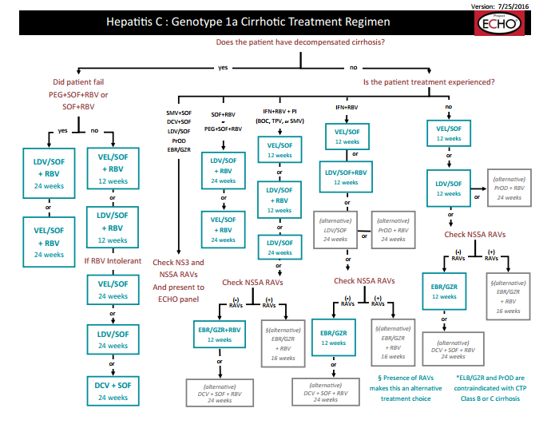

Slide 25
elbasvir/grazoprevir
Zepatier
Treatment
Genotypes 1 and 4
Elbasvir/Grazoprevir
  NS5A inhibitor - NS3/4A protease inhibitor
Oral and once daily
Must perform resistance
testing in genotype 1A
  If resistance present must add Ribavirin and extend therapy from 12 to 16 weeks
DO NOT use in advanced liver disease (Child Pugh B or C
May use with GFR < 30 ml/min
May use in Dialysis
May use with PPI
FDA-approved Jan 28, 2016

Slide 26
Clinical Case # 3
Treatment
73 year old HCV positive male with no risk factors
  Genotype 2
  VL 3.4 million/ML
  Treatment naïve
  Fibrosis Stage F3-F4
  History of ascites
  Labs: GFR of 69 ml/min, Hg 13.4, Platelets 88
  Other medical conditions
    Prediabetes/40 pack/year smoking/HTN on amlodipine Hypercholesteremia on atorvastatin
What are your options?

Slide 27
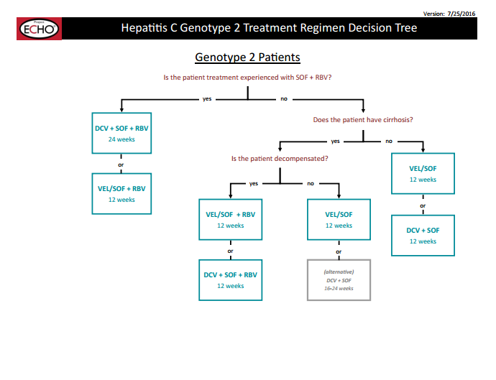
Do I need any workup before I start Ribavirin?
What are his Drug - Drug Interactions with Epclusa?

Slide 28
velpatasvir/sofosbuvir
(Epclusa®)
Treatment
Once Daily Single Oral Tablet
Minimal DDIs, no food effect
Genotype 1,2,3,4
Do not co-administer with PPI
  If medically necessary, take Epclusa with food 4 hours before omeprazole 20 mg andOnly doses < omeprazole 20 mg
Do not use in patients with GFR < 30
VEL
NS5A
inhibitor
SOF - NS5B
nucleotide polymerase inhibitor
Approved: June 28, 2016
Epclusa® [package insert]. Gilead Sciences, Foster City, CA
Notes:
LedipASivr and daclatASvir – AS: Assembly interference… prevent virus from reconstructing in our bodies

Slide 29
Ribavirin (RBV)
Treatment
Administration
  Weight-based dosing (Twice daily)
    1000 mg if > 75 kg
    1200 mg if ≥ 75 kg
  Take evening dose (8 hours apart) in the afternoon to keep from disturbing sleep
Pregnancy category X
  Contraindicated in pregnant women or male partners of pregnant women
  Use 2 effective forms of contraception during treatment and for at least 6 months after completion of therapy (both male and female patients)
LexiComp

Slide 30
Ribavirin
Treatment
Adverse Events
  Headache
  Fatigue
  Nausea
  Insomnia
  Depression
Lab abnormalities:
  Hemolytic anemia
    Decrease ribavirin dose by 200 mg daily for a 2g or more drop in HgB
Monitoring RBV
  CBC & CMP
  At baseline, weeks 2 and 4, as clinically indicated
  TSH at week 12
  Preexisting cardiac issue
Ophthalmic exam
  Preexisting opthalmic disorders
HCG
  At baseline
  Monthly during treatment and for 6 months after treatment

Slide 31
Who To treat, and when?
Who to Prioritize?
Treatment
Who to treat?
  All patients with chronic HCV should be treated, unless:
    Life expectancy is < 1 year that cannot be remediated by treating HCV or liver transplantation (AASLD)
    Uncontrolled comorbidities that can cause HCV treatment discontinuation (Dr. Mera’s Opinion)
When to Prioritize
  Limited resources for medication procurement
  Limited clinical capacity to treat

Slide 32
Who to Prioritize
Treatment
Prioritize treatment only if limited by clinical capacity
  Decompensated cirrhotic
  Non decompensated cirrhotic first, then F3, F2, F0-F1
  HCV related nephropathy/vasculitis
  PWID
Dr. Mera’s Opinion
Highest Priority for Treatment Owing to Highest Risk for Severe Complications | Strength of Recommendation
Advanced fibrosis (Metavir F3 or F4) | Class I, Level A
Organ transplant | Class I, Level B
Type 2 or 3 essential mixed cryoglobulinemia with endo organ manifestations (vasculitis) | Class I, Level B
Proteinuria, nephrotic syndrome, or MPGN | Class IIa, Level B
  AASLD/ IDSA HCV Guidelines
Notes:
And if you think about it… how many diseases can actually be cured?

Slide 33
Special Treatment Considerations

Slide 34
Special Treatment Considerations
Drug-Drug Interactions
Treatment
Most anti convulsants are contraindicated
  Due to decreased antiviral levels
Regimens with protease inhibitors tend to have more drug interactions
  PrOD (Viekira Pak) (has 2 PI), Simeprevir (Olysio) elbasvir/grazoprevir (zepatier)
Daclatasvir (Daklinza) has numerous DDI and may need dose adjustment
Sofosbuvir/velpatasvir (Epclusa) and sofosbuvir/ledipasvir (Harvoni)
    Decreased absorption with anti acids specially Proton Pump Inhibitors

Slide 35
Special Treatment Considerations
Renal and hepatic impairment
Treatment
Renal Impairment:
  elbasvir/grazoprevir (Zepatier) is approved in ESRD and dialysis
  PrOD (Viekira Pak) is approved with CrCl <30
Hepatic Impairment (Child Pugh B/C):
  PrOD (Viekira Pak) (has 2 PI), Simeprevir (Olysio) elbasvir/grazoprevir (zepatier) are contraindicated
  May require addition of ribavirin or treatment extension

Slide 36
Special Treatment Considerations
Genotypes
Treatment
Genotype 1a
  Will require Ribavirin if PrOD (Viekira Pak) is used
  May treat for 8 weeks with sofosbuvir/ledipasvir (Harvoni) if viral load is < 6 million, treatmente naïve and non cirrhotic
  If elbasvir/grazoprevir (zepatier) is used resistance testing needed
Genotype 2 and 3
  Sofosbuvir/velpatasvir (Epclusa) is first line therapy but PPI use and low GFR are a problem

Slide 37
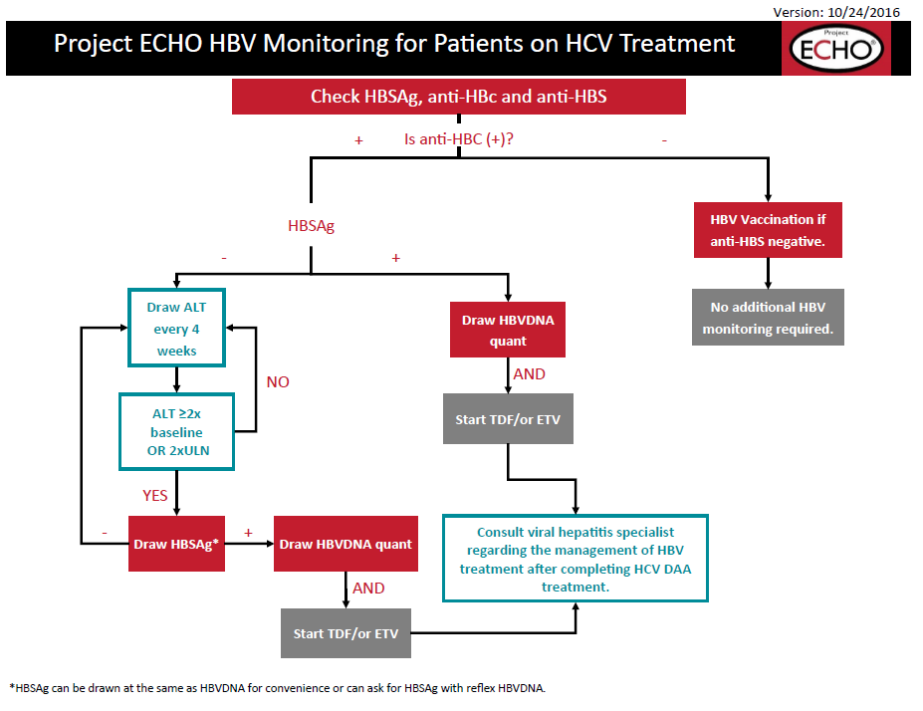
Special Treatment Considerations
Hepatitis B Status
Treatment

Slide 38
Summary:
What do you need to Know to select the best treatment option
Treatment
Genotype
Viral load for GT1a (< 6 million ?)
Liver Fibrosis Staging
  Cirrhosis vs no Cirrhosis
  If Cirrhotic
      Compensated vs Decompensated
Previous treatment status
Kidney function
    CrCl < or > 30
    Dialysis
Drug interaction check
  Anti seizure meds, PPI, etc.
Check Hepatitis B status to monitor reactivation

Slide 39
What now?
Join the ECHO Community and start Paving the Road to HCV Elimination in Native America

Slide 40
Telemedicine Improves ACCESS by using technology to bridge distance
Treatment
Primary Care Clinician
OR Patient
Specialist
Notes:
Telemedicine is a valuable tool for connecting a patient or a primary care provider to a far away specialist for a consultation. This improvement in access does not improve capacity.( Note- information is disseminated in one direction from specialist to primary care provider.)

Slide 41

The ECHO model improves
CAPACITY and ACCESS simultaneously
Treatment
Notes:
What you see here is an ECHO Knowledge Network. This is not a one to one model as it is in telemedicine, but rather a way to link a multidisciplinary disease specialist team at the Hub with many ( sometimes dozens) of individuals or small groups of community clinicians (Spokes). Access is increased as case presentations receive simultaneous coordinated multidisciplinary consultation. Capacity is increased as community providers gain the expertise to treat complex cases on their own. This off-loads the most manageable cases, increasing the capacity of the Hub to treat the truly complicated patients.

Slide 42

Treatment
MOVING KNOWLEDGE INSTEAD OF PATIENTS

Slide 43

Treatment
SHARING EVIDENCE BASED BEST MEDICAL PRACTICES

Slide 44

Treatment
Benefits to Rural Clinicians
Professional interaction with colleagues with similar interest
  Less isolation with improved recruitment and retention
A mix of work and learning
Obtain HCV certification
Access to specialty consultation with GI, hepatology, psychiatry, infectious diseases, addiction specialist, pharmacist, patient educator

Slide 45
Treatment
Benefits of ECHO® model to Health System
Quality and Safety
Rapid Learning and best-practice dissemination
Reduce variations in care
Access for Rural and Underserved Patients, reduced disparities
Workforce Training and Force Multiplier
De-monopolize Knowledge
Improving Professional Satisfaction/Retention
Supporting the Medical Home Model
Cost Effective Care- Avoid Excessive Testing and Travel
Prevent Cost of Untreated Disease (e.g.: liver transplant or dialysis)
Integration of Public Health into treatment paradigm

Slide 46
Impact of ECHO in CNHS HCV Program
Treatment
CNHS: Cherokee Nation Health Services

Slide 47
Helpful Resources
http://www.hcvguidelines.org/
http://www.hepatitisc.uw.edu/
  On-line curriculum on liver disease and HCV, includes clinical studies, clinical calculators, slide lectures
ECHO guidelines

Slide 48
References
“HCV Epidemiology in the United States.” Hepatitis C online. University of Washington. http://www.hepatitisc.uw.edu/. Accessed 10 April 2016.
Centers for Disease Control and Prevention (CDC).”People Born 1945-1965 & Hepatitis C”. 31 May, 2015 Web. Accessed 10 April 2016.
World Health Organization (WHO). “Hepatitis C” Media Centre, Fact Sheet # 164, July 2015, Web. Accessed 10 April 2016.
HCV Guidance: Recommendations for Testing, Managing, and Treating Hepatitis C. http://hcvguidelines.org
Maylin S, et al. Eradication of hepatitis C virus in patients successfully treated for chronic hepatitis C. Gastroenterology. 2008;135(3):821-829
Singal AG, et al. A Sustained Viral Response Is Associated With Reduced Liver-Related Morbidity and Mortality in Patients With Hepatitis C Virus. Clinical Gastroenterology and Hepatology. 2010;8(3):280-288
Morgan TR, et al. Outcome of Sustained Virological Responders with Histologically Advanced Chronic Hepatitis C. Hepatology. 2010;52(3):833-844
Kwong AD, et al. Current Opin Pharmacology. 2008; 8(5):S22-31
Ly KN, et al. Rising mortality associated with hepatitis C virus in the United States,2003–2013. Clinical Infectious Diseases Brief Report. Published 17 March 2016.
Sovaldi® [package insert]. Gilead Sciences, Foster City, CA
Harvoni® [package insert]. Gilead Sciences, Foster City, CA
Vikeira Pak [package insert]. North Chicago, IL: AbbVie Inc.
Daklinza [package insert]. Princeton, NJ: Bristol-Myers Squibb Company
Lexicomp Online, Hudson, Ohio: Lexi-Comp, Inc.; 2016; Accessed 1 January 2016.
NATAP Conference Report. http://www.natap.org/2015/AASLD/AASLD_168.htm. Accessed 17 January 2016.
Project ECHO. University of New Mexico. http://echo.unm.edu/
The NNT. Statin Drugs Given for Five Years for Heart Disease Prevention. http://www.thennt.com/nnt/statins-for-heart-disease-prevention-without-prior-heart-disease/. Accessed 17 January 2016.

Slide 50
ECHO Decision Trees

Slide 51
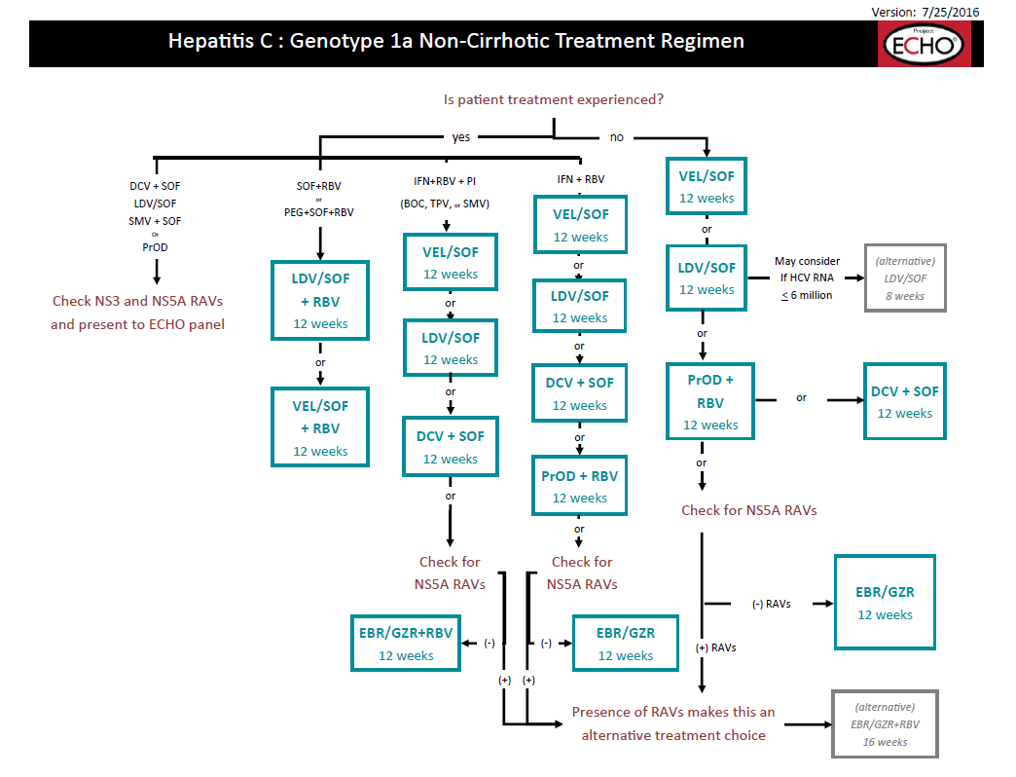

Slide 52
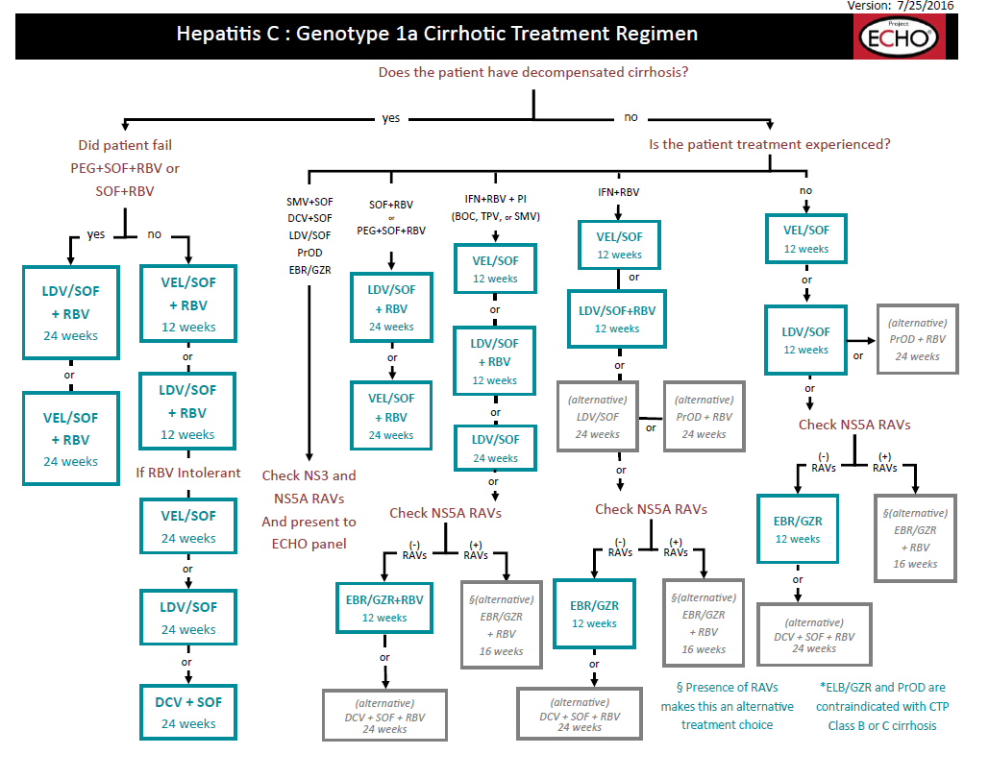

Slide 53
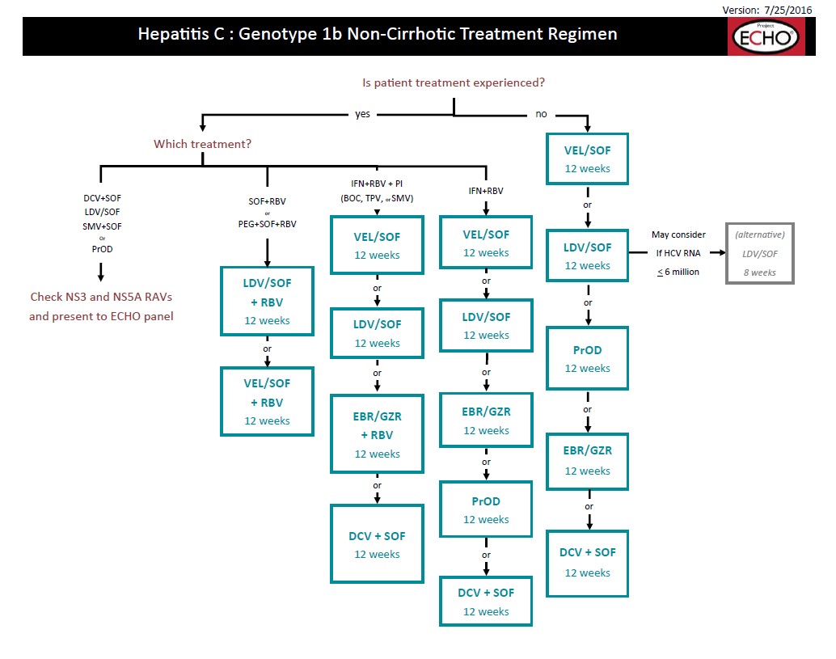

Slide 54
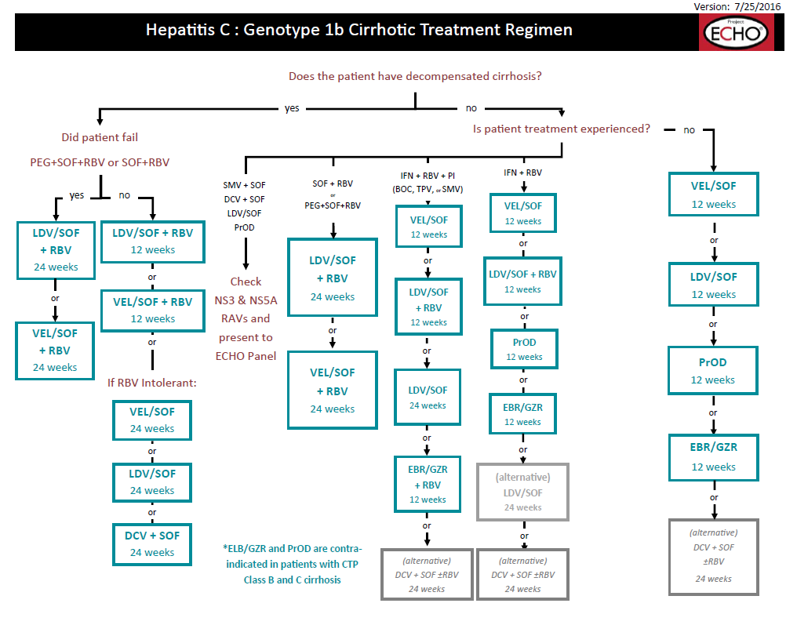

Slide 55
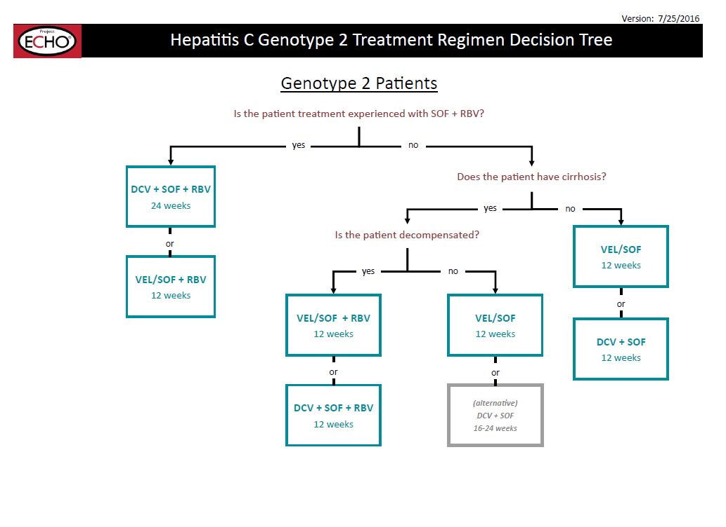

Slide 56
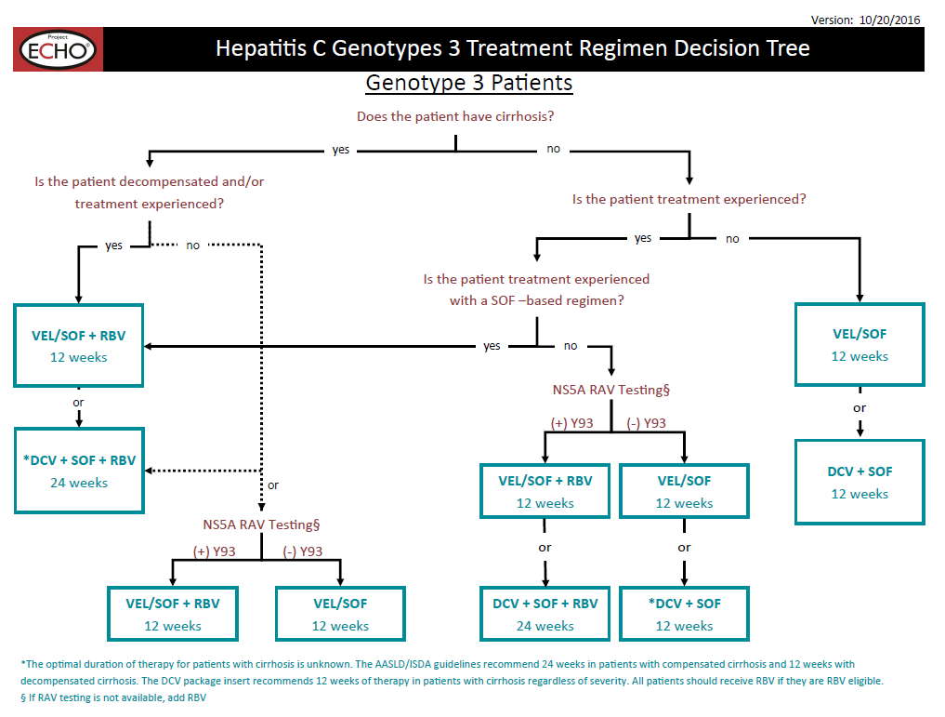

Slide 57
