Slide 1
Accessing HCV Medications at Lummi Tribal Health Center
Jessica Rienstra LPN
Hepatitis C Project Coordinator
Lummi Tribal Health Center
jessicar@lummi-nsn.gov
360.312.2426
September 22 2017

Slide 2
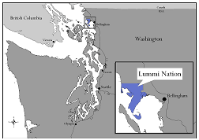
The Lummi Tribal Health Center is located in Bellingham, Washington on the Lummi Nation.
Established in 1978, LTHC serves close to 6,500 patients. The Lummi Nation operates an ambulatory direct care facility under a Title III Self-Governance Compact with the IHS. The center offers general comprehensive medical and dental, mental health and substance abuse counseling, WIC, family planning, community health outreach (CHR) and health education. 60% of LTHC employees are community members.

Slide 3
Identify Insurance and Eligibility
Notes:
Within our HCV database and Care Cascade we also have identified each patient’s insurance and current status. Updating this information has increased priority as several times during the prior authorization process a patient’s insurance has “termed” and therefore caused an unnecessary denial of medication. This is not a permanent issue, but does make the process more time consuming as many more phone calls are then required and at time a new PA submission.

Slide 4
Obtaining Treatment Approvals
Notes:
This takes a TEAM APPROACH. Tribal Assisters, Pharmacists, Lab, Receptionist, MDs and Nursing staff, are all a HUGE part of our ability to get patient’s treatment to them successfully and in a timely manner.
Another reason for this insurance screening is an effort to minimize return visits for the patient. Each insurance company has slightly different requirements for their prior authorization, including different lab values and screening points.

Slide 5
MEDICAID
Fibrosis Score (Fibrosure not Fibrometer)
Genotype (cannot be prior to last IVDU)
Initial HCV AB (must preceed viral load by 6 months)
Current Viral Load
Transmission Risk Factors and Time Frames
CrCl, APRI, Albumin, total Bilirubin, INR (within last 6 months)
https://www.hca.wa.gov/assets/billers-and-providers/13-830A.pdf
https://www.hca.wa.gov/assets/billers-and-providers/13-835.pdf
Notes:
Some differences to note from different insurance companies.
If using fibrosure for fibrosis stating, ensure not fibrometer (washington state specific)
Medicaid aligns closely to the ECHO form, with the exception of requiring an INR within the last 6 months and
Often times this will be sent back with addional questions, and 7 days to respond before denial. Don’t give up, respond anyway and reopen the case and you can still receive your approval.
When filling out this prior auth we have the MD order the medication which signals the pharmacy to fill out the 13-835 which is the cover sheet to the 13-830A.

Slide 6
Molina
Stage 3 fibrosis needed for Prior Authorization
Aetna
Requires SVR labs to be submitted. (others by request only)
http://www.aetna.com/pharmacy-insurance/healthcare-professional/documents/HepC-MedicationPrecertificationRequest.pdf
Cigna
More specific cirrhosis screening for ALL patients. (APRI, FIB-4 and Abd US not enough for non cirrhotic screening.)
https://www.cigna.com/assets/docs/pharmacy/Pharmacy_hepatitis_c.pdf
Notes:
When sending these PA’s ensure that the patient

Slide 7
Insurance Phone Numbers Medicaid 1-800-562-3022 ext 15483 for pharmacy authorization Kaiser Permanente 1-800-729-1174 for Pharmacy Drug Benefit Help Desk Cigna 1-888-992-4462 1-800-351-3606 for Specialty Pharmacy Services 800-244-6224 for physician for prior authorizations Aetna 1-866-503-0857 for Precertification Notification HMA 1-877-408-9742 option #5 for Caremark Specialty Pharmacy
Notes:
Important phone numbers, find these for your area and make them visible to everyone on your team

Slide 8
CREATE A TEMPLATE
Inclusive of all the Prior Authorization requirements from each Insurance company in your area and the ECHO presentation form.

Slide 9
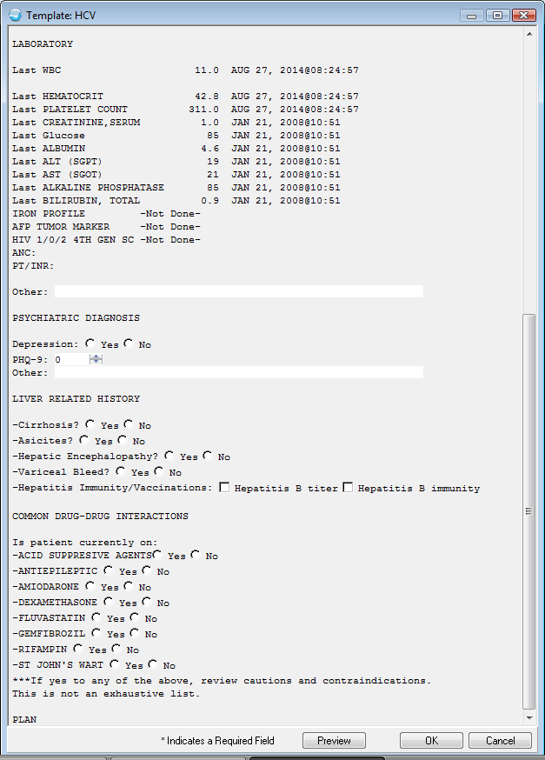
Notes:
This is an example of one of our earlier templates, based off of ECHO screening guidelines and medicaid and HMA guidelines. This really helps streamline and add structure to the screening process. It is not uncommon for one of our patients to have a change of insurance during the screening process, which is why I try to screen inclusive of all requirements. This visit can be referenced when preparing a case for ECHO presentation or preparing a Prior Authorization for medication coverage.
(Template just guides the visit but is not the entire documenation)
(opened on a “demo patient” file)

Slide 10
Other Options
Gilead Support Path
http://www.mysupportpath.com/
Specialty Pharmacy CVS Health (Seattle)
Adeline Veniegas, MBA
Adeline.veniegas@cvshealth.com
CMOP
Notes:
Depending on your clinic and pharmacy set up and available support staff it may be easier/necessary to use outside pharmacy. Many specialty pharmacies are very helpful and very motivated to connect the patients to care.
The benefit of treating patient’s in house for us, is that with a 340b pharmacy we can be reimbursed for our medicaid patients at a profit, so that we can have funding to provide care for the patient’s who do not meet coverage

Slide 11
Patient Assistance Programs can be difficult to navigate but are helpful with motivated patients.
Cigna and Kaiser Permanente both assisted patient’s with payment plans. Offering a RX card that allowed patient’s to get the medication for $5.00.
HMA insurance connected patients to CVA Caremark Pharmacies that offer each 28 tablets of medication for a $20.00 co-pay.
Notes:
In OUR experience. In Washington state.

Slide 12
Case Management
Home visits
Transportation
Weekly phone calls
Med Drop offs
Flexible Lab Visits
Client Oriented plan of treatment
Help address other needs and priorites
Notes:
Frequency of RF’s and visit schedule.
Previous commitments? Drug Court, OTP, court ordered counseling? Collate with those schedules!!!
Get EVERYONE’s number. And potential address changes and addresses of closest relatives.
Get friendly with Local Jails and DOC’s in your area. Open communication with Health Departments in your state. Become very aquainted with your patient’s network of contacts.
Keep consistent contact people when possible. I have found that with patients that I triage and that see the same provider the level or report is built up and they are more likely to be forthcoming about life changes and usage habits then those patients who see a wider variety of staff.

Slide 13
Example Letter for Patient to Carry

Slide 14
Questions?
Thank you!

