Slide 1
HCV Elimination
Is it possible?

Slide 2
Objectives
Define elimination as it relates to infectious diseases
Understand the gaps in the current cascade of care for HCV
Identify interventions required to achieve HCV elimination in a defined population

Slide 3
Linkage to Care
Screening
Quality of Care
HCV
Unsafe Medical Practices
IVDU
Harm Reduction Strategies
Poverty
Domestic Violence
Mental Illness
Historical Trauma
Cultural
Disconnection
others
Prevention

Slide 4
Discovery of HCV and Impact on HCV Incidence in US
Incident cases per 100,000 persons
Discovery of HCV
1989
Year
22,000 cases of incident HCV infection reported in 2012
Alter MJ JAMA 1990; Jagger J, J infect Dis Pub Health 2008; CDC.gov/hepatitis;
Notes:
HCV Incidence Was Highest Before the Discovery of HCV. Prevention Strategies have had a huge impact on incidence in United States
And rates dropped but you note a slight uptick nationally starting in 2010
(John,
I couldn’t get 2012 data to appear on the x-axis.
Please verify that label for
Please take a moment to emphasize the PH triumphs these points represent.
A larger risk of HCV transmission before prevention interventions
1987 Universal precautions
1991 OSHA blood borne pathogen standard
1992 Screening blood transfusions for HCV antibody
2001 Needle stick safety and prevention act
)

Slide 5
Definitions
Control:
The reduction of disease incidence, prevalence, morbidity or mortality to a locally acceptable level as a result of deliberate efforts; continued intervention measures are required to maintain reduction. Example: diarrheal diseases
Elimination:
Reduction to zero of the incidence of infection caused by a specific agent in a defined geographical area as a result of deliberate efforts; continued measures to prevent re- establishment of transmission are required. Example: measles, poliomyelitis.
Eradication
Permanent reduction to zero of the worldwide incidence of infection caused by a specific agent as a result of deliberate efforts; intervention measures are no longer needed. Example: Smallpox
Miller M. et al. In Disease Control Priorities in Developing Countries: 2nd Edition 2006

Slide 6
Feasibility Criteria for Elimination
In General¹ | Hepatitis C Virus | Check list
No non- human reservoir and the organism can not multiply in the environment | No human reservoir
There are simple and accurate diagnostic tools | Serology widely available
Practical interventions to interrupt transmission | Treatment as prevention Needle exchange programs Opioid substitution programs
The infection can in most cases be cleared from the host | Treatment is 95 % curative
1. Hopkins DR NEJM 2013. 368;1

Slide 7
Essential Goals to Eliminate HCV
Prevent sequelae of advancing liver disease in those already infected
Baby Boomers, born 1945 -1965
Prevent new or “incident” infections
Persons who inject drugs
Unsafe healthcare practices
Sexual exposures in Immunocompromised individuals

Slide 8
Why is HCV Elimination Needed in CNHS?
Higher prevalence than US population
Estimated > twice the national prevalence
~ 4158 AI/AN patients in the CNHS are estimated to be chronically infected with HCV
~1247 will develop cirrhosis
~50 will develop liver cancer
Ongoing transmission is occurring at an unknown rate
At the present time we can deliver curative treatment to >90% of patients
AI/AN: American Indians/Alaskan Natives
Notes:
Highlight – present time

Slide 9
HCV Elimination Program Goals
Secure political commitment for HCV elimination
Expand screening program
Establish robust programs to link to care, treat, and cure patients with HCV.
Reduce the incidence of new HCV infections
Model elimination of HCV infection
Notes:
These goals were pre-implementation goals from over 1 year ago and they still hold true today.

Slide 10
Goal #1: Political Commitment
Public support and community awareness backed by government officials
Build the infrastructure needed to meet program goals
Notes:
We knew within our tribal community that we would need public support and visible community awareness --- there would have to be tribal government officials who vocally supported our cause in order for us to build the infrastructure needed to meet our program goals.

Slide 11
Goal # 2
CDC guidelines for Hepatitis C testing
Baby boomers (born from 1945-1965)
Current or past injection drug users
Certain medical conditions (high ALT, HIV, HD, transfusion/transplant prior to 1987/1992)
Recognized exposure: healthcare worker incident or child born to HCV infected mother
Expand Screening Program
Are the age and risk targeted screening guidelines applicable to the CNHS population?

Slide 12
CNHS HCV: Age Distribution (n=263)
CDC Birth Cohort Target
Cherokee Nation median HCV (+) age range
Patients who were evaluated for treatment at CNHS (2012)
Notes:
This graph shows the number of HCV positive patients seen per 5 year birth cohort. In purple, you can see where screening would target using the current CDC guidelines, but we needed to include the younger population, which is where about ½ of our patients fell as you can see here.

Slide 13
Goal # 2: Expand Screening Program
Expand age targeted screening to 20-69 year old
Screen 85 % of targeted age group who access the CNHS
Expand screening sites
ED/UC, dental, behavioral health

Slide 14
Hepatitis C Screening at CNHS Impact of EHR Reminder
HCV 101

Slide 15
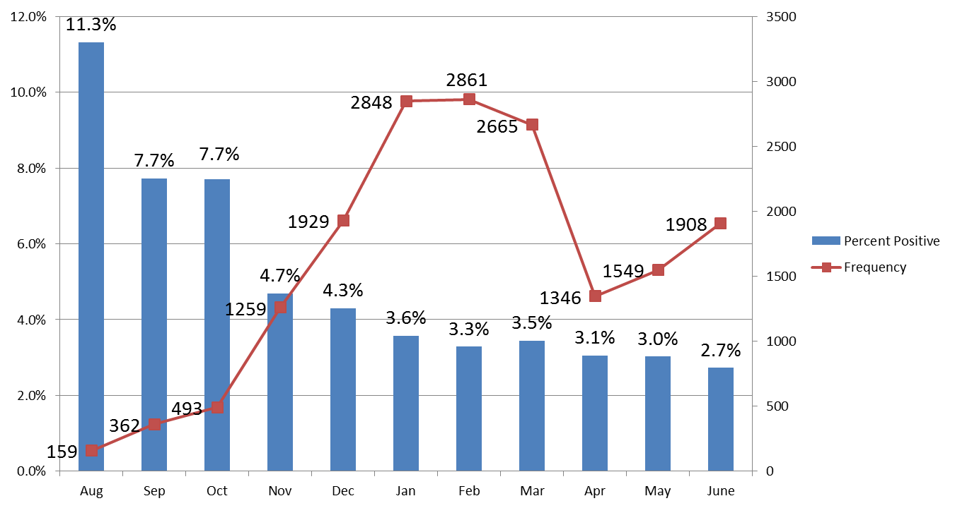
HCV Screening by Month (9/2015-6/2016)
Impact of lab triggered screening
Expanded Age (20-69)
targeted Screening
Lab Triggered
Screening discontinued
Lab Triggered
Screening

Slide 16
Lab Triggered Screening: Hospital Services Where Patients Were Screened
67 %

Slide 17
HCV “Lab Triggered” Screening WW Hastings Hospital

Slide 18
Goal #3: Establish Robust Program to link to care, treat and cure patients with HCV
Linkage to care, evaluation and treatment
Centralized screening reporting and linkage to care
Expand local ECHO program
Expand case manager workforce
Measurable Program goals:
Treat 85% (~3,508) of patients with active HCV infection in 3 years
Cure 85% (~2982) of treated patients defined by SVR12
Notes:
READ TITLE: Once patients were screened, we had to have an efficient system to evaluate them clinically and we felt like we could do this by centralizing the screening reporting and assigning the tracking of those patients to specific work group members to decrease our lost to follow up rates. Some things we could implement to help in this effort were the use of rapid screening tests in which we could get a screening result in 20 minutes and immediately get the patient an appointment with one of our Hepatitis C providers. We also planned to expand the ECHO program to increase our coverage in the outlying clinics --- on a side note, we now have 12 PCPs and 8 pharmacists within our system treating hepatitis C with the support of the ECHO model. Expanding case management services was also a must. With the processes in place for procuring medications and then the close follow-up these patients would require, we had to increase our case manager work force. So we developed a measureable goal to treat 85% of patients in 3 years and cure 85% of those treated.

Slide 19
Goal #4: Reduce the incidence of new HCV infections in CNHS
Develop and conduct culturally-competent public awareness of risk factors for transmission
Treatment as Prevention
Contact tracing of acute HCV cases
Harm reduction Program
Needle exchange
Pharmacological substitution
Behavioral health

Slide 20
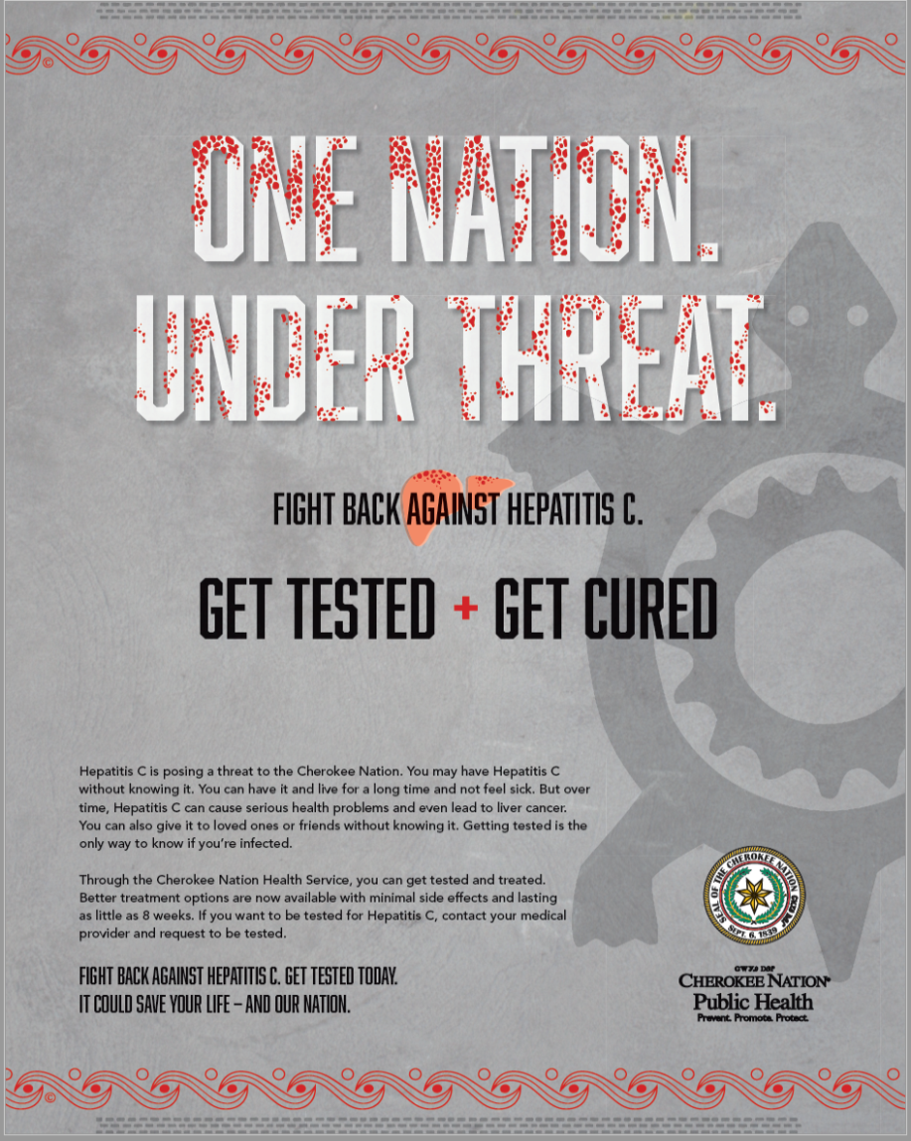
Develop and conduct culturally-competent public awareness of risk factors for transmission

Slide 21
HCV Transmission can be Prevented
In the US 80% of HCV Transmission Occurs in PWID
An Effective Intervention to Prevent HCV Transmission
Treatment as prevention Harm reduction strategies in combination
Opioid substitution programs
Needle exchange programs
Hagan H et al. 2011. J I D 201, 74-83

Slide 22
HCV Cascade of Care: 2012-2013
(based on a prevalence of 5.8 %)

Slide 23
HCV Cascade of Care: 2012-2015
(based on a prevalence of 3.7 %)

Slide 24
Cherokee Nation HCV Treatment Quarterly Data 1/2014 – 12/2016
Number of Patients That Started HCV Treatment
Number of Patients

Slide 25
Decreasing Transmission of HCV
Goal #4 Goal #5
Objective |  | Outcome
Education |  | Public campaign developed by OSHD
Harm Reduction | Pharmacological Substitution | Weekly ECHO addiction clinic started
 | Syringe/Needle Exchange | Discussion with legislature ongoing
 | Behavioral Health | Same day consultation established
Treatment as prevention |  | -PWID are offered treatment -Reinfections are being monitored
Acute HCV surveillance |  | Contact tracing program started August 2016
Mathematical Modeling |  | Yale School of Public Health
OSHD: Oklahoma State Health Department

Slide 26
Conclusions
Elimination of HCV is possible but not effortless
The tools for elimination are available
HCV elimination will need the involvement of political leaders, policy makers, public health officials, medical providers, scientists, epidemiologist and activists from the community

Slide 27
THANK YOU FOR YOUR TIME AND INTEREST
WADO

