Slide 1
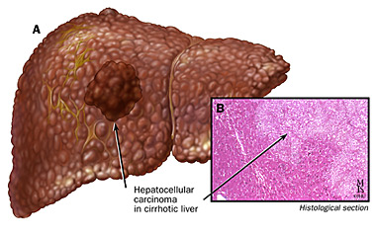
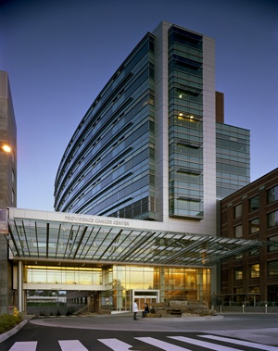
Hepatocellular Carcinoma: Diagnosis and Management
Pippa Newell, M.D.
Medical Director, Liver Cancer Program Providence Cancer Center, Portland
Hepatobiliary Surgeon
The Oregon Clinic
philippa.newell@providence.org
Cell: 646-320-8488
Liver Cancer Clinic: 503-215-8650
May 24, 2017

Slide 2
Case Study 1: Ultrasound reveals 1.5 cm mass and ascites

Slide 3
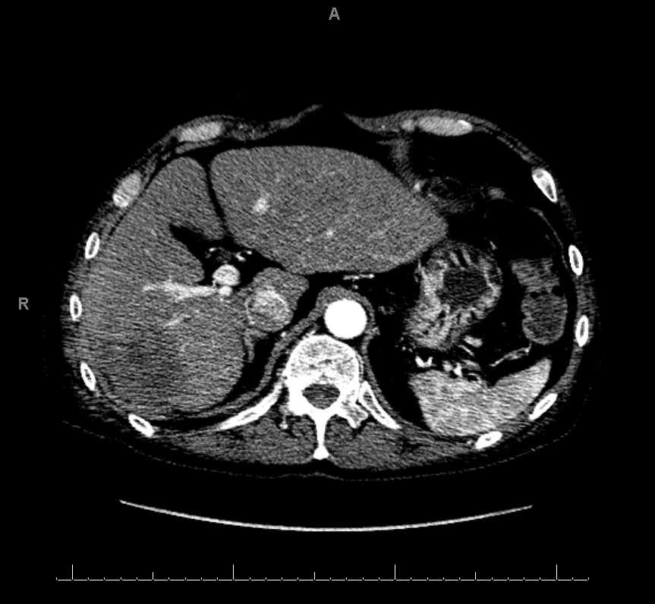
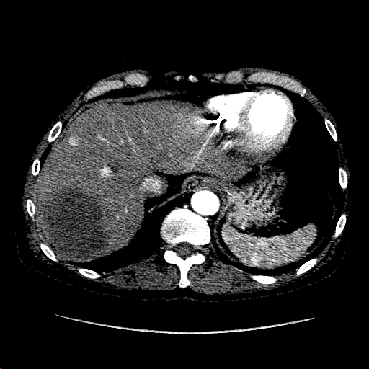
Case Study 2: Large multifocal HCC
Homeless; from Warm Springs
Chronic hepatitis C, never treated
Shortness of breath

Slide 4
Discussion Points
Management – Algorithms and Dilemmas
Early
Intermediate
Advanced
“Terminal”
Who ‘owns’ the patient

Slide 5
Treatment Based on BCLC Staging
AALSD guidelines, EASL-EORTC guideline. J Hepatology 2012

Slide 6
Treatment Based on BCLC Staging
AALSD guidelines, EASL-EORTC guideline. J Hepatology 2012

Slide 7
Liver Transplantation
61% 5 year survival (intention to treat)
18% removed from waiting list due to disease progression or death
Treats liver disease and cancer
Low rate of HCC recurrence
Milan Criteria:
1 tumor less than 5 cm
3 tumors less than 3 cm
Liver Transplantation 2009; 15:859

Slide 8
MELD Exception Points
2-5 cm HCC: Arterial enhancement with venous washout → MELD exception
If 2-3 HCC, all 1-2 cm:
Rim enhancement (capsular enhancement)
Biopsy
Growth > 50% on serial CT/MRI done < 6 months apart

Slide 9
MELD Exception changes as of October 8, 2015
Balances HCC exceptions and patients with high biologic MELD
New applications after 10/8/15:
Listed at biologic MELD for 6 months
After 6 months, priority exception of 28
New cap for HCC patients at 34
MELD 35 policy: pts with MELD>35 participate in regional sharing of organs
https://www.transplantpro.org/news/li/revised-liver-policy-regarding-hcc-exception-scores/

Slide 10
Liver Resection for HCC
Patients with no portal hypertension
Platelet count > 100
No ascites
No varices
No encephalopathy
Good performance status
Only 20% patients eligible for resection
Adequate liver remnant

Slide 11
Adequate future liver remnant
Volumetrics: >40% of original volume

Slide 12
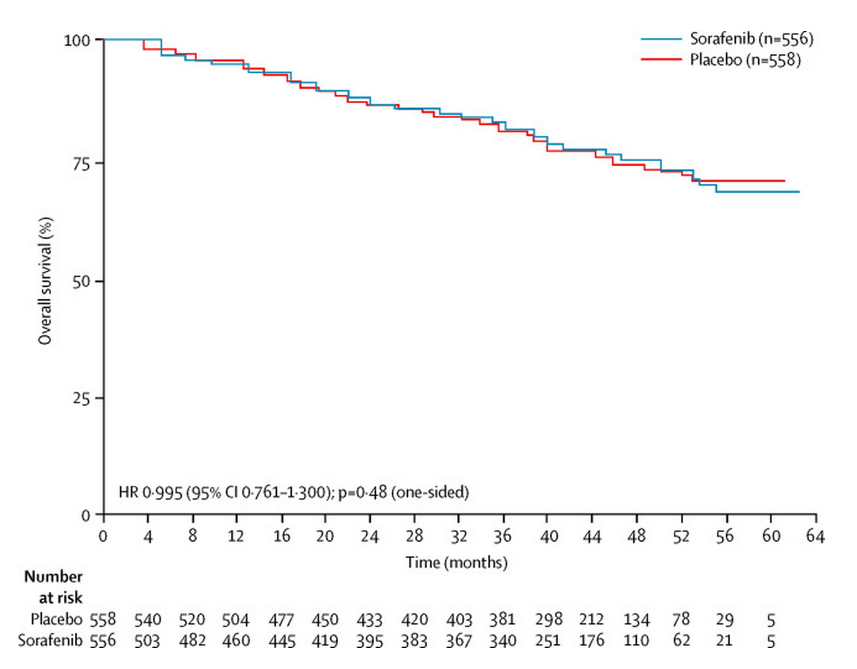
Resection Solitary tumors < 5 cm
Resection 5 year survival in >1000 patients in RCT: 70%
Bruix et al. Lancet Onc Sep 2015

Slide 13
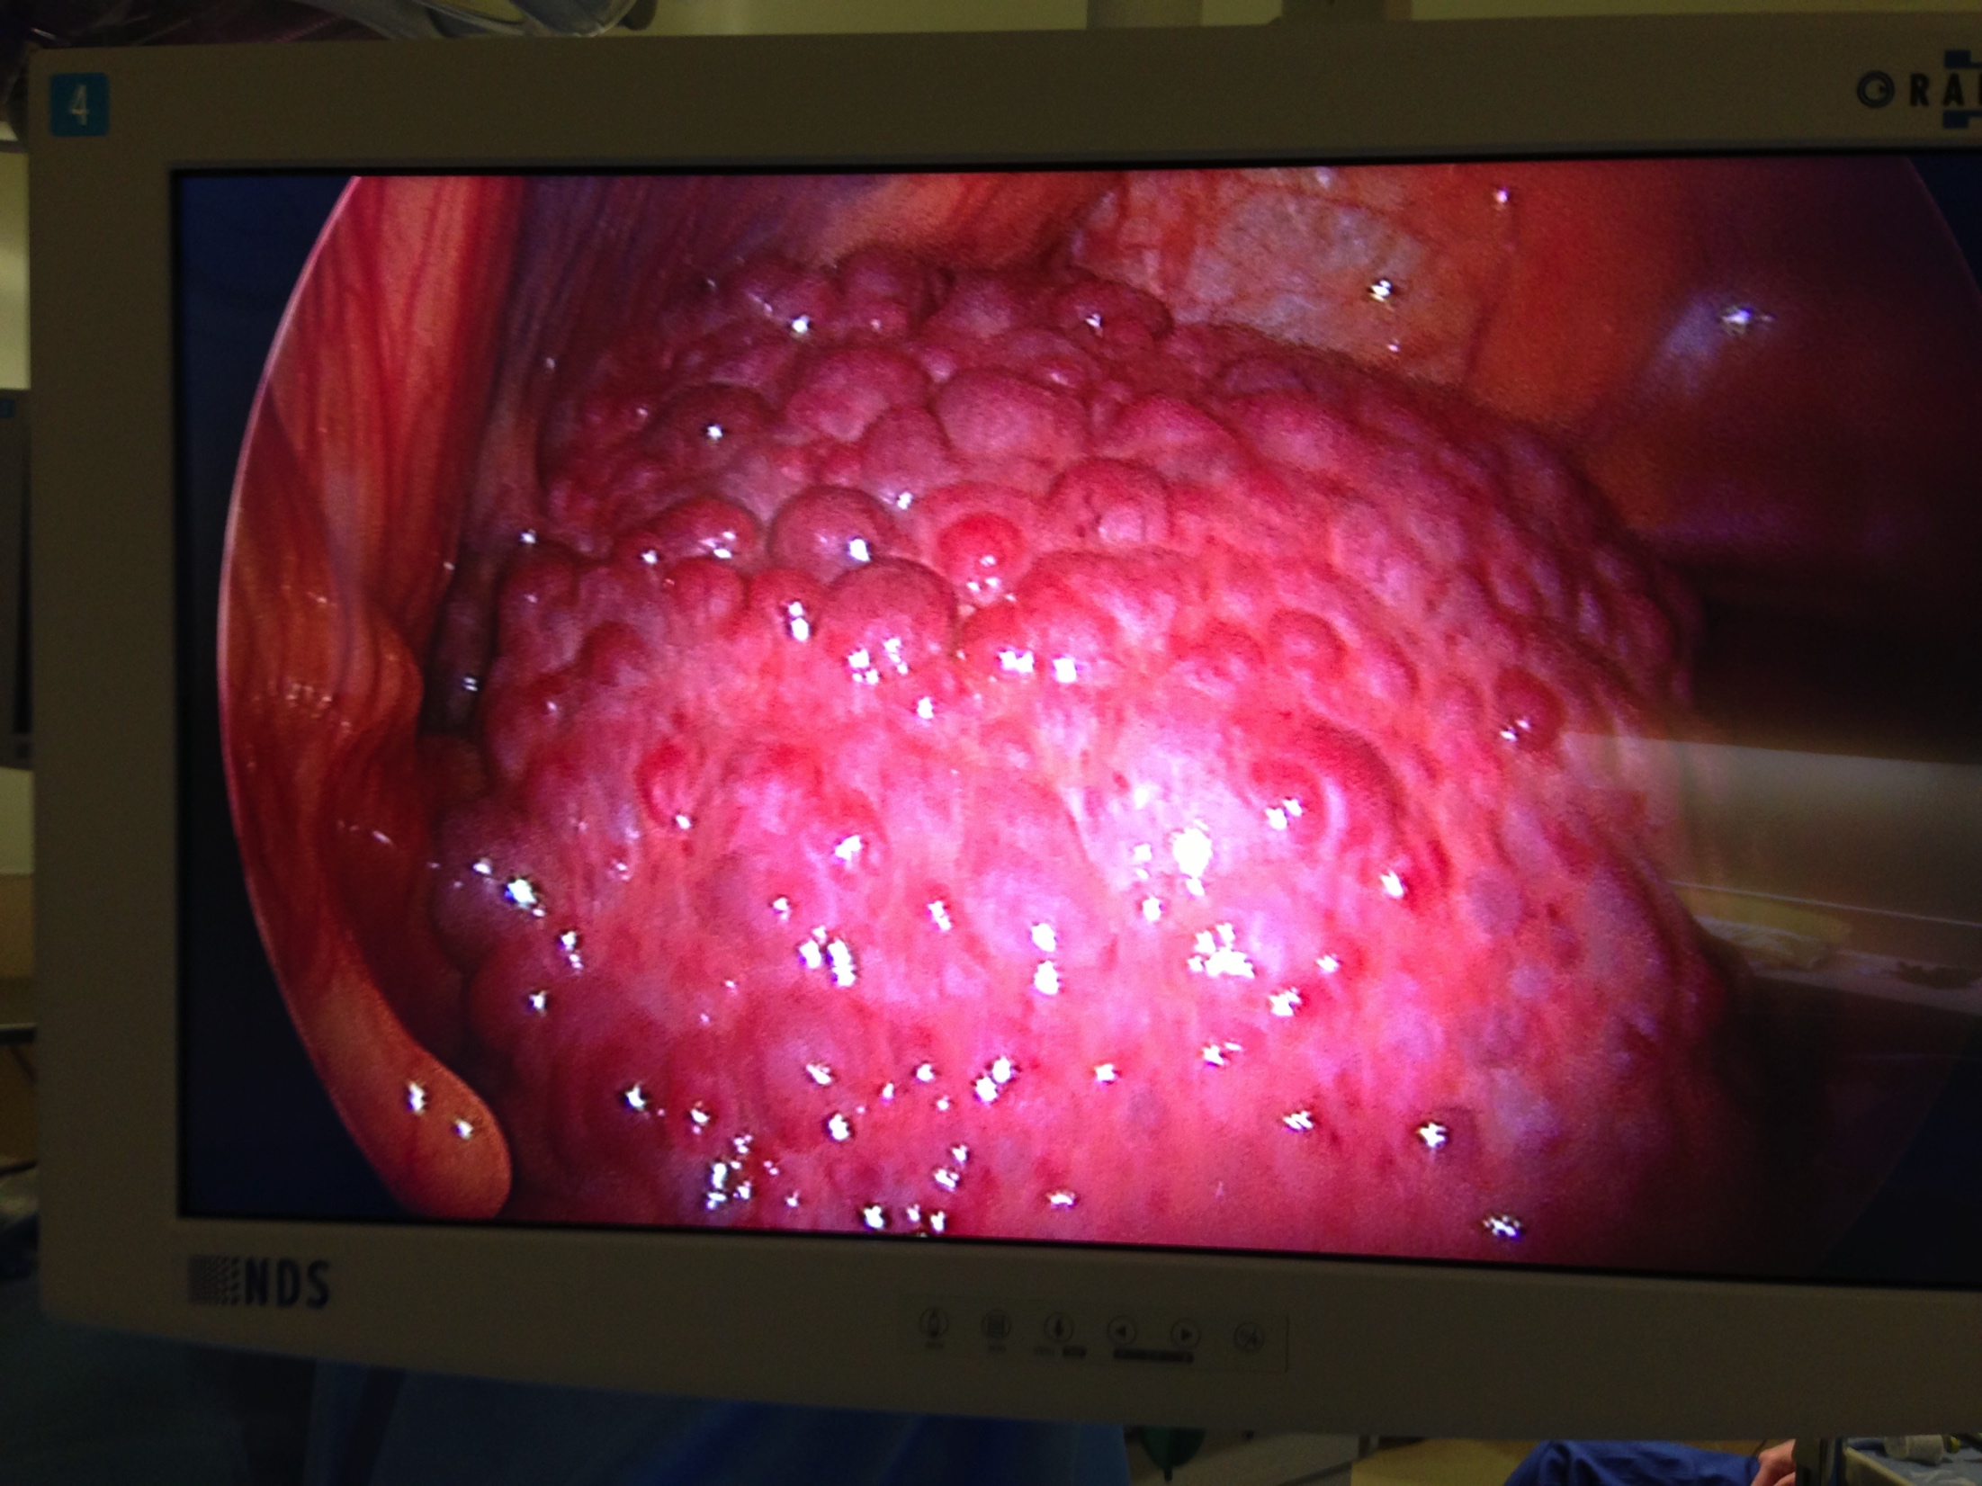
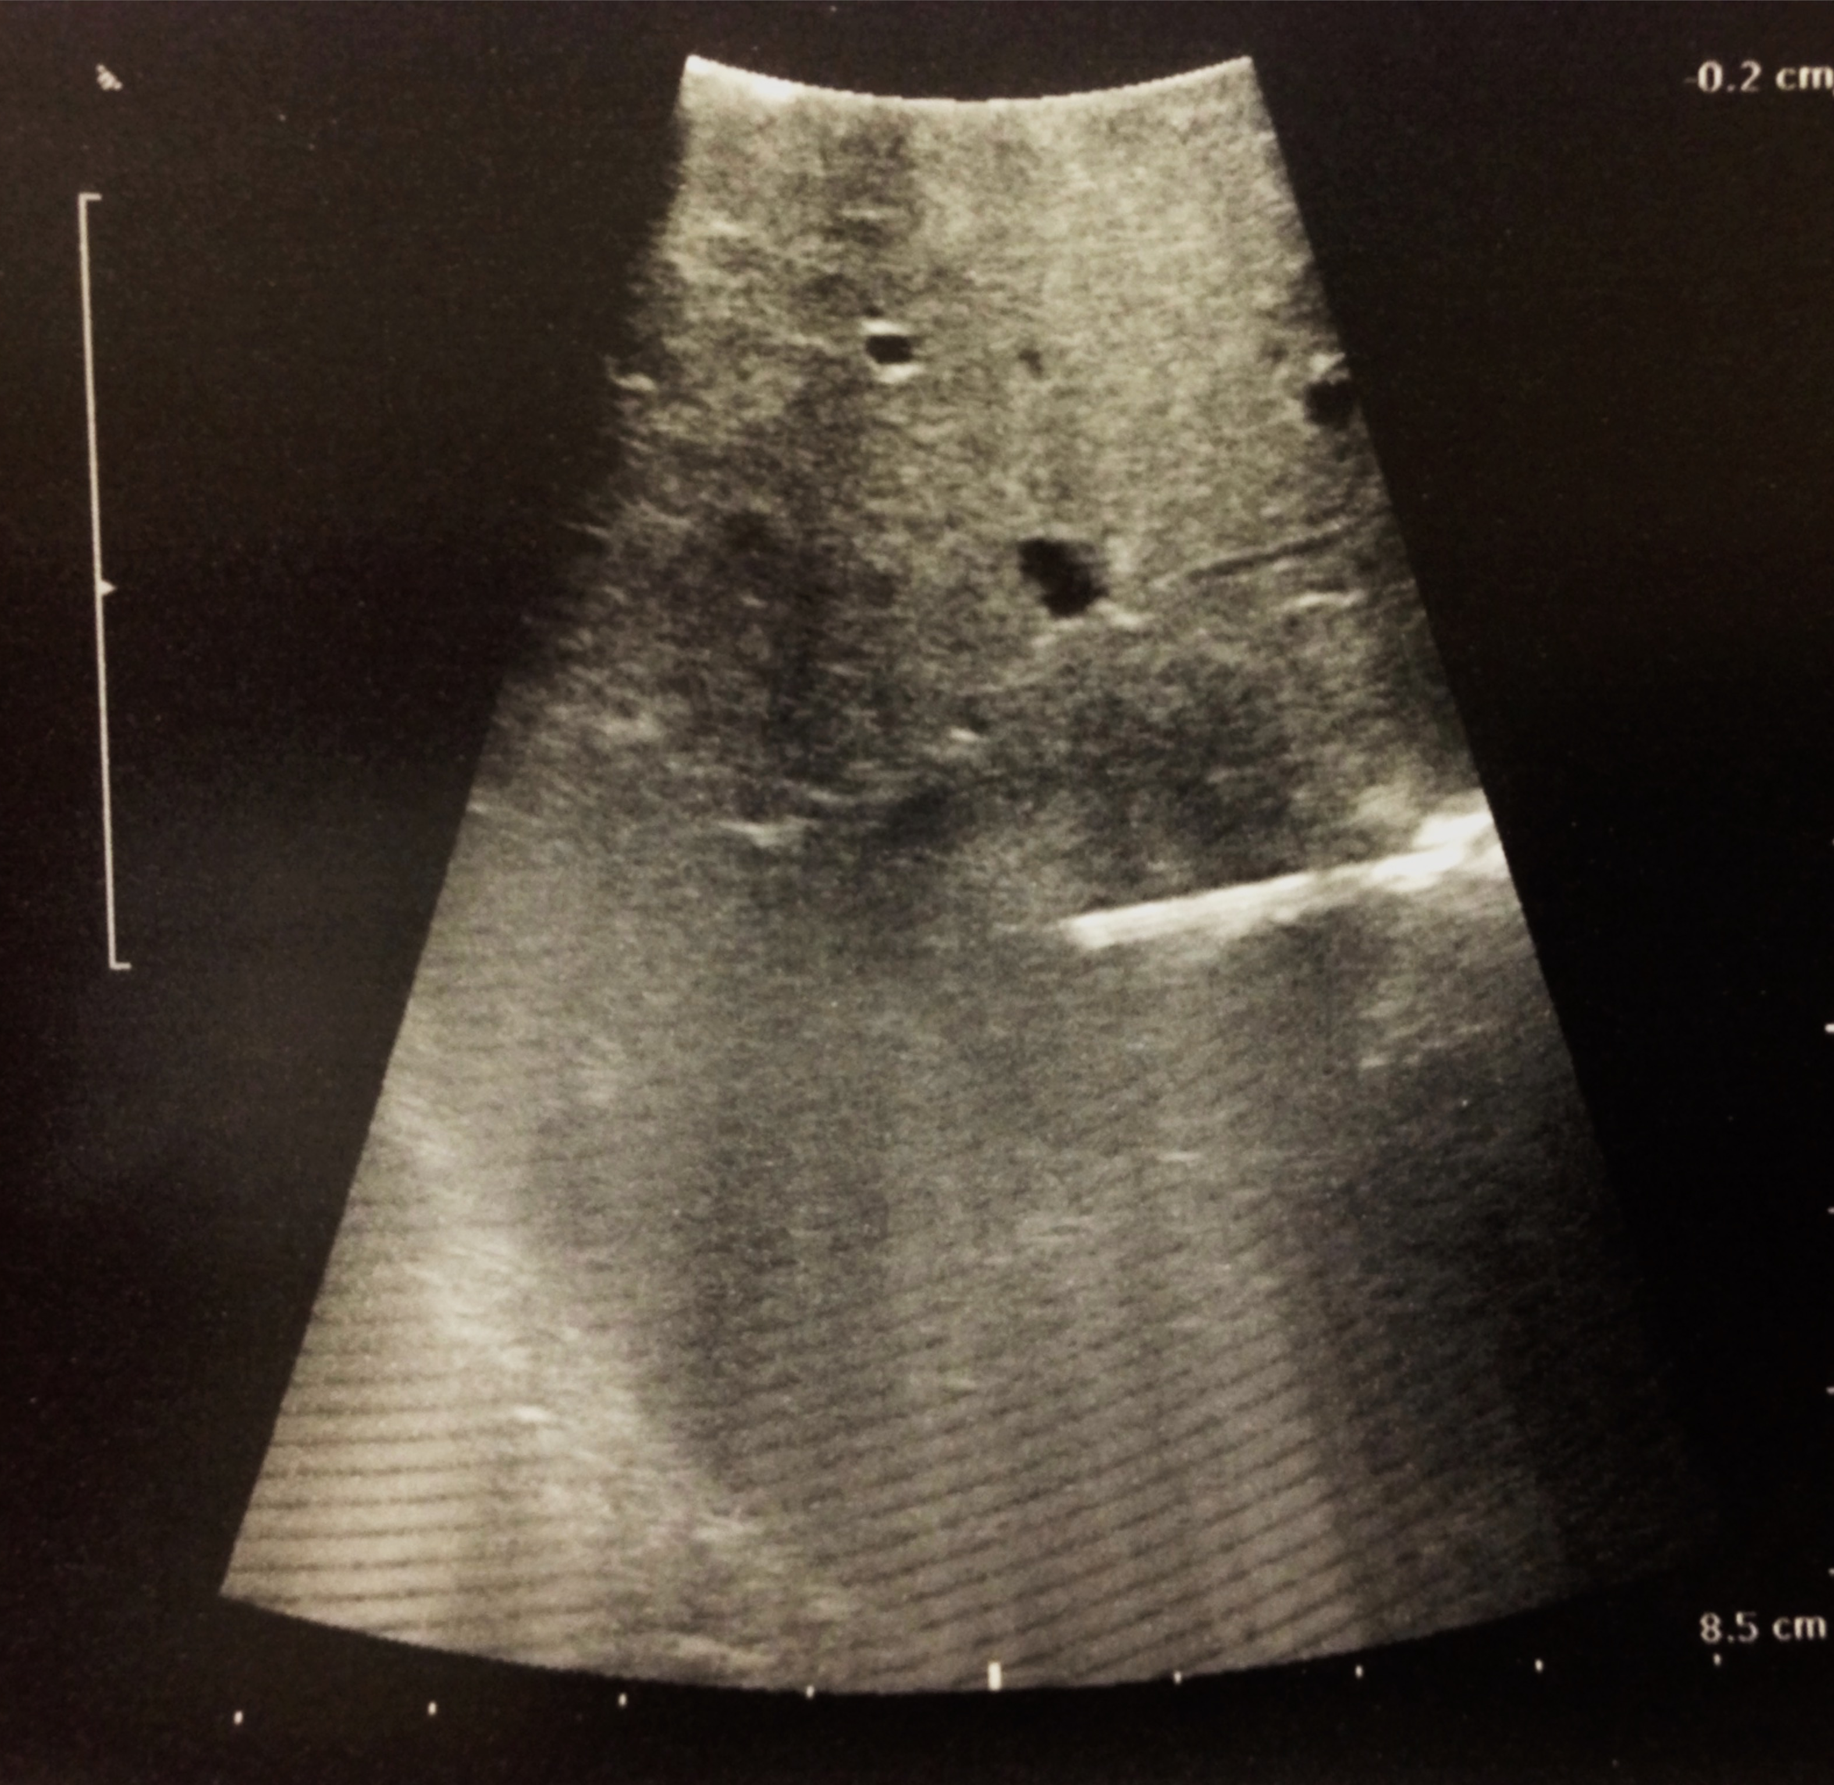
Radiofrequency Ablation (RFA)
Limited to patients with HCC < 3 cm, >2 cm away from bile ducts
RCT x 2: Resection versus RFA
Survival equivalent if solitary < 3 cm; recurrence slightly higher

Slide 14
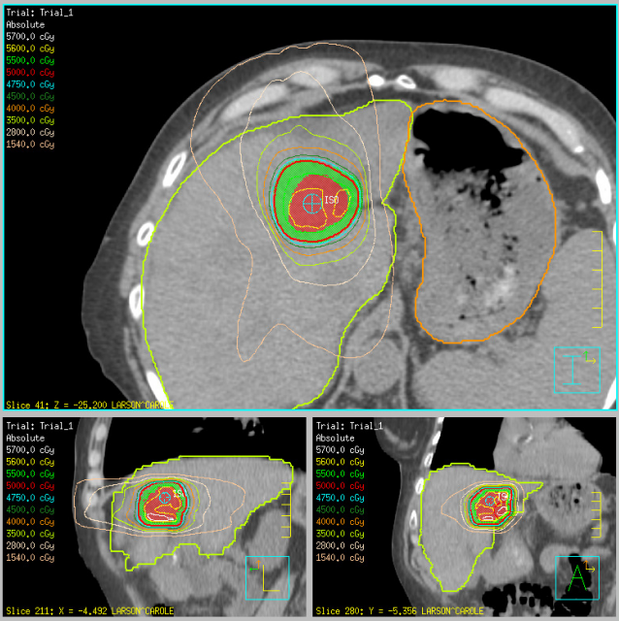
Stereotactic Body Radiotherapy
High dose radiation given over 5 or fewer fractions
Typical ablative doses are >8Gy per fraction
Narrow margins: 3-5mm
Steep dose fall off
Follow up limited

Slide 15
Treatment Based on BCLC Staging
AALSD guidelines, EASL-EORTC guideline. J Hepatology 2012

Slide 16
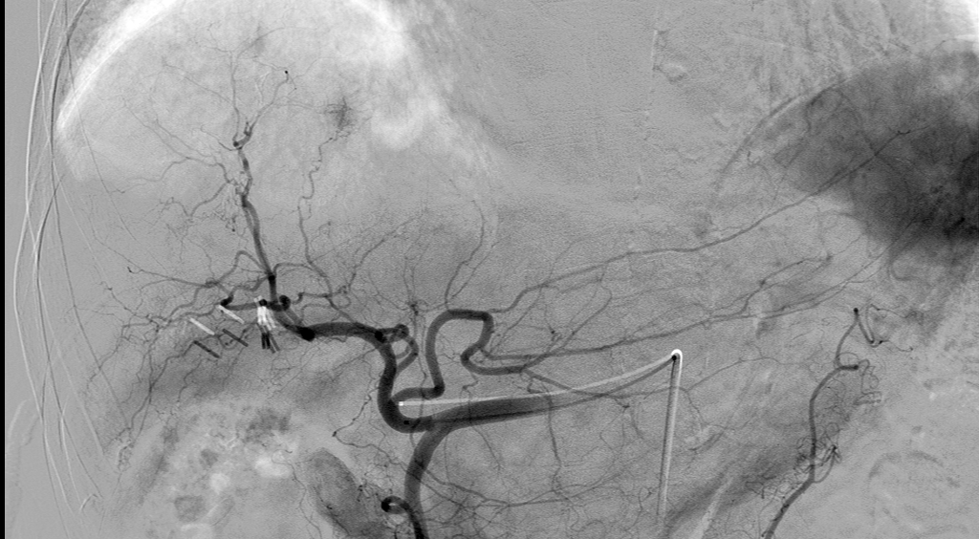
Intermediate Stage: Endoluminal Treatment
Transarterial chemoembolization
Transarterial radioembolization
Yttrium 90 (Y-90)

Slide 17
Intermediate Stage: Endoluminal Treatment
Child-Pugh A or B
Bilirubin < 2 (occasionally up to 2.5)
Transarterial chemoembolization
Drug-eluting beads embolic
Transarterial radioembolization
Yttrium 90 (Y-90)
Nonembolic
Selected cases w/ portal vein tumor thrombus

Slide 18
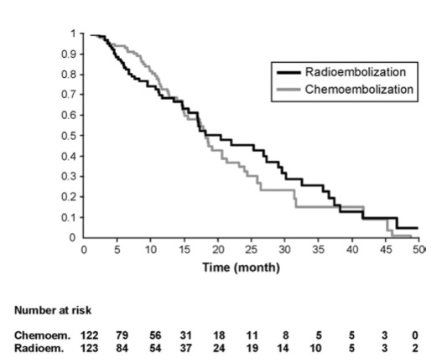
Survival Curve TACE vs. Y90
Salem et al. Gastroenterology 2011

Slide 19
Treatment Based on BCLC Staging
AALSD guidelines, EASL-EORTC guideline. J Hepatology 2012

Slide 20
Advanced Stage: Systemic Treatment
Sorafenib
Median survival 10.7 months with sorafenib vs. 7.9 months in placebo group
Regorafenib = second line (FDA approved April 2017)
Immune therapy
Trials ongoing
Notes:
Double blinded, placebo-controlled

Slide 21
Phase 1/2 Safety and Antitumor Activity of Nivolumab in Patients With Advanced Hepatocellular Carcinoma (HCC): CA209-040<br />
Presented By Anthony El-Khoueiry at 2015 ASCO Annual Meeting

Slide 22
Preliminary Overall Survival
Median survival: >13 months
El-Khoueiry et al, Lancet 2017

Slide 23
Who takes care of this patient?
ER
PCP
Palliative Care
GI
Surgery
Medical Oncology
Interventional Radiology

Slide 24
Case Study 1: Ultrasound reveals 1.5 cm mass and ascites
Can you control ascites/encephalopathy?
Yes → ablation or radiation
No →
Transplant candidate?
Yes → Wait until 2 cm
No → Palliation

Slide 25
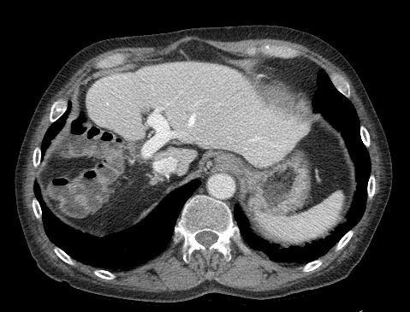
Case Study 2: Large multifocal HCC
Chemoembolization 8/2012
Portal vein embolization 9/2012
To make the left lobe bigger
Radiofrequency Ablation 1/2013
Resection 2/2013
June 2016: Disease free

Slide 26
Thank you!
Maybelle Clark Macdonald Foundation
Providence Cancer Center, Portland OR

