Slide 1
Cowlitz Indian Tribe Health Clinic HCV Treatment
Freida Eng MD
September 22, 2017

Slide 2
About Us
Family Practice Clinic
Longview Washington
Serving Cowlitz Indian Tribal Members and Other American Indian/Alaska Natives

Slide 3
About Us
Board Certified Family Physician
Family Practice ARNP
2 RNs
2 MAs

Slide 4
About Us
Onsite Point of Care Labs
Quest Send Out Labs
Local Radiology Available
RPMS Electronic Health Record
ICare

Slide 5
How We Started
October 2016 Indian Health Service Sent Out Guidelines for HCV Screening and Treatment

Slide 6
How We Started

Slide 7
How We Started
Identified Some Active Patients
Talked About Patients Who Previously Were Treated
One Patient Getting All Labs With Us While UW Prescribed Harvoni

Slide 8
How We Started

Slide 9
How We Started
Began Ordering Tests Needed For ECHO Presentation For Current Patients
Had to Identify Which Labs to Order
Only Had CT Scans in Area

Slide 10
Team Keeps Going
Scheduled Wednesday ECHO Meetings
Close Contact With NPAIHB Staff
Presented First Two Patients April 2016
Next Two in May
Continued to Work on Gathering Data

Slide 11
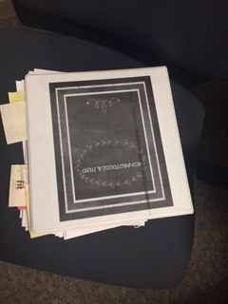

Slide 12
Team Keeps Going
Began to Learn Some of the Details
As a Team, Everyone Heard What They Needed
Still Not Screening
New Patients Came With HCV Diagnosis

Slide 13
Team Keeps Going
June 2017
Lost to Contact
Persistent Excited Patients
Had Not Started Screening Yet

Slide 14
Team Keeps Going
Worked With NPAIHB to Learn
Still Not Screening
New Patients Came With HCV Diagnosis

Slide 15
Team Keeps Going
July 2017
Six Patient Presented Ready to Treat
Addressing Barriers to Treatment
Began to Learn Prior Authorization Process
Still Not Screening

Slide 16
Team Keeps Going
August 2017
Realized Need for Better System
Began Treatment for First Two Patients
Participated NPAIHB PSA
Still Not Screening

Slide 17
Team Keeps Going
September 2017
Worked With NPAIB to Update ICare
Scrambled to Reauthorize Patient Treatment
First 4 week HCV RNA
LFTs Returned to Normal
Medical Assistants Started Screening

Slide 18
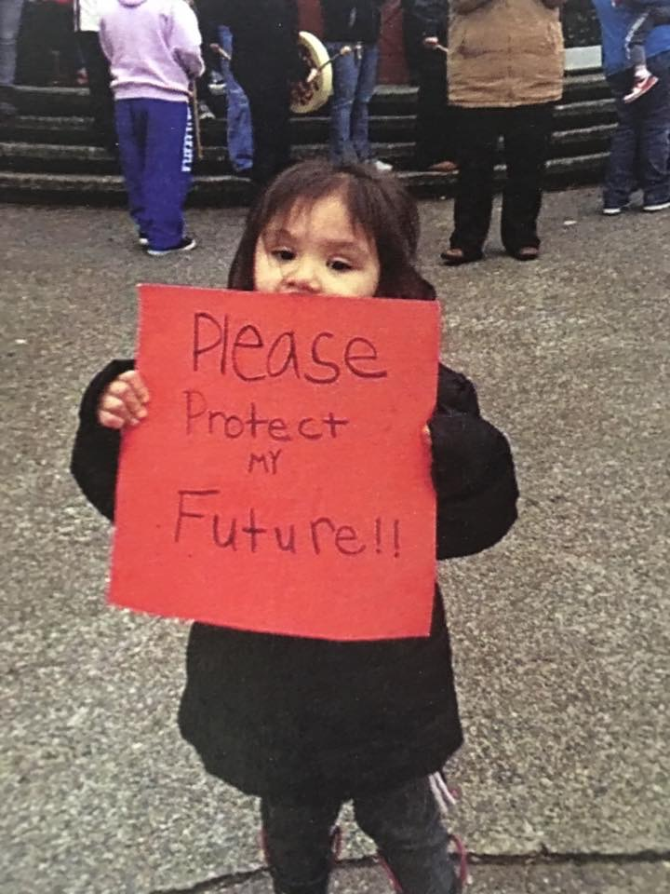
T

