Slide 1
Listening Session on
Tribal Public Health Accreditation
California Rural Indian Health Board (CRIHB) &
Northwest Portland Area Indian Health Board (NPAIHB)
Joint 15th Biennial Board of Directors Meeting
Kaye Bender, PHAB President/CEO
Thunder Valley Resort, Lincoln, CA
July 17, 2019

Slide 2
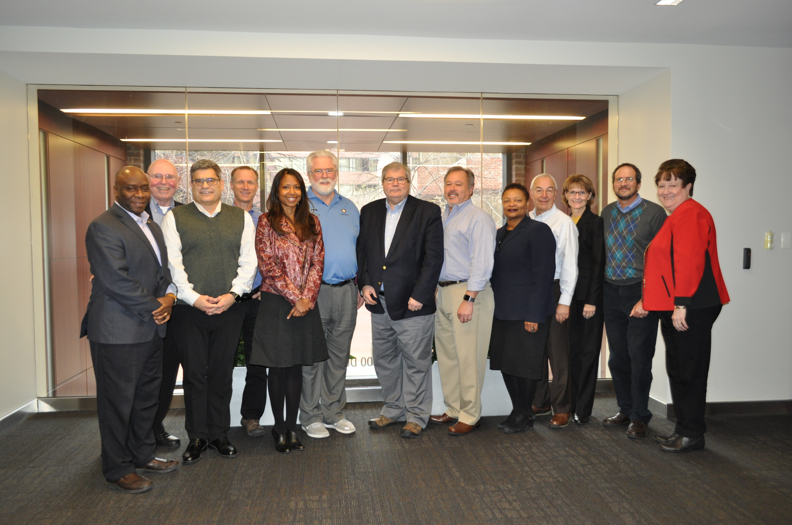
PHAB Board of Directors 2019
Notes:
.

Slide 3
Thank you!!!!

Slide 4
Public Health Accreditation Board
The Public Health Accreditation Board (PHAB) is the national, non-profit organization that administers accreditation for state, local, tribal, and territorial health departments.
Located in Alexandria, VA
Incorporated in 2009; issued first accreditations in 2013.
Our development was funded by the CDC and the RWJF. Accreditation fees are now almost half of our budget.

Slide 5
Public Health Accreditation Board Update
Initial Accreditation
** Of the 504, 60 that are accredited and 72 that are in process serve 50,000 or fewer.
Reaccreditation
 | Reaccred In Process | Reaccred completed | Total
State | 5 | 1 | 6
Local | 37 | 9 | 46
Total | 42 | 10 | 52

Slide 6
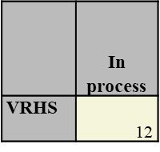
Public Health Accreditation Board Update
Vital Records/Health Statistics at the State Level (Launched February 2019)
International Accreditation
Initial Accreditation Population Summary (as of 6/18/2019)
All HDs in the system (437 + system) | 401,545,870
All HDs in the system (unduplicated) | 277,264,005
Accredited HDs | 343,413,019
Accredited HDs (unduplicated) | 245,334,057
Smallest Population of Applicant | 725
Largest Population of Applicant | 37,691,912

Slide 7
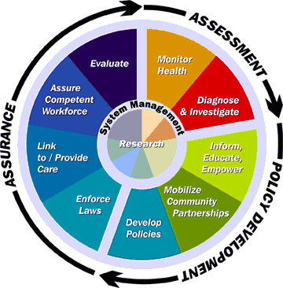
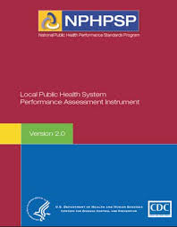

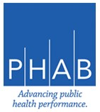


Slide 8
Benefits One Year after Accreditation
% Strongly Agree or Agree
91%*
Accreditation has stimulated greater collaboration across HD departments/units
88%
Accreditation has improved the management processes used by the leadership team
86%*
Accreditation has improved the credibility of the HD within the community and/or state
83%
Accreditation has improved the HD’s accountability to external stakeholders
Post-Accreditation Survey, N=118
*N=35

Slide 9
Financial Effects
% Strongly Agree or Agree
56%
Accreditation has improved the utilization of resources within the health department
42%
Accreditation has improved the health department’s competitiveness for funding
Post-Accreditation Survey, N=118 and 72, respectively
Respondent Quote
Accreditation “created some efficiencies, especially with QI projects. As we try to diffuse that culture of QI throughout the agency, we get lots of suggestions for QI projects that save staff time and resources.”

Slide 11
final document

Slide 12
How Was The Document Developed?
The document was developed in partnership with the Tribal Public Health Accreditation Advisory Board, part of the National Indian Health Board.
It was reviewed by the PHAB Board of Directors.
It was placed for public comment on PHAB’s website for approximately three months.

Slide 13
Purpose and Use of the Document
The document was developed to be used with the PHAB Standards and Measures, Version 1.5 in order to provide some Tribal specific guidance related to the documentation and process requirements.
PHAB recommends that the user of this document put it side-by-side with the standards and measures so as to appropriately apply the supplemental guidance.
This webinar does not attempt to re-state the language in the document. It is a guide to use the document. Tribal health departments should refer to the specific language in the document and not these slides when working on their documentation.

Slide 14
Version 2.0 Timeline
Psychometrics
Evidence Base
Content Analysis
Commissioned Papers
Expert Panels
Think Tanks
Develop Drafts
Accreditation Improvement Committee
Vetting Draft
Standards & Measures Version 2.0
2017 & 2018
2018- 2020
Mid- 2020
End of 2020
14

Slide 15
Tribal Public Health and Accreditation
https://www.nihb.org/tribalasi/tribal_asi_tools.php

Slide 16

Questions

Slide 17
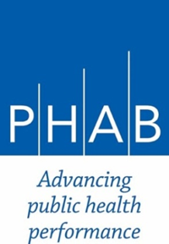
Public Health
Accreditation Board
www.phaboard.org
1600 Duke Street, Suite 200
Alexandria, VA 22314
703.778.4549
SIGN UP TO RECEIVE THE PHAB NEWSLETTER

