Slide 1
Tackling the Opioid Epidemic in California Indian Country
Vanesscia Cresci, MSW, MPA
Acting Epidemiology Manager, California Tribal Epidemiology Center
Director, Research and Public Health Department

Slide 2
What is happening in California? Opioid-related deaths
37 opioid-related deaths among AIAN alone in 2017.
Anyone identified as AIAN, whether alone or in combination with another race and including Hispanics, increases to 76

Slide 3
California emergency room visits are on the rise for opioid-related non-fatal overdoses

Slide 4
Hospitalizations for opioid-related non-fatal overdoses

Slide 5
Tribal Opioid Capacity Assessment preliminary results
Has your Tribal Council passed any policies, laws, or ordinances to address the opioid crisis in your Tribal community?
No: 84% (32)
Yes: 16% (6)
Tribal ordinances, housing policies, pre-employment testing

Slide 6
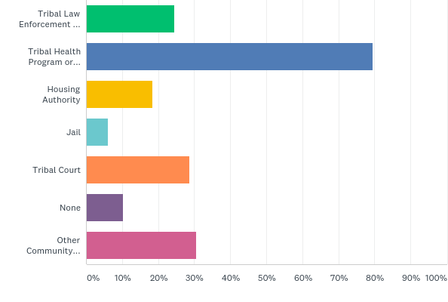
Tribal Opioid Capacity Assessment preliminary results
Which of the following Tribal organizations in your community have been involved in addressing the opioid crisis?

Slide 7
Tribal Opioid Capacity Assessment preliminary results
Which of the follow statements best describes the Tribe’s access to opioid-related health data to monitor trends and patterns pertaining to your Tribal community? | % | #
The Tribe manages their own database to monitor opioid-related health trends and patterns. | 13.33% | 6
The Tribe has an agreement/collaborates with outside agencies who share data with the Tribe about opioid-related health trends and patterns. | 8.89% | 4
The Tribe does not have their own database to monitor opioid-related health trends and patterns. | 11.11% | 5
The Tribe does not have access to opioid-related health data about our Tribal community. | 11.11% | 5
The Tribe does not currently manage their own database, but has an interest in managing their own database to monitor opioid-related health trends and patterns. | 13.33% | 6
The Tribe does not currently manage their own database, but has an interest in collaborating with an outside agency to receive data to monitor opioid-related health trends and patterns about our Tribal community. | 26.67% | 12
Other (please specify) | 15.56% | 7

Slide 8
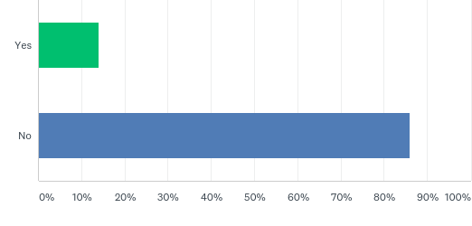
Tribal Opioid Capacity Assessment preliminary results
Does your Tribe have any system to detect early signs of potential opioid overdoses in your Tribal community?

Slide 9
California Tribal Opioid Summit What does an opioid-free Tribal community look like?
North
Limit prescription of pain medication and use alternative treatments
Central
Redesign services to reach clients at critical points: jail, prisons, hospitals, wellness courts, treatment centers
Transformational housing with mentoring and psychological services
South
Increased access to physical and spiritual activities
Drug and alcohol free community events and gatherings
Active lifestyles and healthy eating
Increase in behavioral health staff
Communities working together
Community has healthy parents, elders, and children
Limit pain medication prescriptions and use alternative treatments
Cultural and traditional, sober living, and treatment services
Integrate services at the Tribal Health Program
Phase out western approaches to wellness and strengthen traditional medicine
Overall recovery and healing is inclusive of all community members and everyone has a role in a strong, resilient, and thriving community
Telemedicine in remote areas to provide services

Slide 10
How is CRIHB responding?

Slide 11
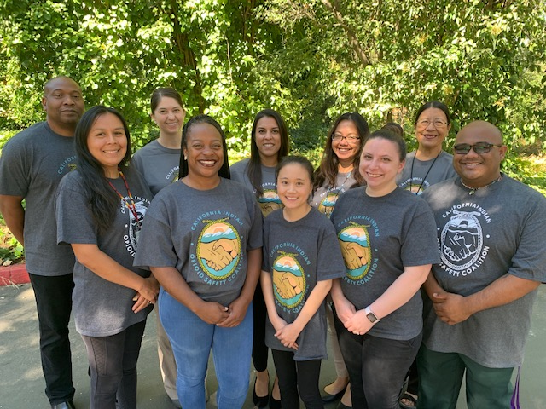
SAMHSA funded Tribal Opioid Response (TOR)
Working with 6 Tribal Health Programs, serving 25 Tribes
CDC funded California Tribal Opioid Strategic Plan
Collecting data across the State
CDPH funded Tribal Medication Assisted Treatment (MAT)
Working with 14 Tribal Local Opioid Coalitions
Providing training across the State

Slide 12
Tribal Opioid Response Activities
Culturally based Community Education
Elder workshops
Enhance Community Support Services
White Bison programming
Culturally appropriate, trauma-informed, harm reduction PSEs in Tribal Health Programs and Tribes
Naloxone education and distribution
Needle exchange
Safe injection sites
Safe prescribing guidelines
Safe disposal sites
Tribal Health Program-wide harm reduction approach
Chronic pain management using alternative approaches
Tribal and Tribal Health Program Leader Engagement
Tribal Health Program partnership with Tribe
Community workshops
Opioids 101
Medication safety
Elder abuse prevention
Pain management alternatives
Prayer ties
Purification ceremonies
Pain management alternative treatment
Other Supportive Activities
Increasing the number of x-waivered providers
Regional opioid summit
Importance of using medications as prescribed
Proper medication disposal
Historical trauma
Building recovery ecosystems
Recovering honoring ceremonies
MAT program
Partnering with California Hub and Spoke Systems to become a spoke
Provide treatment, transitional housing, and sober living services
Community stakeholder engagement
Community meetings
Talking circles
Partner with spiritual leaders
MAT self-assessment

Slide 13
California Tribal Opioid Strategic Plan
Create an Tribal Opioid Strategic Plan
6 Youth Focus Groups
5 Elder Focus Groups
15 Key Informant Interviews with adults and elders
Tribal Opioid Summit feedback
Form a Tribal Opioid Advisory Committee
Provide guidance to all CRIHB opioid projects
Guide the development of the Tribal Opioid Strategic Plan
Implement a Tribal Opioid Capacity Assessment
Assess Tribal-specific capacity and gaps
Tribal Head Start pilot project
Focus on developing resiliency-focused, culturally-based interventions

Slide 14
Tribal Medication Assisted Treatment (MAT)
Three MAT Champions
Statewide Opioid Summit and Regional Opioid Trainings
Distribution and training of Naloxone
Community opioid education campaign
Funding 14 Tribal Local Opioid Coalitions
Telehealth infrastructure support
Alternative Treatment Options: acupuncture, yoga, reiki, traditional healers, herbalists
Provider, CHR & MA Training
Partner with Project ECHO and TeleWell to implement MAT

Slide 15
Tribal Local Opioid Coalition Framework
Phase 1: Setting Up for Success
Phase 2: Getting the Work Done
Phase 3: Growing & Sustaining
Community Readiness Assessment
Tribal Action Plan
Identify and develop community partnerships
Increase access to MAT
Implement Safer Prescribing Practices and Guidelines
Stigma reduction strategies
Support recovery and peer support services
Youth prevention activities
Community-based, culturally appropriate prevention strategies
Expand access to non-opioid pain treatment
Develop coalition work plans
Continue to implement and expand 7 strategies
Develop sustainability plan
Develop Tribal Subject Matter Experts
Link coalitions to Subject Matter Experts
Tribal MAT Champions provide coaching
Tribal MAT Champions provide coaching
Tribal MAT Champions provide coaching

Slide 16
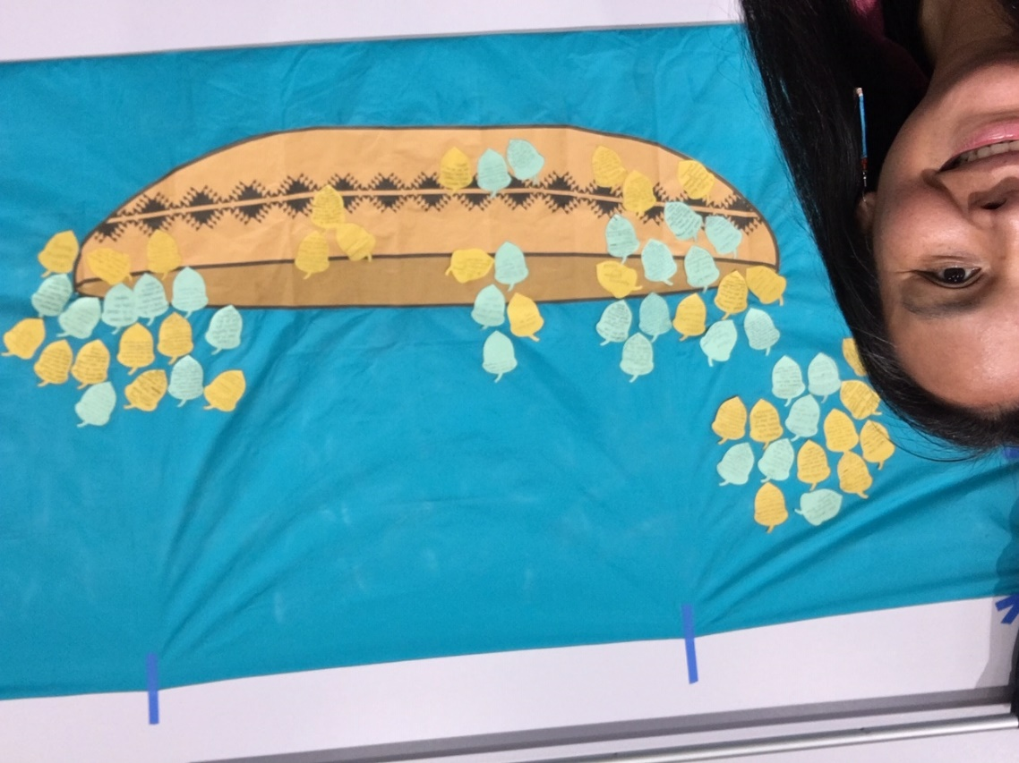
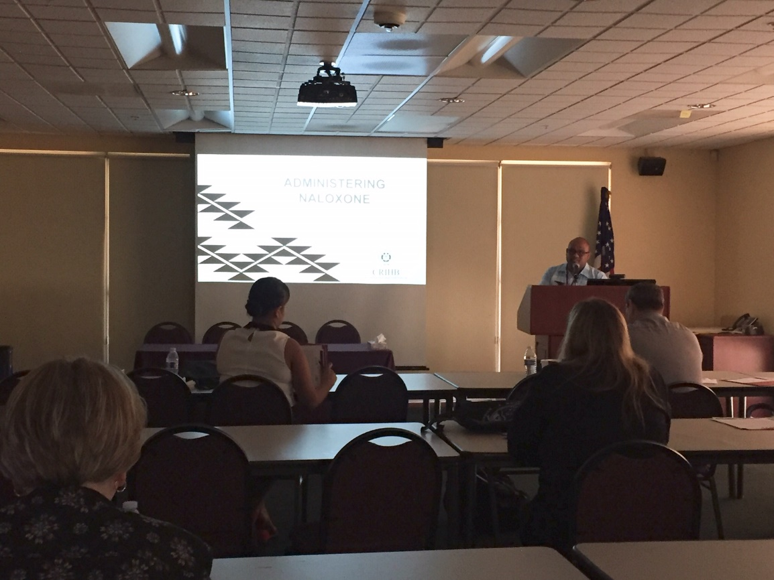
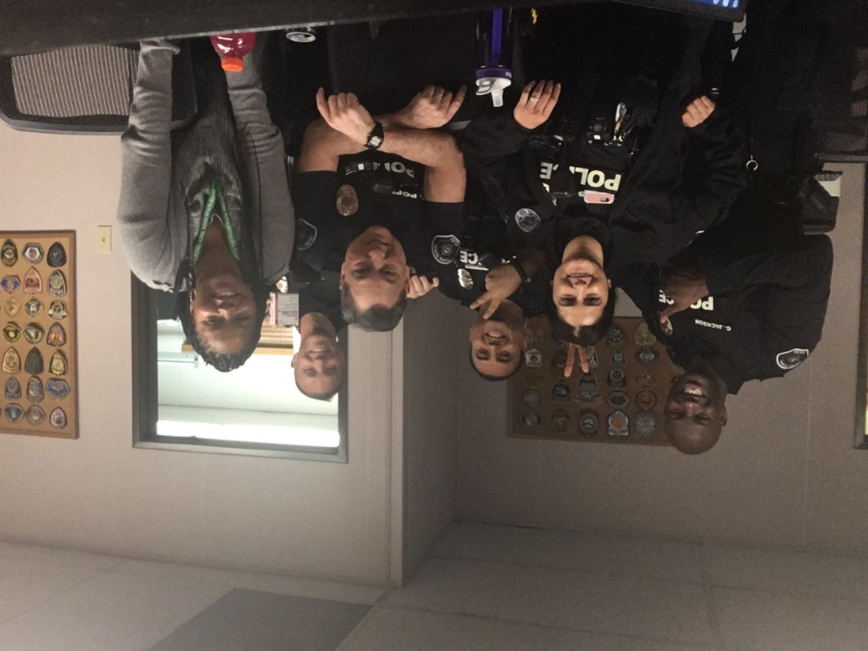
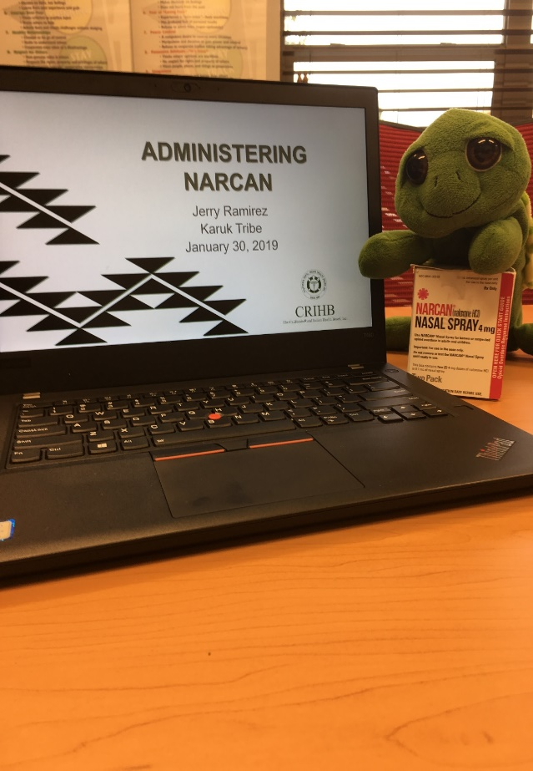
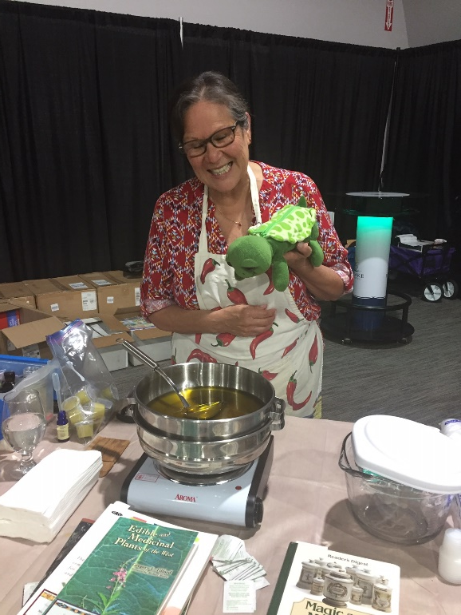

Slide 17
Thank You!
Vanesscia Cresci, MSW, MPA
Acting Epidemiology Manager, California Tribal Epidemiology Center
Director, Research and Public Health Department
(916) 929-9761 ext. 1500
vcresci@crihb.org

