Slide 1
Injury Prevention in Indian Country
Bridget Canniff
Project Director
Injury Prevention Program

Slide 2
What is Injury?
Damage or harm caused to the body by an outside agent or force
Unintentional Injury (aka “Accidents”)
unplanned/unexpected events (most falls, motor vehicle crashes, drowning, burns, etc.)
Intentional Injury
self-inflicted violence (suicide/attempt)
assault, domestic violence, homicide
Notes:
Injuries are also categorized as fatal or non-fatal

Slide 3
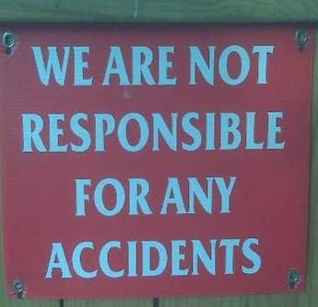
Injuries are NOT accidents!
They are NOT random, unavoidable events
They occur in predictable patterns
They are associated with risk factors
Most are preventable
Notes:
Injuries are not accidents--they do not happen by chance. Like disease, they follow a pattern. By identifying the risks for injury, it is possible to predict and prevent it. The problem of injury can be approached through the same methods that have led to success in preventing infectious disease.
What different types of energy cause injury? mechanical, electrical, thermal/chemical.
Ask the Participants what type of injury is common for people who crash their motor vehicles? These are examples of mechanical energy.
Ask the Participants what type of injuries are common among people who attempt suicide? Could be poisoning (chemical) or gunshot (mechanical), etc.
Ask the Participants if they can think of injuries that would result from the absence of heat and the absence of oxygen.

Slide 4
What is Injury Prevention?
Efforts to prevent or reduce the severity of injuries before they occur
Programs which advance the health of the population by preventing injuries and improving quality of life

Slide 5
Key Unintentional Injury Topics
Motor Vehicle Safety
Seat Belts, Child Safety Seats, Impaired or Distracted Driving Prevention
Elder Falls Prevention
Poisoning Prevention
Home Safety & Fire Prevention
Bike Safety & Helmet Use
Water Safety & Drowning Prevention
Firearms Safety
Notes:
NPAIHB and NWWIHB were two of 23 new sites to receive a TIPCAP (Tribal Injury Prevention Cooperative Agreement Project) grant in 2010. Our grant is $65K and directs us to focus on Motor Vehicles and Elder Fall prevention.
MV Safety can also include Impaired/Distracted driving, Teen or Older Drivers, Speeding

Slide 6
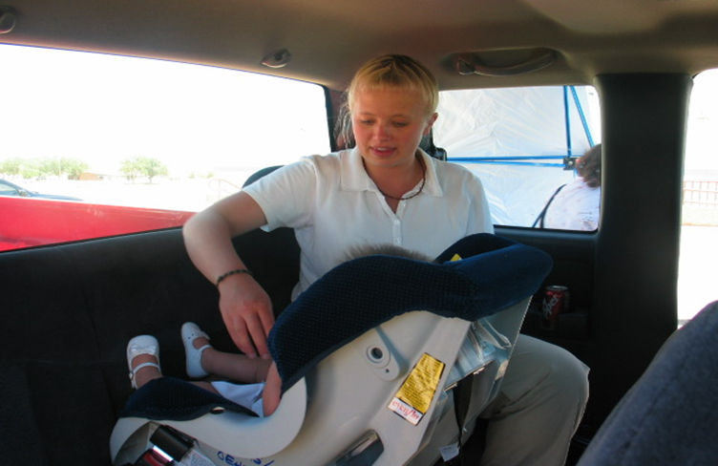
Motor Vehicle Safety
Buckle up those you love and for those who love you
Seat Belts and Child Safety Seats

Slide 8
Motor Vehicle Safety
What things can help improve safety on the road?
What can we do to prevent crashes and reduce injury from crashes?
Notes:
Trying to prevent crashes and reduce injury from crashes are key parts of motor vehicle safety.
AI/AN represent approximately 1.9% of the U. S. population, however they account for 6.8 % of all deaths due to motor vehicle crashes (NHTSA Race and Ethnicity Report 1999-2006) According to this same study, approximately 78% of all AI/AN motor vehicles fatalities involved unrestrained occupants.

Slide 9
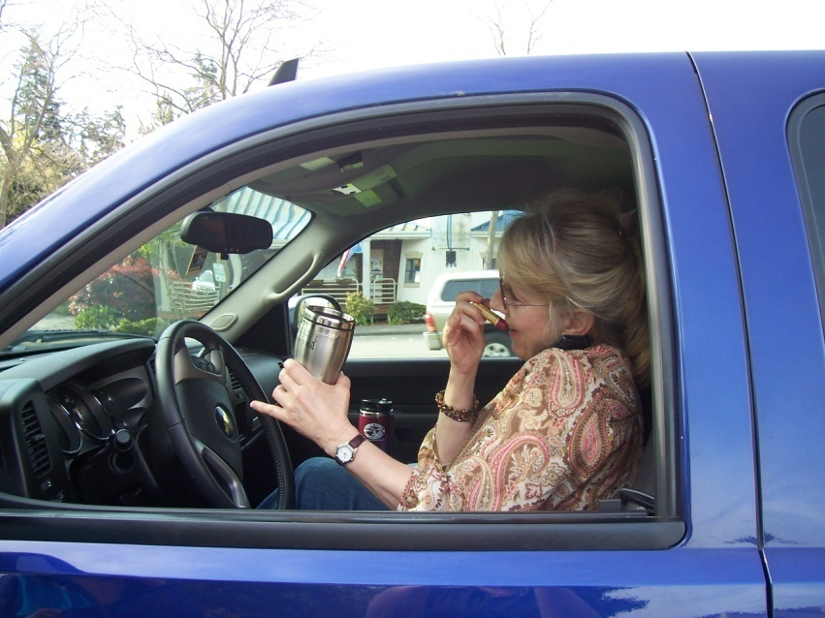
Motor Vehicle Safety
Ensure vehicles are safe and in working order
Promote restraint use for all ages
Discourage aggressive / distracted driving
Enforcement of laws
Provide community education
Change societal attitudes
Notes:
"Teenagers tend to think they're invincible and can multitask while driving," said CHP Commissioner Joe Farrow in a statement. "In reality, they're inexperienced when it comes to driving and they need to recognize the responsibility and the risks associated with the privilege.“ On January 26, 2011, one of my son’s friends, who was a pedestrian, was a fatal hit and run victim of a male teenage driver who was texting.
From 1999 to 2006, an average of 16,375 teenagers died in the United States every year, the Centers for Disease Control and Prevention reported. According to the CDC, motor vehicle accidents are the leading cause of death to young people, representing over one-third of all fatalities.
According to the National Highway Traffic Safety Administration (NHTSA), an average of 30 people are killed every day on our nation’s roadways as a result of alcohol-impaired crashes. However, there is good news. During 2009, there were 10,839 alcohol-impaired driving deaths nationwide, a decrease of more than 7% from 2008.
Promote restraint use: car seats for children, seat belts for drivers and passengers
Discourage aggressive driving, cell phone use and texting while driving
Enforce laws: speed limits, seat belts, impaired and distracted driving

Slide 10
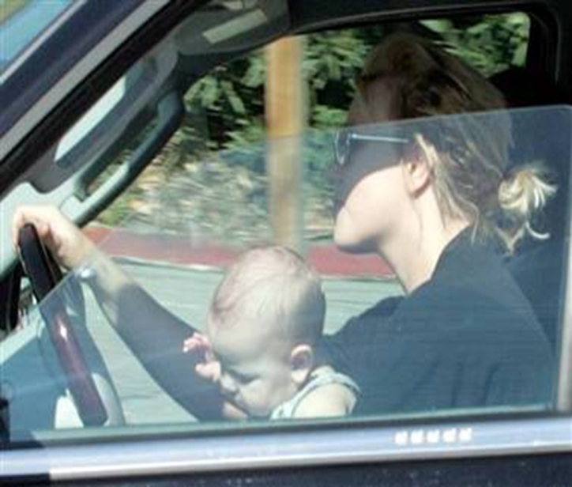
“We Don’t Buckle Up!”
WHY?
“We don’t get tickets on the Rez.”
“I am only going down the street.”
“I just don’t think about it.”
“He’ll stop crying if I hold him in my lap.”
“She thinks she’s too old.”
Notes:
When the Child Safety Seat study and Native CARS conducted seat belt observations from six NW tribes, we got these responses when they asked drivers why they didn’t buckle up.
MVCs happen on and off the reservation, for your own safety, BUCKLE UP. Even a 10 MPH crash can send you through the windshield if you aren’t buckled up.
In 2006, according to NHTSA the overall rate of seat belt use on reservations is relatively low (55.4%) Belt use varies greatly across reservations, ranging from a low of 8.8% to a high of 84.8%.
Ask your group if they always wear their belt. It is good to hear feed back on the issue.
Ask them to explain why they may choose not to belt up. What would make them change their behavior?
Ask the group what is better: buckling up because they won’t get a ticket (In Oregon the fine is $91, Idaho $10, Washington $119) OR buckling up so they won’t injure themselves or others?
A new CDC report released in January 2011 shows that seat belt use has increased to 85% in the United States as crash-related injuries have decreased. Oregon State has a self-reported seatbelt use rate of 94% and a low of 59% in North Dakota. These findings were released as part of CDC Vital signs.

Slide 11
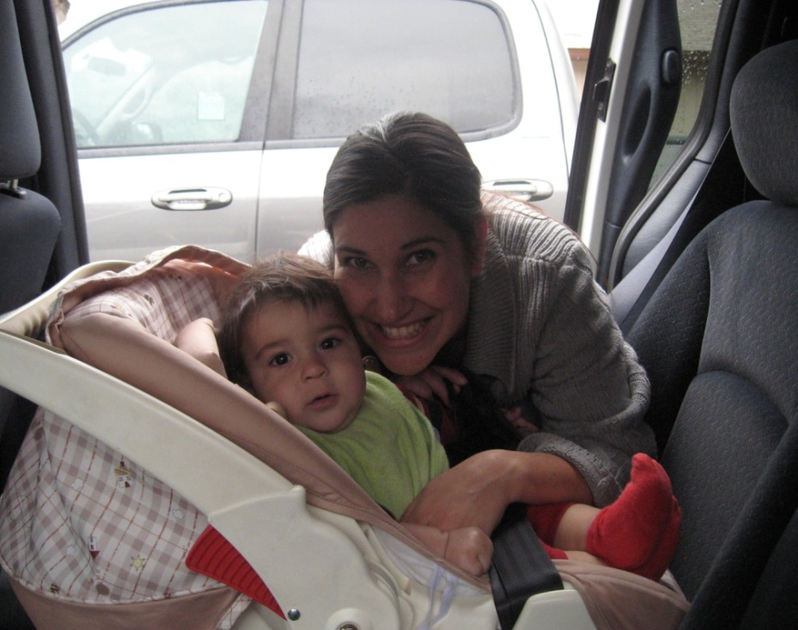
5 Ways Seat Belts and Child Safety Seats Prevent Injury
Help the body slow down
Contact the strongest parts of the body
Spread forces over a wide area of the body
Protects the brain, spinal cord, & for kids, abdomen
Keep adults and children in the vehicle

Slide 12
4 Steps for Kids
Rear-facing
Forward-facing
Booster seats
Adult seat belts
Notes:
For the best protection for Kids , the National Highway Traffic Safety Administration’s (NHTSA) recommends :
Rear-facing child restraints, as long as possible up to the height or weight limit of the child restraint. Keep infants rear-facing until a minimum of age 1 and at least 20 pounds. Best practice now recommends 2 years old. A rear-facing Child Safety seat spreads the force of the crash along the entire back, neck, and head. Children are five times safer riding rear-facing than forward-facing into the second year of life - Dr. M. Bull/Dr. D. Durbin
Forward-facing child restraints until they reach the upper weight or height limit of the child restraint (usually around age 4 and 40 pounds).
Booster seats until the vehicle lap shoulder seat belt fits properly. The seat belt fits properly when the lap belt lays across the upper thighs and the shoulder belt fits across the chest (usually at age 8 or when they are 4’9” tall).
Seat belts fit properly when the lap belt lays across the upper thighs and the shoulder belt fits across the chest. All children are safer if they remain in the back seat until their 13th birthday

Slide 13
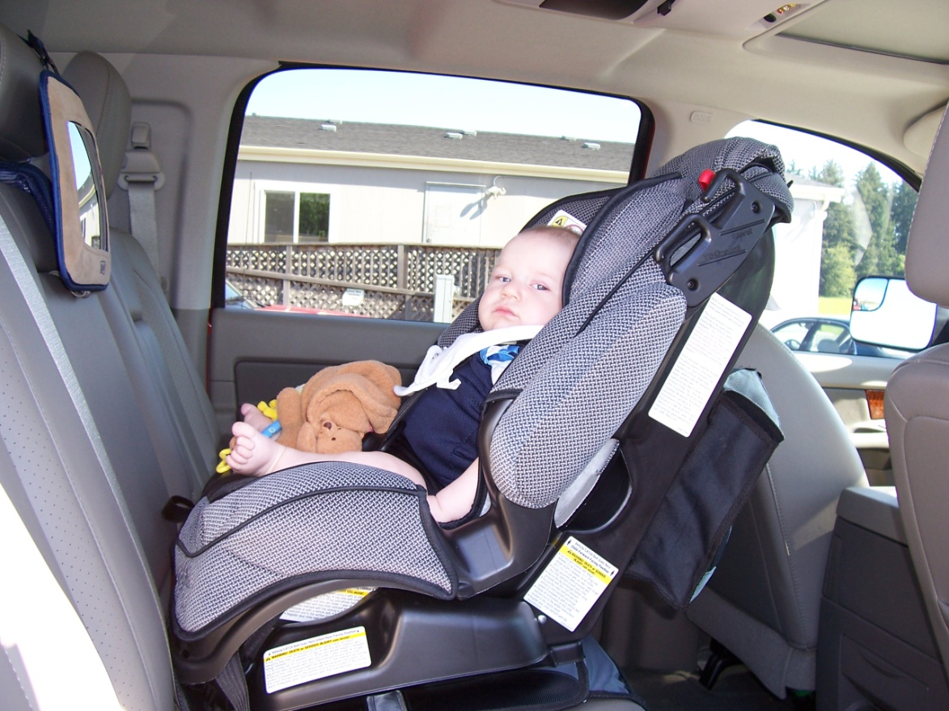
Step 1
Rear-Facing Infant Seats
At minimum: Keep infants rear-facing until 1 year and 20 lbs
Recommended: until 2 years
Notes:
NEVER PLACE IN FRONT OF AN ACTIVE AIRBAG.
A rear-facing Child Safety seat spreads the force of the crash along the entire back, neck, and head.
Most newer convertible seats are approved for rear-facing go up to 30-35 pounds and should be considered for infants whose height or weight have exceeded the limits of the rear-facing infant-only.
When it is properly installed (read your seat instructions):
Safest angle is 45 degrees because the child’s head could fall forward and cut off the their breathing.
The harness straps must come through the slots at or below the child’s shoulders. If the straps are above baby’s shoulders when in the lowest slots, then that car seat is not appropriate for your child.
You should NOT be able to move the seat more than an inch side to side or front to back at the belt path.
The harness clip should be positioned at the child’s armpit. If the clip is too low, there can be damage to internal organs.
Should be snug—should not be able to pinch excess.

Slide 14
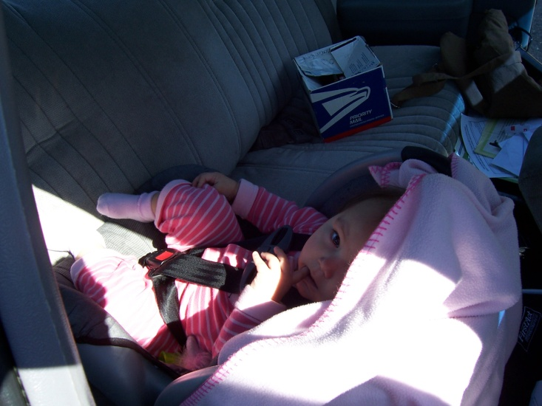
Steps 1 & 2
Rear-Facing /
Forward-Facing Convertibles
Reclined for rear-facing and upright for forward-facing
Notes:
You can switch to a forward-facing seat only if the baby is older than one year or two as currently recommended and also weighs more than 20 lbs.
Don’t use a rear-facing seat with a baby that is heavier than the weight limit OR if the baby’s head is within an inch of the top of the shell.
If child is not one year old, move the baby to a rear-facing convertible seat with a higher rear-facing weight limit.
Another type of restraint for rear-facing are convertible restraints – they “convert” from rear-facing to forward-facing depending on the needs of the child and manufacturer’s recommendations.
Rear-facing – Convertible seats may be used facing rear for infants from birth to 30 lbs. or more. Many are now approved rear-facing up to 30-35 lbs. The rear-facing position is safest, children should ride rear-facing as long as possible.
Under one year and 20 pounds
Use in reclined position (make sure to read the instructions)
Use the harness slots that are at or below the shoulder level
If you use the latches, be sure to buckle the seat belt so child won’t pull seat around their neck.
Forward-facing – Move the foot from the reclined position to an upright position. The weight limit for forward facing goes up to 40 pounds or higher depending on the manufacturer’s specifications.
Must over 1 year old and over 20 pounds to turn them around
Make sure the seat is in the upright position
Harness slots should be in the reinforces slot at or above the shoulders (read the instruction book)

Slide 15
Step 2
Forward-Facing Child Seats
Follow recommendation for specific seat
Notes:
We have already talked about convertible restraints and how to use them rear-facing. We are now going to talk about how to use convertible forward-facing and child restraints that can only be used forward-facing. The American Academy of Pediatrics recommends that children should remain rear facing until the limits of the child restraint are reached or age 2.
Convertibles and Forward-facing child restraints:
The harness must come through the slots at or above your child’s shoulders. The appropriate harness slot for a child can vary by manufacturer
There are some child restraints with harness straps that go over 40 pounds. Read the labels of your seat to check the weight limits.
Should only be used for children who are at least one year old AND who weigh at least 20 lbs.
Forward facing restraints can have a 5-point harness or a tray-shield. Tray shields are not recommended for small children because in a crash it can fly up and hit them in the face

Slide 16
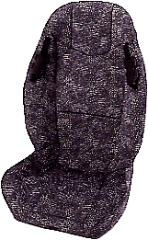
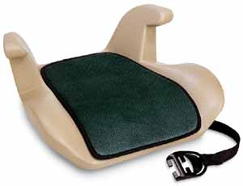
Step 3
Booster Seats
High back booster
Booster seats are for children from 40 to 80/100 pounds
Lap/shoulder belt only
Head restraint
Use shoulder belt positioners
Belt-positioning backless booster
Notes:
Booster seats are for children who outgrow their forward facing child restraint.
They use the seat belt system by raising up the child so that the seatbelt comes across the child’s hips not belly and the shoulders not neck. They have a lower weight limit of 30-40 pounds and an upper limit of 80-100 pounds.
All boosters must be used with a lap and shoulder belt only.
Never allow the child to move the shoulder part of the belt under their arm or behind their back.
High back booster seats must be used if the vehicle seat backs are low or do not provide head restraints. When vehicle seats backs are not low or have head restraints then either a backless or high back booster may be used
Most boosters come with a shoulder belt positioners to adjust the shoulder belt height on the child. Note the child’s ears should not be above the back of the vehicle seat or the top of the head restraint
Some newer boosters have the option to use the tether or lower anchors
When the child is not riding in their booster seat, make sure you buckle up the booster seat so it doesn't become a projectile in a crash.

Slide 17
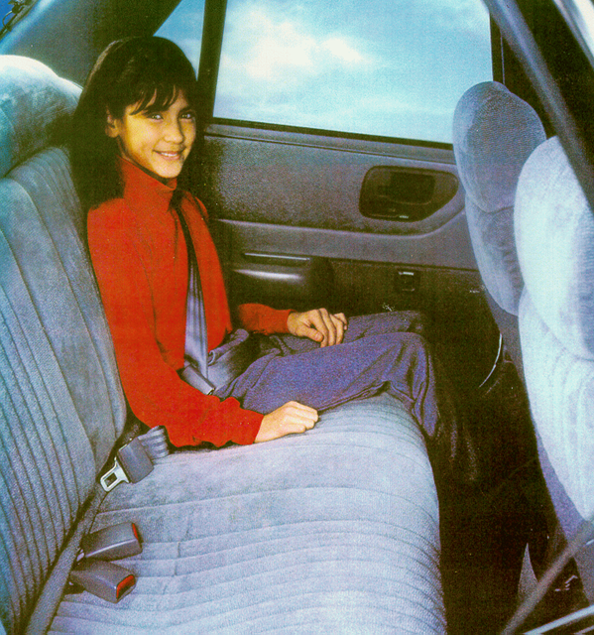
Step 4
Seat Belts
Vehicle seat belts are made for adults and older children 4’9” or taller
Most children reach this height at 8 years old and 80+ pounds
All children under the age of 13 should still sit in the back seat
Notes:
One of the most common questions parents have is “When can my child ride in the car using just the adult seat belt?” Whether parents ask what is the law or what is safest for their child, our answer is always the same: “When the adult seat belt fits properly." That happens when you can answer YES to all five of these questions:
Does the child sit all the way back against the auto seat?
Do the child's knees bend comfortably at the edge of the auto seat?
Does the shoulder belt cross the center of the shoulder and chest?
Does the lap belt fit low and snugly across the hips—touching the tops of the thighs—not up over the abdomen?
Can the child stay seated like this for the whole trip?
If you answered NO to any of these questions, or if your child puts the shoulder portion of the seat belt under their arm or behind their back, your child needs a child restraint, such as a booster seat or high-weight harness seat, until the child can pass the 5-Step Test. Remember, use the 5-Step Test to check belt fit in every vehicle in which your child rides. Source: SafetyBeltSafe U.S.A.
Children, although they meet the height requirements to sit in the vehicle seat belt, they may still not be fully developed enough to withstand the impact of a front passenger air bag. This is why the back seat is safer for children.

Slide 18
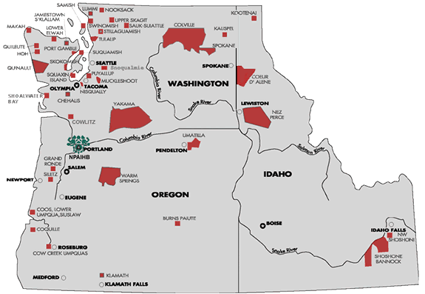
Incorrect Restraint Use
Children using adult seat belt face 3.5 times greater risk for serious injury
51-82% of infant car seats and 30% of booster seats are used incorrectly
incorrect installation
incompatible with child’s height, weight, or age
straps are too loose
Notes:
What’s the right safety seat or restraint to use?
Each type of child restraint has advantages and disadvantages.
Think about them all when you choose or recommend a child restraint:
Choose the one that:
Fits the child (age appropriate, weight and height)?
Fits the vehicle (Does the child restraint work well with the seatbelts or LATCH system?)
Will be used correctly every time (Can all the parents/caregivers install it correctly each and every time?)

Slide 19
Seat Belts & Child Safety Seats
Does your tribe have current laws for on reservation belt/safety seat use, or follow state law?
What do the laws mandate?
What are your impressions of community compliance with state or tribal laws?
Notes:
Tribes are sovereign nations and may enact laws for their own lands
Enforcement depends on tribes’ agreements with local and state authorities

Slide 20
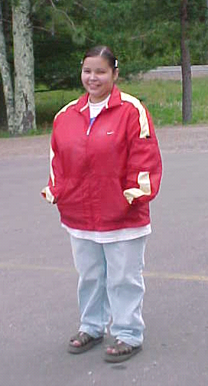
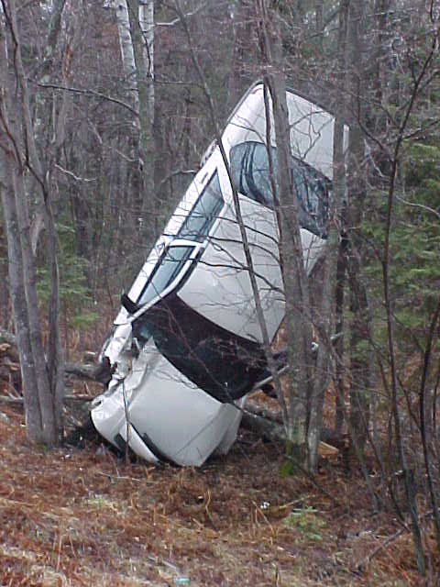
The Message for Native Communities
Wearing a seat belt and keeping children in safety seats is the easiest way to prevent injury or death
It only takes a few seconds – you never know when you may be in a crash
Buckle up for every ride, even short trips
Notes:
This teenage girl from Lac Courte Oreilles Reservation in Wisconsin credits the local tribal occupant protection program in getting her to use her seat belt, which likely saved her life is this violent crash. Her car rolled several times when she tried to avoid a deer. She walked away from this crash, and survived because she was wearing her seatbelt!
Once when I was leaving my son’s house, my pre-school granddaughter, came to the door and yelled “Allah, Buckle Up! I love you!” Last year, she passed my husband a note which said, “Grandpa, Buckle Up, DON’T MAKE me have to tell you again.”
If you decide not to wear a seatbelt you increase the chance that you will injure yourself or others
YOU may be a safe driver BUT You can’t predict other drivers behaviors
There is no good excuse for not being safe and buckling up!

Slide 21
Interventions
Community Education
Enact and enforcement of restraint laws
Educating Head Starts, daycares, schools and health care providers
Encouraging Tribal leaders and elders to spread the message
Notes:
Speakers and activities at community events, videos, posters, information
Enact seat belt/child passenger restraint laws, increase enforcement of laws
Health care providers asking about seat belts and car seat use, reinforce their importance
Tribal leaders and elders spreading the message
Train on proper seat use/installation

Slide 22
Interventions
Car seat distribution programs and checks
Certified Child Passenger Safety (CPS) technicians
Working with car manufacturers and car seat designers on compatibility

Slide 23
Motor Vehicle Safety Resources
NPAIHB IP Program
Luella Azule, IP Coordinator & CPS Technician
lazule@npaihb.org 503-416-3263
National Highway Traffic Safety Administration
www.nhtsa.gov
Washington Safety Restraint Coalition
www.800bucklup.org
Washington State Booster Seat Coalition
www.boosterseat.org

Slide 24
Elder Safety and Falls Prevention

Slide 25
Impact of Elder Falls
In the Northwest, falls are responsible for up to 25% of unintentional injury deaths for American Indians/Alaska Natives aged 55 and over
Source: Centers for Disease Control and Prevention, National Center for Injury Prevention and Control. Web-based Injury Statistics Query and Reporting System (WISQARS) [online]. (1999-2007) [cited Feb 18 2009]. Available from URL: www.cdc.gov/ncipc/wisqars
Notes:
Led only by motor vehicle crash deaths – these are preventable deaths!!

Slide 26
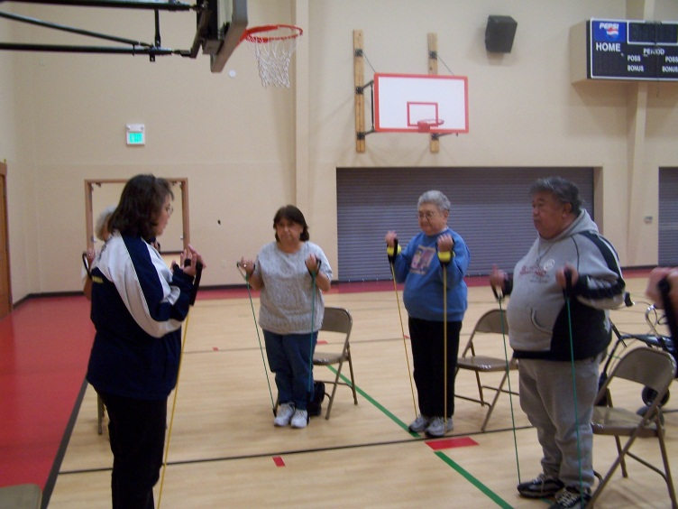
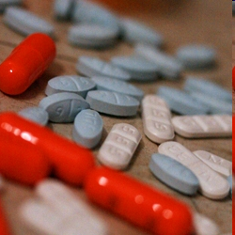
Proven Interventions
Comprehensive check-ups
Medication management
Vision care
Make home safe
Regular exercise for balance & strength
Notes:
Clinical Assessment/Medication
Have a doctor or pharmacist review prescription medications
Some medications, or combinations of medicines, can cause dizziness or drowsiness
Keep a list of all current prescriptions on hand
Vision Care:
Poor vision can increase the chances of a fall. Diabetes can cause poor vision
The wrong glasses, cataracts or glaucoma can limit vision
As we age, our vision may change – need regular checkups
Exercise
Exercise and stretching increase strength and reduce the chances of a fall
Numerous other health benefits to exercise – living longer & feeling better!
Home safety:
Remove rugs, wires, and other trip hazards
Use non-slip mats and grab bars in the bathroom
Improve lighting in both bedroom and hallways
Wear low heels shoes with non-skid soles at all times, inside or outside the home

Slide 27
Elder Falls Resources
NPAIHB IP Website
www.npaihb.org/epicenter/project/ injury_prevention_program
Fall Prevention Center of Excellence (CA) www.stopfalls.org
CDC National Center for Injury Prevention and Control www.cdc.gov/homeandrecreationalsafety/falls

Slide 28
Poisoning Prevention

Slide 29
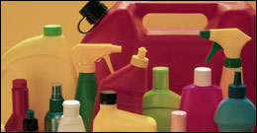
Poisoning Prevention
Household chemicals and poisons
Lead
Carbon monoxide
Medications and drugs
Notes:
29
Pictured above are the first of a couple local coalitions that helped begin an alliance that came together a couple more times to provide a car seat check up event in the community.
What these meetings have done is help build bridges among community folks who formally were not working together, and now they are planning how they can get involved with car seat checks, bike rodeo’s health fairs and also they are discussing the issues of youth and impaired driving.
Sharing resources is the best way to accomplish your Injury prevention goals.
Discussion: What kind of injury prevention efforts are happening in your community? Who is involved?

Slide 30
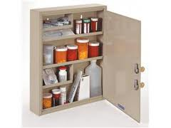
Interventions
Keep cleaning products and chemicals out of children’s reach
Test for lead paint
Install carbon monoxide detectors
Lock up medications

Slide 31
Poisoning Resources
Lock Your Meds
www.lockyourmeds.org
Take Back Your Meds (WA)
www.takebackyourmeds.org
CDC Healthy Homes – Poisoning Prevention
www.cdc.gov/healthyhomes/bytopic/
poisoning.html

Slide 32
Community Injury Prevention

Slide 33
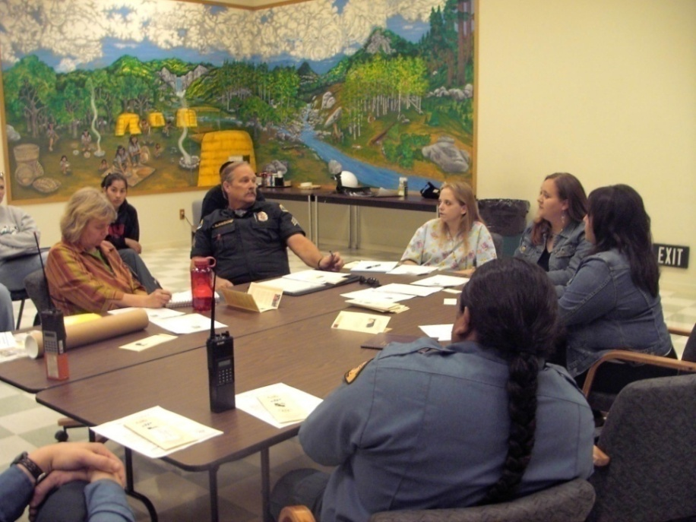
Priorities & Partnerships
What injury prevention efforts are priorities for YOUR tribal communities?
Who is involved, or could be involved?
Needs? Interests? Goals? Resources?
Notes:
33
Pictured above are the first of a couple local coalitions that helped begin an alliance that came together a couple more times to provide a car seat check up event in the community.
What these meetings have done is help build bridges among community folks who formally were not working together, and now they are planning how they can get involved with car seat checks, bike rodeo’s health fairs and also they are discussing the issues of youth and impaired driving.
Sharing resources is the best way to accomplish your Injury prevention goals.
Discussion: What kind of injury prevention efforts are happening in your community? Who is involved?

Slide 34
Public Health Approach
Define the
Problem
-Surveillance
Implement &
Evaluate Programs
-Prevention
Identify
Risk Factors
-Who, What?
Find what Prevents
the Problem
-What Works?
Adapted from National Center for Injury Prevention and Control, CDC
Notes:
Public Health is a processes (mostly directed at the community as a whole and not the occurrences of one individual) involving:
Define the nature and extent of the injury problem in your community through local data surveillance; (Falls, MVC, Suicide,
Identify risk factors--Learn more about the problem, What caused the problem, who is at risk? where, when and other factors that contribute to the problem
What Prevents the Problem: Target a proven or promising intervention strategy to prevent the injury--What Works? Learn about effective strategies in other communities and the literature; Tailor them to your community needs and culture; Pilot project might be required before full blown project.
Implement an effective program and evaluate Uses multiple ways to address injury problems--Figures out the success or failure of prevention activities
Additional benefits: Organizes local groups Combines resources
Review slide and each major element:
Implement & Evaluate: Were you successful in carrying out the activities of your prevention plan? Was the project successful in protecting people from injury? Successful in reducing the occurrence of injury causing events (crashes)? Successful in reducing injury severity or deaths? What lessons were learned? Share those lessons learned with other communities who are dealing with similar injury prevention concerns.
Here is a public health approach with a more circular arrangement. This model takes into account that the public health approach is circular. The process is repeated as the intervention projects develop, as the epidemiology of the problem changes, or as the needs of the community change.
Just as we discussed before, the public health approach to injury means defining the specific injury problem, identifying the specific factors involved in the problem, identifying solutions to the problem, and then implementing AND evaluating the preventive measures that reduce the problem.
It’s very important to include the evaluation of the prevention measures, in order to verify the success or failure of the preventive measures in reducing the injury problem.

Slide 35
Assess the Need in Your Community
Who is being injured? Where? Circumstances?
How? How many? How serious?
What time period? Increasing or decreasing in frequency?
Which of these injuries is most significant in terms of:
personal impact
economic costs
social consequences 
Notes:
The first step in developing a program to prevent injuries is to conduct an assessment of the need in your community for such a program. This can be anything from an informal review of the major sources and impacts of injuries, to a formal study that gathers hard data on the injury problem. One of the major challenges of injury prevention work in Indian Country is the relative lack of available data to fully describe the problem and its impact on American Indian/Alaska Native communities. If there is no data, then usually there is no funding.
Answering the following questions will help you start to understand the problem of accidental or unintentional injuries in your community, and think about what actions could be taken to start reducing the problem. See slide.
what are the circumstances under which these injuries occur?

Slide 36
Assess the Need in Your Community
Local injury rates: higher/lower than national/state rates? How does it compare to other health problems?
Community issues (cultural, attitudes, beliefs, behaviors) contributing to injuries?
How to decreasing injuries? Proven/effective strategies?
Community strengths (cultural, attitudes, beliefs, behaviors) to reduce injuries?
What’s needed to evaluate an intervention?
Notes:
Are local injury rates higher or lower than the national or state rate? How does it compare to other health problems?
What community issues (cultural, attitudes, beliefs, behaviors) could be contributing to injuries?
What is involved in decreasing injuries? Are there strategies other communities have used that have proven effective or promising?
What community strengths (cultural, attitudes, beliefs, behaviors) could help reduce injuries?
What information will be needed to evaluate an intervention?

Slide 37
Injury Prevention Resources
NPAIHB Injury Prevention Program www.npaihb.org/epicenter/project/ injury_prevention_program
CDC National Center for Injury Prevention and Control (NCIPC) www.cdc.gov/injury

Slide 38
Injury Prevention Contacts
Luella Azule (Yakama Nation/Umatilla)
Injury Prevention Coordinator
503-416-3263
lazule@npaihb.org
Bridget Canniff
Project Director, Injury Prevention Program
503-416-3302
bcanniff@npaihb.org

Slide 39
Questions?
Thank you!

