Slide 1
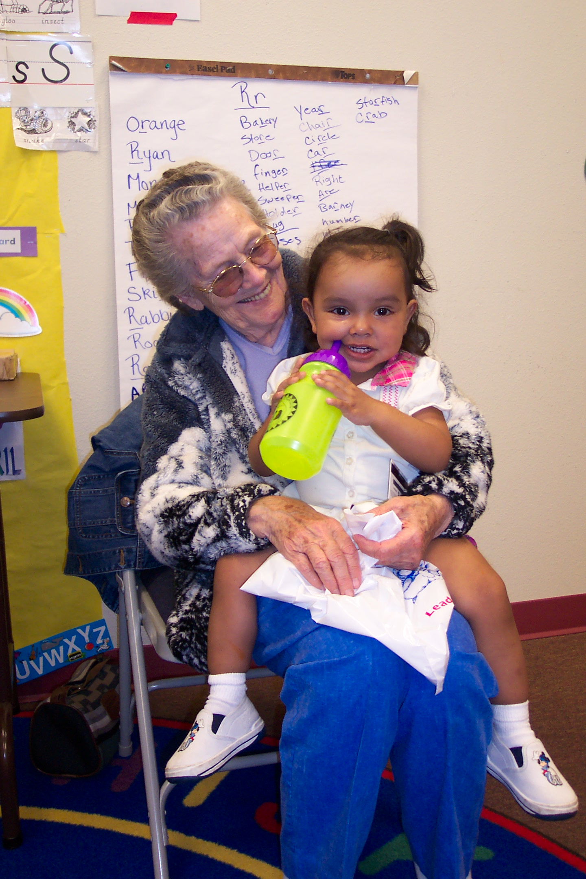
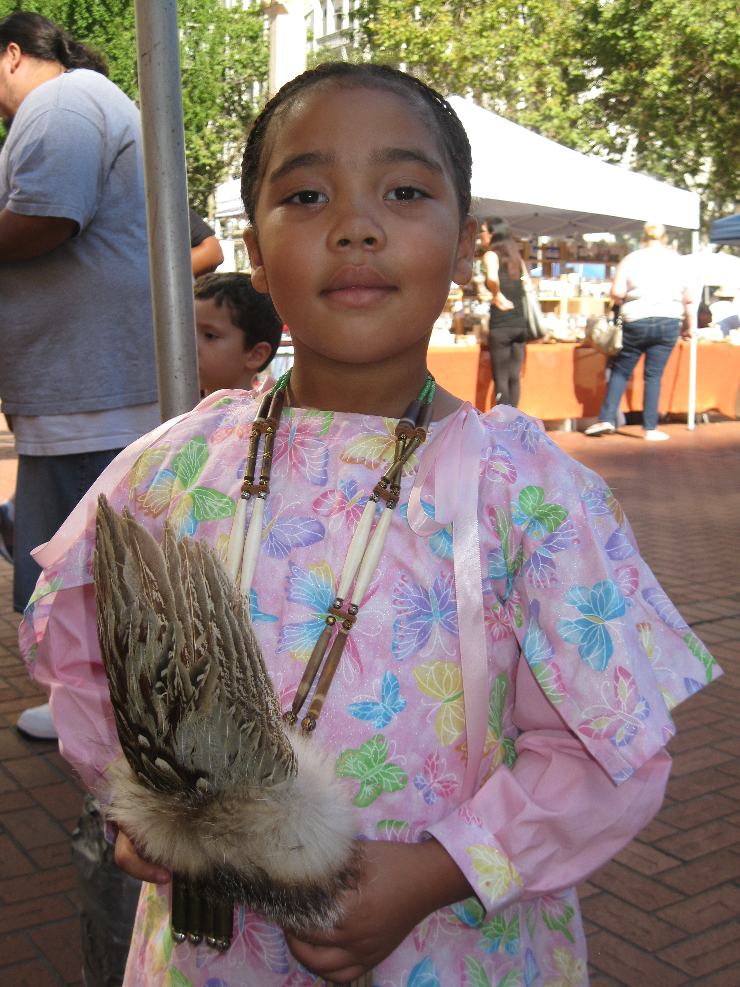
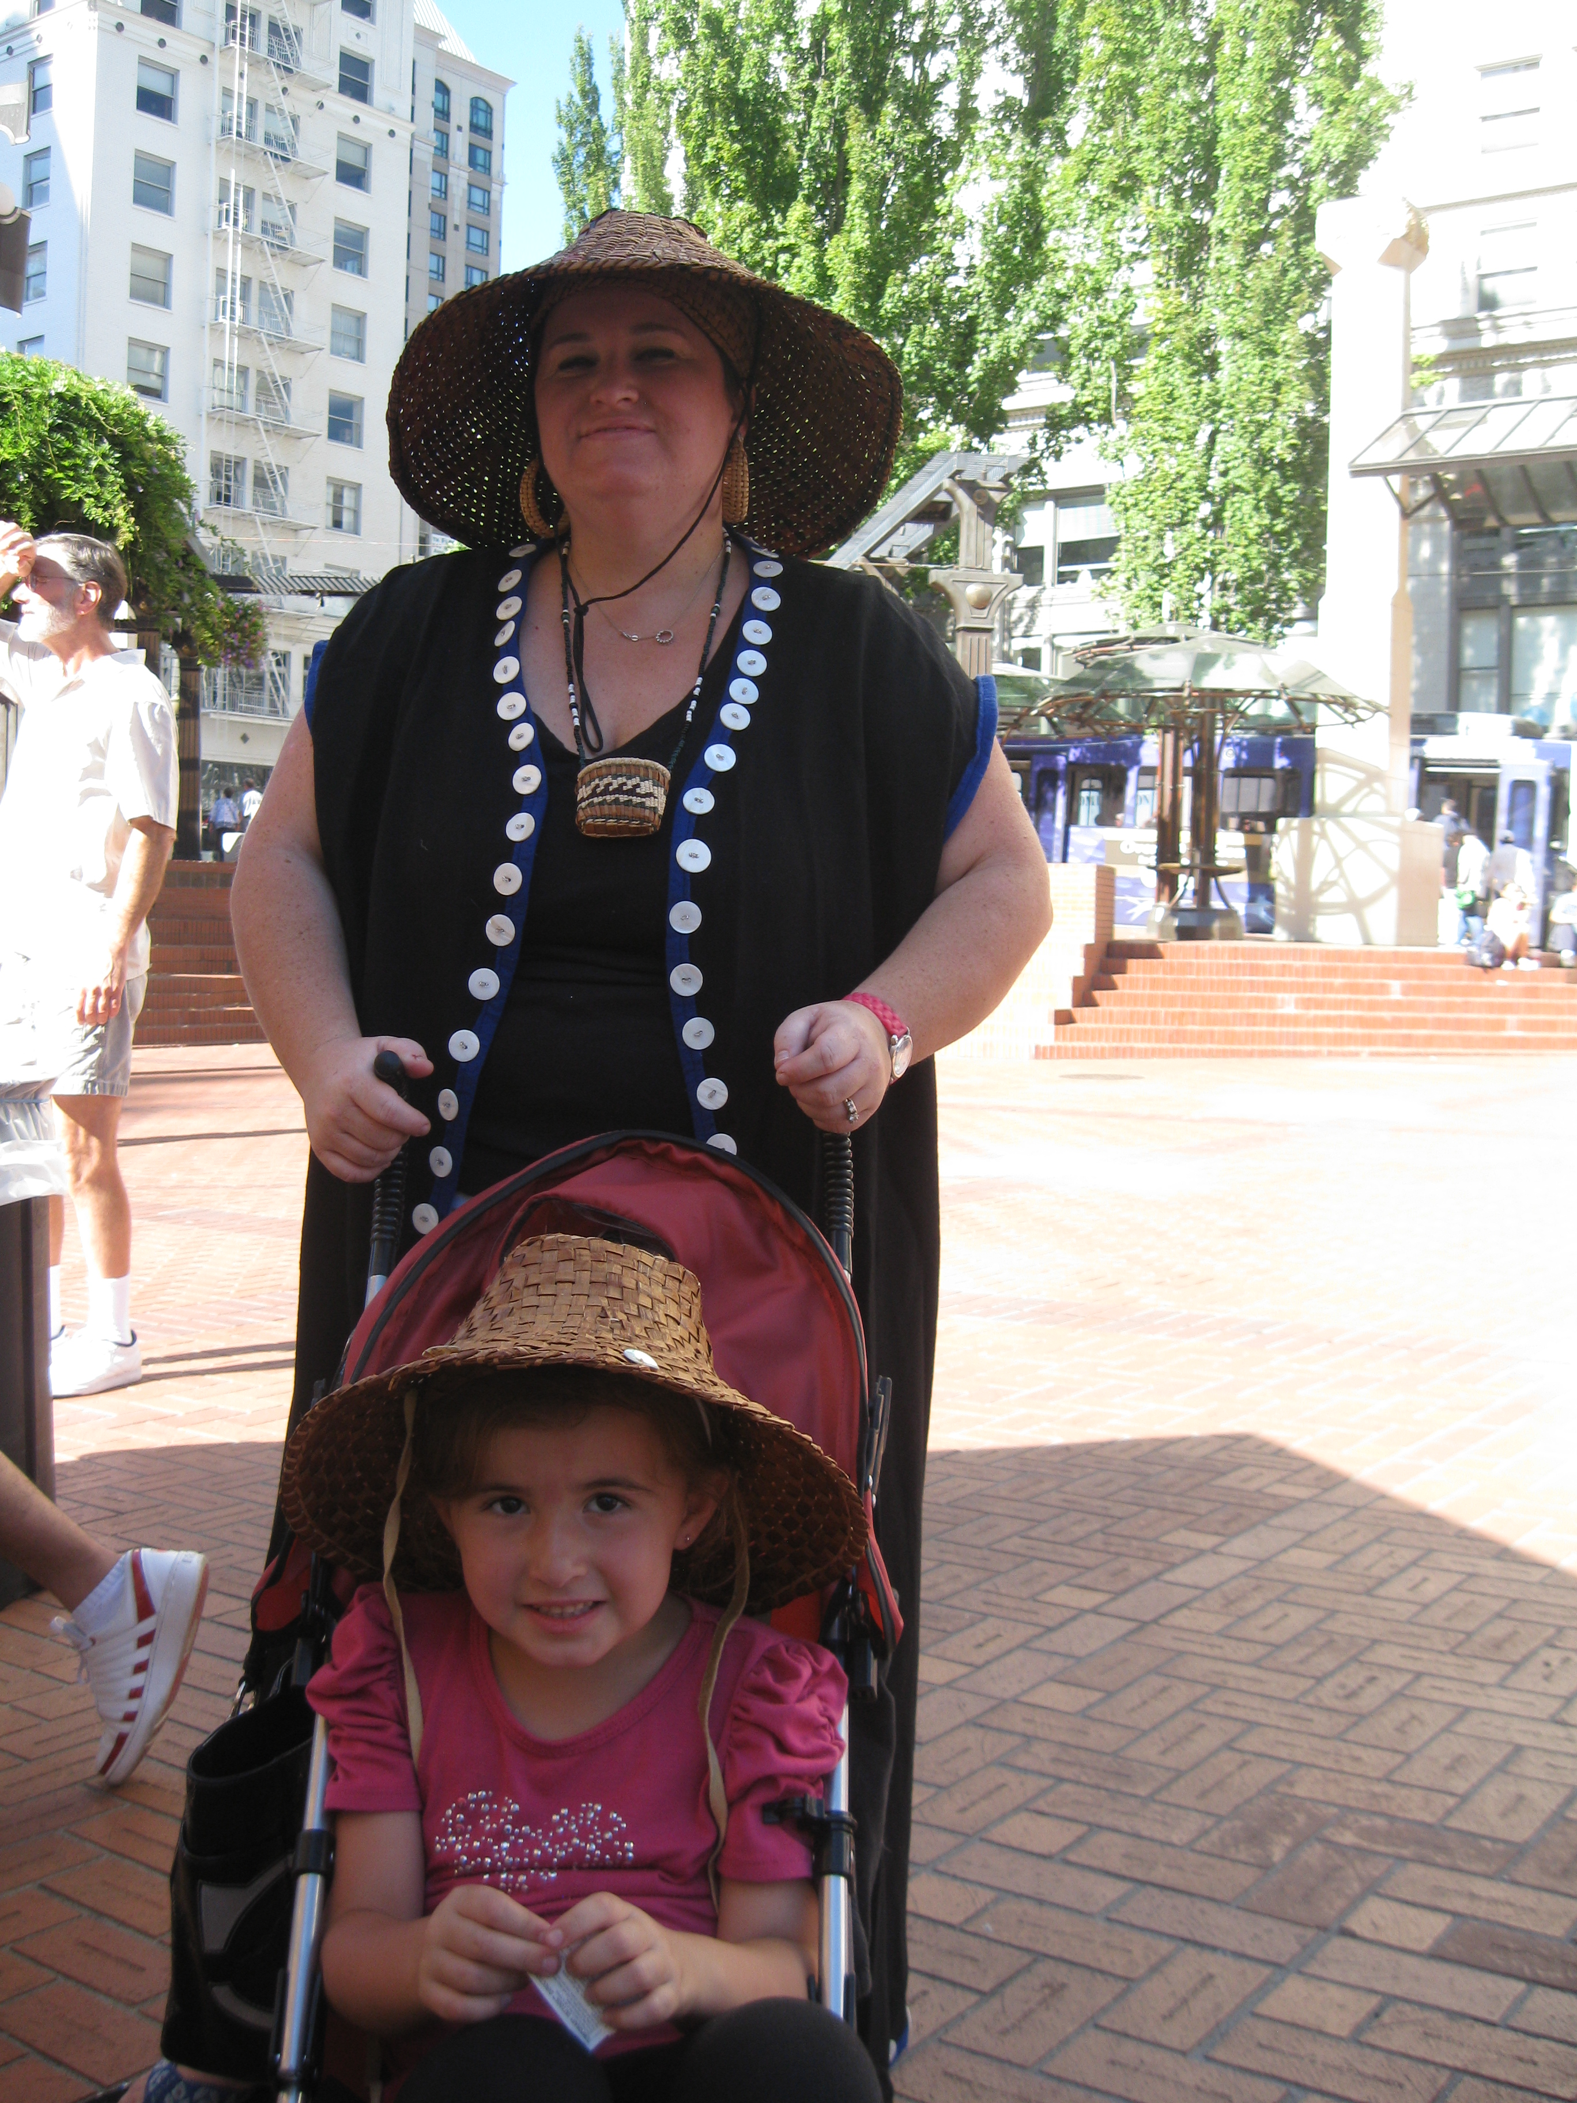
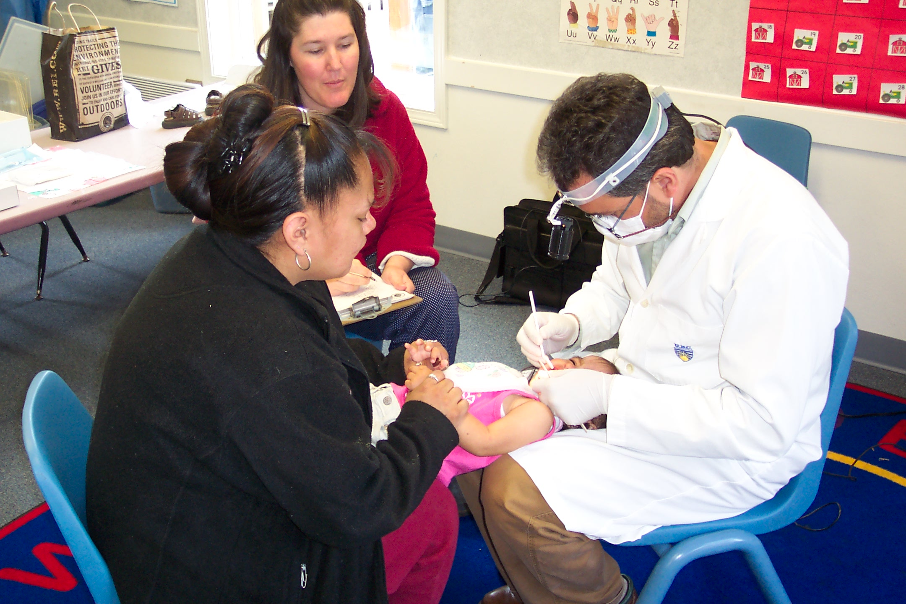
Maternal and Child Health Guiding Framework for the Northwest Portland Area Indian Health Board
A SUMMARY OF QUALITATIVE DATA COLLECTED BY NPAIHB

Slide 2
Overview
MCH Core inquiry
Process
Share Key themes
Discussion
Application to Framework and Strategic Plan
Discussion
Notes:
Elicit Feedback from Delegates: Does any of this surprise you? Are things that we have missed?
If you don’t get your comments in we will have a table set up on Wednesday

Slide 3
A start
We wanted to understand Maternal Child Health (MCH) efforts provided to NW Tribes both internally and externally
We wanted to elicit MCH priorities for NW Tribes
We wanted to understand how MCH fits into the NPAIHB overall strategic plan
We wanted to elicit Tribal input in the direction of how we should approach improving MCH.
Before developing a guiding frameworks or specific statement relating to MCH and the NPAIHB’s mission or and goals, the MCH Core decided to employ a student intern to conduct interviews of those who work in MCH and serve Tribal people.

Slide 4
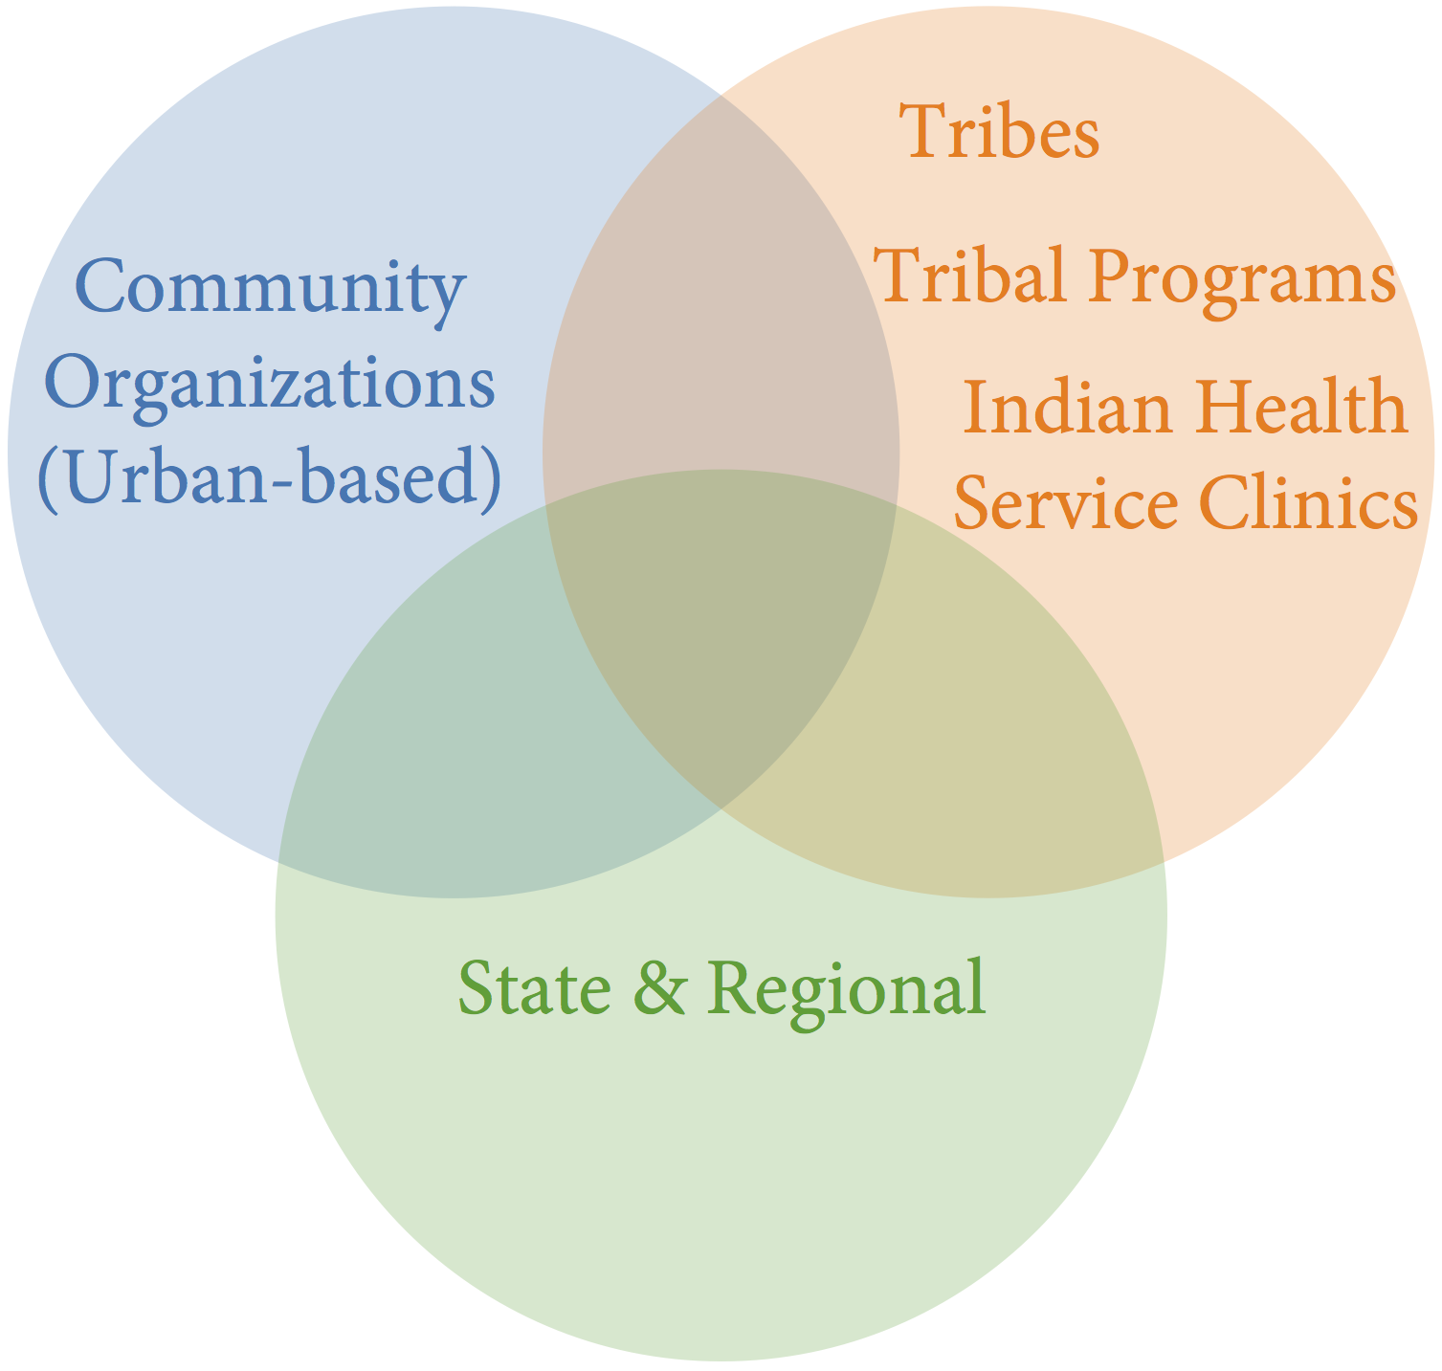
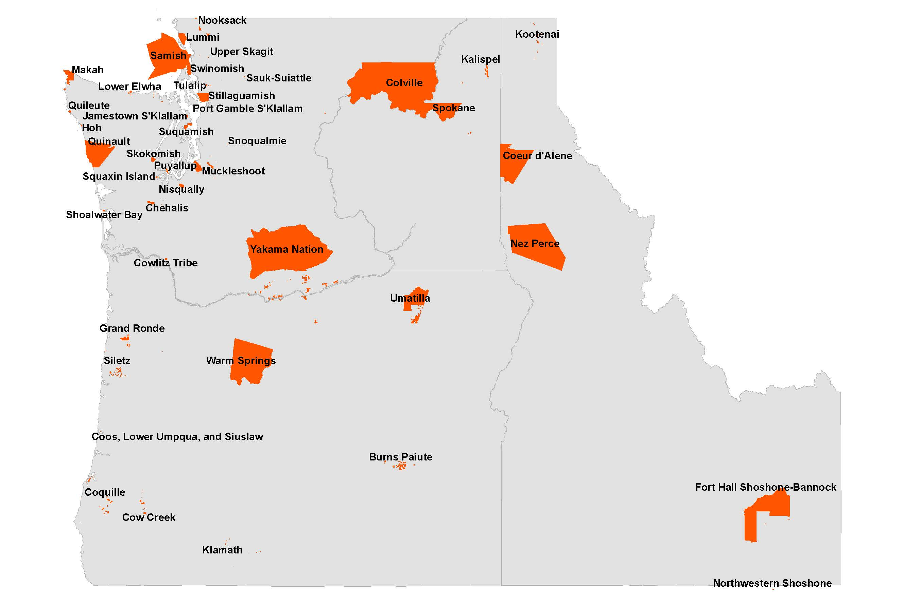

Slide 5
Purpose of the MCH Inquiry
Identify priority areas in MCH for NPAIHB Tribal Epidemiology Center
Not comprehensive
Identifies key MCH issues and NPAIHB internal capacity
Create road map for NPAIHB MCH efforts
Link to NPAIHB Strategic Plan

Slide 6
PROCESS

Slide 7
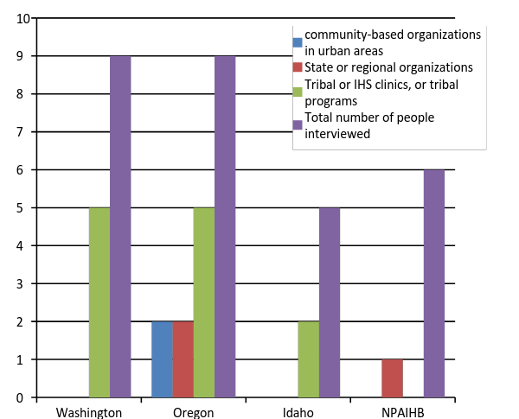
Who did we speak with?
Conversational, open-ended interviews
MCH definition, priorities, supporting wellness
23 interviews, 29 participants
17 organizations: NPAIHB, clinics (IHS, Tribal), tribal health and human services, community-based organizations in urban areas, state/regional level organizations
Feedback from a tribal clinic and the Native American Rehabilitation Association of the Northwest
Notes:
Again, not comprehensive, but representative.
23 interviews conducted
Conversational, open-ended
17 organizations
By State, except NPAIHB
Purple, Blue, Red, Green

Slide 8
Questions
Tribal Leaders
Background
Population you serve
What makes for healthy…
What supports growth
Outside Influence
What you would do
Resource available
Challenges
Key issues
Board Members
Background
MCH definition
What make healthy…
What does good health look like
Strengths/assets
Challenges
Important Issues
Available Resources
Urban Organizations
Background
MCH Definition
Population you serve
Priority Issues for NW
Suggested Indicators to Measure Progress
Key Issues
Notes:
Different Questions – similar concepts

Slide 9
FINDINGS
Notes:
For each finding I will have just have enough time to provide “why we pursued that topic” , “an example of quotation from the interviews” and a “summary of what the meant to us”
We won’t have time to go over every quotation but they can found in the DRAFT of the framework.
I’ll try to get through some keys finding, not all but what I do in 15 minute
We hope to have at least 5 minutes for discussion so we can include your input into framework from you today.
SET UP
QUOTATION
COMMENT

Slide 10
What is MCH?
“The beginning [of MCH] is difficult because some things are important for a healthy pregnancy, before you are planning to become pregnant. I see the separation between adolescent health because that is such a huge beast of its own. I would say [MCH] goes up to maybe age 12, but the cutoff is not firm, or as important”
“I would like to see no age restraint on MCH—a child is a child until age 18; [I see it as] more of a continuum of support for whole wellness (beyond just clinical care) throughout life”
“We should be able to define what [MCH] means to us firstly; but…programs have specific funding for specific populations. We are reactive in that sense. We work in the areas that are funded”
“There are multiple generations involved in support; and the community and systems impact the mother and child. There are circles of involvement”
Notes:
Circles of involvement

Slide 11
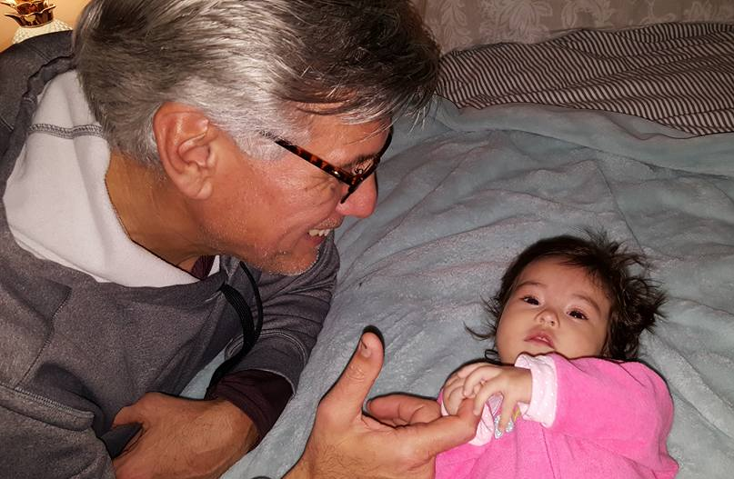
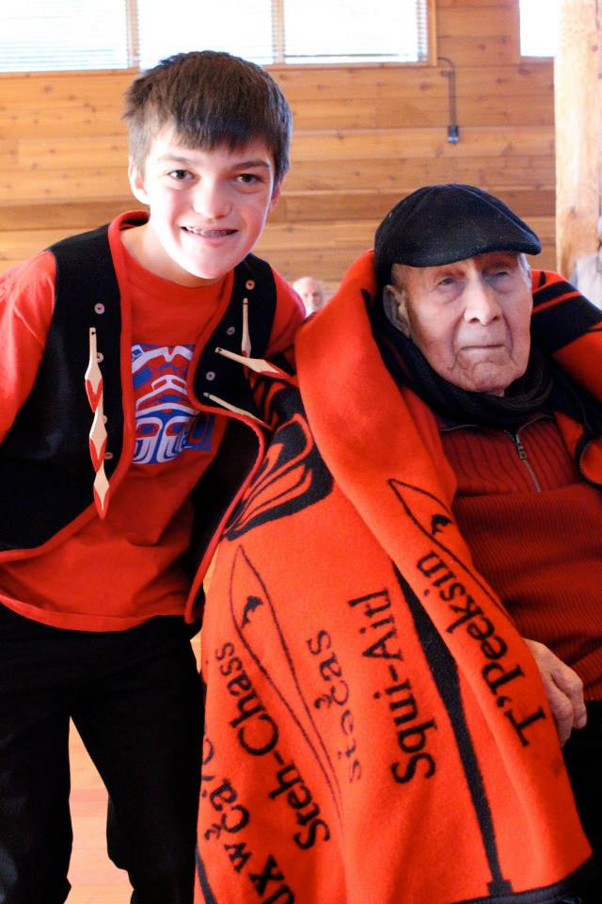
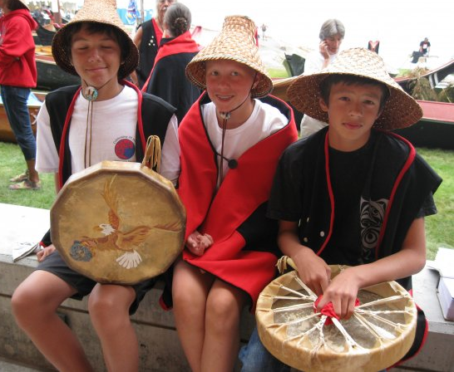
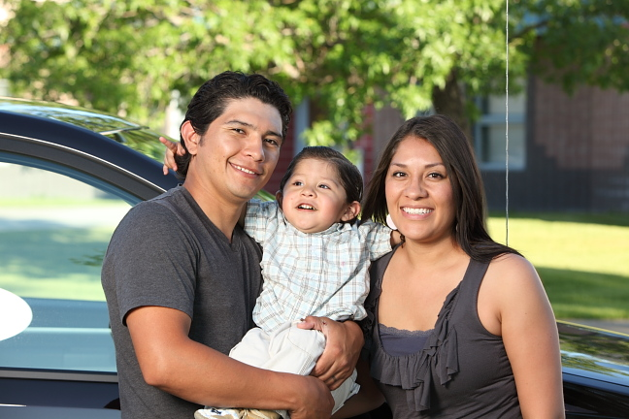
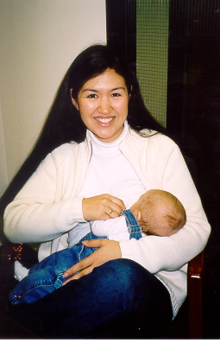
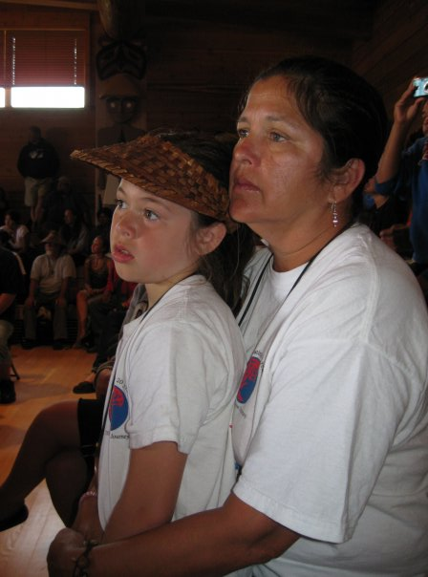
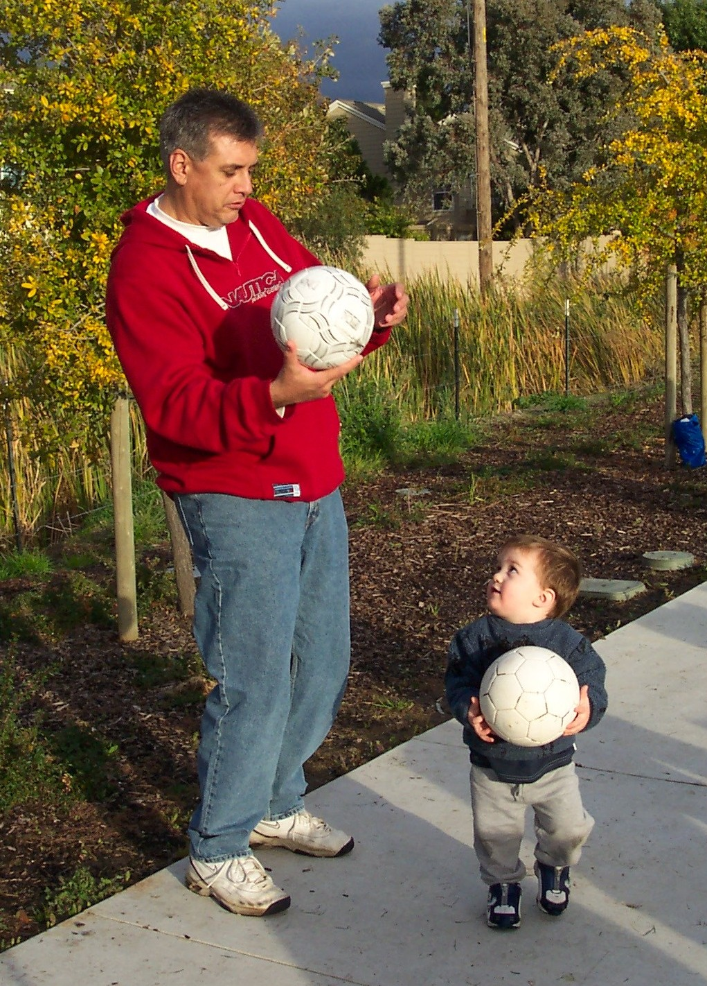
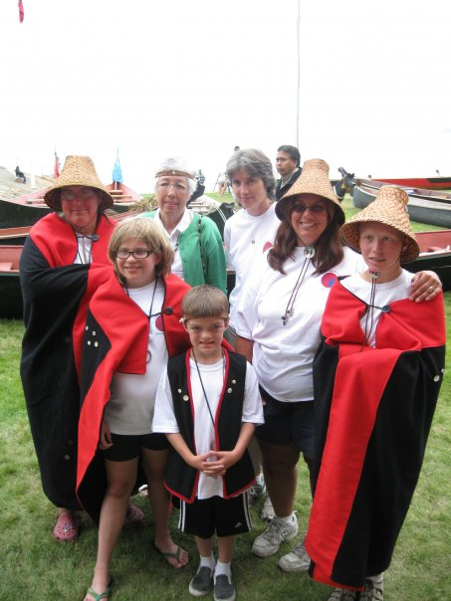
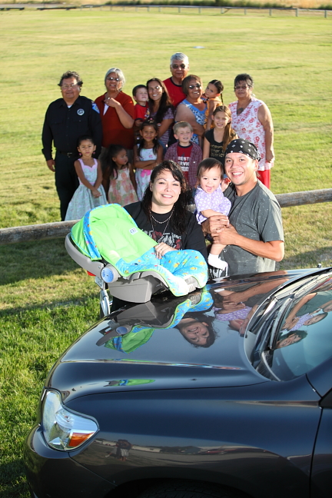
What is MCH?
Mothers and children at the core
Fathers, elders, communities play a role
Distinct challenges at different ages and stages of life, but fluidity and overlap between stages
Focus areas (often in response to funding priorities) but whole picture view is necessary

Slide 12
Common MCH Topics
Frequently Mentioned MCH Topics
Social and Community Support
Substance (Tobacco, Alcohol, Drug) Abuse
Education
Connection to Culture
Child/Youth Development/Aging
Nutrition
Mental Health (Overall)
Breastfeeding
Oral Health
Sexual Health and Family Planning
Prenatal care
Historical Trauma and Stressful Life Events
Housing
Car seats/Car Safety
Transportation
Income
Immunizations and Well Child Visits
Violence
Access to Healthcare
Sleep
Geographic Location
Notes:
Frequent topics
Social Support, Education, substance abuse, connection to culture-will go through the top and can answer some questions about the others; what’s interesting here is that these are not typically revealed through quantitative data participants mentioned

Slide 13
Support

Slide 14
Support: Quotes
Focus on Specific Groups:
“There is a tendency for us to focus more on women…Indian mothers pass along cultural and traditional teachings to women and have high expectations…We sometimes tend to let men slide. We don’t hold young men to the responsibility of being community leaders and fathers…In some ways we have let our men down”
Culturally Relevant Support:
“[We need] support systems for parents. [We] need support that is delivered in a culturally and socially appropriate way, respectful and non-judgmental. [We need to] serve people with open minds and open hearts”

Slide 15
Support: Topics
Childcare
Home visiting
Delivered in an integrated way
Gatherings or support groups
Culturally relevant
In collaboration with medical providers (prenatal care, pediatricians)
Breastfeeding support
Especially for young moms
Need for reaching specific groups
Fathers, young mothers, connection between elders and younger generations

Slide 16
Education

Slide 17
Education: Quotes
“In the US there is not always support for parents, and that can be isolating. Many Native people are still reeling from a time when kids were taken away from parents and put in boarding schools. There was a break in parenting and it comes up today and is traumatic. People feel they do not know how to parent; so encouraging traditional ways in parenting is very important. There is a lot of focus on pregnancy and delivery, but less focus on parenting”
“The hospitals have training for parents and support groups, but something more local or regional and culturally relevant would be better. Parents may want to have support groups with people they have grown up with, and have something more meaningful and relevant to them”

Slide 18
Education: Topics
Education for parents that is culturally relevant and tribally specific
Understanding childhood and adolescent milestones
Education for mothers and fathers
Notes:
8 of 19 interviews mentioning education discussed the need for parental education.
There was a desire to have parenting classes and education that was culturally relevant, and tribally specific
Participants wanted education to focus on developmental milestones in early childhood, and adolescent development.
Participants wanted to promote understanding of milestones in the Western sense, and some specifically mentioned the importance of supporting traditional coming of age ceremonies, and educating mothers and fathers about cultural beliefs around pregnancy and parenting.
Two mentioned challenges with media, social media, and cyber bullying. They mentioned the importance of open communication between parents and children about what was happening online.
Health fairs and community events were described as strengths by several participants, but one felt that you often see the same people at these events. A suggestion for reaching new people was to have a community member share success stories, or explain a personal story to demonstrate why preventive screenings, for example, are important.

Slide 19
Mental Health and Substance Use

Slide 20
Mental Health & Substance Abuse: Quotes
“Many problems in pregnancy, birth, and development are related to addiction. The health of the baby is connected to the health of the mother and the community. Trauma, stress, and depression are passed in utero, and trauma is ongoing, not just historical. Early intervention at the start of pregnancy and before pregnancy, and intervention after birth is critical”
“The timing of this conversation is crucial considering challenges with drug abuse in Indian Country, and the many disparities faced. Children [are] facing struggles with meth, suicide, bullying, gangs, and drugs. Moms and dads don’t know how to cope with these challenges. MCH is a way to make a difference”
Notes:
Mental health often goes hand in hand with substance abuse; talk about transfer across generations—something FGC is well aware of, and addressing root causes
4 interviews mentioned mental health and wellness for families, and 4 talked about motherhood and supporting mothers dealing with isolation or postpartum depression.
Behavioral health programs were strong in many areas, and included grief and loss counseling, family therapy, and clinically licensed social workers who were tribal members.
4 interviews focused on addressing trauma, as well as grief and loss. 3 interviews talked about a need for more opportunities for healing

Slide 21
Mental Health & Substance Abuse: Topics
Mental Health:
Mental health for families
Postpartum depression
Strong behavioral health programs
Trauma, grief, and loss and a need for opportunities for healing
Connection between reproductive health and mental health
Substance abuse:
Drugs (general)
Alcohol
Other
FASD
Tobacco
Addiction Support

Slide 22
Connection to Culture & Holistic Health

Slide 23
Holistic Health: Quotes
“[I would like a] facility or wing with a full healthcare team, including a nurse, dietician, primary care provider. A comprehensive wellness and care team for mothers and their partners, and for children. It would offer the full spectrum of care: nutrition, fitness, healthy eating, parenting, healthy relationships, housing, case management. It would be a one-stop-shop for everyone”
“People don’t come in pieces”
Notes:
Along with culture, holistic health was an emphasis.
12 interviewees mentioned promoting holistic health (e.g. mind, body, spirit), and 5 talked about prevention and an “upstream approach”
4 specifically envisioned a center, or a wing of a clinic/hospital, for mothers to access holistic health information and health care. Ideas for the center included incorporating exercise and birth classes, information on cultural, traditional, and spiritual teachings, comprehensive care teams, and hospital admitting privileges so doctors from the center could participate in delivery.

Slide 24
Holistic Health: Topics
Upstream approaches to disease prevention
Incorporation holistic health information and holistic health care to clinical settings
For example:
Clinics incorporating exercise and birth classes
Information on cultural, traditional, and spiritual teachings

Slide 25
Culture: Quotes
“Culture is Prevention”
Notes:
Discussion focused on “culture” not as a catch-all term that is the same for every person or every tribe, but talking about it’s importance in identity formation, in development of a child, and having something positive to connect with; feeling like culture is lost through the generations, and the need to integrate it; However, also discussed that people are finding and practicing culture in different ways; A common solution expressed and showcased in different ways was to make cultural teachings more accessible and available through the tribal system. And the systems should be structured in a way that is supportive of traditional culture as opposed to Western ways (for example in one tribe, there was a desire to make the justice system more restorative instead of punitive)
Connection to culture was mentioned in 78% of interviews (18/23). 4 interviews discussed successful language programs, including language programs integrated into Early Learning and Head Start. 4 also mentioned the importance of spirituality and supporting a strong spiritual foundation. 3 mentioned the importance of having traditional healers and medicine available.
Hunting and gathering and learning about traditional foods was a common theme. 5 interviews discussed traditional foods, and some mentioned successful programs to integrate traditional foods into nutritious diets.
qhest Life is funded by a CDC REACH grant and supports wellness, including physical activity and nutrition, through the traditional beliefs and ways of the Coeur d’Alene Tribe. (Click image below).
Overall, many participants suggested that engaging with traditional practices should be an option that is supported, and available for people to choose.
Many also described that connecting to culture, or incorporating cultural practices into health is not a “one-size-fits all” approach. There is a need for tribally specific information and approaches.
Some emphasized the importance of restructuring systems, such as the justice system and medical system, to make them more culturally relevant and less focused on Western ideals (e.g. making the justice system less punitive and more supportive of healing).
One participant described that discussions with traditional healers in their area revealed that healers did not necessarily want to be supported through hospital or clinic funding. However, the participant stressed that resources, like brochures, could be used to educate people about traditional practices, and direct them that way if they decided to take that path.

Slide 26
Culture: Topics
Not a “one size fits all” approach
Making traditional practices an accessible option by supporting culture through health and social systems and education
Traditional foods, language programs, spirituality, traditional medicine and healing

Slide 27
Data Collection

Slide 28
COMMON DATA COLLECTION ISSUES AND SUGGESTIONS
Suggestions
Collecting local, tribal-specific baseline data for comparison across tribes or between communities within a reservation.
Building community-level metrics, looking at connectedness and wellness.
Measuring attendance at well-child, prenatal, and dental appointments
Issue: Statistical Significance
“There is also this idea of ‘statistical significance’ and populations with small sample sizes do not get reported because they are not ‘significant’. [This] leads to exclusion of populations and ‘statistical significance’ drives funding”
Notes:
5 emphasized collecting local, tribal-specific baseline data, and some suggested data that could be compared across tribes or between communities within a reservation.
5 suggested building community-level metrics, looking at connectedness and wellness.
4 suggested that measuring attendance at well-child, prenatal, and dental appointments as a good indicator of overall health.

Slide 29
Suggestions & Next Steps for NPAIHB

Slide 30
Suggestions
Information sharing
Advocacy
Partnerships and creative thinking
Regular needs assessment including community members
Notes:
3 of 4 tribal organizations wanted opportunities for information sharing with other Northwest tribes.
There was a suggestion to extend the Board’s MCH workgroup to include tribal MCH program representatives in Oregon, Washington, and Idaho. Participants also suggested publishing the MCH Guiding Framework online.
One participant wanted updates on IHS protocol related to MCH. Another suggested providing technical assistance and the opportunity to connect with other Northwest tribes for support and guidance in implementing successful MCH programs
Participants emphasized the frustration of working in a grant-funded environment, where funds are targeted toward specific issues, making it difficult to take a holistic view.
7 specifically discussed political will and the importance of advocacy.
One participant explained that mothers facing poverty and competing priorities, often don’t have the time to participate in the political system, and their voices are not heard.
Another explained the challenges of working in Western-dominated systems, but suggested it is possible, with creative thinking, to simultaneously work within and challenge these structures. (See OHA right)
There were two recommendations for formal partnerships, across organizations, and locations (state, urban, and tribal) to promote creative thinking and MCH advocacy
4 discussed evaluating community needs. 2 NPAHIB staff suggested regular assessment of community priorities and feedback to inform programs. 3 tribal organizations suggested including elders, patients, and community members in the decision-making about MCH priority issues, programs, and important indicators.

Slide 31
SPECIFIC DATA COLLECTION ISSUES AND SUGGESTIONS
CLINICS
Care coordination and tracking of attendance at appointments
Better follow up after delivery
Lost data on patients when mothers referred out for OB care, or when children attending private pediatric appointments
Lack of data sharing between systems
NPAIHB
Indicators to measure connection to culture or tradition
Qualitative data and story telling
Data linkage across sectors
Creating shared metrics
COMMUNITY
Indicators to measure connection to culture or tradition
Qualitative data and story telling
Data linkage across sectors
Creating shared metrics

Slide 32
Discussion
Do these themes resonate in the community(s) you serve?
Is there anything about these topics that surprises you?
Are topics we haven’t heard that you think are important?
Are there other questions you think we should ask?

Slide 33
Next Steps
Facilitating opportunities for information sharing:
Developed and publishing MCH Guiding Framework online
Developing our Vision, Mission Statement, and Goals that blend with the NPAIHB Strategic Plan
Determining How Board Delegates would like to be engaged in the process
Deciding how NPAIHB and other organizations should collaborate moving forward

Slide 34
Acknowledgements
Respondents
HRSA Maternal Child Health Board Graduate Student Epidemiology Program
Alyssa Bosold

Slide 35
Project Contact
Tam Lutz Monika Damron
tlutz@npaihb.org mdamron @npaihb.org

