Slide 1
Tribal Endocrinology teleECHO Clinic Pilot 2018
Presented by
Nanette Star, MPH (Project Director WEAVE-NW NPAIHB)
Kathi Murray MS, RDN, CDE (Portland Area IHS Diabetes Consultant)

Slide 2
Tribal Endo ECHO Project
ECHO is…
Extension for Community Healthcare Outcomes
Purpose
Improve quality of clinical services
Enhance community-clinical relationships
Increase experts in the field
Adopt cultural practices
Notes:
Through the use of video conferencing, education, and research,

Slide 3
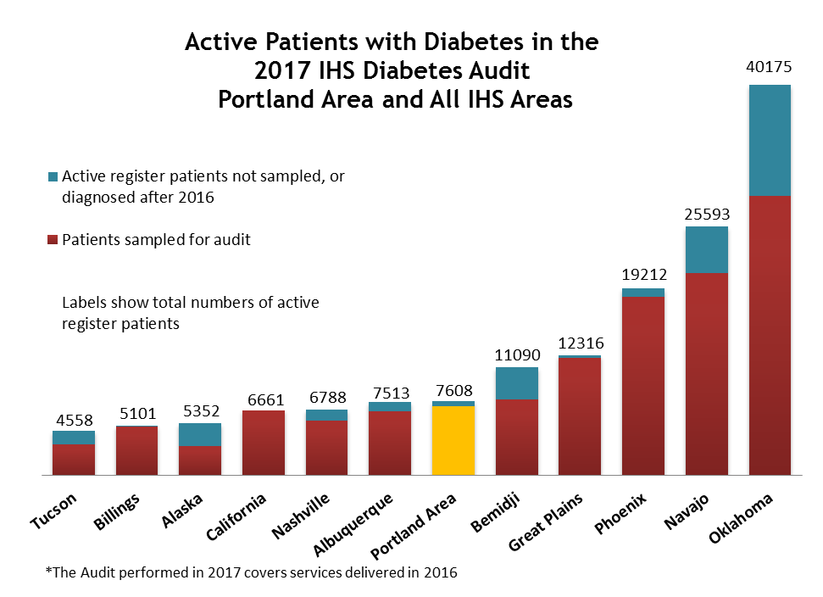
*Graphs generated by NPAIHB - Western Tribal Diabetes Project.

Slide 4
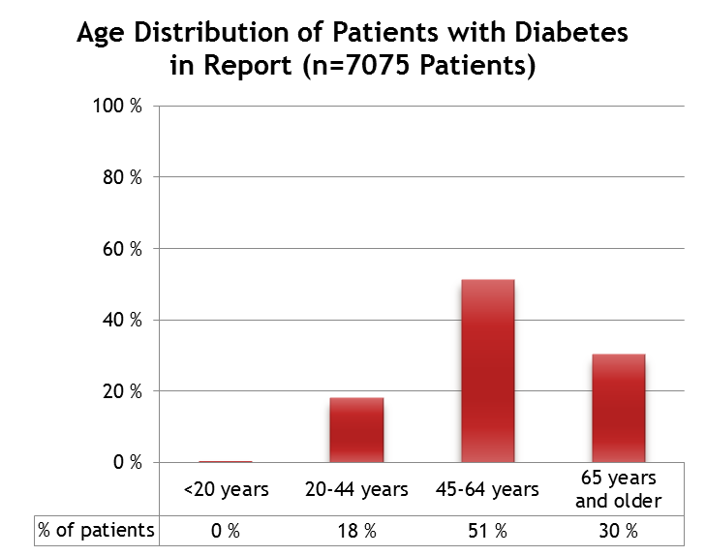
* Number of patients in 2017 diabetes audit report
Notes:
Middle-aged and older adults are still at the highest risk for developing type 2 diabetes.
Average age of onset for type 2 diabetes
Many people with diabetes do not know they have it, making regular screening tests important for those at risk.
The American Diabetes Association (ADA) recommend annual diabetes screening tests after the age of 45. But the age at which someone develops the condition depends on too many differing factors to accurately predict.
A wide mix of individual health and lifestyle factors can influence the progression of the condition. Many people have diabetes for years before being diagnosed, causing a large variation between the age of onset and age of diagnosis.
Meanwhile, some estimates claim that nearly one-third of those with diabetes do not know they have it, which further complicates estimates.

Slide 5
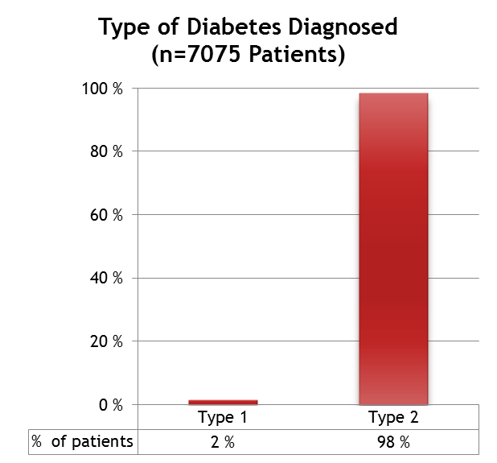
Notes:
In general, people with diabetes either have a total lack of insulin – Type 1 diabetes or they have too little insulin or cannot use insulin effectively - Type 2 diabetes.

Slide 6
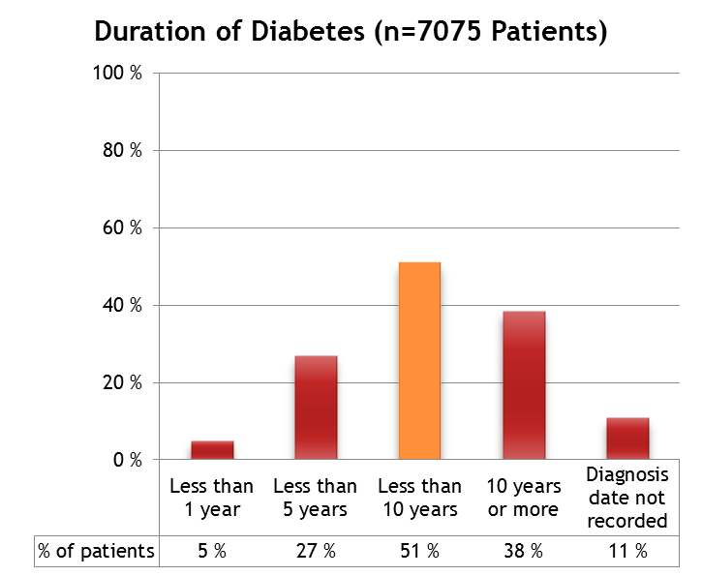
Portland Area
Notes:
Diabetes can be effectively treated. The goal of glucose management is to reduce long-term complications of diabetes.
There is strong evidence for the benefits of tight glucose control early in the course of diabetes. While intensive glycemic control in newly diagnosed patients is beneficial, tight control in the general diabetes population has not demonstrated the same benefits.
It is important to achieve individualized glucose targets and to avoid poor glycemic control.
Two primary measures are available for health providers and patients to assess the effectiveness of glycemic control: A1C and patient self-monitoring of blood glucose (SMBG).

Slide 7
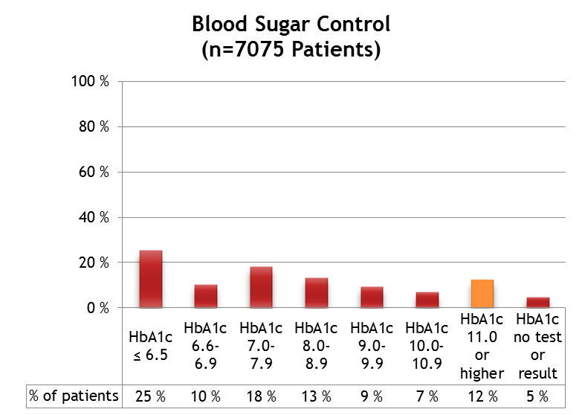
Notes:
Recommendations for Glycemic Control:
Perform A1C testing every 3 to 6 months in "stable" patients to monitor progress toward clinical targets and facilitate therapeutic decision-making:
A1C testing may be repeated as soon as 1 month later to assess response to initiation or a change in therapy.
A1C Testing: A1C is a measure of glycemic control over the preceding 120 days. The more recent days contribute a greater percentage to the measure than the distant days. Specifically, the mean level of blood glucose in the 30 days immediately preceding the test contributes approximately 50% of the final result.
In the United Kingdom Prospective Diabetes Study (UKPDS), each 1% reduction in mean A1C was associated with reductions in risk of 21% for any end point related to diabetes, 21% for deaths related to diabetes, 14% for myocardial infarction, and 37% for microvascular complications.
Correlation of A1C and Estimated Average Glucose (eAG) Results
A1C % eAG mg/dL
126
154
183
212
240
269
298
In general, the A1C goal is < 7%.
Consider: More stringent goals (e.g., < 6.5-7%) for younger, healthier patients
Less stringent goals (e.g., 7-8%, 8-9%) for those with increased risks with tight control
Performance Indicators, Standards of Care, and Individualized Targets
It is important that providers distinguish between performance indicators, standards of care, and the need to individualize patient goals.
Performance indicators such as the Government Performance and Results Act (GPRA) are established by a government agency or other official entity to evaluate the clinical performance of providers. These indicators compare clinical measures (e.g., A1C or blood pressure) of patient panels against a benchmark.
Standards of care refer to clinical goals set by professional organizations (e.g., ADA) based on the best science available at the time. The standards of care set the goals for patients, in general, as well as the standards by which clinical care should be judged.
Note: However, neither performance indicators nor standards of care should be understood to dictate the clinical goals for a particular patient, especially those whose medical conditions make achieving such goals unwise or even unsafe.

Slide 8
Team Based Approach for Diabetes Care
Notes:
Caring for patients with diabetes is a challenge that requires cooperation across health care specialties. Evidence suggests that using a care team-based approach to diabetes management—incorporating clinician specialists across various disciplines—is a cost-effective way to provide high-quality, patient-centered diabetes care.¹

Slide 9
Why a Pilot Project?
Request from tribes for increased specialists
Established model in PNW Tribal Clinics
Measure effectiveness of Tribal Endo Clinic
Build best practices
Launch with other Projects
Notes:
Diabetes prevalence in Native American Communities is greater than 2 times that of non-Hispan- ic whites. Despite the high prevalence, access to endocrinology in IHS and Tribal clinics is limited. Optimizing blood sugar control in tribal communities would improve patient outcomes and improve quality of life.

Slide 10
Tribal Endo ECHO Pilot: Your Clinic’s Role
Submit a case
Join our Endo ECHO as a participant or to learn more about ECHO
2nd Thursday of every month April – October 2018
Physicians
Physician Assistants (PAs)
Nurse Practitioners
Registered Dieticians
Medical Assistants
Community Health Workers
Other Health Providers
SDPI Grantees
Medicine Person/Tribal Leaders
Behavioral Health Specialist
Notes:
Type 1 & Type 2 Diabetes

Slide 11
Tribal Endo ECHO Pilot
2nd Thursday of every month April – October
First Clinic:
April 12, 2018 from 10-11am PST
Evaluation:
April – October 2018
Process Evaluation Results shared at each QBM
Final Report & Continuation Plan: November 2018

Slide 12
For more information or to submit a case please contact weave@npaihb.org 503.416.3254

