Slide 1
Indian Health Service Portland Area Director’s Update
Dean M Seyler - Area Director
January 16, 2018
Embassy Suites – Portland Airport
NPAIHB Quarterly Board Meeting

Slide 2
Division of Financial
Management
FY 2018 Continuing Resolutions (CRs)
CR 1: Public Law 115-56 authorizes funding from October 1 through December 8, 2017. The CR continues activities authorized in FY17 at the FY17 levels, but reduced by 0.6791%.
CR 2: Public Law 115-90 authorizes funding through December 22, 2017. The CR continues activities authorized in FY17 at the FY17 levels, but reduced by 0.6791%.
CR 3: Public Law No. 115-96 authorizes funding through January 19, 2018. The CR continues activities authorized in FY17 at the FY17 levels, but reduced by 0.6791%.

Slide 3
Division of Financial
Management
FY 2020 Portland Area Budget Formulation Meeting
When: November 30, 2017
Location: Embassy Suites, Portland Airport
Attendees: Portland Area Tribal Leaders, Health Directors, representatives from the Northwest Portland Area Indian Health Board and leadership of the Indian Health Service - Portland Area Office.
Notes:
-

Slide 4
Division of Financial
Management
Summary of Portland Area National Budget Recommendations
 | National +36% | National +36%
 |  | with reduction to HCFC
Current Services (Fixed Costs) | +$189.1 million | +$189.1 million
Binding Obligations | +$275 million | +$175 million
Purchased and Referred Care | +$922.7 million | +$1.056 billion
Affordable Care Act & Indian Healthcare Improvement Act | +$173.1 million | +$198.2 million
Long Term Care | +$92.1 million | +$105.5 million
Restoration of Pay Act | +$90 million | +$103.1 million
Facilities | +$97.3 million | -$110.3 million
Regional Referral Center | +$57.4 million | +$65.7 million
Information Technology & Electronic Health Record | +$32.3 million | +$37 million
Behavioral Health | +$61.1 million | +$70 million
Total Current Service and Program Increases | $1.9 billion | $1.9 billion
Notes:
-

Slide 5
Division of Financial
Management
FY 2020 National Budget Formulation Work Session
When: February 15-16, 2018
Location: Crystal City, VA
Portland Area Elected Representatives:
Andrew Joseph Jr., The Confederated Tribes of the Colville Reservation
Steve Kutz, Cowlitz Indian Tribe
CAPT Ann Arnett, Executive Officer – Portland Area

Slide 6
Division of Business Operations
Purchase and Referred Care
FY17 Catastrophic Health Emergency Fund
Total Number of Cases: 56
Total Number of Amendments: 23
Current Reimbursement Amount: $1,686,871.00
Current Pending Reimbursement Amount: $504,221.56
81% Reimbursed
CHEF Balances as of January 9, 2018 $ 9,636,575

Slide 7
Indian Health Service Portland Area
Small Ambulatory Program (SAP)
Health Facility Construction Funding Opportunity
Applications Were Due December 1, 2017
$5.0M Reserved / Max Award is $2.0M
3-5 Awards Anticipated (Highly Competitive)
Four Applications Submitted from Portland Area Tribes
All Were Reviewed and Endorsed by the Area Office
IHS HQ Has Not Yet Established a Timeline for Making Award Decisions
Contact CAPT Jason Lovett With Any Questions, jason.lovett@ihs.gov

Slide 8
Indian Health Service Portland Area
Annual Combined Space Verification
Sent to Tribes in Early November
Verify the Amount and Location of Facility Space Used for IHS PSFA’s
Response Due Date: December 31, 2017
Please Review the Provided Data and Certify if is Accurate
Used to Calculate Share of Equipment and M&I Funds
Used to Update and Maintain the CMS Facilities List for Encounter Rate Billing
Used to Verify Facility Type and Other Statistical Items
If Data is Not Accurate, Please Follow Included Instructions to Update
Questions:
Jonathan McNamara – Health Facilities Engineering – jonathan.mcnamara.ihs.gov
Peggy Ollgaard – Business Office – peggy.ollgaard@ihs.gov
Mary Brickell – Statistics – mary.brickell@ihs.gov
Or 503-414-5555 – please ask for one of the three above.

Slide 9
Indian Health Service Portland Area
April 25, 2018- Northwest Tribal Clinicians’ Cancer Update
April 26-27, 2018- Portland Area Spring Clinical Director’s Meeting
Embassy Suites-Washington Square, Tigard, OR

Slide 10
Indian Health Service Portland Area
Influenza Vaccine Coverage, Portland Area IHS

Slide 11
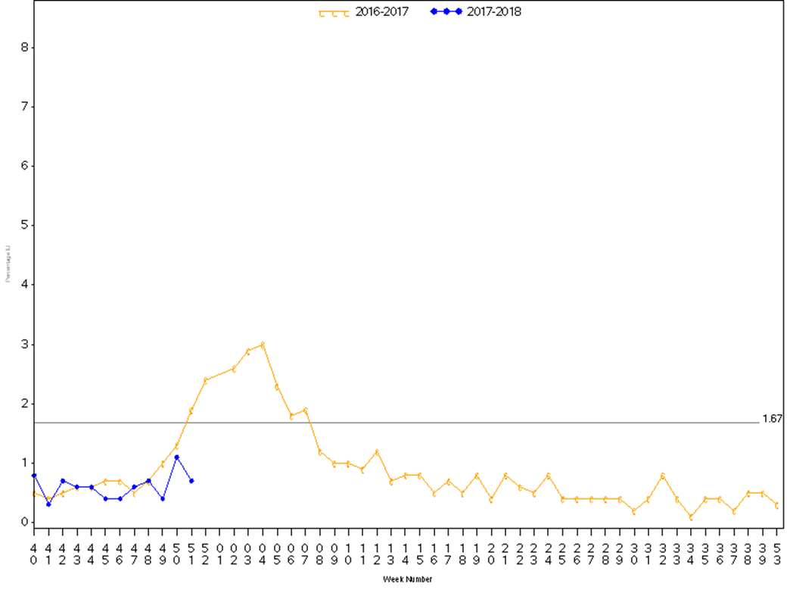
Indian Health Service Portland Area
Influenza-like Illness, Portland Area IHS

Slide 12
Indian Health Service Portland Area

Slide 13
Indian Health Service Portland Area
Key Points Regarding Influenza:
It is not too late to get vaccinated
Influenza vaccine is still an important public health prevention tool
As in past years, washing your hands frequently, covering your cough and staying home when ill are also important measures to help prevent the spread of influenza
Influenza Vaccine Effectiveness could be as low as 32% this year for preventing influenza A(H3N2) infections
The current influenza vaccine is well matched to prevent influenza A (H1N1) and influenza B infections that are also circulating
People at high risk for complications from the flu, including American Indians/Alaska Natives should seek care early to receive the maximum benefit from antiviral medications

Slide 14
Questions or Comments
Our Mission... to raise the physical, mental, social, and spiritual health of American Indians and Alaska Natives to the highest level.
Our Goal... to assure that comprehensive, culturally acceptable personal and public health services are available and accessible to American Indian and Alaska Native people.
Our Foundation... to uphold the Federal Government's obligation to promote healthy American Indian and Alaska Native people, communities, and cultures and to honor and protect the inherent sovereign rights of Tribes.

