Slide 1
NPAIHB
Pathways to Health Professions: Supporting Native Youth in Pursuing Health Careers
April17, 2018
Gerald Hill, MD Klamath Tribes Delegate, Immediate Past President Association of American Indian Physicians and Ex-Officio Member of the National Indian Health Board

Slide 2
Indian Health Workforce Development
THE NEED FOR AMERICAN INDIAN AND ALASKA NATIVE HEALTH PROFESSIONALS
TO MEET THE HEALTH PROFESSIONAL WORKFORCE SHORTAGE IN INDIAN HEALTH SERVICE, TRIBAL AND URBAN INDIAN HEALTH PROGRAMS

Slide 3
The Need for Native Health Professionals
IHS Federal Vacancy Rates*
Physicians 34%
Pharmacist 16%
Nurse 24%
Dentist 26%
PA 32%
AP Nurse 35%
*IHS FY 2015 Scholarship, Extern, Scholarship and Grant Programs and Partnership with NHSC Fact Sheet
Nearly 150 physician positions currently being advertised on the IHS web site.

Slide 4
The Need for Native Health Professionals
Current vacancy rates make it nearly impossible to run a quality health care program.
Competition for primary care physicians and other practitioners is at an all time high.
The IHS has been unable to meet the workforce needs with the current strategy.
The IHS must improve its ability to meet the workforce needs if the Nation’s Indian health care needs are to be met.

Slide 5
The Need for Native Health Professionals
Current IHS workforce development relies upon recruiting primarily non-Indians through the loan repayment program.
The current IHS budget devotes over 30 million dollars to loan repayment and only 17 million to scholarships and programs to increase the numbers of Indian health professionals.
Given the vacancy rates in IHS facilities the current strategy has proven to be a failure.
The long term solution is to increase the number of AI/AN health professionals serving Native communities.

Slide 6
Supporting Native Youth
WHERE WILL THE AMERICAN INDIAN AND ALASKA NATIVE HEALTH PROFESSIONALS COME FROM?

Slide 7
Supporting Native Youth
IHS Health Professions Scholarships- 2015*
The IHS funded all 17 physicians and all 5 dentists who applied for the scholarship who were eligible by score.
17 of 25 (68%) of eligible PAs and NPs were funded
16 of 34 (47%) of eligible bachelor level nurses were funded
21 of 112 (19%) of eligible undergraduate pre-health professions students were funded.
All eligible unfunded students were AI/AN from federal or state recognized tribes.
*IHS Pipeline Programs “Workforce, Hiring Challenges and Strategies”

Slide 8
Supporting Native Youth
IHS Loan Repayment Program
Pays $20,000 annually in student loans ($5000 less than NHSC)
Current Legislation to increase to $35,000 Annually
1211 health professionals funded in 2015 with 437 being new recipients.
613 (33%) of the health professionals who applied for LRP were not funded.
Only 19% of LRP recipients were AI/AN
*IHS Pipeline Programs “Workforce, Hiring Challenges and Strategies”

Slide 9
Supporting Native Youth
Immediate Need for Funding
Health Professions and Pre-Health Professions Scholarships- Additional $3.3 Million to fund all eligible applicants.*
Loan Repayment- Additional $30.39 Million to fund all eligible applicants.*
Salary modifications to competitive levels.
*IHS Pipeline Programs “Workforce, Hiring Challenges and Strategies”

Slide 10
Supporting Native Youth
2017 AI/AN Medical School Facts (AAMC Data)
AI/AN Applicants = 100* / 51,628 (.02%)
AI/AN Matriculants = 42*/21,326 (.02%)
* AI/AN not in combination with another race on application

Slide 11
Supporting Native Youth
AI/AN Medical School Facts (AAMC Data)
AI/AN Medical School Graduates in 2017:
30 of 19,254 (0.15%)
Total AI/AN Enrollment in 2017:
210 of 89,904 (0.2%)
40% of the 2017 Total AI/AN Enrollment was in just 6 (4%) of the Nations 150+ Medical Schools:
Oklahoma, North Dakota, Minnesota, Arizona, New Mexico, Washington

Slide 12
Supporting Native Youth
Long Term Solution Strategies: Native health professionals from our own communities
What Can be Done?

Slide 13
Supporting Native Youth
Many Things but Three Basic Strategies:
Make the most of our successful students
Build up our pool of successful students
Support our students throughout the process

Slide 14
Supporting Native Youth
Making the Most of our Successful Students
It is a myth that the only strategy is to start at the earliest levels to increase our AI/AN health professional workforce. Much can be done to make better use of our talented, intelligent, hard working AI/AN students. There are many hundreds of AI/ANs who have proven this and hundreds more with the potential to be successful health professionals.

Slide 15
Supporting Native Youth
Making the Most
Enrichment programs to identify and support those with an interest- UMD, UNM, UND, U of A, OHSU, ASDOH and others.
Enhance and expand health professions schools of medicine, dentistry, nursing, psychology and others that target IA/AN populations
Provide financial support for AI/AN undergraduate and health professions students (90% of medical students are from the top 10% income tier)

Slide 16
AAIP Student Activities
Preadmissions Workshops for Native Students preparing to apply to Health Professions School- UMN, AZ,NM,CO,UT, UND
National Native American Youth Initiative- Annual Program in Washington DC for High School Students interested in the Health Professions
Workshops for early college, community college students interested in the Health Professions in partnership with UCD, UCLA, others
Cross Cultural Workshop-Annual workshop with emphasis on Traditional Healing practices that can be used in parallel with Western medicine
Sponsorship for AI/AN medical students to Annual Meeting and Cross Cultural Workshop
ALL student programs have more applicants than we can fund

Slide 17
U of MN COE Student Activities
Native Americans into Medicine (NAM) summer enrichment for college students interested in health careers
Intense personal recruitment of AI/AN students to the medical school
Indian Health curriculum including courses and clinical work
Sponsorship of AI/AN medical students to AAIP Annual Meeting and Health conference and to the AAIP Cross Cultural Medicine Workshop
Pre-matriculation program to prepare accepted students
Superstar program to identify and support promising high school students
More!!
Similar programs at UND, AZ, NM, WA, OHSU

Slide 18
Supporting Native Youth
Build up our pool of successful students
30% of AI/AN children live in poverty (AICF)
70 % AI/AN HS Graduation Rates are the lowest in the Nation
50% AI/AN HS Graduation Rates in the 7 states with the highest population of AI/AN
26% of AI/AN HS Graduates go to college
10% gain a four year degree required for most health professions (NIEA)
This leaves only 7% of our youth eligible for HP School
The NSF reported only 708 AI/AN gained a science degree in 2014

Slide 19
Supporting Native Youth
Build up our pool of successful students
Enhance math and science education at all levels in AI/AN communities, including urban Indian communities
Work with tribal and Indian Nation communities to identify higher achieving students with an interest in science and the health professions
Provide enrichment and inspirational programs to promising AI/AN students in junior high, high school, community college, and universities

Slide 20
Supporting Native Youth
Support our students throughout the process
Provide AI/AN health professional role models to our students in Native communities
Increase opportunities for exploration of the health health profession in AI/AN communities
Increase scholarship opportunities for AI/AN students including full funding of the IHS pre-health professions and health professions scholarship program so that all qualified students can be funded
Enhance the partnership between health professions schools that are dedicated to AI/AN health professions education and the IHS
Welcome AI/AN graduating health professions students in all IHS facilities including Phoenix Indian Medical Center, Alaska Native Health Center, and others.

Slide 21
Supporting Native Youth
Where to Start?
National Indian Health Board- NIHB has access to virtually every IHS and tribal health program in the Nation through elected tribal delegates from every IHS Area and then to tribal delegates from almost every tribe and Indian Nation in the country through the Area Health Boards represented at NIHB.
National Council of Urban Indian Health- NCUIH has access to urban Indian Health programs in cities with the largest AI/AN populations.
Association of American Indian Physicians- Over 400 Indian physicians in the membership all of whom have been through the medical education process and many of whom work in academic institutions and have expertise in working with AI/AN health professions students. AAIP has over 30 years experience working to increase the number of AI/AN health professionals. AAIP also has MOUs with the NIHB, AAMC, ACOG, AAP, AAFM,AMA and others.

Slide 22
Supporting Native Youth
Where to Start?
Develop Indian Nation based programs to identify and support promising students.
Partner with academic institutions to develop programs targeting Indian health workforce development: Minnesota, North Dakota, Arizona, New Mexico, Washington, Oklahoma, Oregon
Support the Association of American Indian Physicians, a national program with proven success in recruiting Native students into medicine and other health professions.
Support the NIHB and NCUIH to access health programs in Native communities throughout the Nation

Slide 23
Supporting Native Youth
How Can NPAIHB Help?
Support increased funding of IHS Health Professions line item funding to fully fund IHS Health Professions scholarships for all qualified applicants to the health professions scholarship program (Additional $3 million).
Support increased funding for INMED programs at health professions schools targeting AI/AN students
Support increased funding to IHS LRP to fund all physicians, nurse practitioners, physicians assistants, nurses, and other direct care practitioners.
Closely partner with OHSU Native American Center of Excellence, AAIP, and health professions schools targeting AI/AN students.
Consider a resolution from NPAIHB addressing the severe workforce shortage in Indian Health and the need for increased IHS funding of the Health Professions line item.

Slide 24
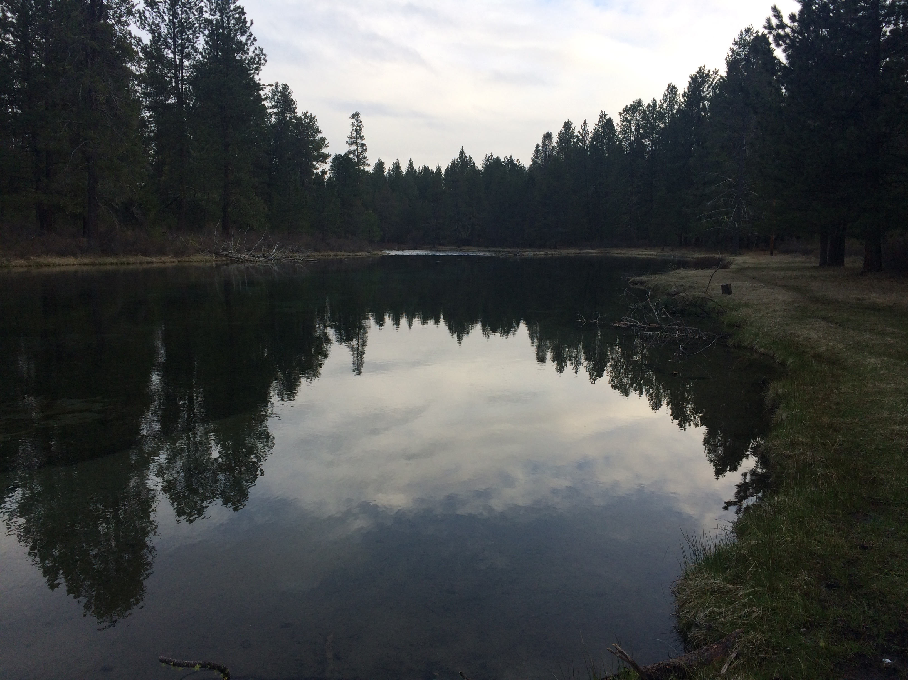
An Indian Physician

