Slide 1
Tribal update
NPAIHB QBM
October 11, 2017

Slide 2
PGST Health Services
Only Indian Health Care provider in Kitsap County, Washington
Primary Care & Urgent Care, Outpatient
FT Family Medicine, FT PA, .2 FTE Pediatrician
4 RNs, 1 LPN, 5 CHRs, 4 MAs
Dental
2+ Dentists, 1 Dental Hygienist, 4 Dental Assistants
Discussions for DHAT, now and training
User Pop: 1695

Slide 3
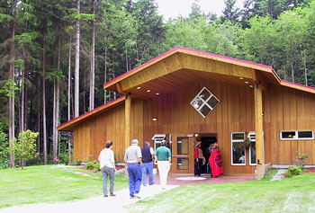
PGST Wellness
Currently part of Children & Family Services
Substance abuse & mental health counseling
15 FTEs: 5 MH, 4 CD, MA, transport, office manager
Group & individual counseling
Suicide prevention
MAT

Slide 4
Behavioral Health Integration
Active effort
98% Wellness pts are PC
Tribal Council support
Qualis PALs – state Medicaid Transformation
Joint Business & Finance Office
Cross training medical assistants
Vision/Strategic planning session
LCSW in primary care clinic
Opioid work as an example

Slide 5
Source: WA DOH Death Certificates
Includes all intent of drug-related deaths with the additional ICD-10 codes of T40.0, T40.1, T40.2, T40.3 or T40.4

Slide 6
state & regional data
2015 Drug Injector Survey
22% overdosed in past 12 months
52% witnessed overdose in past 12 months
47% said they or someone else had called 911
46% carry naloxone
50% hooked on rx opiates prior to heroin
51% interested in getting help to cut down or quit but only 2 people in treatment (in our county)
http://adai.uw.edu/pubs/infobriefs/2015druginjectorhealthsurvey.pdf
1036 Valid Responses Statewide (WA)

Slide 7
Quick detour

Slide 8
Opiates or opioids?
Opiate refers to natural substances that come from opium.
Opium poppy
Morphine
Codeine
Opioids are medicines/drugs that bind to the same receptors as opiates, but do not occur naturally.
Semi-synthetic opioids
oxycodone & hydrocodone
Synthetic opioids
fentanyl & methadone

Slide 9
Chemical cousins
Morphine
Codeine
Thebaine
Diacetylmorphine (Heroin)
Hydrocodone (Vicodin)
Oxycodone (Oxycontin)
Oxymorphone (Opana)
Hydromorphone (Dilaudid)
Tramadol
Fentanyl
Methadone
Opiates
Semi-synthetic opioids
Synthetic opioids

Slide 10
Opioid
Opiate
Opioid: natural, synthetic, or semi-synthetic substances
Opiate: naturally occurring substances within the opioid class

Slide 11
Opioid Summit
Opioid Summit: 3-County Coordinated Response
January 30, 2016
Discuss results from assessment and planning phase
Move from planning to action
2 Opioid Plans: Review WA State Plan & 3-County
14+ PGST tribal council & staff attended
Continue to be involved
Olympic Community of Health
Medicaid Demonstration
Project plans, weekly calls

Slide 12
2017 Washington State Interagency Opioid Working Plan
Goal 1: Prevent opioid misuse and abuse | Goal 2: Treat opioid dependence | Goal 3: Prevent deaths from overdose | Goal 4: Use data to monitor and evaluate
Priority
Goals
Priority
Actions
Improve prescribing practices | Expand access to treatment | Distribute naloxone to people who use heroin | Optimize and expand data sources
http://www.doh.wa.gov/YouandYourFamily/PoisoningandDrugOverdose/OpioidMisuseandOverdosePrevention

Slide 13
Our response
How to make this meaningful for PGST?
Executive Director called f/u opioid meeting
Tribal council members, police department, wellness staff, chief medical officer, youth workers and more
Reviewed state and county plan and adopted our own Tribal Healing Opioid Response (THOR)

Slide 14
Notes:
Opioid vs opiate

Slide 15
The plan

Slide 16
Goal 1: Prevent Opioid Misuse and Abuse | Lead Department | Partner Department
1A: Promote best practices for prescribing | Health | Wellness, CHR
1B: Raise awareness of risks including overdose; reduce stigma | Wellness | Re-entry, Court, Health
1C: Prevent opioid misuse in communities, particularly with youth | Chi-e-chee, Youth, Education | Wellness, Health
1D: Promote safe storage and disposal of prescription medicine | Health | Police
1E: Decrease the supply of illegal opioids | Police | Court

Slide 17
Goal 2: Expand Access to Opioid Use Disorder (OUD) Treatment | Lead Department | Partner Department
2A: Expand capacity of health providers to recognize signs of opioid misuse | Health, Wellness | Police
2B: Increase access to & utilization of best practices OUD treatment in communities | Wellness | Health, Reentry
2C: Increase access to & utilization of best practices OUD treatment in the criminal justice system | Reentry | Wellness, Police
2D: Increase capacity of syringe exchange programs to provide overdose prevention training including naloxone and to engage clients in supportive services | Health | Wellness
2E: Reduce withdrawal symptoms in newborns | Children & Family | Health, Wellness, ECE, Chi-e-chee

Slide 18
Goal 3: Prevent deaths from overdose | Lead Department | Partner Department
3A: Educate community to know how to recognize and respond appropriately to an overdose | Chi-e-chee | Human Resources, Wellness, Health
3B: Increase availability of overdose reversal medication naloxone | Health | Police, Wellness, Natural Resources

Slide 19
The work

Slide 20
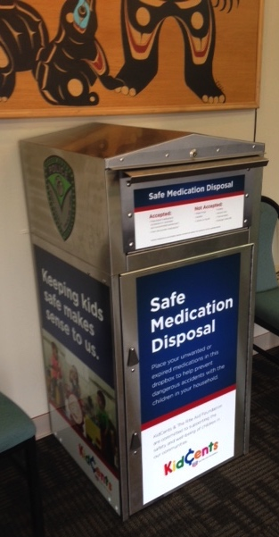
Preventing diversion
Drug take back
Secure box in lobby of tribal government building
Police pick up
Medication lock box
In coordination with health services

Slide 21
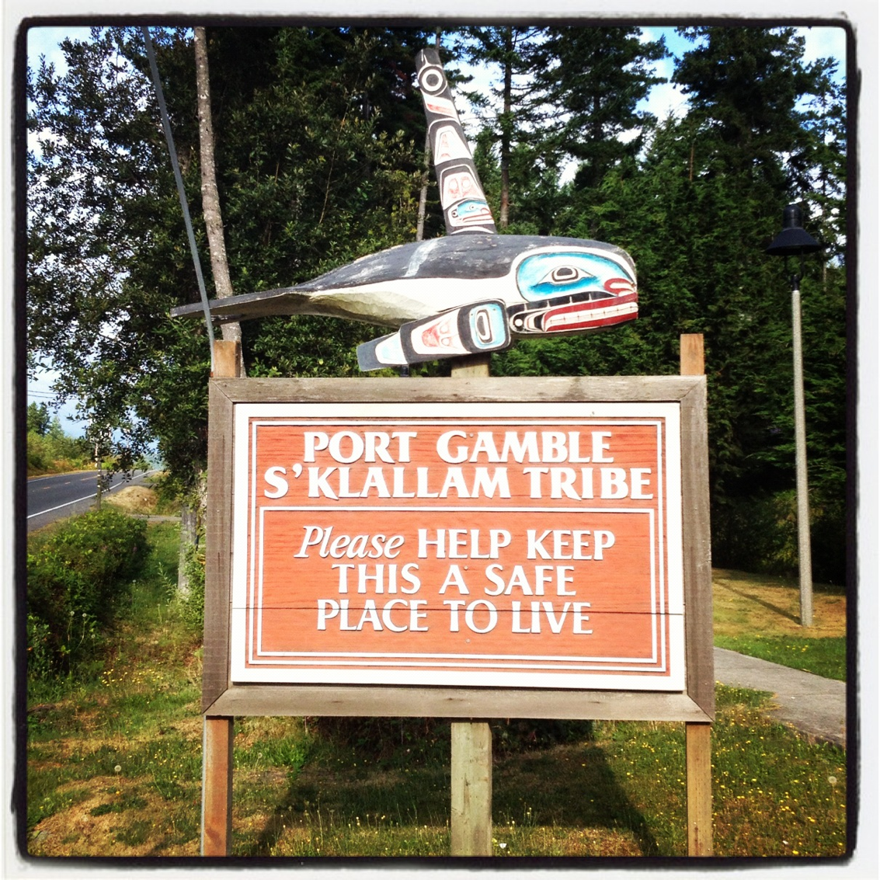
Community Engagement
General Council
March 2017
Opioid Town Hall
December 2016
October 12, 2017

Slide 22
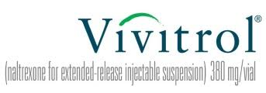
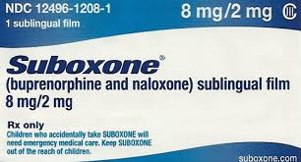
Medication Assisted Treatment
Staffing: 2 MDs, 1 ARNP, supported by MA
Suboxone & Vivitrol
Program Structure
Counseling, individual and group
Random call backs

Slide 23
Chronic Pain Management
Opioids don’t work
Tachyphylaxis: rapidly diminishing response
Hyperalgesia: abnormally heightened sensitivity to pain
Opioid Pain Agreement
Patients think opioids work, already dependent
Education, leadership, patients, THOR…
Dramatic decrease in rx
18% decrease one year, 75% seven years
Multiple reasons, further evaluation needed

Slide 24
Harm Reduction
Narcan
Tribal Code: Good Samaritan provision
Police, NR, patients, every home
Standing Orders, Policy
Unexpected delay – account set up
Needle Exchange
Successful
Message: exchange, not supply

Slide 25
Success
Examples abound
Transition to MAT
Non-opioid treatment only
Exercise, mental health, non-opioid meds, etc.
PRN opioids only
Decreased dosage
Prevention is better
Surgeon General’s Report on Alcohol, Drugs, and Health

Slide 26
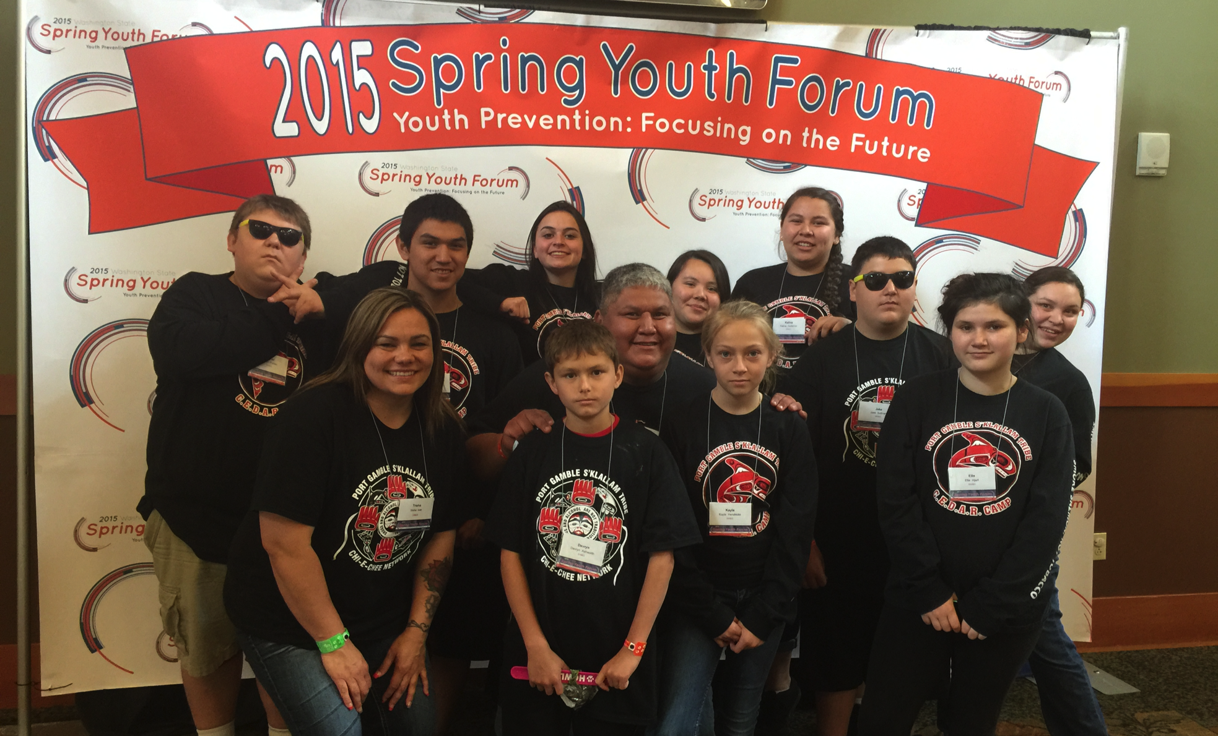
Youth Prevention
Youth Services
Serves K-12 grades and young adults
Monday-Saturday
6 staff
Support groups, culture, recreation, leadership, outings, mentoring, etc.

Slide 27
Youth Prevention Activities
Tae Kwon Do
Fitness Initiatives
Hiking
Basketball
T-ball
Skate Camps
Prevention weekend
Red ribbon week
Youth Prevention Summit
Youth Leadership Group
Youth Annual Honoring
Youth Employment workshop
College trips
Thrive conference
Youth & Elder Socials
Cultural classes;
Beading
Cedar/wool weaving
Cooking traditional fish
Archery
Regalia making
Canoe journey
Pow-wow’s
Autism Acceptance Walk
Child abuse Prevention Walk
Places of Importance

Slide 28
Community Prevention
CHI-E-CHEE
(Klallam word for “the workers”)
Vision
Committed to working together to provide a safe, healthy Tribal community with bright futures for our youth and future generations.
Mission
The mission of the Port Gamble S'Klallam Tribe’s Chi-e-chee is to promote healthy families through the elimination of alcohol, tobacco and other drug abuse in the Port Gamble S'Klallam community, in accordance with the Tribe’s culture, values, and traditions.
Executive Director suggested Chi-e-chee as lead group for THOR

Slide 29
Ongoing process
Monthly Tribal wide meetings
Review progress, update plan
Discuss what are we doing
What do we want to do?
How much does it cost?
Who is on point?
Appointed a lead staff person to THOR
THOR Logo
Next: community engagement, town hall, funding

Slide 30
Funding & Collaboration
Right thing to do
Significant cost & commitment
Leadership
Collaborations with other departments

Slide 31
Tribal Specific Data & Evaluation
Tribal Specific Data Pull
Needle exchange, opioid dependence, rx
Requested technical assistance
NPAIHB Epi Center
Kitsap County
Olympic Community of Health
Evaluation
How will we know it is working?
What do we measure?

Slide 32
Port Gamble S’Klallam Tribe
Artist & Designer
jeffreyveregge@gmail.com
www.jeffreyveregge.com
360-516-0406

Slide 33
Available Resources & Links
THOR plan
THOR Community Handout (July 2017)
Opioid Pain Agreement (draft)
Narcan Standing Orders
Narcan Training Guide
PGST Good Samaritan code
Helpful Links:
https://aims.uw.edu/
https://addiction.surgeongeneral.gov/surgeon-generals-report.pdf

Slide 34
Thank you!
Karol Dixon
Health Services Director
360-620-4378
karold@pgst.nsn.us

