Slide 1
Nak Nu We Sha
(NNWS)
“We Care”
June Adams, MSW
Yakama/Cherokee
Yakama Nation NNWS Program Manager
Laretta Smiscon, NNWS Social Worker Supervisor
Yakama Nation

Slide 2
Nak Nu We Sha Staff
Program Manager
SW Supervisor
12 Social Workers
2 Office Asst.
1 Bookkeeper
1 Foster Care Licensor

Slide 3
Nak Nu We Sha Mission and Vision Statement
Vision Statement—Nak Nu We Sha envisions children raised within their community, culture and tradition, protected by exercising Yakama Nation Sovereignty.
Mission Statement—The mission of the Yakama Nation Nak Nu We Sha Program is;
the prevention of the disintegration of our Indian Families;
Through early intervention and remediation services.

Slide 4
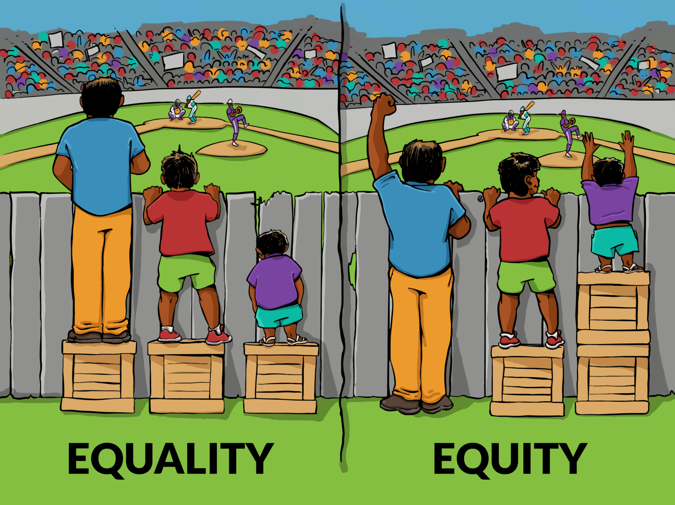
What Nak Nu We Sha does for children

Slide 5
What does Nak Nu We Sha do?
Child Abuse Prevention Activities (Tule Gathering, Pow Wow) One time emergency assistance, clothing donations, car seats
Independent Living Classes (cooking classes)
Kinship Services-Respite, gas vouchers, electricity, vouchers, Food, Clothing, Personal Hygiene, diapers, etc.
Foster Care Licensing
Child Placement Agency-Places dependent children, Basic and Intensive Case Management for Dependent Children (transportation, visits, referrals, family reunification)

Slide 6
Who Nak Nu We Sha Services
Enrolled Yakama Children and Indian Children Living on the Yakama Reservation under 21
Dependent Children of Nak Nu We Sha are victims of child abuse or neglect
Nak Nu We Sha receives notice of Approx. 35 Child Abuse and Neglect Intakes
Title IVB Population 5,605 (3,419 Yakama)
Serves 209 to 225 Dependent Children
Serves 197 Kinship Children (Children living with relatives)

Slide 7
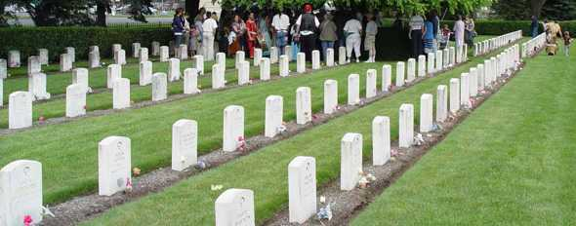
Historical trauma is the collective emotional wounding across generations that results from massive cataclysmic events – Historically Traumatic Events (HTE)*
The trauma is held personally and transmitted over generations. Thus, even family members who have not directly experienced the trauma can feel the effects of the event generations later
Notes:
Intergenerational transmission of trauma is a relatively recent focus of mental health. First observed in 1966 by clinicians alarmed by the number of children of survivors of the Nazi Holocaust seeking treatment
The multigenerational aspects of trauma continue to be treated as secondary and, consequently, the behavior of many children of survivors of massive trauma is misunderstood and not treated appropriately
The historical unresolved grief is a part of the trauma being experienced.

Slide 8
Inter-Generational Basis for Chronic Disease Disparities Among American Indians and Alaska Natives
Gestational Stressors
Childhood Stressors
Adulthood Stressors
Chronic Disease Disparities
Historical Trauma
Birth
Genocide
WIC
FDPIR
Boarding School Experiences
Abuse (physical, sexual)
Neglect
Abandonment
Forced Removal
Loss of culture & language
Forced Christianity
Lost traditional parenting & family structure
Adverse Childhood Experiences
Abuse (physical, sexual)
Neglect
Substance Abuse in home
Mental Health Dx in home
Witnessing violence
Divorce
Food insecurity
Family member in prison
Adverse Adulthood Experiences
Alcoholism & SA
Suicide rates / death rates
Poverty / Poor nutrition
Racism / Toxic Stress
Role models
Few positive
Many negative
Parenting
© Warne & Lajimodiere 2012
Next generation

Slide 9
Funding Sources and Contracts
Title IV B- Part I-Child Welfare Services
Title IV B-Part II –Promoting Safe and Stable Families
BIA ICWA Federal Funding
State Foster Child Placing Agency
State ICWA
Independent Living Services
Kinship Services-Tribal
Kinship Services-State
Notes:
Intergenerational transmission of trauma is a relatively recent focus of mental health. First observed in 1966 by clinicians alarmed by the number of children of survivors of the Nazi Holocaust seeking treatment
The multigenerational aspects of trauma continue to be treated as secondary and, consequently, the behavior of many children of survivors of massive trauma is misunderstood and not treated appropriately
The historical unresolved grief is a part of the trauma being experienced.

Slide 10
Behavioral Health Referrals
NNWS will do a Mental Health CAN Screen on all dependent children they case manage.
Initial referral will be sent to Yakama Nation Behavioral Health until client resides out of area or has exceptional circumstances.
Immediate Suicidal Clients will be referred to Comprehensive Mental Health 575-4200 or taken to the Hospital for immediate treatment.

Slide 11
Case Closures ( 1 Year as 7/17)
50 Case Closures (19% of cases closed last year)
40% of the cases Children Returned back to parents
40% of the cases Children went into Guardianship (non-Indian or Indian)
16% of the cases Aged Out
4% of the case child deceased
89% (186 cases) Need Permanency

Slide 12
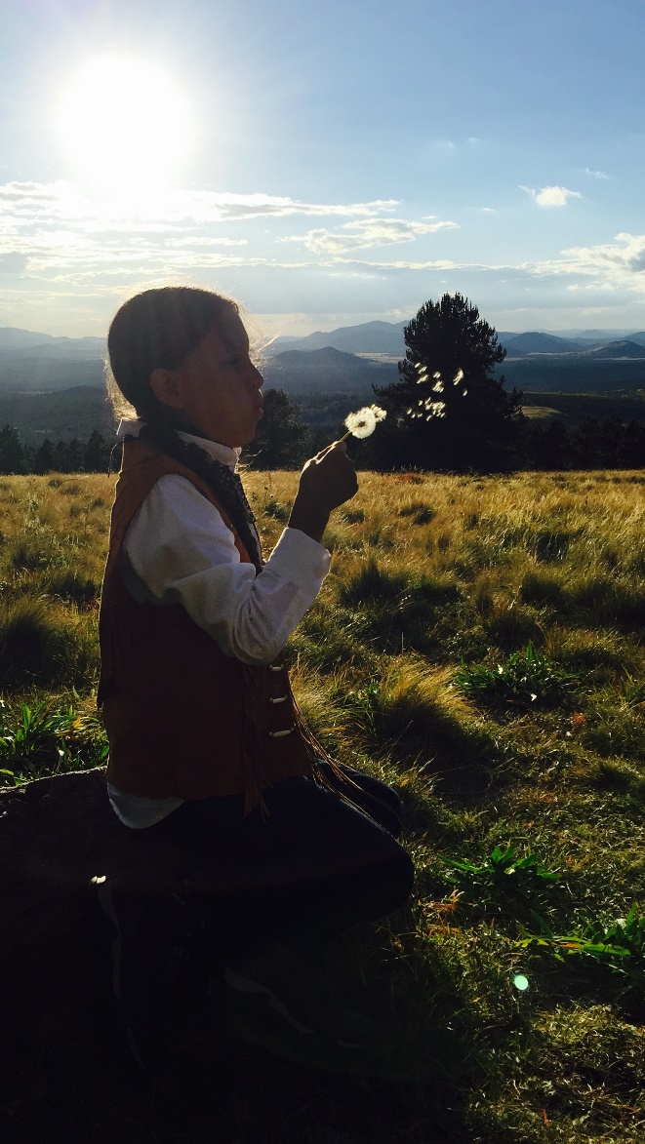
Future Directions
Prevention
Intervene before a child is abused or neglected
Reduce Riske Factors-Parenting Skills
Embrace Traditions
“To be yourself in world that is constant trying to make you something different”

Slide 13
80 Percent of Nak Nu We Sha’s Resource are focused on Tertiary Prevention

Slide 14
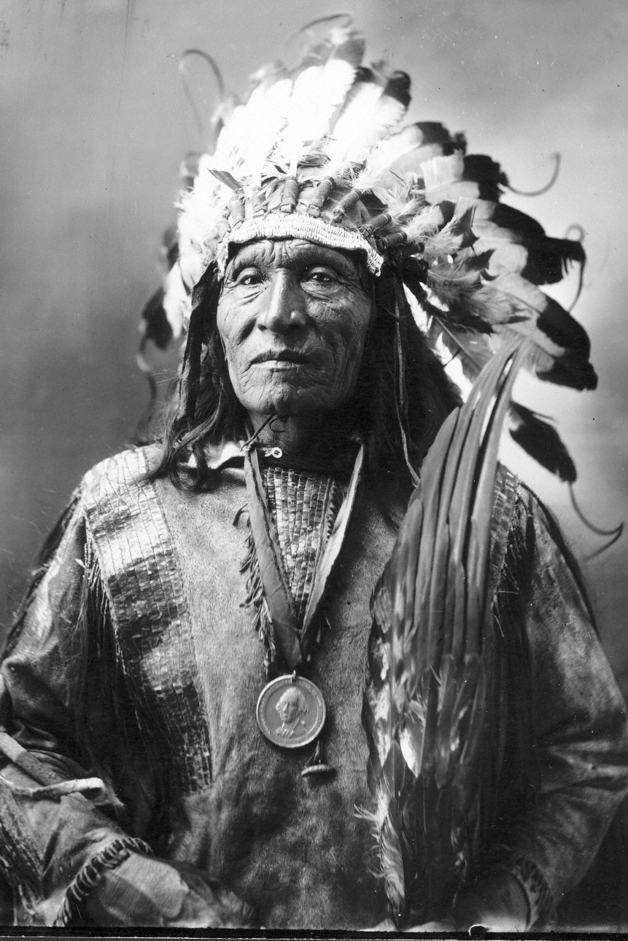
Blackfeet Saying
A child is sacred. And when that child comes into the home, the family must welcome it. And if the child is happy and feels the want, he will come into this world very, very strong. And not to know this is to know nothing.

Slide 15
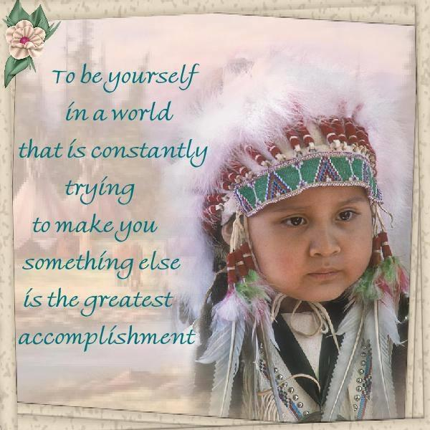
June Adams
June_Adams@Yakama.com

