Slide 1
Dental Health Aide Therapists
The Community Health Aide Program
CRIHB and NPAIHB Joint Board Meeting
July 20, 2017 3:15 PM
Christina Peters, Native Dental Therapy
Initiative Project Director
Northwest Portland Area Indian Health Board
Notes:
Hello,
My name is Christina Peters, I am the oral health project director for the Northwest Portland Area Indian Health Board and I’m really pleased to be here today to talk to you about the work we are doing in the Portland Area. I am going to start by attempting to cram about 5 hours of presentation on what the CHAP program is, the history of our work and the opportunity for economic development into about 10 minutes. So please don’t hesitate to ask questions, find me later for a deeper discussion, or google everything I say. But just remember, at the end I have an ask so please at least pay attention to that part

Slide 2
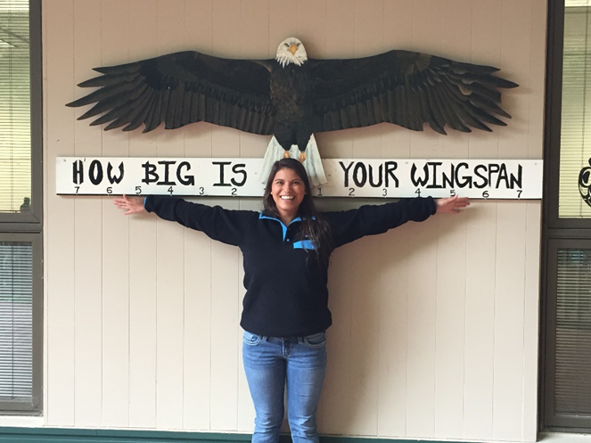
Building a 21st Century Health Team
Notes:
For a very long time, the health system has been failing native communities, not just in lack of access to care, but with low numbers of native providers. In the Portland Area we are doing exciting work based off of a system developed by the Alaska Natives, the Community Health Aide Program.

Slide 3
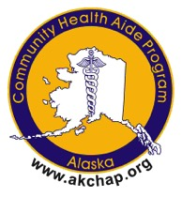
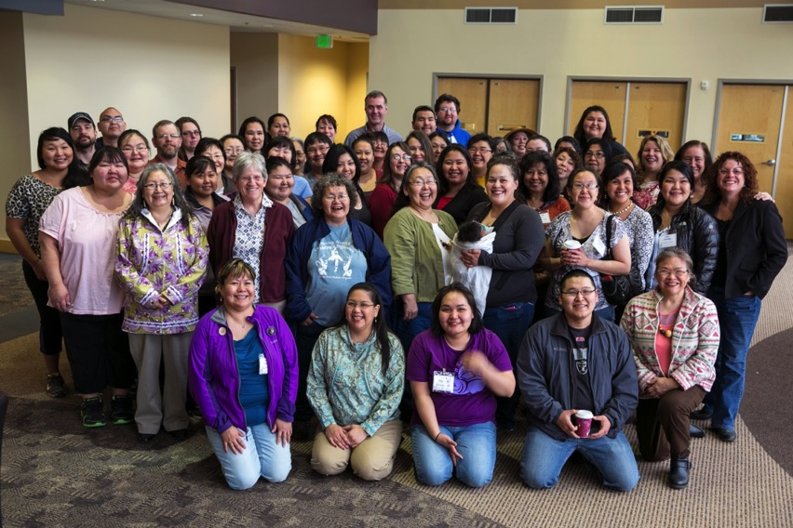
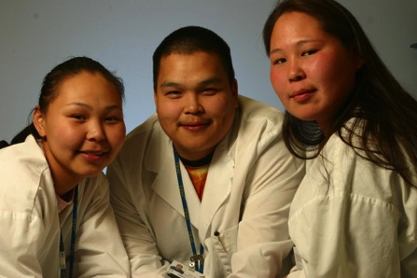
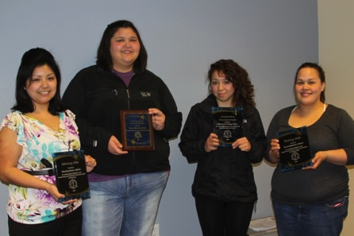
The Alaska
Community Health Aide Program
Alaska Native Tribal Health Consortium
web: www.akchap.org |www.anthc.org
Notes:
The Community Health Aide Program is a network of community health, behavioral health, and dental health providers in over 170 rural Alaska villages. Alaska Community Health aide practitioners are the frontline of healthcare in their communities.
Our most mature work in the Portland Area is the work to implement Dental Health Aide Therapy in the Portland Area. Dental Health Aide Therapists are one of many provider types available through this program.
In the Portland Area, we are exploring the possibility of implementing a full CHAP program

Slide 4
CHAP History
1950s Chemotherapy Aides (Volunteers)-Direct Observed Therapy for TB patients
1960s Formal Training/Federal Funding 1968
1976 Indian Health Care Improvement Act (IHCIA) (PL 94-437)
1992 IHCIA amended to add § 119 that provided for the Alaska Community Health Aide Program under authority of the 25 U.S.C. § 13 popularly known as the Snyder Act and require a Certification Board (PL 102-573)
Notes:
WALTER: A key time event in the evolution of the Community Health Aide Program, I would say, was the February 1964 meeting of the area service unit directors in Anchorage. That is, those individuals, in this case, physicians, that would be responsible for the various service units in Alaska having a -- you had a meeting in Anchorage.
The thrust of this meeting was how to get the community involved. And I actually have the letter that was sent out by the area director, Dr. Holeman Warrick, to those of us who participated to talk about getting more community involvement.
The idea of training local people came up at the meeting, and it was a very animated discussion.
A number of the Public Health nurses who had carried this burden as itinerants, going to the villages, instructing people in midwifery and -- and giving immunizations and all the other things they did, always came back with a list of medical problems and would sit down with us physicians and try to resolve them. These problems that they had encountered in the villages.
Pilot programs from 1964-1968
Congress did then approve and budget, in 1968, funds to support 185 health aide positions in 157 villages. That being the official beginning of the funded Community Health Aide Program.
As a little sidelight, these folks were called -- were referred to as medical aides, usually, but because of all this emphasis on community was sort of the buzz word at the time, that's switched over.
And also, it took -- in retrospect, that took a little of the sting out of the -- out of the threat to the -- the medical hierarchy, probably. And because they were “health” rather than “medical” was less of a hot button.

Slide 5
CHAP History
1998 Alaska Area Director appoints a CHAP Certification Board (CHAPCB) with a majority of tribal representatives. CHAPCB Standards and Procedures adopted and CHA/Ps formally certified.
2002 Standards amended to address dental health aides (including threrapists).
2005 First Dental Health Aides Certified
2008 Standards amended to address behavioral health aides/practitioners
2009 First Behavioral Health Aides Certified
Notes:
WALTER: A key time event in the evolution of the Community Health Aide Program, I would say, was the February 1964 meeting of the area service unit directors in Anchorage. That is, those individuals, in this case, physicians, that would be responsible for the various service units in Alaska having a -- you had a meeting in Anchorage.
The thrust of this meeting was how to get the community involved. And I actually have the letter that was sent out by the area director, Dr. Holeman Warrick, to those of us who participated to talk about getting more community involvement.
The idea of training local people came up at the meeting, and it was a very animated discussion.
A number of the Public Health nurses who had carried this burden as itinerants, going to the villages, instructing people in midwifery and -- and giving immunizations and all the other things they did, always came back with a list of medical problems and would sit down with us physicians and try to resolve them. These problems that they had encountered in the villages.
Pilot programs from 1964-1968
Congress did then approve and budget, in 1968, funds to support 185 health aide positions in 157 villages. That being the official beginning of the funded Community Health Aide Program.
As a little sidelight, these folks were called -- were referred to as medical aides, usually, but because of all this emphasis on community was sort of the buzz word at the time, that's switched over.
And also, it took -- in retrospect, that took a little of the sting out of the -- out of the threat to the -- the medical hierarchy, probably. And because they were “health” rather than “medical” was less of a hot button.

Slide 6
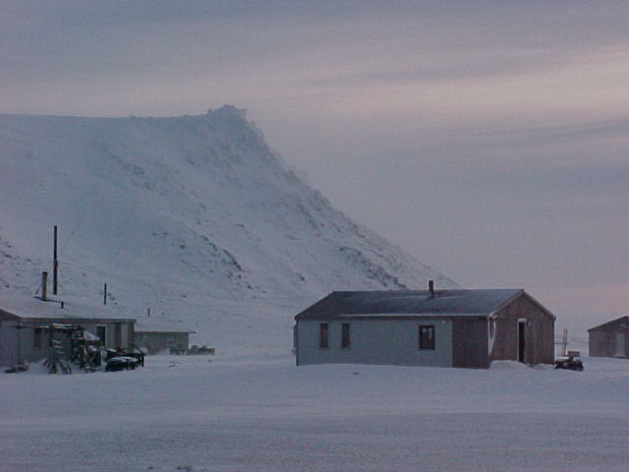
Health Aide Program Key Components
Community’s Role in Selection
Culturally Competent Care
Competency based curriculum
Team-Based Care
Gambell
Notes:
The CHAP program is different from the traditional health system because it was created by and for Native communities in Alaska. It works in tandem with the existing health system to create an accessible rung on the health providers profession ladder. This is important because American Indians and Alaska Natives are severely underrepresented in the health professions and their numbers are declining.
There is interesting work happening to better understand why fewer American Indian and Alaska Native youth are choosing the health professions, and we believe that the CHAP program is one of the many tools that we can use to both increase access to care and increase the number of native providers.

Slide 7
What is CHAP
CHAP is a system of allied health professionals that work with supervising dentists, doctors, and mental health professionals at the community level that extend the reach of those providers
CHAP providers are community members
Community Health Aides
  4 levels CHA I, II, III, IV, and CHA/P
Behavioral Health Aides
  4 levels BHA I, II, III, and BHA/P
Dental Health Aides
  5 levels PDHA I, II, EFDHA I, II, and DHAT

Slide 8
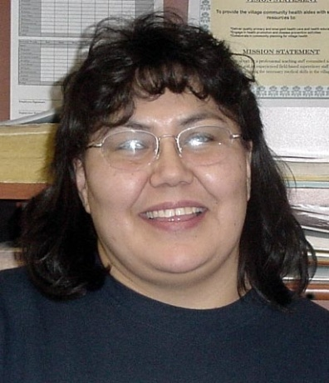
Role of CHA/P on the medical team
  Emergency Medical Response
  Front office manager/receptionist
  Admissions and registration clerk
  Medical records clerk
  Nurse
  Provider
  Lab technician
  Pharmacy technician
  Medical Travel clerk
  Medical supply officer
Agnes Silas CHP, Minto
Notes:
Not an AIDE
What makes them different is they are treating family and friends, they know patients on a different level, as people. They know your baseline normal and therefore often can notice before a generic midlevel would when something just isn’t right.
Enormous job, not just anyone can do the job

Slide 9
CHAP Certification Board
  Established in 1998
  Federal Authority, 12 members
Standards and Procedures
      Individuals, Training Centers, Curricula
489 individuals certified
      405 Community Health Aides
      60 Dental Health Aides
      32 Behavioral Health Aides
Notes:
The federally authorized Community Health Aide Program Certification Board (CHAPCB) was established and charged with formalizing the process for maintaining Community Health Aide/Practitioner training and practice standards and procedures. Alaska Area Native Health Area Director supervised the establishment of an eleven person board which first convened in July.
Amendments to add 6 Dental Health Aide providers
Dental Health Representative added to the Board
2005 First DHAs certified
Amendments to add 4 Behavioral Health Aide providers
Behavioral Health Representative added to the Board
2009 First BHAs certified

Slide 10
Certification Board Members
4 Training Center Regions
CHA Training Center
CHAP Director’s Association
CHA Association
Medical Director
Federal (Alaska Area Native Health Service)
State of Alaska Representative
Dental Health Aide Representative
Behavioral Health Aide Representative

Slide 11
CHAP Standards and Procedures
Certification requirements
Program oversight
Supervision requirements
Scope of practice
Competencies
Training and related curriculum
Practicum/Preceptorship
Continuing Education
Approved Training sponsors
http://www.akchap.org/resources/chap_library/CHAPCB_Documents/CHAPCB_Standards_Procedures_Amended_2017-01-26.pdf

Slide 12
CHA/P Providers
Hired, usually by village council
Pre-session: Intro to CHAM/CHA role/ETT or EMT
Session I: 4 weeks → 60 hours in village clinic
Session II: 4 weeks → 200 hours in village clinic
Session III: 3 weeks → 200 hours in village clinic
Session IV: 4 weeks → 200 hours in village clinic or
Session IV Blended: 18 weeks (16 weeks in village via Distance Learning Network, 2 weeks at Training Center )→ 200 hours in village clinic
Preceptorship: 1 week- skills & patient encounters; exam
Federal Certification at each level
Notes:
Blended Session I/II in progress

Slide 13
CHA Training session I and II
Body Systems approach
Focus on medical history & basic exams-problem specific & complete history and physical
Intro to basic anatomy, physiology, and function
Skills including blood draw, urine dip, lab testing, suturing, wound care, IV therapy, splinting, med administration
ETT review, mental health, substance abuse

Slide 14
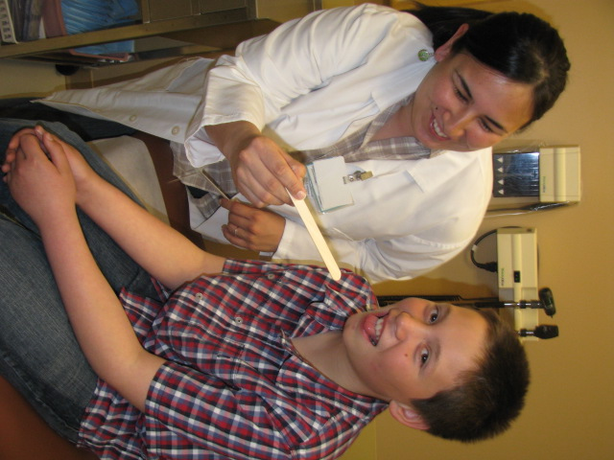
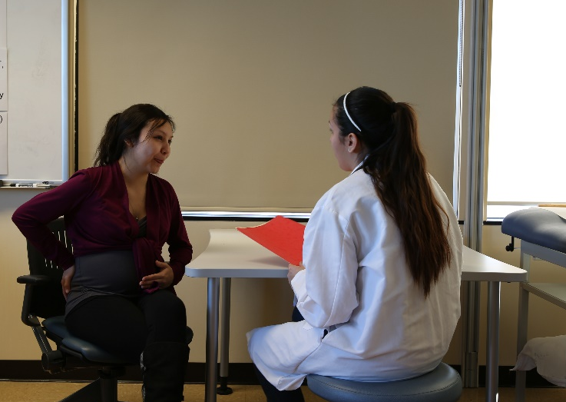
CHA Training Session III
Women’s Health, STI, prenatal visits, emergency delivery
Well child
Mental health, substance abuse
ETT review

Slide 15
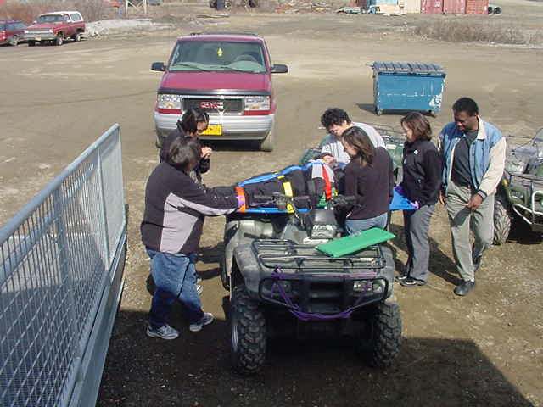
CHA Training Session IV
Focuses on follow-up of patients with chronic illness (COPD, DM, CAD, seizures, CVA)
Elders
Tobacco cessation, mental health, substance abuse prevention
ETT review

Slide 16
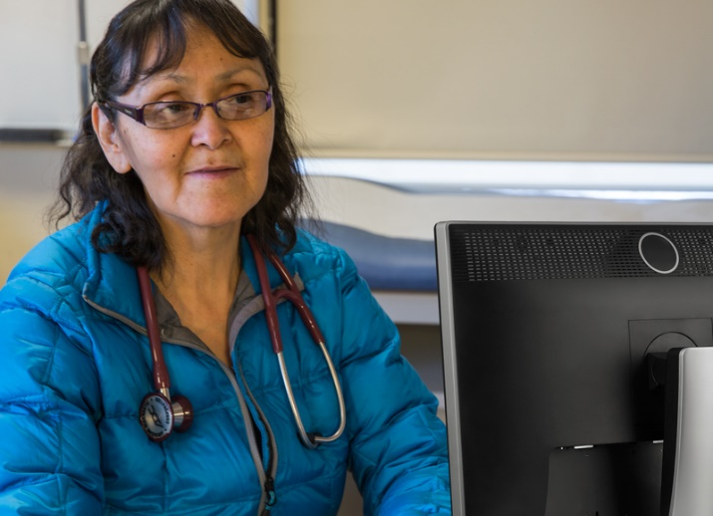
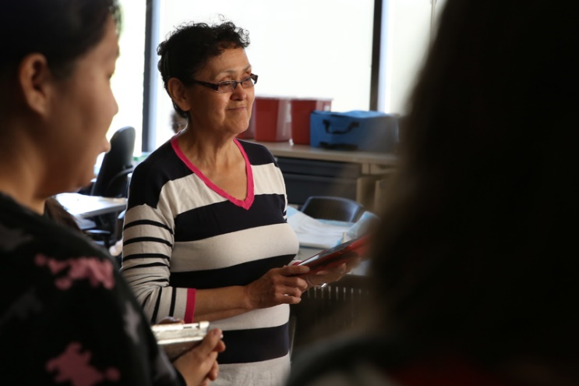
CHA Training Session IV Blended
Same curriculum objectives
Students have scheduled interaction with faculty
More time for students to integrate material
Clinical and skills requirements same as face-to-face training
Model efficiencies allow more students to progress through training

Slide 17
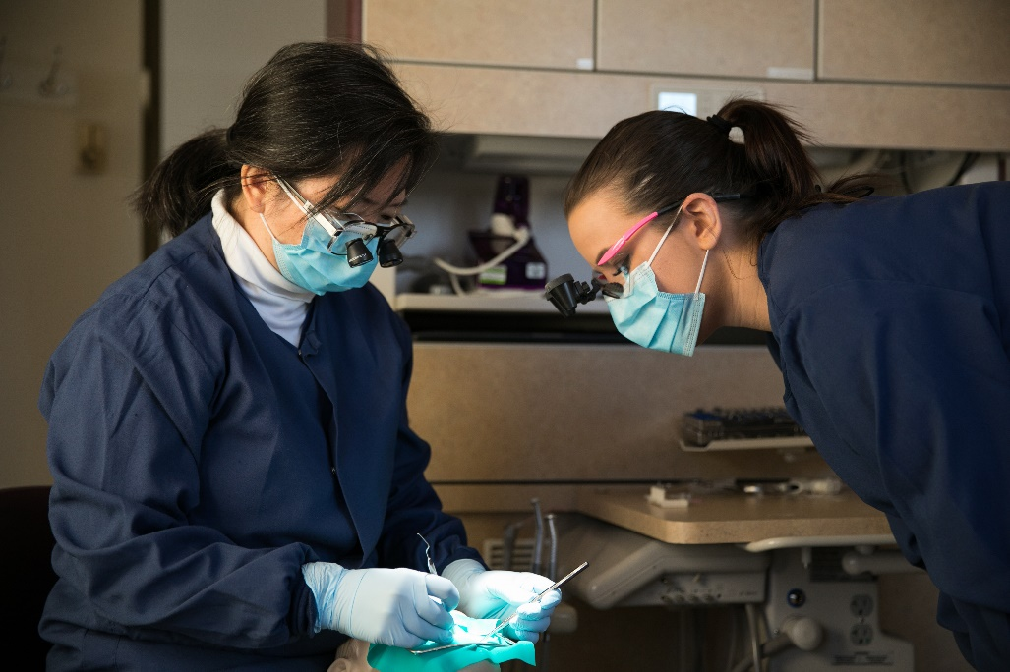
Types of Dental Health Aides (DHA)
Primary DHA (CDHC)
  Oral Health Educators
  Restorations, cleanings, temporary fillings
Expanded Function DHA
DHA Hygienist
  Local anesthesia
DHA Therapist (DHAT)
  Prevention, operative, urgent
Supervised providers
Teams led by Licensed Dentists
Alexandria Jones, Coquille, DHAT class of 2018 and instructor Dr. Lynn Van Pelt

Slide 18
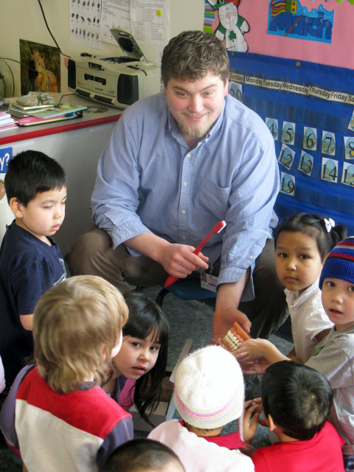
Dental Therapist: A definition
Primary oral health care professionals
  Basic clinical dental treatment and preventive services
  Multidisciplinary team members
  Advocate for the needs of clients
  Refer for services beyond the scope of the dental therapist’s practice.*
*SASKATCHEWAN DENTAL THERAPISTS ASSOCIATION
Ben Stewart, DHAT, Cow Creek Band of Umpqua, now serves the Urban Indian population of Portland, OR at NARA

Slide 19
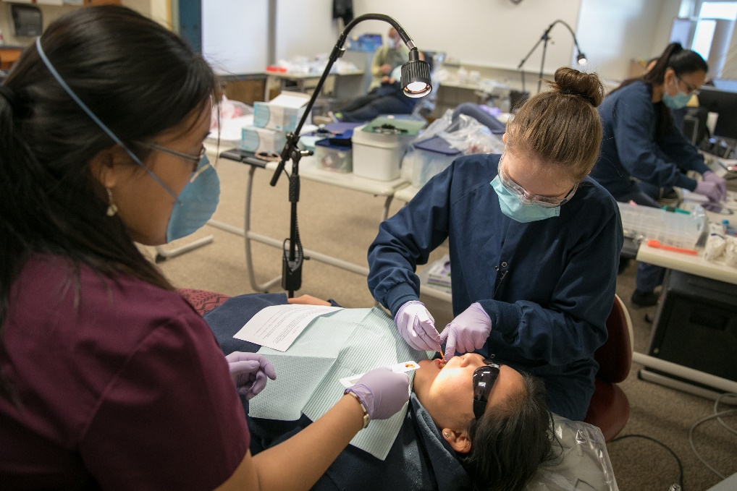
DHAT Curriculum
Year 1: basic health sciences, basic dental concepts, maths, professional role development, introduction to clinic, patient and facilities management.
Year 2: clinical year, expansion of concepts learned in first year, extractions, community project, village dental rotations
Naomi Petri, DHAT, Confederated Tribes of Coos, Lower Umpqua and Siuslaw Indians

Slide 20
Different provider
Different education
DHAT
Limited scope, 46 procedures
DENTIST
NEED to know+ nice to know
Large scope, 500+
Supervised
Prevention oriented team approach
Accessible to students in target populations
Culturally competent
Patient centered
Team leader
Surgically oriented
Education is difficult to access, especially for minorities
Struggling to address cultural competency
Practice centered
NEED TO KNOW

Slide 21
DHAT Scope of Practice
Serves patients of All ages
• Works under General Supervision
• Part of a team of dental and medical providers
Diagnosis and Treatment
Planning, Prevention,
Basic Hygiene,
Radiographs,
Infection Control,
Restorative,
Pediatric,
Urgent Care,
Extractions,
Community Projects,
Clinic Management,
Equipment Repair and
Maintenance,
Referral Process
DHAT, Ben Steward, examining patient
Notes:
Dental therapists are not “mini-dentists.” They are highly specialized providers who perform a limited number of procedures—46 procedures compared to the 500-plus procedures that dentists are trained perform. Their education is intensive and focused on preparing them to be experts in these procedures. After completing a rigorous education program, they enter a preceptorship, working under direct supervision of a dentist for at least 400 hours. In Alaska, they must undergo direct observation every two years to be recertified. Dental therapists have the education, the preparation, and the clinical experience they need to do their jobs really well. (Dental Therapists participate in continuing education)
Questions? About a DHAT’s scope of practice or training, I have a lot more material to cover so your questions might get answered later, but this is all I have around scope and training.

Slide 22
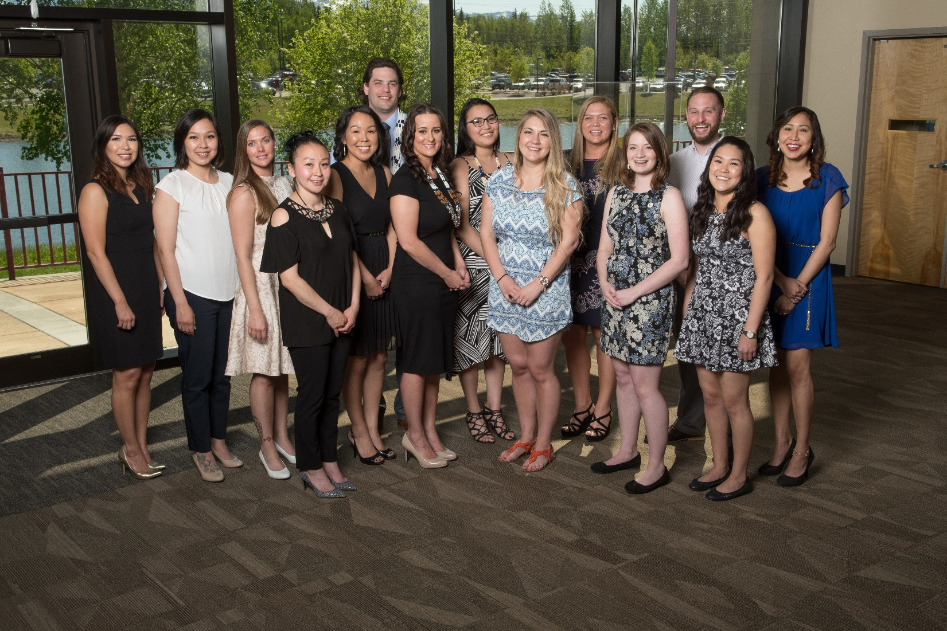
DHAT class of 2017 and transitioning 1st year students

Slide 23
Alaska’s BHA/Ps

Slide 24
Behavioral Health Aides
Adverse Childhood Events
  Historical Trauma
Unintentional Injury
Suicide
Substance abuse
  Binge drinking
  Alcohol abuse mortality
Domestic Violence

Slide 25
BHA Program
Scope of practice
  Culturally-informed, community-based, clinical services
  Behavioral health prevention, intervention, aftercare, and postvention
Certification Requirements
  Training
  Practicum
  # of work hours
  Competencies
  40 CEUs every 2 years

Slide 26
BHA Scope of Practice
BHA-I
Screening
Initial intake process
Case management
Community education, prevention, early intervention
BHA-II
Substance abuse assessment and treatment
BHA-III
Rehabilitative services for clients with co-occurring disorders
Quality assurance case reviews
BHP
Team leadership
Mentor/support BHA-I, II,
and III
Notes:
There are four levels of BHA certification (BHA-I, BHA-II, BHA-III, and BH Practitioner)
The scope of practice 1) varies by level and 2) build upon each other
Provide services across the continuum from prevention, early intervention, intervention, and post-vention
Per the Certification Standards and Procedures, these are the services BHAs are trained to provide

Slide 27
Who do BHAs provide services to?
Elders
Families
Youth
Individuals
Domestic Violence prevention and intervention
Substance abuse prevention and intervention
Suicide, Grief, and Loss prevention, intervention, postvention
And more

Slide 28
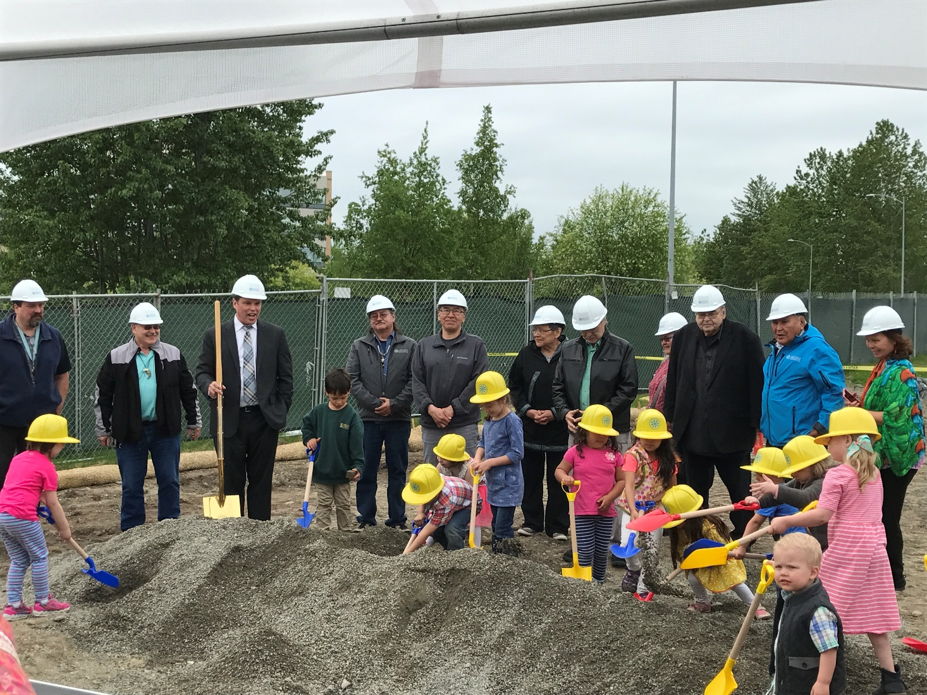
CHAP Training Program Expansion in Alaska
Notes:
Breaking ground, make jokes about child labor

Slide 29
National CHAP Expansion Efforts
Since 2010, state-by-state efforts to pass dental therapy legislation
June 2016: Dear Tribal Leader Letter seeking tribal consultation on a policy statement describing the intention of the IHS to create a national Community Health Aide Program (CHAP)
October 2016: The Tribal Consultation on the draft policy statement concluded
IHS issued a DTLL and report on January 4, 2017 on the CHAP tribal consultation process.
Notes:
So where are we today?

Slide 30
January 4th Report Highlights
Summary of comments:
Emphasized opportunity for CHAP to increase access to services
Reiterated community nature of program and importance of community involvement
Highlighted need for baseline standards with enough flexibility that each Area can set-up its own program.
Nationalization intended not to disrupt existing CHAP programs
Highlighted need for federal legislative change to fully utilize DHATs
Notes:
Need to stay vigilant
Dentists have their own federal legislation change in mind and it isn’t to make it easier for anyone to use DTs.

Slide 31
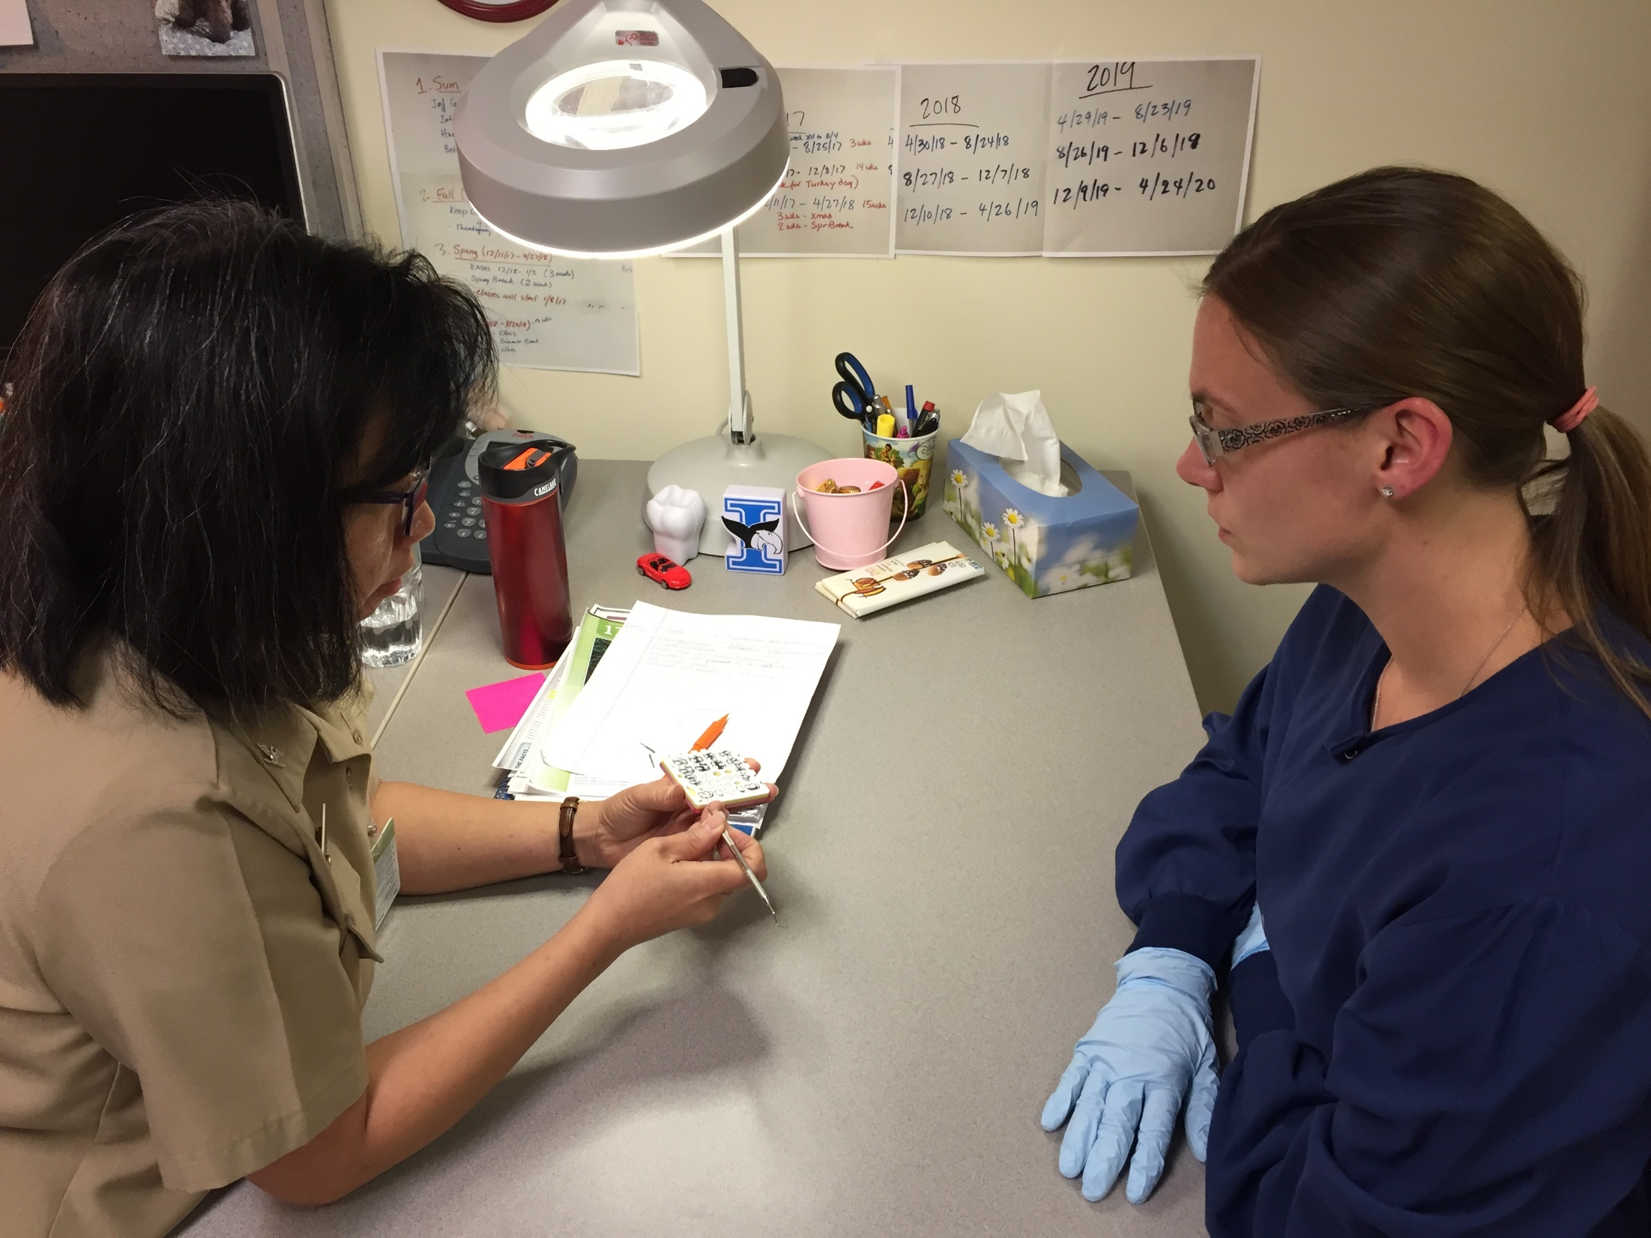
Next Steps in the Portland Area
Convene Advisory Committee for creation of Education program for Dental Health Aide Therapy in Washington
Convene Advisory Committee for planning of implementation of full CHAP program in Portland Area
Convene Advisory Committee Behavioral Health Aide planning process
*not necessarily three separate committees

Slide 32
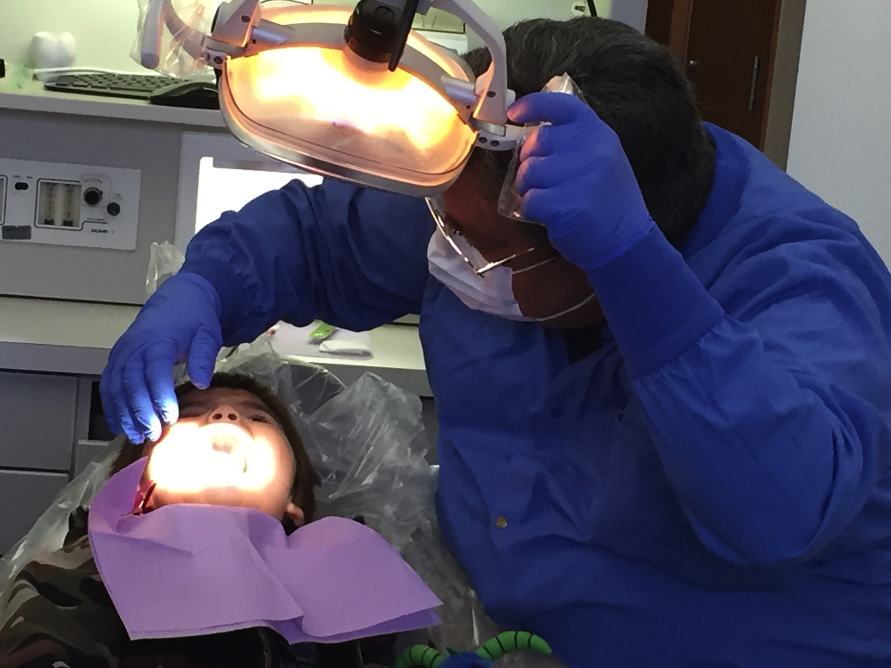
Questions?

Slide 33
Northwest Portland Area Indian Health Board
For more information please contact:
Christina Peters, Native Dental Therapy Initiative Project Director
cpeters@npaihb.org
206.349.4364
Pam Johnson, Native Dental Therapy Initiative Project Specialist
pjohnson@npaihb.org
206.755.4309
Tanya Firemoon, Native Dental Therapy Initiative Project Coordinator
tfiremoon@npaihb.org
503.228.4186
Indian Leadership for Indian Health

