Slide 1


The Opioid Epidemic:
The Indian Health Service Response to a National Crisis
IHS National Committee on Heroin, Opioids, and Pain Efforts (HOPE)
IHS National Combined Councils, Nashville
June 22, 2017

Slide 2
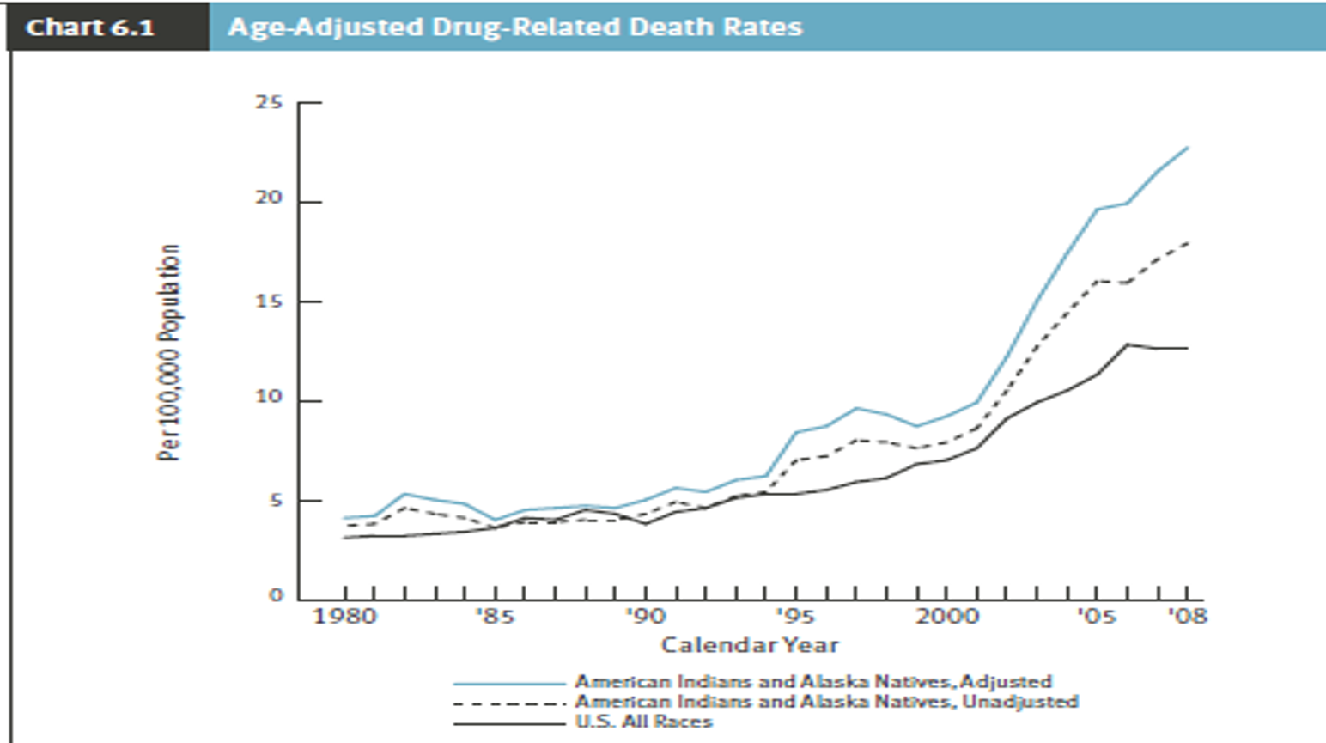
IHS- Drug-Related Death Rates, 1980—2008
Notes:
The age-adjusted AI/AN drug-related death rate is 4.1 deaths per 100,000 population for the three-year period 1979-1981, as compared to the AI/AN death rate of 22.7 in 2007-2009. This is an increase of 454 percent since drug-related death rates were first introduced for AI/AN in 1979.

Slide 3
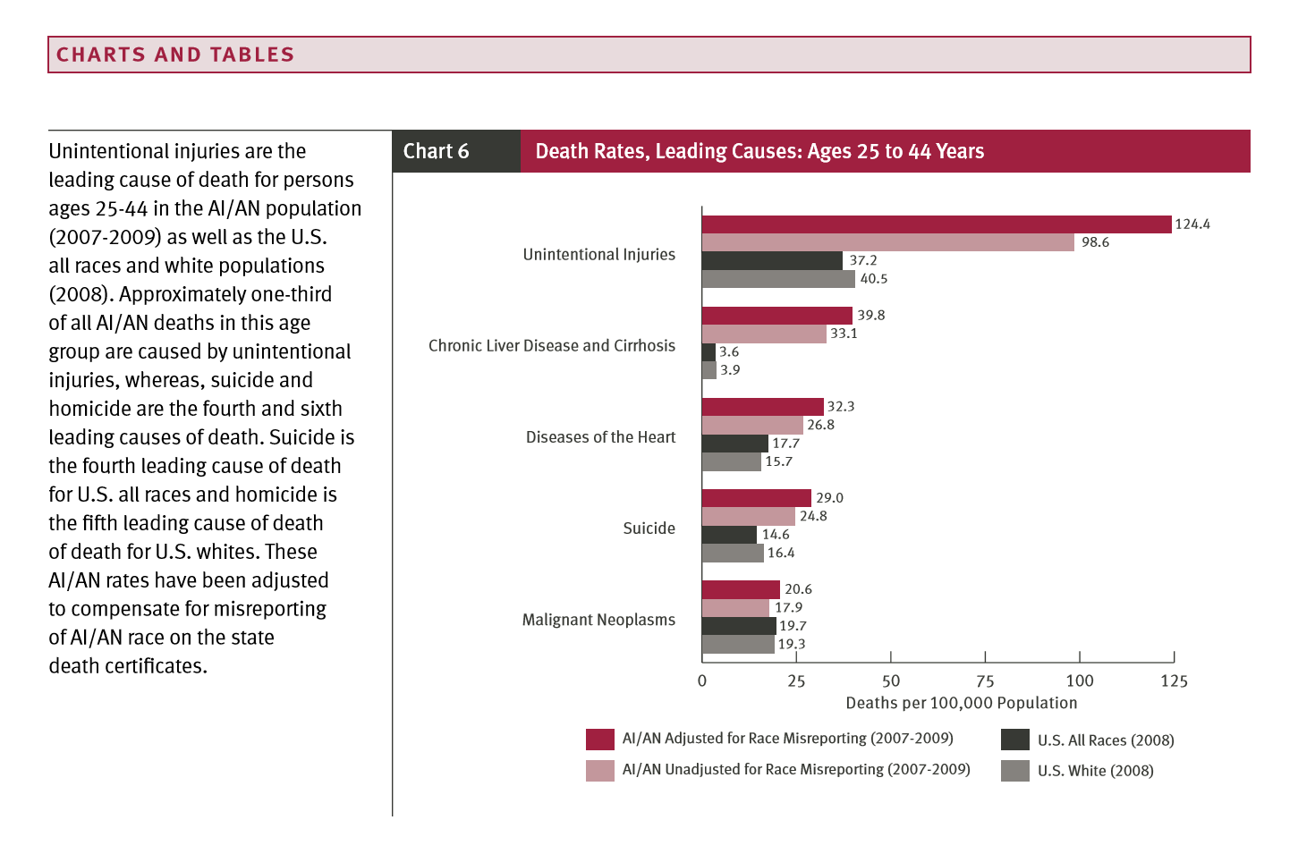
https://www.ihs.gov/dps/includes/themes/newihstheme/display_objects/documents/Injuries2016Book508.pdf

Slide 4
IHS Prescription Drug Abuse (PDA) Workgroup
Established by the IHS Chief Medical Officer and the National Combined Councils in July, 2012.
Focus areas:
  Patient care
  Policy development/implementation
  Education
  Monitoring
  Medication storage/disposal
  Law enforcement

Slide 5
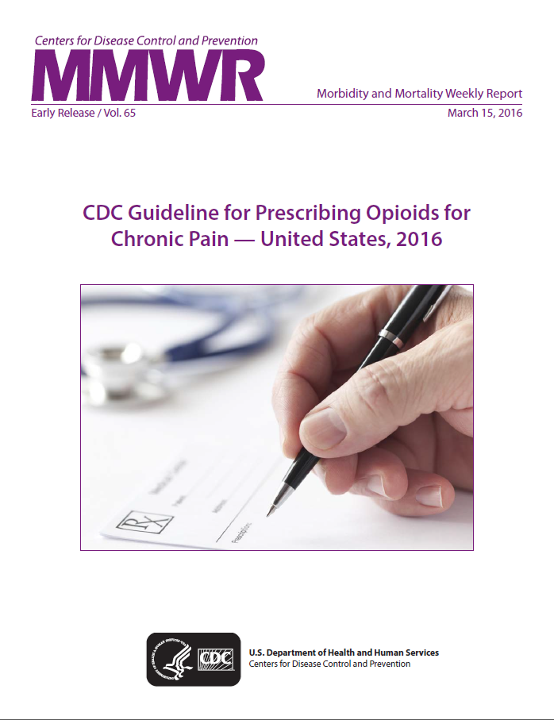
Policy Efforts
IHM Part 3, Chapter 30- Chronic Non-Cancer Pain Management
  Published in June 2014.
  Provides best practice guidelines surrounding management of chronic non-cancer pain.
  Currently under revision to ensure alignment with CDC Guideline for Prescribing Opioids for Chronic Pain- United States, 2016.
IHM Part 3, Chapter 32- State Prescription Drug Monitoring Programs
  Published June 2016.
  Establishes requirement for IHS Federal prescribers to register with State PDMP to request reports for new patients, and when pre-scribing opiates for acute pain (>7 days of treatment) and chronic pain.
  Establishes requirement for IHS Pharmacies to report dispensing data and conduct PDMP queries prior to dispensing outside prescriptions.

Slide 6
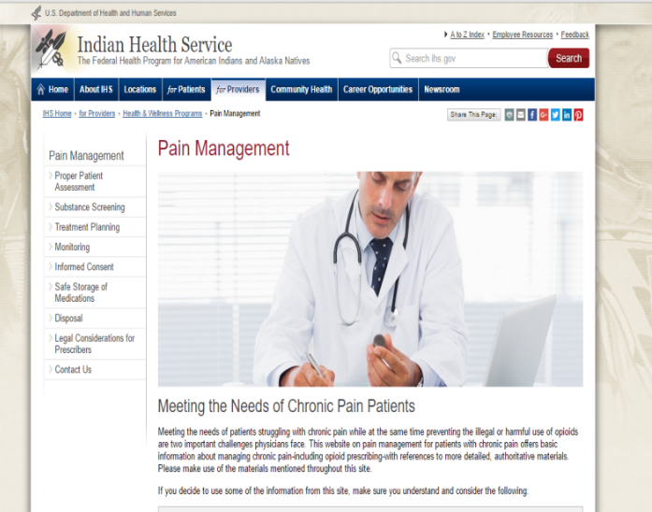
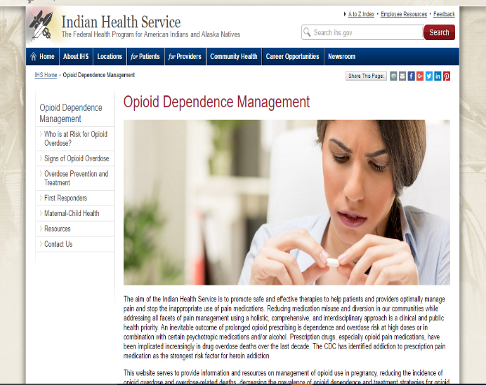
Clinician Supports
  IHS Websites
    Pain Management www.ihs.gov/painmanagement
    Opioid Dependence Management www.ihs.gov/odm
Notes:
Pain management updates: PDMP
ODM pending: naloxone toolkit; MAT; responsible disposal

Slide 7
Clinician Supports
  IHS Chronic Pain and Opioid Management TeleECHO Clinic
    Weekly video conference
    Allows front-line clinicians to consult with experts in:
      Pain management
      Addictions
      Behavioral Health
    Weekly format rotating to noon hour for each time zone.

Slide 8
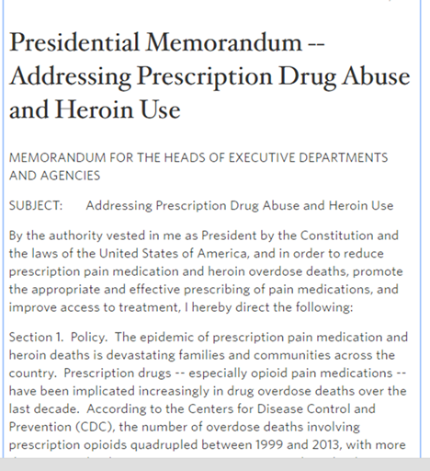
Presidential Memorandum
Addressing Prescription Drug Abuse and Heroin Use- Oct. 21, 2015
  Adequate training of medical professionals on appropriate pain medication prescribing practices.
  Increased utilization of naloxone.
  Increased access to medication-assisted therapy (MAT) for opioid dependence.
  Reduced utilization of methadone.

Slide 9
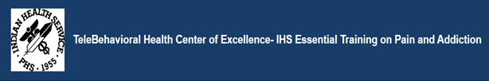
Safe Opioid Prescribing Training
IHS Essential Training on Pain and Addiction (ETPA)
  IHS specific training developed with cooperation by the University of New Mexico.
  Web-based live trainings (5 hour course) conducted since Jan. 2015.
IHS Special General Memorandum 2016-05: Mandatory Training for Federal Prescribers of Controlled Substance Medications
  All IHS Federal prescribers of controlled substances are required to complete EPTA training.
  By the end of 2016, 2931 participants had completed the ETPA course.
    1296 IHS Federal controlled substance prescribers (96%).

Slide 10

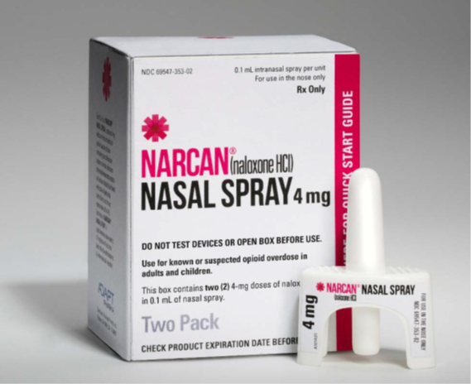
Naloxone—First Responder
IHS-BIA Memorandum of Understanding- December 2015
  Agreement that IHS Federal pharmacies will provide
  naloxone and training on its use to local BIA Tribal Police
  for use by First Responders.
  Total BIA Officers Trained:
IHS pharmacists have developed a training
  curriculum and toolkit.
  Training video developed:
    https://www.youtube.com/watch?v=KcjF9Iw0iuw

Slide 11
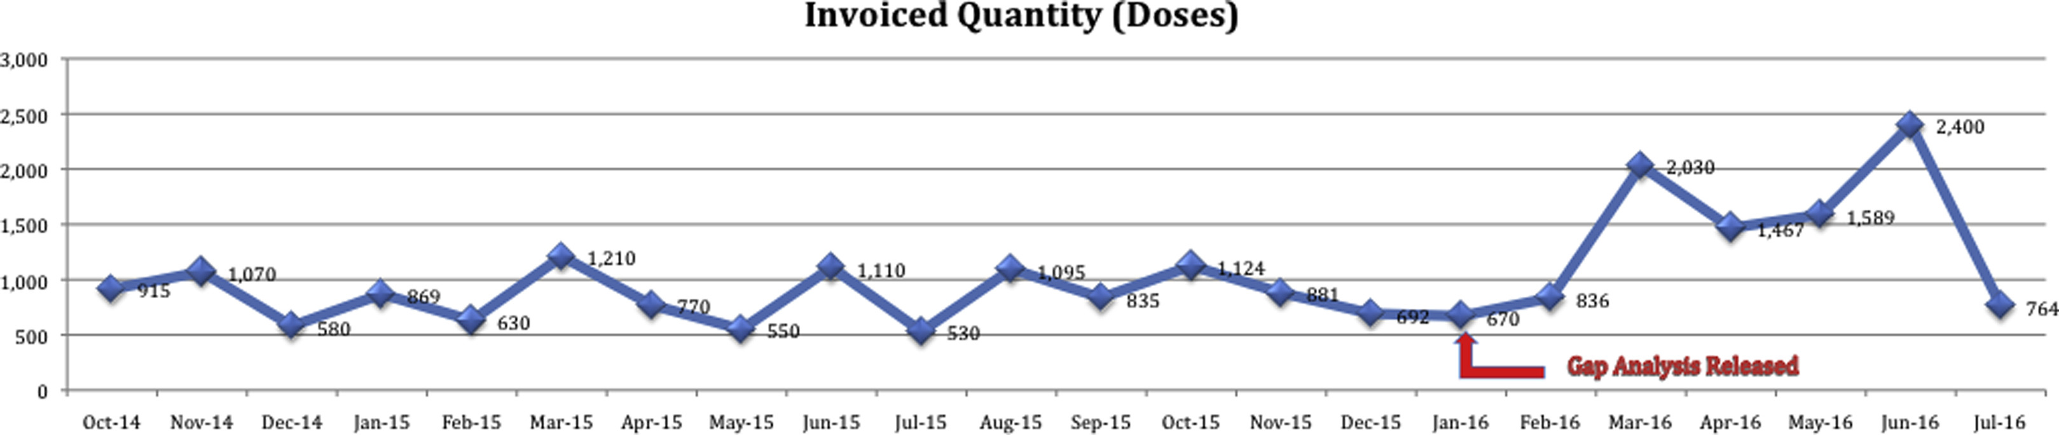

Naloxone—Co-Prescribing
Co-prescribing grand rounds conducted February 17, 2017
    https://ihs.adobeconnect.com/p727st8p3lj/
Pharmacy-based model collaborative practice program developed
    www.ihs.gov/odm.resources
Journal of the American Pharmacists Association 2017 57, S135-S140DOI: (10.1016/j.japh.2017.01.005)

Slide 12

Medication Assisted Treatment (MAT)
Medication-assisted treatment is treatment for addiction that includes:
  The use of medicine
  Counseling
  Support systems
Treatment that includes medication is often the best choice for opioid addiction.
If a person is addicted, medication allows him or her to regain a normal state of mind, free of drug-induced highs and lows.
Notes:
It frees the person from thinking of all the time about the drug.
It can reduce problems of withdrawal and craving.
These changes can give the person the chance to focus on the lifestyle changes that lead back to healthy living.

Slide 13
Medication Assisted Treatment (MAT)
Office-Based Opioid Treatment Training
  Live web-based training sponsored by American Osteopathic Academy of Addiction Medicine and SAMHSA.
    Provides 8 hours needed to obtain waiver to prescribe buprenorphine in an office-based setting:
      Webinar training (4.25 hrs)- 3 modules
      Online study/exam (3.75 hrs)- 5 modules, 24 questions.
  Pain Skills Intensive Training- Albuquerque, NM- March 2017
    Included optional 4 hour MAT training.
    Duplicate training planned for Nov. 2017 in Portland Area.

Slide 14
Methadone Prescribing
Methadone has dual roles:
  Used as a long-acting opioid in pain treatment.
  Used for opiate maintenance to treat opioid dependence disorder (opiate addiction)
Chemical properties of methadone increase risk compared to other opioids
  Can cause cardiac rhythm complications.
  More likely to cause an opiate overdose.
Guidelines recommend against using methadone as a first-line opioid choice.
IHS monitors prescribing data on methadone and trains providers on proper pain management.

Slide 15
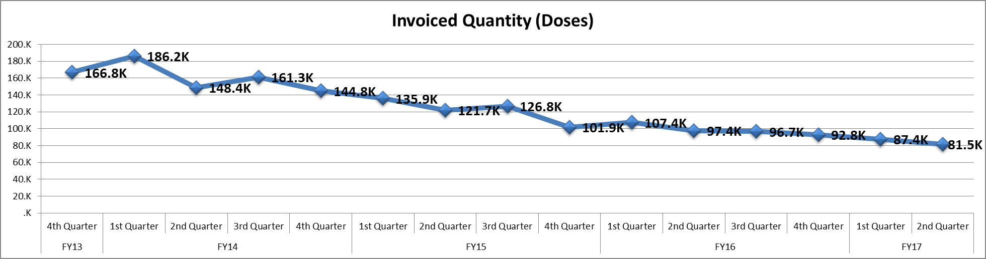
Methadone

Slide 16
HHS Strategies
Address by Thomas Price, MD, Secretary, Dept. of Health & Human Services, National Rx Drug Abuse and Heroin Summit- Apr. 19, 2017
  Improving access to treatment and recovery services.
  Promoting use of overdose-reversing drugs.
  Strengthening our understanding of the epidemic through better public health surveillance.
  Providing support for cutting edge research on pain and addiction.
  Advancing better practices for pain management.

Slide 17
National Committee on Heroin, Opioids, and Pain Efforts (HOPE)
New IHS Committee created in March 2017
Evolved out of the Prescription Drug Abuse Workgroup
Membership: physicians, pharmacists, behavioral health providers, nursing consultation, and epidemiologists
Purpose:
  Promote appropriate and effective pain management.
  Reduce overdose deaths from heroin and prescription opioid misuse.
  Improve access to culturally appropriate treatment.

Slide 18
HOPE Workgroups
Prescriber Support
Medication Assisted Treatment
Harm Reduction
Perinatal Substance Abuse
Program Effectiveness (Metrics)
Technical Assistance
Communications and website development

Slide 19
Prescriber Support
Goals
  Foster tribal relationships to identify local resources that are available to treat pain and substance use disorders and ensure adequate administrative support to effectively coordinate patient care.
  Encourage IHS facilities to increase clinical capacity by facilitating provider participation with required and recommended agency training surrounding pain management, utilization of effective screening models for substance use, and expanded access to Medication Assisted Treatment (MAT).
  Develop access to peer support networks for clinicians using tele-behavioral health models.

Slide 20
Prescriber Support
Goals (continued)
  Enhance early screening efforts surrounding opioid misuse, risk factors for addiction, and subsequent clinical documentation.
  Enhance provider access to best and promising practices including maintenance of clinically current website materials and advanced distribution of Agency efforts surrounding pain management, substance use, and treatment.

Slide 21
Tentative Workplan 2017-2018
Host ETPA as enduring content eligible for home study CEU credits
Release Chapter 30 update
Expand myofascial pain training combined with DATA waiver training
Expand availability of controlled substance disposal services
Develop dental acute pain prescribing guideline
YouTube MAT video series for tribal and local leadership education
Host tribal consultation sessions to communicate HOPE updates and obtain feedback from tribes regarding the annual work plan

Slide 22
Medication Assisted Treatment
Medications in the Support of Recovery
Goals
Assist with the identification of funding sources to implement culturally appropriate, holistic Opioid Treatment Programs.
Identify current status and conduct comprehensive barrier analysis to identify the necessary program and policy changes needed within IHS to expand patient access to MAT services.
Identify viable training and educational resources to support IHS prescribers, practitioners, tribal leadership, and community members to facilitate meaningful discussions surrounding development of comprehensive MAT strategies.
Assist with the identification and implementation of best-practices surrounding utilization of tele-health models to increase access to care where appropriate.
Acknowledge potential for compassion fatigue and burn-out to assist with creation of sustainable MAT programs.

Slide 23
Tentative Workplan 2017-2018
Conduct survey regarding current status and perceived barriers
MAT guideline hosted on ODM website
  Subsections by discipline
  Content: pharmacological treatment; treatment programs options (OBOT/OTP); supportive services (including integrated care); patient selection and pathways; withdrawal support
  Best and promising practices from Indian Country
Expand staff capacity
  DATA waiver training

Slide 24
Harm Reduction
Goals
Expand availability of co-prescribed and first responder access to naloxone to patients at risk for opioid overdose
Promulgate best practices surrounding development of safe and responsible syringe programs in Indian Country

Slide 25
Tentative Workplan 2017-2018
Develop and release IHS policy surrounding first responder access to naloxone
Release naloxone first responder toolkit on ODM website
Assist BIA with increasing naloxone access for tribal law enforcement officers
Develop and release a law enforcement naloxone testimony on the IHS youtube channel
Research components of safe syringe exchange programs and determine mechanisms to conduct harm reduction services in collaboration with local tribal programs

Slide 26
Perinatal Substance Abuse
Goals
Expand Neonatal Opioid Withdrawal Syndrome (NOWS)/Neonatal Abstinence Syndrome (NAS) guideline to increase screening and referral to treatment for pregnant and parenting mothers.
Expand awareness and advocacy for Tribal Healing to Wellness Courts to advocate voluntary diversion and recovery for patients with Opioid Use Disorders.

Slide 27
Tentative Workplan 2017-2018
Promulgate best and promising practices for reducing NOWS incidence in pregnant and parenting populations that include early access to MAT
Identify mechanisms to increase access to prenatal care services for substance using mothers
Notes:
Promising collaborative in the Billings Area. The Blackfeet tribe has partnered with the Office of Womens Health, the Montana Healthcare Foundation, St. Vincents Hospital, ACOG and the AAP's CONACH committee to embark on two grant programs aimed at increasing the level of comprehensive prenatal care with a focus on the Substance Using/Abusing mothers. One of the end goals is the development of culturally appropriate best practice models which may be used IHS wide.
Education, communication and service coordination is underway as well to institute comprehensive MAT treatment programs for our pregnant mothers.

Slide 28
Program Effectiveness (Metrics)
Goals:
Improve data collection, analysis, and evaluation to target strategies to impact pain management and addiction in tribal populations

Slide 29
Metrics Workplan 2017-2018
National budget measure: naloxone dispensing
Develop regional and local data collection and analysis tools to assist sites and areas with identifying current status, trends, and impact of interventions
  MMEs
  Percentage of opioid prescriptions per 100 patients
  Concurrent MME >90 + Benzodiazepine

Slide 30
Resources
Alcohol and Substance Abuse Program: https://www.ihs.gov/asap/
Pain Management: https://www.ihs.gov/painmanagement/
Opioid Dependence Management: https://www.ihs.gov/odm
Methamphetamine and Suicide Prevention Initiative: https://www.ihs.gov/mspi/
Youth Regional Treatment Centers: https://www.ihs.gov/yrtc/
Tele-behavioral Health: https://www.ihs.gov/telebehavioral/

Slide 31
Questions
Stephen.Rudd@ihs.gov (Chair)
Cynthia.Gunderson@ihs.gov (Vice Chair)
Brandon.Anderson@ihs.gov (Secretary)
Prescriber Support: Dr Chris Fore
MAT: CDR Kailee Fretland
Harm Reduction: CDR Hillary Duvivier
Perinatal Substance Use: Dr Jonathan Gilberts; CDR Ted Hall
Metrics: Dr Tamara James
Technical Assistance: CDR Tyler Lannoye
Website & Communications: LT Kristin Allmaras

