Slide 1
NPAIHB QBM
Thrive
We R Native
Project Red talon
january 2017
Notes:
Thank you for the opportunity to share our work on THRIVE and We R Native…

Slide 2
Agenda
Grant help - Support for Expectant and Parenting Teens, Women, Fathers, and Their Families
THRIVE updates
Suicide Prevention Signs
Zero Suicide Sites
WRN collaboration update on Concerning Post Webinar
Social Marketing Campaigns
Project Red Talon and We R Native Updates
www.wernative.org
Gen – I Bootcamps
Healthy Native Youth Portal
Notes:
ZS is embedded in the National Strategy for Suicide Prevention, and is a priority of the National Action Alliance for Suicide Prevention.
Two goals from the National Strategy for Suicide Prevention specifically relate to Zero Suicide:
GOAL 8: Promote suicide prevention as a core component of health care services.
GOAL 9: Promote and implement effective clinical and professional practices for assessing and treating those at risk for suicidal behaviors.
The foundational belief of the Zero Suicide Model is that suicide deaths for individuals under care within health and behavioral health systems are preventable.
This is a relatively new approach that is being embraced by large health care organizations, the Indian Health Service, and individual clinics.

Slide 3
Support for Expectant and Parenting Teens, Women, Fathers, and Their Families
https://www.surveymonkey.com/r/SupportParentingTeens
Notes:
4. Support for Expectant and Parenting Teens, Women, Fathers, and Their Families
While tribes may want to apply for the teen parenting one independently, I think a regional application will probably be more competitive. Can use the survey results for a regional application or of any of your Tribes end up applying!
The goal of this FOA is to fund States and Tribes for the development and implementation of programs for expectant and parenting teens, women, fathers, and their families to improve health and related educational, social, and economic outcomes. Funded grants will provide an integrated and seamless network of supportive services in multiple primary settings: high schools, community service centers, and Institutions of Higher Education (IHE). OAH anticipates funding up to 20 grants with an annual budget of $500,000 - $1,500,000 for a three-year project period. To learn more, please visit the Open Grants page of the OAH website, or view the announcement on Grants.gov.
· Letters of Intent – Due January 31, 2017
· Applications – Due March 24, 2017
· Technical Assistance Webinar for Potential Applicants – Thursday, January 19, 2017 from 3:00-5:00pm ET. Call-in number: 1-800-857-4868, passcode 7877854; Net conference log-in: https://www.mymeetings.com/nc/join.php?i=PWXW1795167&p=7877854&t=c
· Up to 20 grants
· $500,000-$1,500,000 per year for 3 years
· Approach: The NPAIHB applied for this grant once before and can tweak and re-submit

Slide 4
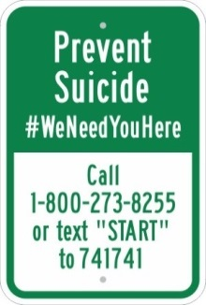
Suicide Prevention Signs
Dissemination by summer
Signs & Poles if wanted
10-11 trigger locks and resource list
Contact info. to order large amounts of trigger locks
Contact Colbie or Celena for the signs and locks
ccaughlan@npaihb.org or 503-416-3284
cmccray@npaihb.org or 503-416-3270

Slide 5
Zero Suicide
3 NW Tribes continue to pilot the implementation
3 additional Tribes hoping to begin the process
Workforce Surveys
Trainings
Challenges
Successes
Notes:
Tribes trained with DBT skills
Tribes signing up for AMSR trainings
Tribes receiving ZS refresher trainings
Safety planning training
Success:
Asking depression questions at each visit
Have identified at risk patients who may have not been identified otherwise
Sharing coding for implementing a suicide specific risk assessment into the EHR system
At least 1 MoU with a local hospital to call the Tribe when a tribal member presents at the ED
Challenges:
Time for follow up of all at risk patients
Staff time for reporting
Staff turnover
Time to draft and approve all of the policies
Staff time to document

Slide 6
Coming Soon. . .
Tool to help educators (or any caring adult) respond to concerning posts seen on social media
Developed by NPAIHB and the Social Media and Adolescent Health Research Team (SMAHRT)
https://vimeo.com/170679097
Notes:
--Because statistics and real life show us we need this tool! Among American Indian/Alaska Native high school aged students, 21.8% seriously considered attempting suicide and 14.7% attempted suicide at least once in the last year. There are a number of factors that contribute to youth suicide: social pressure, stress, bullying and depression
--As a parent, mentor, or health educator, you are trusted advocates and resources for Native youth. In some cases, you might be the only person a young adult feels they can talk to. As you know, youth use social media to connect and communicate with friends, and as a way to express emotion. While this often comes across as funny cat videos and Powwow dance clips, sometimes these posts contain concerning content – things that reference or allude to depression, substance use, harm to self, or harm to others.
--Social Media and Adolescent Health Research Team and We R Native designed a study to create a resource for adults to assist youth who view concerning posts and tools to create an appropriate response plan.
--Study -- Our aim was to better understand the experiences and perspectives of Native youth when they view concerning posts on social media, barriers that prevent them from responding to such posts, and their recommendations for designing solutions. To gather this information, we held three small-group discussions with 32 Native youth 14-22 years old. 4 goals came out of these group discussions and they are the goals of the webinar:
1) that you’ll be able to identify youth who witness concerning social media posts, letting them know that they need not respond alone, all on their own
2) that everyone is aware of, and feels trained to navigate these situations
3) that you’ll be able to assess the experience of those who see concerning posts, and address their concerns, frustration, or fatigue;
4) that you’ll be able to confidently complete and implement the “viewer care plan” to support youth who post and witness concerning posts.
The discussions also told staff that:
--public disclosures on social media provide opportunities to identify youth at risk, and connect them to appropriate resources and support. Almost all adolescents use social media, and nearly a third reference depression symptom on the profiles they maintain. During conversations with Native youth, all of them said they’d viewed concerning posts online. They also mentioned that trusted adults would be people they would seek support from, including parents, mentors, and tribal health educators.
Even though this is a pretty common occurrence, when tribal health educators were polled, only 5% felt adequately prepared to respond.

Slide 7
Concerning Posts Webinar
Partnership with SMHRT
Introduction to the topic and webinar
Real life experiences
Suicide or self-harm posted on social media
Responses to posts
Goals of the webinar
Statistics
Study before the webinar
https://vimeo.com/170679097
Tools for educators/adults
Resources
QPR
Factsheets
Websites
Videos
Completing IRB
Available for pilot testing Mar-May 2017
Who is interested??
Notes:
--Because statistics and real life show us we need this tool! Among American Indian/Alaska Native high school aged students, 21.8% seriously considered attempting suicide and 14.7% attempted suicide at least once in the last year. There are a number of factors that contribute to youth suicide: social pressure, stress, bullying and depression
--As a parent, mentor, or health educator, you are trusted advocates and resources for Native youth. In some cases, you might be the only person a young adult feels they can talk to. As you know, youth use social media to connect and communicate with friends, and as a way to express emotion. While this often comes across as funny cat videos and Powwow dance clips, sometimes these posts contain concerning content – things that reference or allude to depression, substance use, harm to self, or harm to others.
--Social Media and Adolescent Health Research Team and We R Native designed a study to create a resource for adults to assist youth who view concerning posts and tools to create an appropriate response plan.
--Study -- Our aim was to better understand the experiences and perspectives of Native youth when they view concerning posts on social media, barriers that prevent them from responding to such posts, and their recommendations for designing solutions. To gather this information, we held three small-group discussions with 32 Native youth 14-22 years old. 4 goals came out of these group discussions and they are the goals of the webinar:
1) that you’ll be able to identify youth who witness concerning social media posts, letting them know that they need not respond alone, all on their own
2) that everyone is aware of, and feels trained to navigate these situations
3) that you’ll be able to assess the experience of those who see concerning posts, and address their concerns, frustration, or fatigue;
4) that you’ll be able to confidently complete and implement the “viewer care plan” to support youth who post and witness concerning posts.
The discussions also told staff that:
--public disclosures on social media provide opportunities to identify youth at risk, and connect them to appropriate resources and support. Almost all adolescents use social media, and nearly a third reference depression symptom on the profiles they maintain. During conversations with Native youth, all of them said they’d viewed concerning posts online. They also mentioned that trusted adults would be people they would seek support from, including parents, mentors, and tribal health educators.
Even though this is a pretty common occurrence, when tribal health educators were polled, only 5% felt adequately prepared to respond.

Slide 8
Suicide Prevention Social Marketing Campaign WE ARE CONNECTED. #WE NEED YOU HERE.

Slide 9
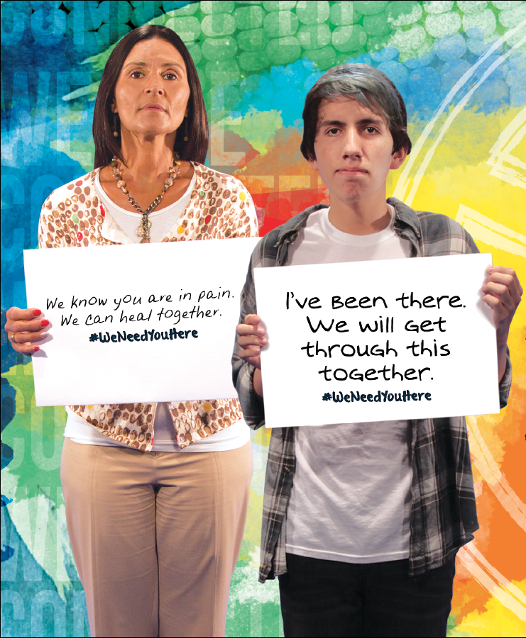
Posters
Blank Flyer
Rack Card
Tip Card
Lanyard
Flash Drives
Radio PSAs
T-shirts
Lived Experience Videos

Slide 10
LGBTQ, TWO SPIRIT Social Marketing Campaign LOVED & ACCEPTED #WE NEED YOU HERE

Slide 11
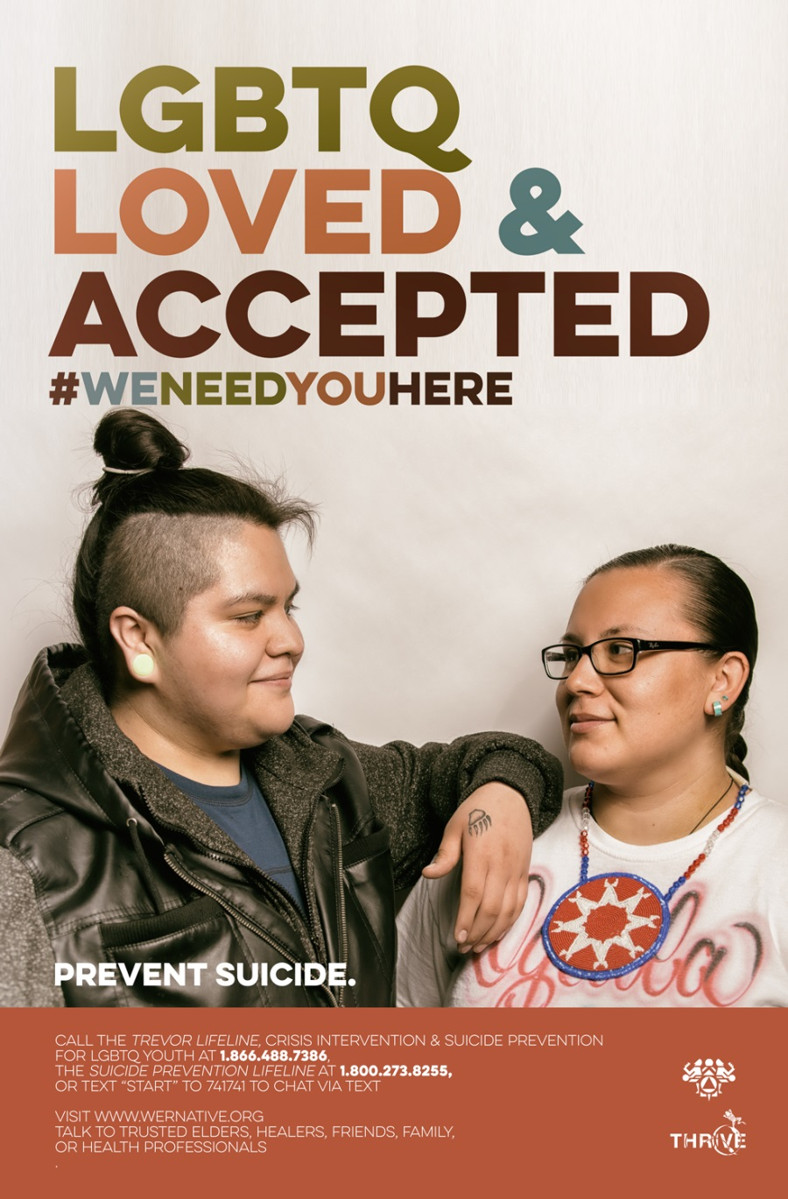
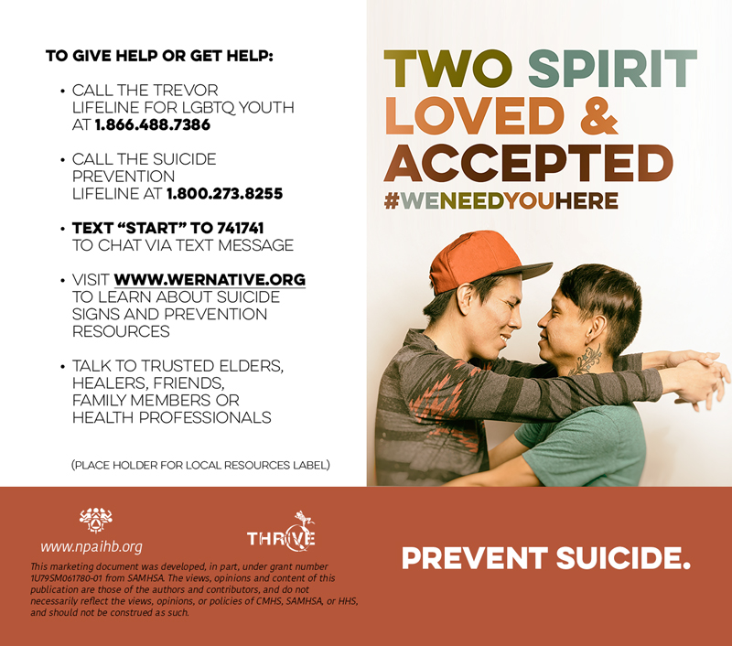
Posters
Rack Card
Tip Card
Radio PSA
Lived Experience Videos

Slide 12
Native Veterans Suicide Prevention Social Marketing Campaign Please fill out the paper survey Put in the box labeled “Veteran Surveys” Fax attn: THRIVE to 503-228-4801 Deadline: Friday January 20, 2017
Developing the. . . .

Slide 13
Notes:
We R Native is a multimedia health resource for Native teens and young adults.
The service was designed using behavior change theory and extensive formative research with Native youth across the U.S. We design our messages to address the social, structural, and environmental stressors that influence adolescent health. With particular focus given to the prevention of suicide, bullying, STDs, teen pregnancy, and drug and alcohol use.
The project is funded by the Indian Health Service HIV and behavioral health programs, and is heavily supported in-kind by our GLS grant.

Slide 14
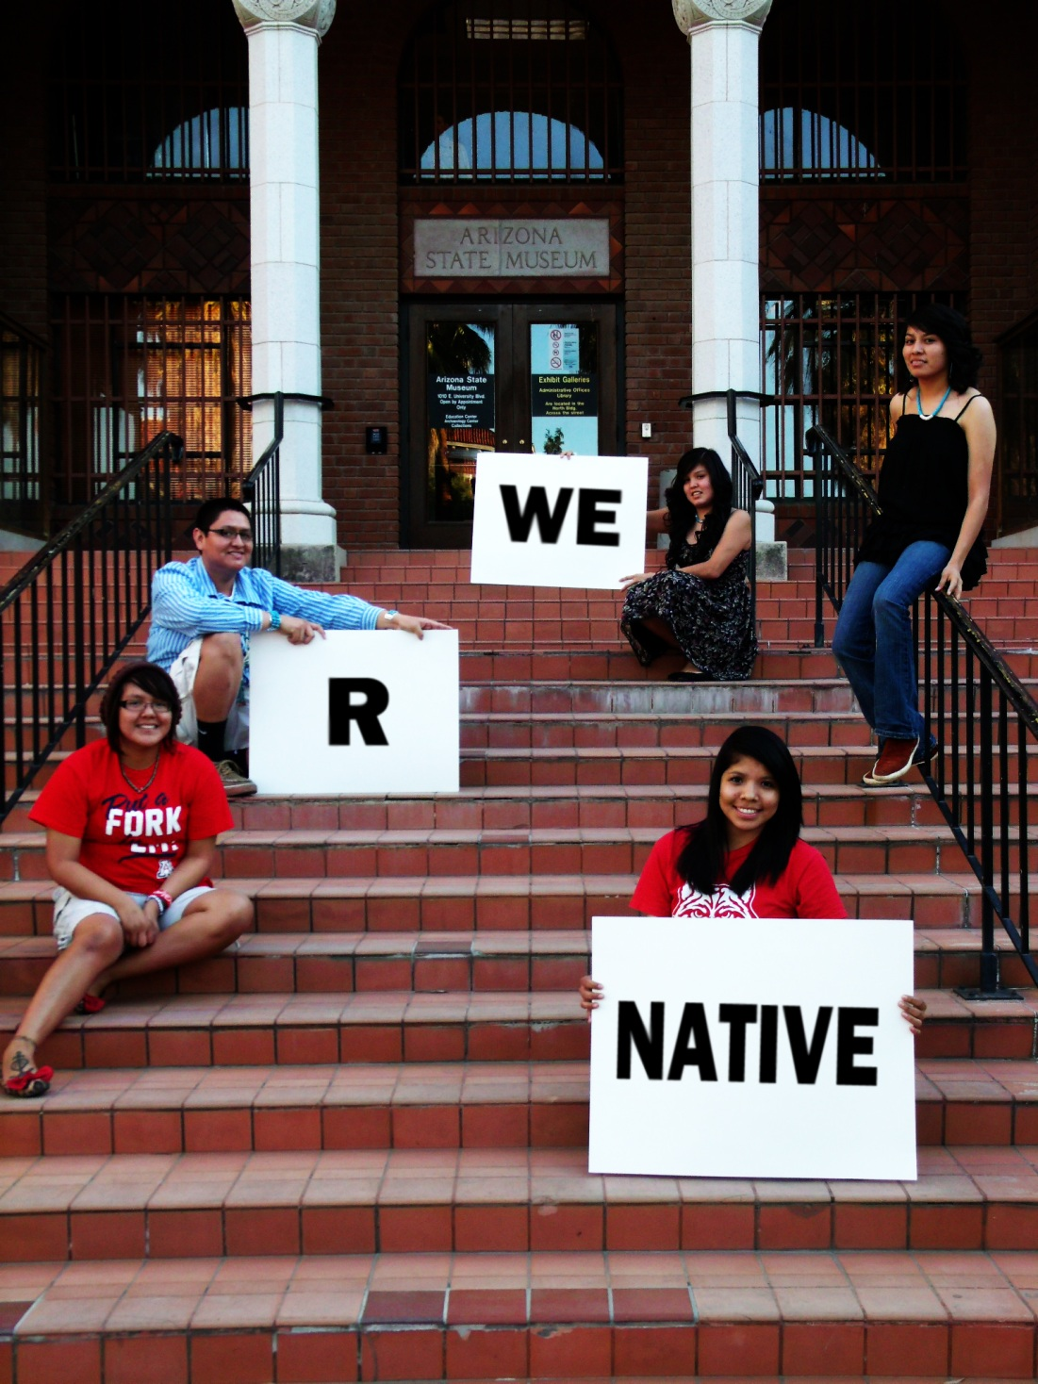
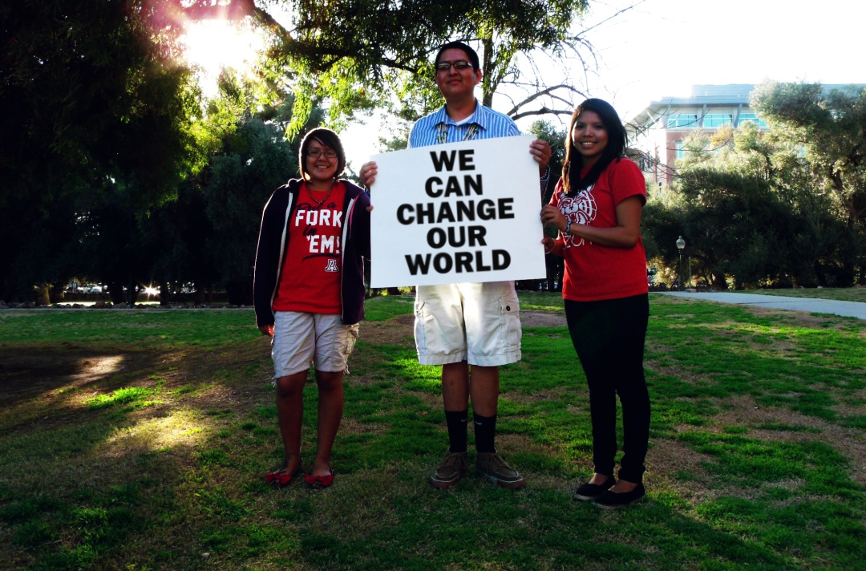
Notes:
We’ll be delivering the campaign through our social media channels in June.

Slide 15
Like us on Facebook
Follow us on Twitter
Subscribe to our YouTube Channel
Follow us on Instagram
Text “HEALTHY” to 97779 to get the latest health curricula and resources for Native youth!
If you’re a young person:
Text “NATIVE” to 97779 to receive weekly health tips, contest, and life advice
Become a WRN Youth Ambassador
Make a positive difference in your community. Apply for up to $475
Notes:
Please help us spread the word about We R Native!

Slide 16
Gen-I Social Media Boot Camps
WeRNative Training
Leadership Skills
Youth Driven Social Marketing Project
Health Activism
Site’s Role
Schedule 2 full days
Recruit 15-20 AI/AN youth
Schedule a facility
Provide adult chaperones to assist WRN staff
Topics
Cultural identity & resilience
Substance abuse prevention
Suicide prevention
WRN Role
Lead or contract a facilitator
Contract a professional media company
Edit the final social marketing project
Offering 2-3 in 2017
Contact Tommy Ghostdog Jr. at tghostdog@npaihb.org
Notes:
THRIVE would like to train AI/AN youth from across the U.S. in leadership skills, social marketing, and health activism. The workshops will need 2 full days to engage and educate participants about youth-driven social marketing campaigns designed to prevent youth suicide and substance abuse.
We call this a social marketing boot camp and hope that 15-20 (or potentially more) Quileute youth would be interested in attending a camp at your location! The training will generate youth-driven social marketing campaigns, focusing on cultural identity and resilience. I know you were hoping to have information be presented about suicide prevention and substance abuse prevention as well so we can weave that in to the campaigns as well, it is a great fit and we have even done boot camps focusing on those two topics in the past 2 months!
To ensure the trainings are designed “for Native youth, by Native youth,” each session will most likely be co-led by a We R Native Youth Ambassador, a NW tribal youth council, or a UNITY youth council member.
As a part of the Generation Indigenous (Gen-I) initiative, the Center for Native American Youth (CNAY) has developed a map of impactful programs and Native American youth leaders creating positive change across Indian Country. The map includes local organizations, youth councils, youth-led volunteer projects, and connects youth with each other to expand access to resources and services. We will use this map, and our existing We R Native Youth Ambassador Facebook group, to identify a youth co-trainer who would like to help lead the training.

Slide 17
2016 Bootcamps
We R Native Youth Ambassadors (Drug/Alcohol Prevention PSA) - https://youtu.be/D7rlAjgb3tI 1:27
Olympia Area Youth (Suicide Prevention PSA) - https://youtu.be/X7k1h9FPLK0 1:42
Quileute Youth (Culture/Native Pride PSA) - https://youtu.be/gOGCVSFVX1M 1:53
Interested? Contact Tommy Ghostdog Jr. at tghostdog@npaihb.org
Notes:
Show videos here:

Slide 18
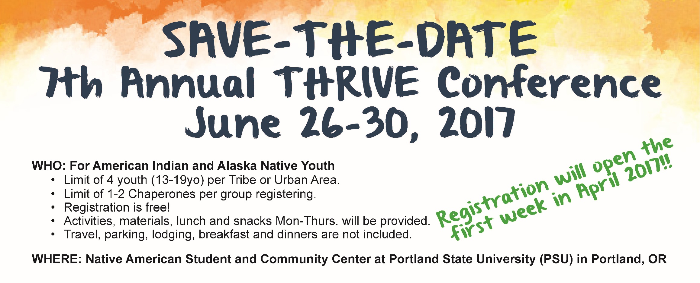

Slide 19
Opportunities
Native STAND
Students Together Against Negative Decision Making (STAND)
Recruiting 25 Tribes or AI/AN organizations for the final year
Mandatory training week, June 26-30, 2017 in Portland
Application deadline is Mar. 1
Contact: Michelle Singer
Native STAND Project Manager
Oregon Health and Science University
Phone: 503-418-2199
Email: singerm@ohsu.edu
PREP in WA State
Personal Responsibility Education Program (PREP)
Recruiting sites
Hoping tribal sites identify curricula from the Healthy Native Youth website (description next slide)
Letters of Interest due Feb. 10
Contact: Lauri Turkovsky, EdD
PREP Grant Coordinator
WA Dept. of Health
Phone: 360.236.3538
Email: Lauri.Turkovsky@doh.wa.gov
Notes:
STAND - recruit 25 Tribes and American Indian/Alaska Native (AI/AN) organizations to receive training on the delivery of Native STAND (Students Together Against Negative Decision Making), a positive youth development program that builds decision making skills on healthy relationships, STD/HIV prevention, and reproductive health. Tribes and AI/AN organizations that serve high school age AI/AN youth (age 14-18) are encouraged to apply.
PREP-Recruiting WA State sites including Tribes to educate youth on abstinence and contraception for the prevention of pregnancy and sexually transmitted infections, including HIV/AIDS, and three adulthood preparation subjects subjects (Healthy Relationships, Parent-Child Communication, and Healthy Life Skills).
Interested in a teen pregnancy prevention program designed specifically for Native American youth?
The Department of Health is offering mini-grants to 5 communities across Washington. Project participation includes:
Curriculum training provided by the Northwest Portland Area Indian Health Board
Implementation support
Free program materials
Onetime $10,000 stipend to assist with start-up costs
Interested tribes may apply by sending a 1-2 page letter of interest briefly describing: leadership and facilitator support; number of youth to be served; curriculum implementation setting; and long-term sustainability plans. All applicants will receive a readiness assessment call to gather more detail on the tribe’s plans for an August 1 project start if selected. Letters are due February 10th.

Slide 20
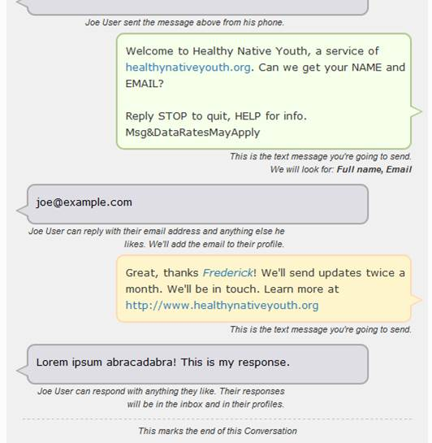
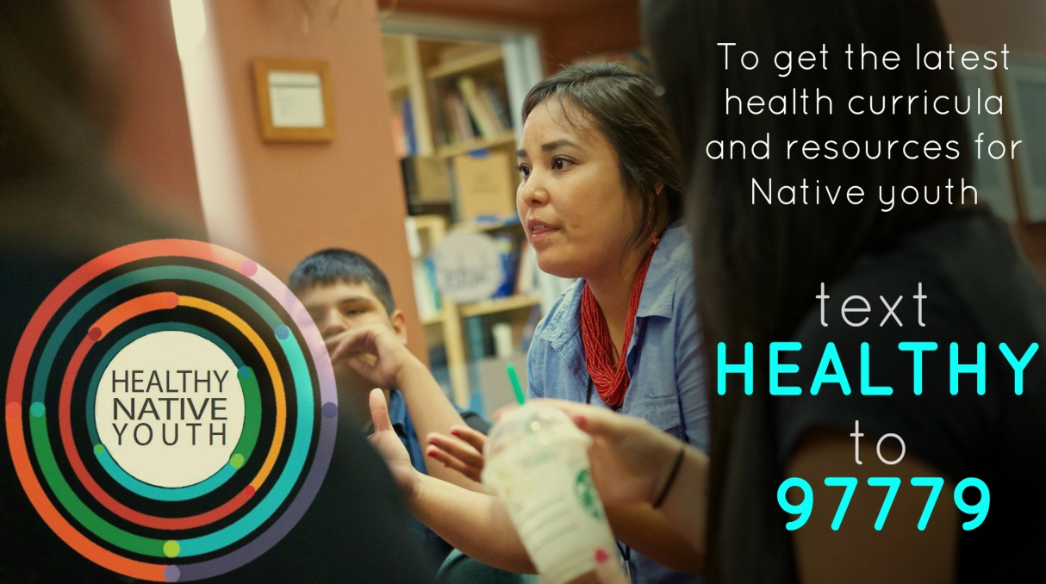
Take Out Your Phones

Slide 21
Healthy Native Youth Website
Notes:
New website that launched in late 2016 and is for educators!!

Slide 22
Healthy Native Youth Website
Notes:
- HealthyNativeYouth.org contains health promotion curricula and resources for
American Indian and Alaska Native youth. The site is designed for tribal health
educators, teachers, and parents – providing the training and tools needed to access
and deliver effective, age‐appropriate programs. Filter and search for curricula by age group,
delivery setting, and evidence of effectiveness. Each program includes lesson
plans, handouts, and supplemental materials; many also include recorded videos and
webinars to help prepare educators to facilitate lessons.
-The site currently includes sexual health curricula, but will expand to include other
health topics over the next year.

Slide 23
Training Opportunities
Applied Suicide Intervention Skills Training (ASIST)
www.livingworks.net
2 full days, CEUs offered (no fee for specific professions in some states)
Working Minds – Suicide Prevention in the Workplace
www.CarsonJSpencer.org
You pick a 2 or 4 hour training
Question Persuade Refer (QPR)
www.qprinstitute.com
2-3 hours, CEUs offered for a fee
Request any of the listed trainings by contacting Colbie Caughlan at ccaughlan@npaihb.org or calling 503-416-3284

Slide 24
Support for Expectant and Parenting Teens, Women, Fathers, and Their Families
https://www.surveymonkey.com/r/SupportParentingTeens
Notes:
4. Support for Expectant and Parenting Teens, Women, Fathers, and Their Families
While tribes may want to apply for the teen parenting one independently, I think a regional application will probably be more competitive. Can use the survey results for a regional application or of any of your Tribes end up applying!
The goal of this FOA is to fund States and Tribes for the development and implementation of programs for expectant and parenting teens, women, fathers, and their families to improve health and related educational, social, and economic outcomes. Funded grants will provide an integrated and seamless network of supportive services in multiple primary settings: high schools, community service centers, and Institutions of Higher Education (IHE). OAH anticipates funding up to 20 grants with an annual budget of $500,000 - $1,500,000 for a three-year project period. To learn more, please visit the Open Grants page of the OAH website, or view the announcement on Grants.gov.
· Letters of Intent – Due January 31, 2017
· Applications – Due March 24, 2017
· Technical Assistance Webinar for Potential Applicants – Thursday, January 19, 2017 from 3:00-5:00pm ET. Call-in number: 1-800-857-4868, passcode 7877854; Net conference log-in: https://www.mymeetings.com/nc/join.php?i=PWXW1795167&p=7877854&t=c
· Up to 20 grants
· $500,000-$1,500,000 per year for 3 years
· Approach: The NPAIHB applied for this grant once before and can tweak and re-submit

Slide 25
Northwest Portland Area Indian Health Board
Stephanie Craig Rushing, PhD, MPH
Director – Project Red Talon & THRIVE
scraig@npaihb.org
Colbie Caughlan, MPH
THRIVE Project Manager
ccaughlan@npaihb.org
Celena McCray
THRIVE Coordinator
cmccray@npaihb.org
Amanda Gaston, MAT
Ask Auntie
agaston@npaihb.org
David Stephens, RN
HCV RN Project Manager
dstephens@npaihb.org
Tommy Ghost Dog
PRT Assistant
tghostdog@npaihb.org
Jessica Leston, MPH
HIV/HCV/STI Clinical Services Director
jleston@npaihb.org
Indian Leadership for Indian Health

