Slide 1
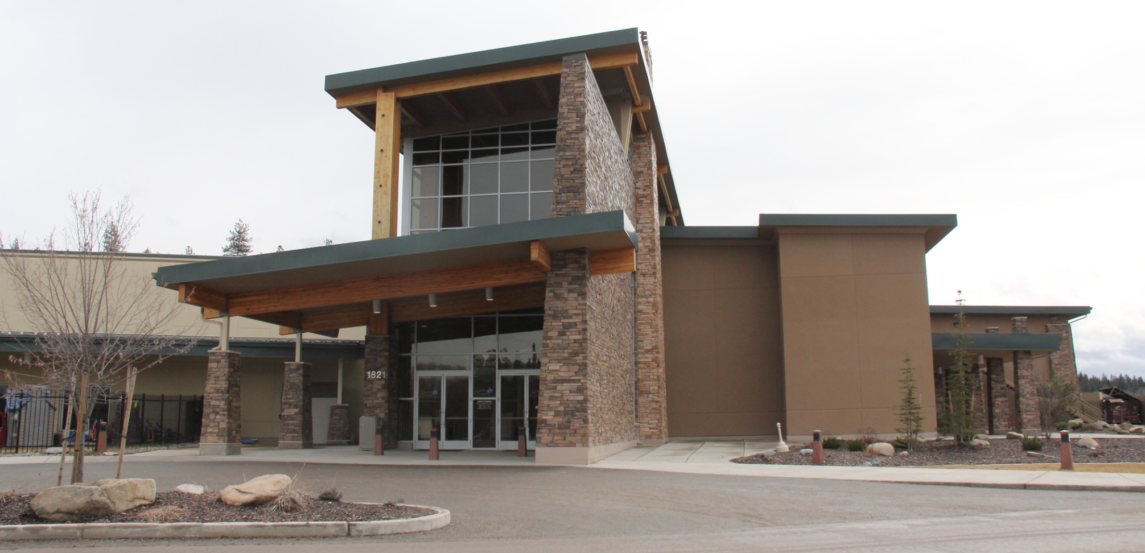
The Kalispel Tribe of Indians invites everyone to the Camas Center for Community Wellness

Slide 2
VISION
In 1992, the Kalispel Tribe of Indians developed a mission statement to reflect the Tribe's belief in positive growth and development of the community as a whole. The statement reflects our desire to promote a bright future that respects traditions, recognizes the power of education, provides a nurturing environment for our children and aims for success through current and future enterprises. It reflects goals the Tribe has established and is currently working to accomplish. The Kalispel people are preparing tribal members and non-tribal community members to attend institutions of higher learning through the Kalispel and Cusick schools. Working with both children and adults, the system provides a well-rounded education that includes Tribal history and culture. Community members are involved in leadership at all levels and students are supported and encouraged to pursue individual and community goals. We are highly successful business people. We have expanded our land base to create ample housing opportunities and meaningful employment for our people, many of whom are self-employed. The Kalispel Tribe lives in harmony with nature and is a national leader in preserving wildlife habitat and fish hatchery preservationists. The Kalispel Tribe of Indians provides complete health care for its people. At the heart of that effort is the belief that a healthy and active lifestyle brings a long and prosperous life. Mission Statement
It is our mission to continue strengthening and building our community while preserving our cultural and natural heritage. We will continue striving to be a good neighbor to the greater community.

Slide 3
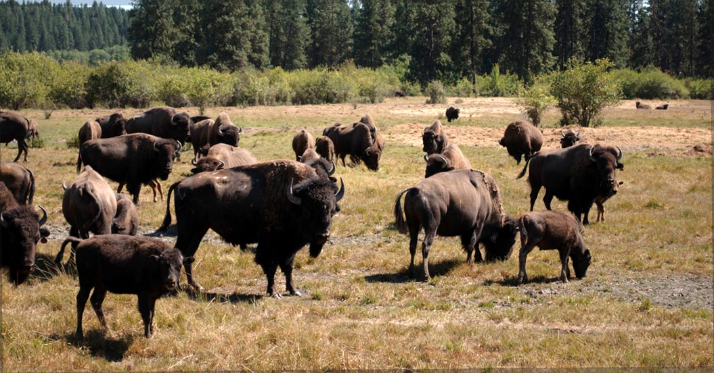

Slide 4
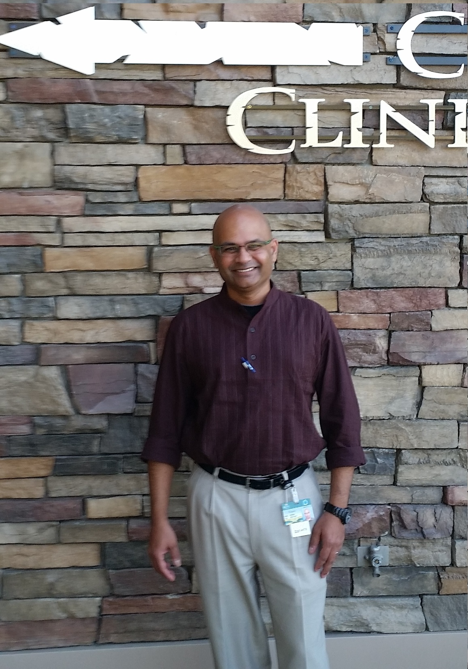
Medical Services
Dr. Raj
1821 N. LeClerc Rd
Cusick, WA 99119

Slide 5
Camas Center Clinic Offers:
Medical clinic for adult and pediatric conditions including urgent walk-ins
Diabetes care and education
Nutritional counseling for Diabetics and Hypertensive-SDPI
On site Pharmacy including intravenous antibiotics
Pharmacy counseling by nursing and pharmacist (when available on site)
Smoking cessation
Wound care
Immunizations and vaccines and Allergy shots
Sports Physicals
Annual Child and Adult physicals/wellness exams
Minor procedures
EKG and interpretation
Lab services re-employment/DOT urine screening
CDC/TMG Grant DataWarehouse

Slide 6
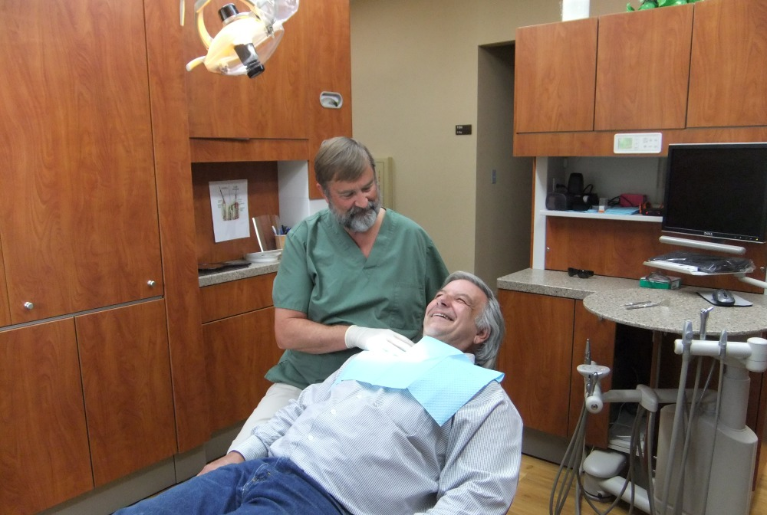
Dental Services – Marvin Gottschall, DDS

Slide 7
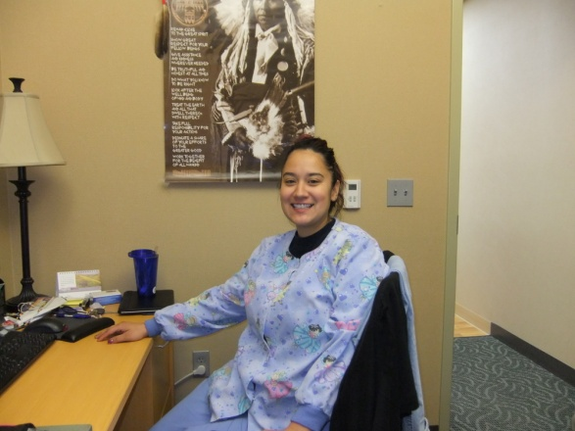
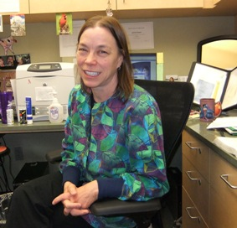
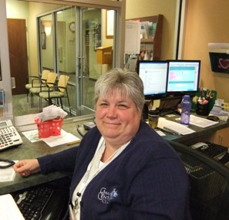
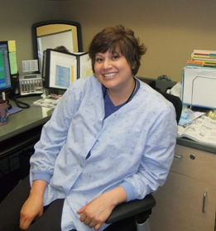
Glenna Abrahamson, CDA
Gwenn Dean, CDA
Dental Assistants & Hygienist
Terry Boncz, CDA
Candy Holford, RDH

Slide 8
Camas Center Clinic Dental Offers:
Examination
Preventative cleanings
Fillings
Crowns
Bridges
Implants
Dentures
Root canals

Slide 9
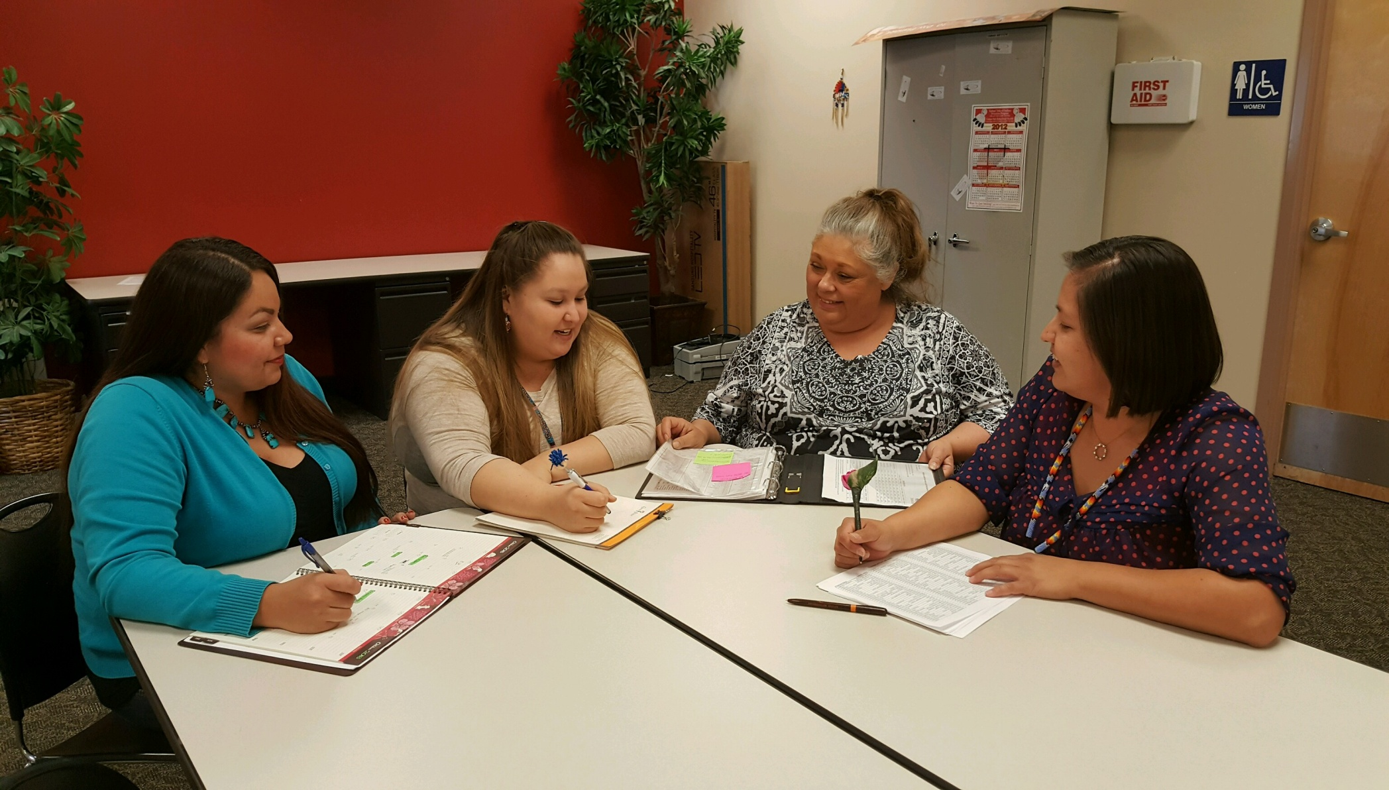
934 S Garfield Rd
Airway Heights, WA 99001
Phone: 509-789-7630
M-Th 7am- 5pm
Behavioral Health Staff

Slide 10
Camas Path Behavioral Health Services:
Chemical Dependency Assessments
Intensive Outpatient
Outpatient
Individual Counseling
EAP
DOT
Problem Gambling

Slide 11
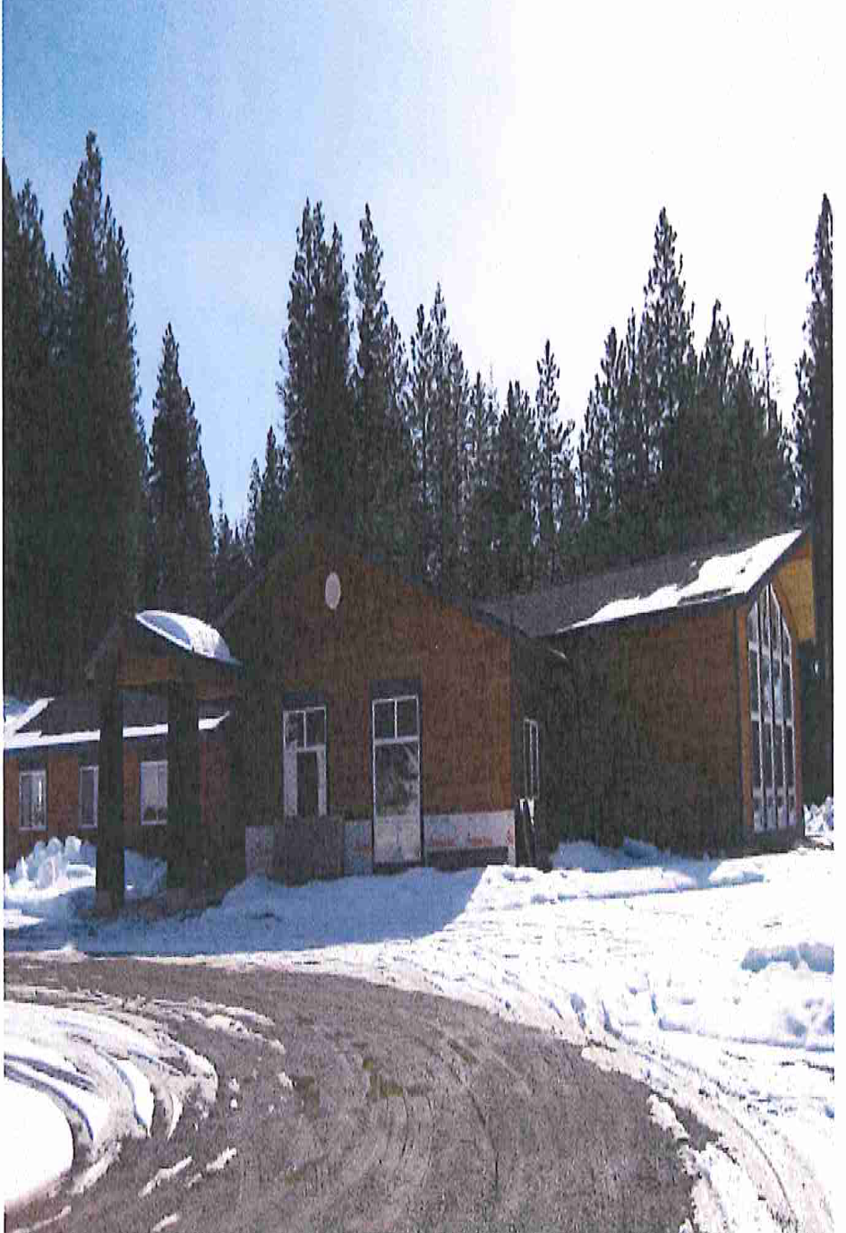
People’s Place

Slide 12
People’s Place Offers:
Family Resource Center
Transitional Living
Monthly Activities: family literacy, living skills, career development, nutrition classes, cultural activities, youth activities

Slide 13
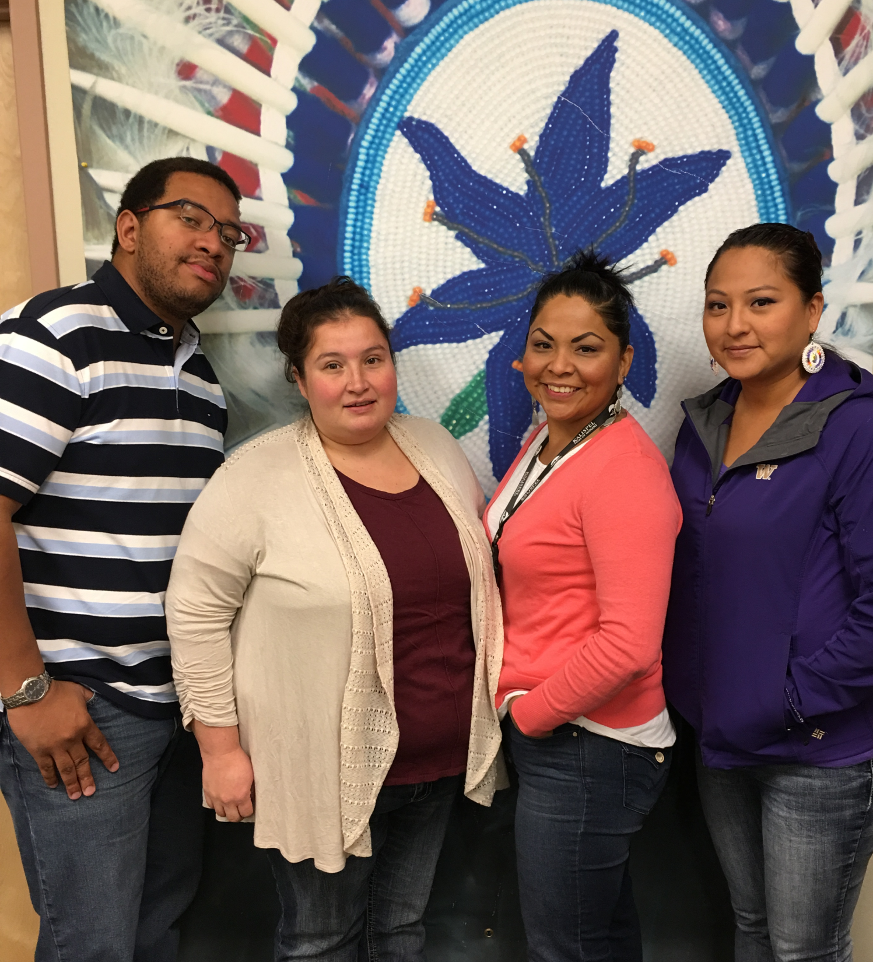
Indian Child Welfare Staff

Slide 14
Indian Child Welfare:
YINOC’s, Guardianships, Wrap-Around Services, Parent/Child visitation
Elders Program and Adult Protection Services:
Promoting Health/Safety for elders and vulnerable adults, reduction in financial exploitation, physical/mental abuse.
DOJ/CTAS:
Forensic Interviewing
Parent/Child Visitation Center
ICW Database Development/Software

Slide 15
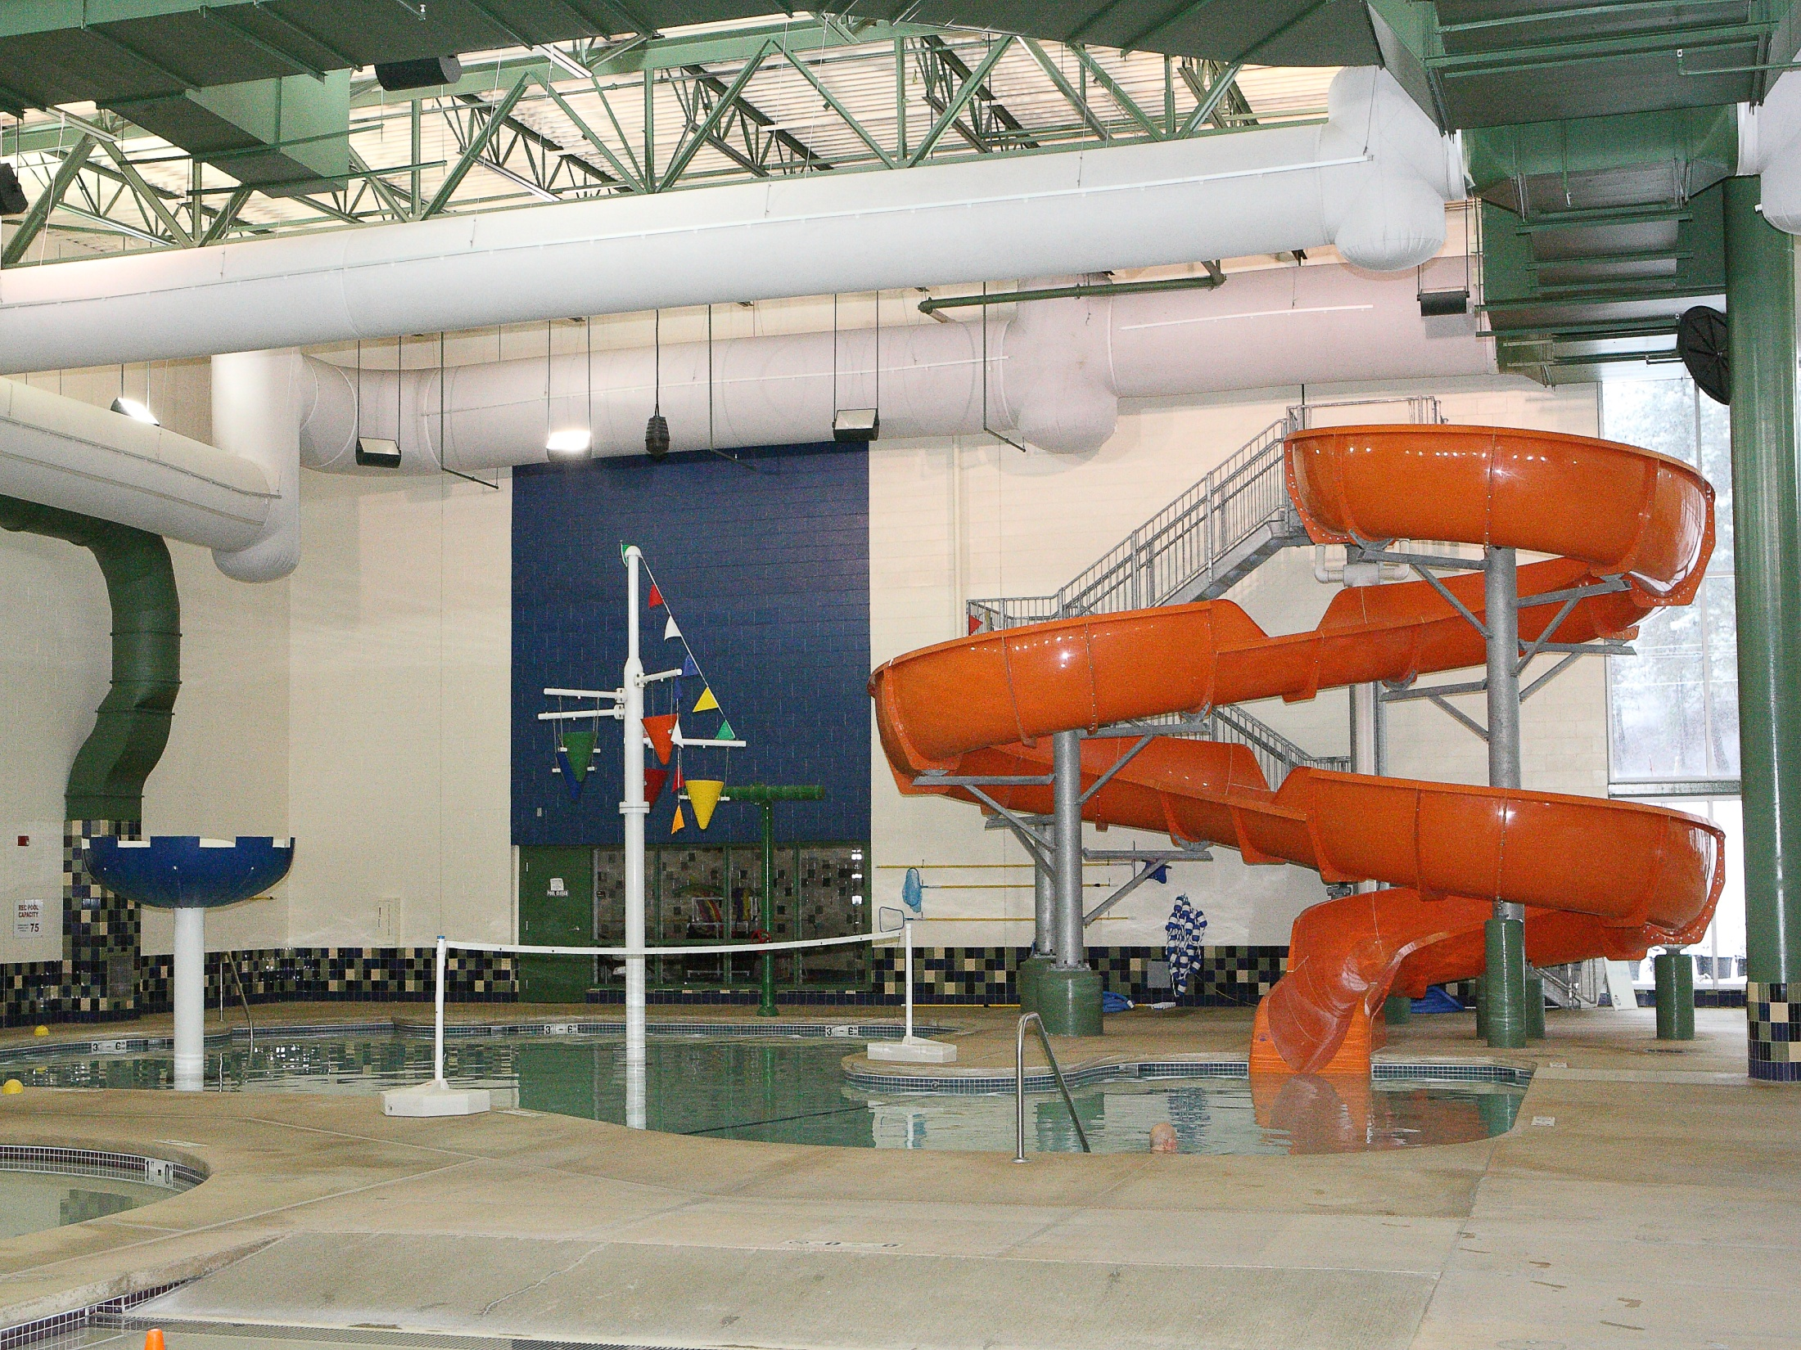
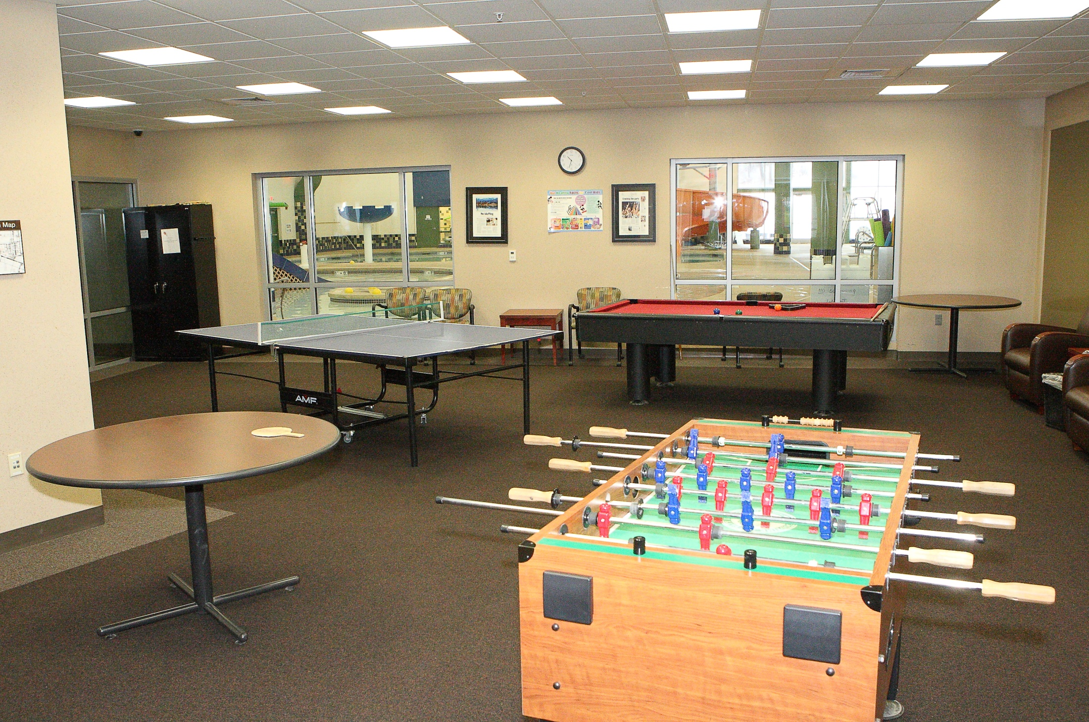
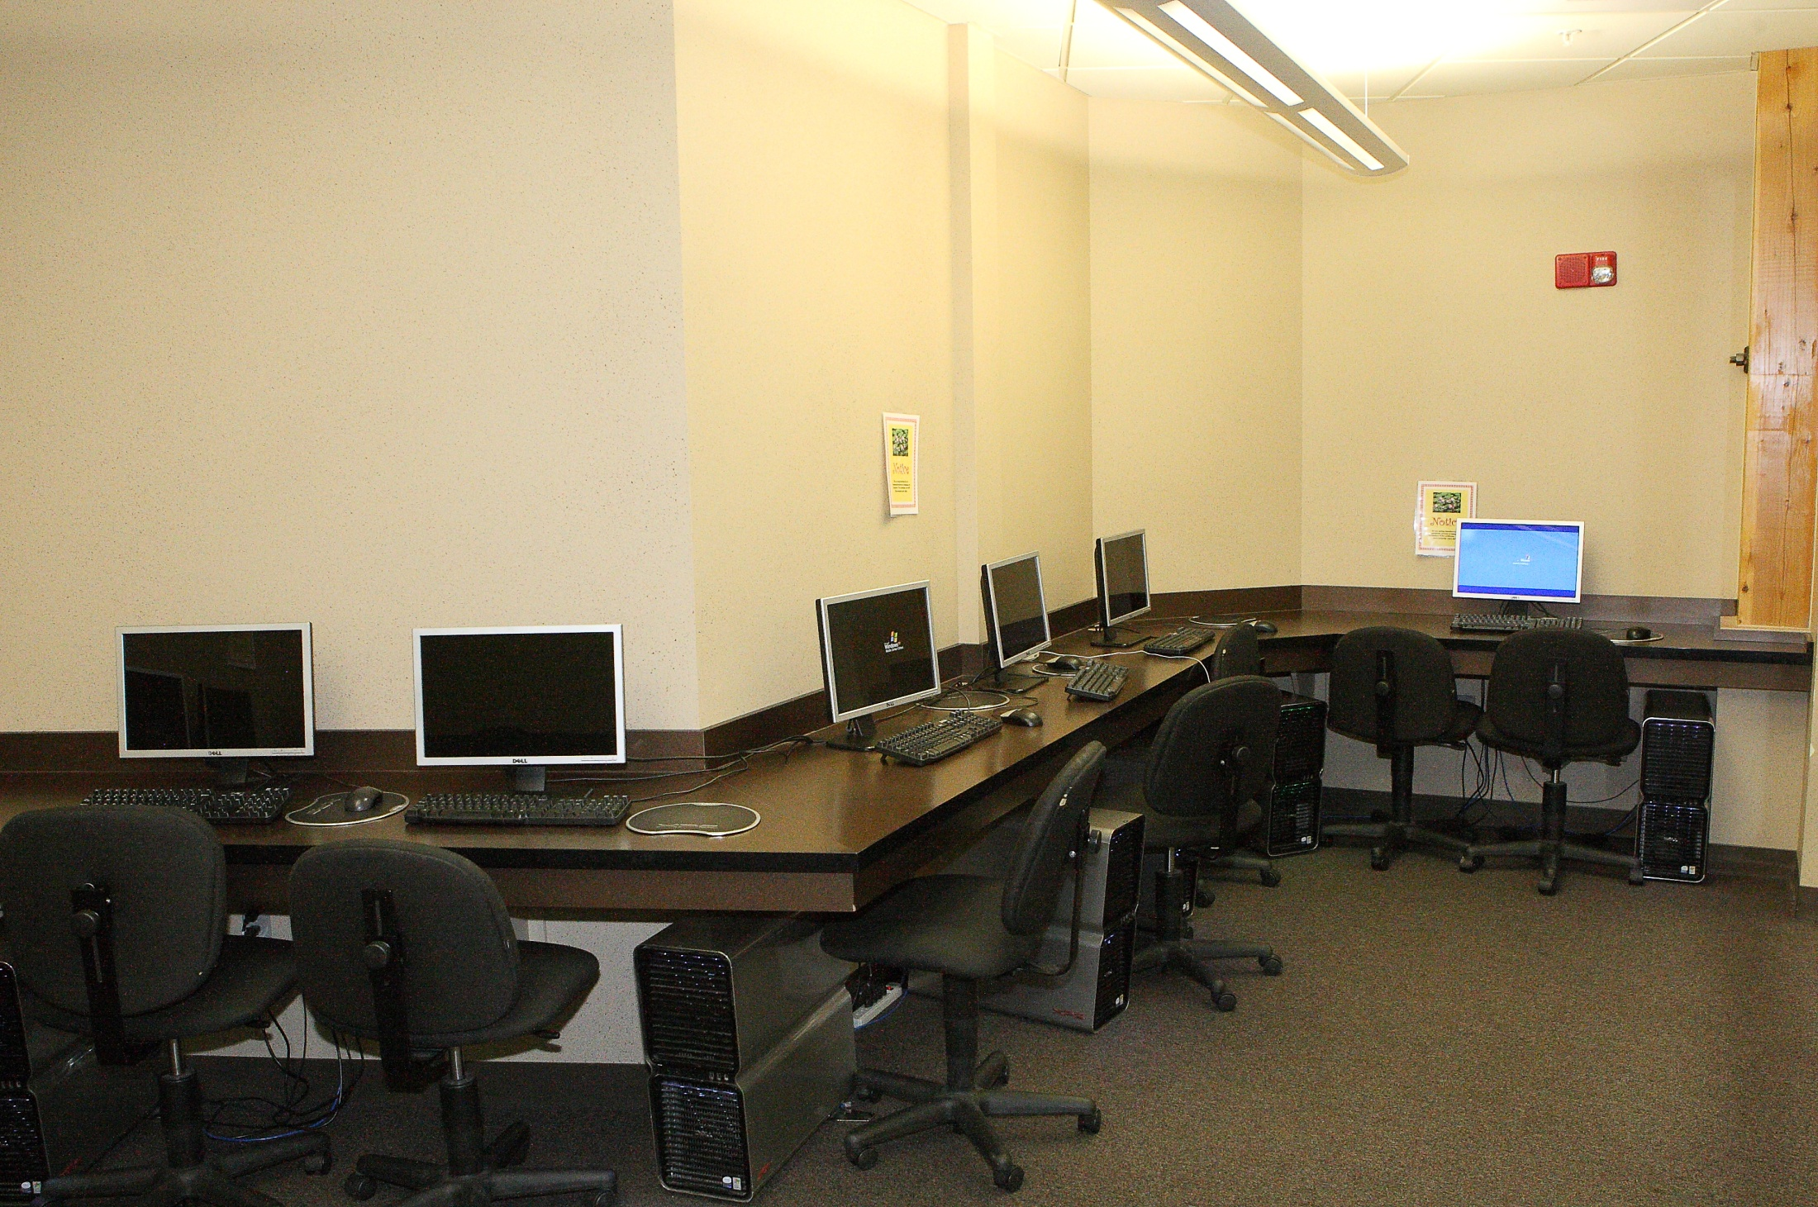
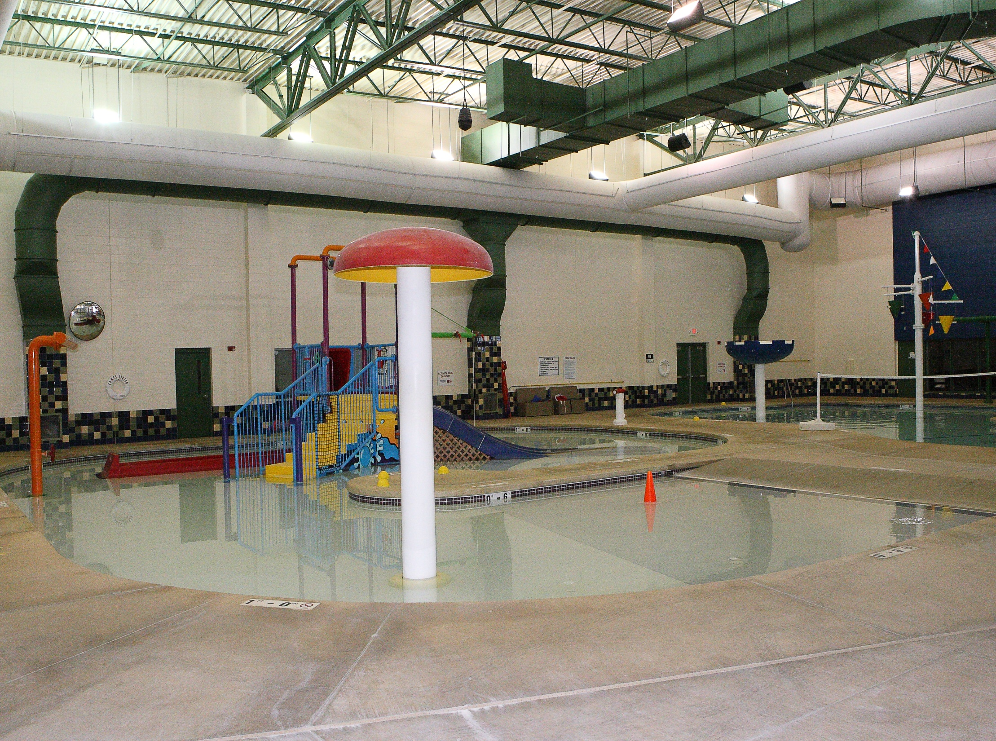

Slide 16
