Slide 1
Data Repository/Data Movement
Victoria Warren-Mears, PhD, RDN, FAND
NWTEC Director
vwarrenmears@npaihb.org

Slide 2
Overview
How does data flow to IHS?
NWTEC Access
EpiData Mart
Linkage Projects
Research Projects
Data Repository Progress
Data Stewardship

Slide 4
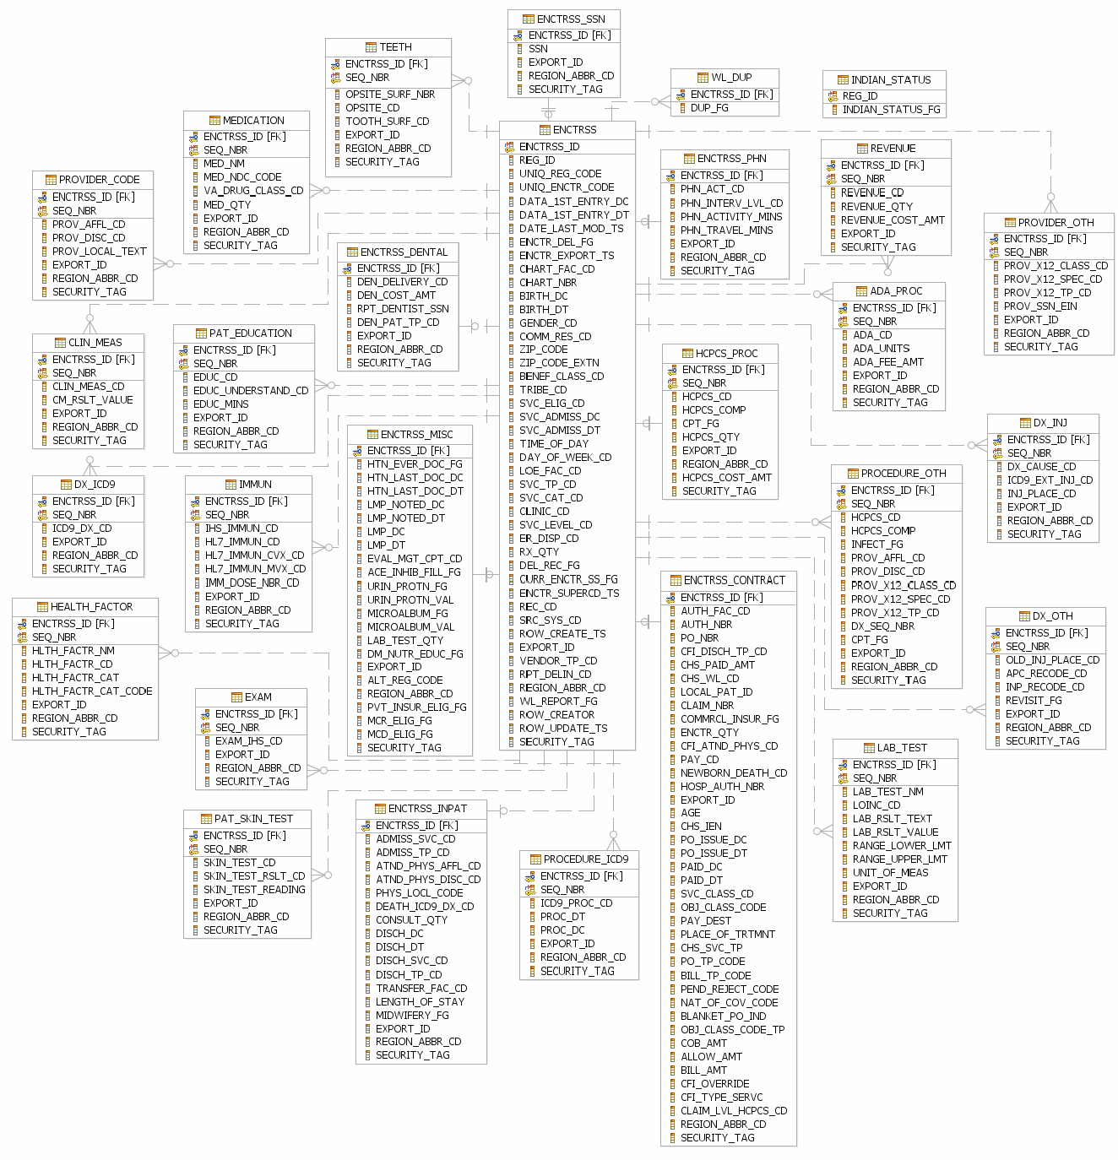

Slide 5
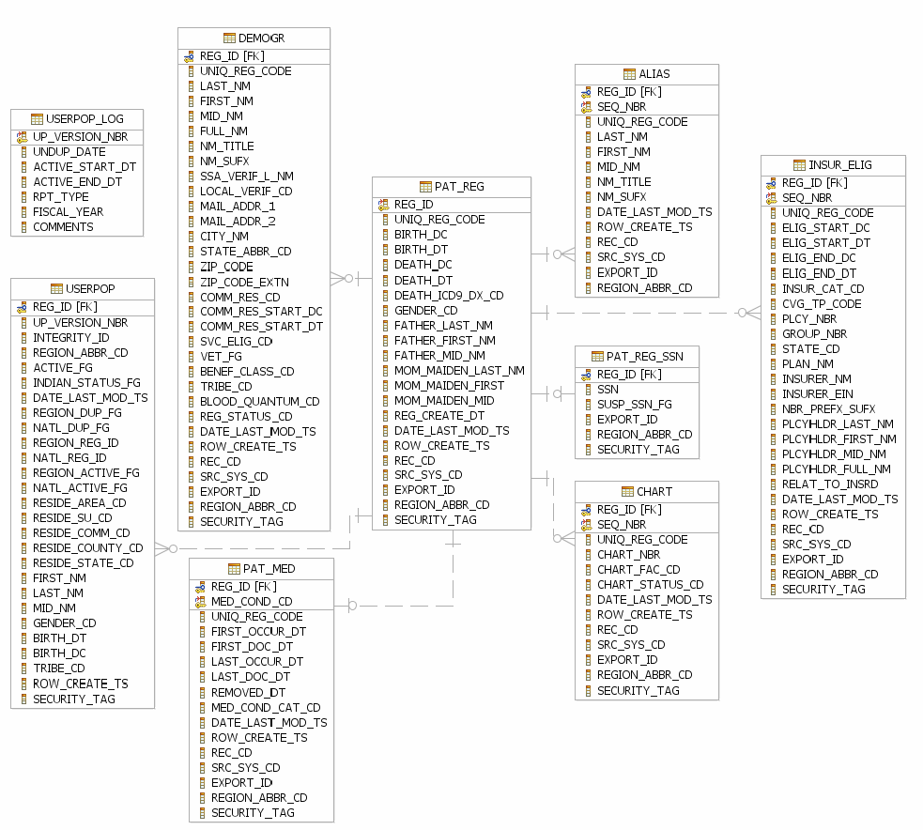
Linkage Data
Compare PAO data with NDW data in 2016 – 2017.

Slide 6
Progress on the Data Repository
HARDWARE |  |  |  |  | Actual |  | Retail
Dell PowerEdge R710 Server |  |  | (Refurb-Recertified) |  | $1,679.00 |  | $1,679.00
Dell PowerEdge R710 Server |  |  | (Refurb-Recertified) |  | $1,679.00 |  | $1,679.00
2 - Spare 3TB 7.2K 3.5" 6Gbps NL SAS Hard Drives |  |  |  |  | $416.51 |  | $416.51
Cisco ASA 5512-x Security Plus Appliance |  |  |  |  | $500.00 |  | $2,414.15
Quantum SuperLoader 3 Tape Backup Autoloader |  |  |  |  | $3,994.34 |  | $3,994.34
20 - Pack of HP LTO-6 Tape Backup Cartridges |  |  |  |  | $866.99 |  | $866.99
RapidRails for server rack installation (4) |  |  |  |  | $338.67 |  | $338.67
Tripp Lite 8-Port Rackmount KVM Switch w/Built in IP |  |  |  |  | $720.99 |  | $720.99
Dell SAS 6 GB NBA External Controller Card |  |  |  |  | $149.00 |  | $149.00
SOFTWARE
3 - Microsoft Windows Server 2012 Standard Licenses |  |  |  |  | $198.00 |  | $3,972.00
50 - Microsoft Windows Server User Client Access Licenses |  |  |  |  | $100.00 |  | $2,200.00
1 - Microsoft Exchange 2016 Mail Server License |  |  |  |  | $53.00 |  | $1,062.00
50 Microsoft Exchange 2016 Server User Client Access Licences |  |  |  |  | $250.00 |  | $5,100.00
25 - Cisco 5500 Series AnyConnect SSL-VPN Licenses |  |  |  |  | $100.00 |  | $1,053.00
 |  |  |  | TOTAL COSTS | $11,045.50 |  | $25,645.65
 |  |  |  | SAVINGS | $14,600.15

Slide 7
Visioning the Future
Finish Data Repository
Data stewardship of data developed and collected at the NWTEC
Data stewardship for other data
Develop data portal for access by tribal leaders
Web based with unique tribal passcodes and protections

Slide 8
Questions and Discussion

