Slide 1
IDEA-NW Project & Data Sharing Agreements npaihb Quarterly Board Meeting January 2016
Victoria Warren-Mears, RD, PHD
Director, Principal Investigator
Northwest Tribal Epidemiology Center
Sujata Joshi, MSPH
Project Director
IDEA-NW Project

Slide 2
Historical Context
Historically, IHS was the source for health care delivery, disease surveillance, and data for Tribes
1990s: Expansion of self-governance in health care delivery led to diminished role and capacity for IHS to provide these services
At the same time, there was increasing recognition that state public health departments were limited in their ability to provide Tribes with disease surveillance and health data.
Inaccurate data on race/ethnicity and tribal affiliation (racial misclassification)
Data not reported at Tribe-level
Limited knowledge and limited consultation with Tribes

Slide 3
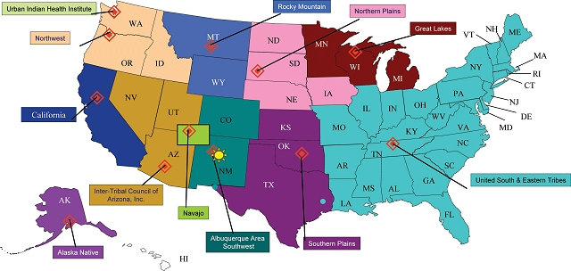
Tribal Epidemiology Centers

Slide 4
Northwest Tribal Epidemiology Center
Mission: To collaborate with Northwest American Indian Tribes to provide health-related research, surveillance, training and technical assistance to improve the quality of life of American Indians and Alaskan Natives
Goals:
Assist communities in implementing disease surveillance systems and identifying health status priorities.
Provide health specific data and community health profiles for Tribal communities.
Conduct tribal health research and program evaluation.
Partner with tribal, state, and federal agencies to improve the quality and accuracy of AI/AN health data.
Notes:
Recognition that Tribes lacked local-level support and expertise in epidemiology and other public health services
First Tribal Epidemiology Centers (TECs) established to build tribal public health infrastructure
Established in 1996 (1997?)
One of 12 TECs that serve Tribes and urban AI/AN populations
Functions as a public health authority for tribes in the Northwest

Slide 5
Injury Prevention Program
NATIVE CARS
THRIVE Suicide Prevention
Northwest Tribal EpiCenter
Injury Prevention
Sexual Health & STD/HIV Prevention
Clinical Support & Preventive Care
Health Surveillance
Cancer & Chronic Diseases
Training Tribal Health Professionals
NARCH
NW Tribal Cancer Project
Western Tribal Diabetes Project
WEAVE-NW
IDEA-NW
Tribal BRFSS Project
Immunizations Program
Tribal Dental Support Center
Project Red Talon
Notes:
Focus Areas
All work approved by tribal resolutions and reviewed by IRB

Slide 6
IDEA-NW Project
Improving accuracy of AI/AN health data through record linkages

Slide 7
AI/AN Misclassification in the NW
Misclassification happens when AI/AN are recorded as being another race (usually White) in a dataset
Ranges from 8-60% of AI/AN records in NW health data
Birth and death records have relatively low (8-10%) numbers of misclassified records
Cancer registries average at around 30% of records
Hospital discharge and trauma registries can have up to 60% of AI/AN records with incorrect or missing race/ethnicity data
Why does this matter?
Small numbers get even smaller
Difficult to establish accurate baseline measures
Can obscure real disparities experienced by tribal communities
Notes:
Small numbers issue

Slide 8
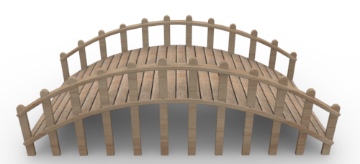
Linkages to correct misclassification
Accurate health statistics
Data for planning
Tribal Data
State
Data
Data and tools for evaluation
NW Tribal Epicenter
Data for grant writing
New Partnerships

Slide 9
Idaho Cancer Incidence Data, 2008-2012
Cancer Site | Pre-linkage AI/AN Cases | Post-linkage AI/AN Cases | Change in Case Count
All Invasive | 243 | 320 | 77
Female Breast | 35 | 45 | 10
Prostate | 28 | 42 | 14
Lung | 29 | 37 | 8
Colorectal | 36 | 42 | 6
Notes:
Difference in N = 77

Slide 10
Leading Causes of Death for Washington AI/AN, 2009-2013
Rank | Cause of Death | Pre-linkage AI/AN | Post-linkage AI/AN | Change in # of deaths
1 | Major Cardiovascular Diseases | 1148 | 1261 | 113
2 | Malignant Neoplasms | 902 | 980 | 78
3 | Unintentional Injury or Accident | 543 | 580 | 37
4 | Chronic Liver Disease and Cirrhosis | 250 | 275 | 25
5 | Chronic Lower Respiratory Diseases | 231 | 260 | 29
6 | Diabetes Mellitus | 206 | 224 | 18
7 | Suicide | 147 | 166 | 19
8 | Alzheimer's Disease | 98 | 111 | 13
9 | Influenza and Pneumonia | 69 | 73 | 4
10 | Other Respiratory Diseases | 68 | 73 | 5
 | Total Deaths | 6759 | 7485 | 726

Slide 11
Linkages completed to date
Idaho
Cancer Registry
Birth Records
Oregon
Cancer Registry
Birth Records
Washington
Cancer Registry
Trauma Registry
Death Records
Death Records
Hospital Discharge Records
Communicable Disease Registries
Oregon Health Plan (Medicaid)
Birth Records
Death Records
Hospital Discharge Records

Slide 12
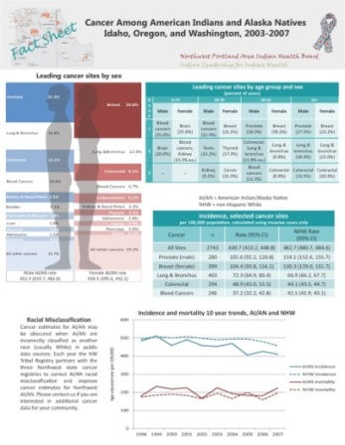
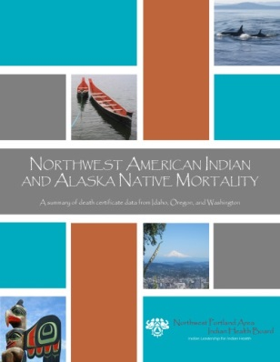
Data Products
State and CHSDA-level Tribal Health Profile Reports
Fact Sheets on Cancer, Suicide, Hospital Admissions, and other topics
Focused reports on NW AI/AN Cancer and Mortality
Data requests from Tribes
Manuscripts and Conference Presentations
http://www.npaihb.org/epicenter/project/reports

Slide 13
Challenges
Improving the Northwest Tribal Registry

Slide 14
Linkages to correct misclassification
Data for grant writing
Data for planning
Tribal Data
State
Data
Data and tools for evaluation
NW Tribal Epicenter
Accurate health statistics
New Partnerships
Notes:
If you think back to this slide, you may have wondered – What tribal data are they using for these linkages?

Slide 15
Northwest Tribal Registry
Portland Area IHS patient list
Urban Indian Health Clinics’ patient lists
Patient list from one Washington Tribe
?
Notes:
NTR
-demographic information only – no health data
-does contain PII – SSN, name, DOB, etc.
Tribes and clinics not on RPMS, or who do not share data with Portland Area IHS office, are not included in the NTR.
As Tribes transition to other EHRs, our data linkages will become less effective at correcting misclassification.

Slide 16
Data Sharing with Tribes
Data sharing agreements formalize how, what, when, and with whom data will be shared between individual Tribes and NWTEC.
Looking forward:
Work with Tribes to identify data sharing opportunities for data linkages and other projects
Establish or update data sharing agreements with all member Tribes

Slide 17
Contact
Acknowledgements
NPAIHB
The Tribes of Idaho, Oregon, and Washington, patients and their families
Partners at the Portland Area IHS, Tribal and Urban Indian Health Clinics, and State Health Departments
Funding Agencies: Office of Minority Health and Indian Health Service
Victoria Warren-Mears
vwarrenmears@npaihb.org
Sujata Joshi
sjoshi@npaihb.org
ideanw@npaihb.org

