Slide 1
Cannabis in Indian Country
Lael Echo-Hawk, General Counsel
National Indian Cannabis Coalition
Attorney, Garvey Schubert Barer
lechohawk@gsblaw.com

Slide 2
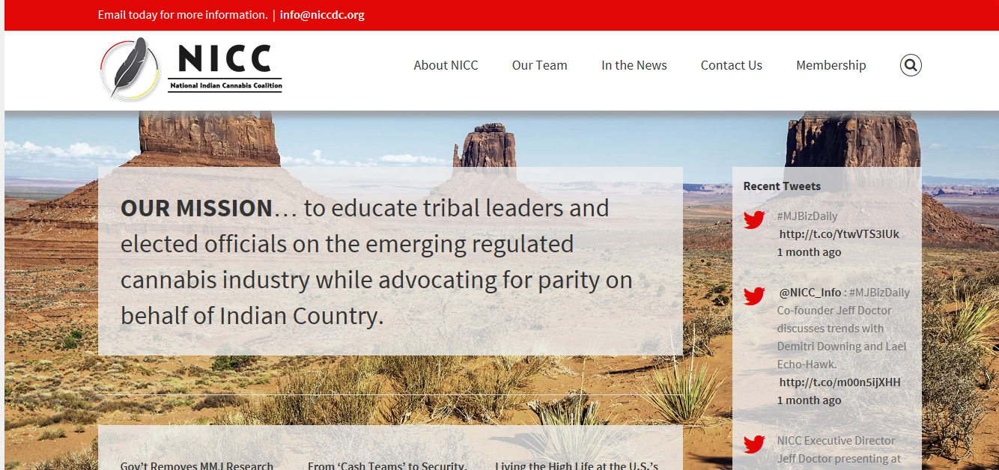
National Indian Cannabis Coalition
www.niccdc.com

Slide 3
Why Are We Here?
December 11, 2014 the DOJ released its internal Policy Statement on Marijuana Issues in Indian Country.
Memo dated October 28, 2014
Internal policy developed without consultation with tribes.

Slide 4
DOJ Policy Statement Regarding Marijuana Issues in Indian Country
Directs each U.S. District Attorney to:
Assess all threats within the District, including those in Indian Country.
Consult with the Tribes in their District on a government-to-government basis.
Focus enforcement efforts based on that district-specific assessment.
Invitation to consult – not blanket authorization to legalize
Guidance only!

Slide 5
Cannabis
Cannabis is derived from the cannabis plant (cannabis sativa).
Cannabis has at least 85 active cannabinoids
THC – is a cannabinoid and can cause a “high”
Cannabidiol (CBD) is one of at least 85 active cannabinoids identified in cannabis.
Hemp – variety of Cannabis plant with less than 3% THC
Produces higher levels of CBD than THC

Slide 6
Across the Country…
23 states, plus WA D.C., recognize and permit the medical use of cannabis
1996: California
1998: Alaska, Oregon, Washington
1999: Maine
2000: Colorado, Hawaii, Nevada
2004: Montana
2006: Rhode Island
2007: New Mexico, Vermont
2008: Michigan
2010: Arizona, New Jersey
2011: Delaware, Washington, D.C.
2012: Connecticut, Massachusetts
2013: New Hampshire, Illinois
2014: Maryland, Minnesota, New York

Slide 7
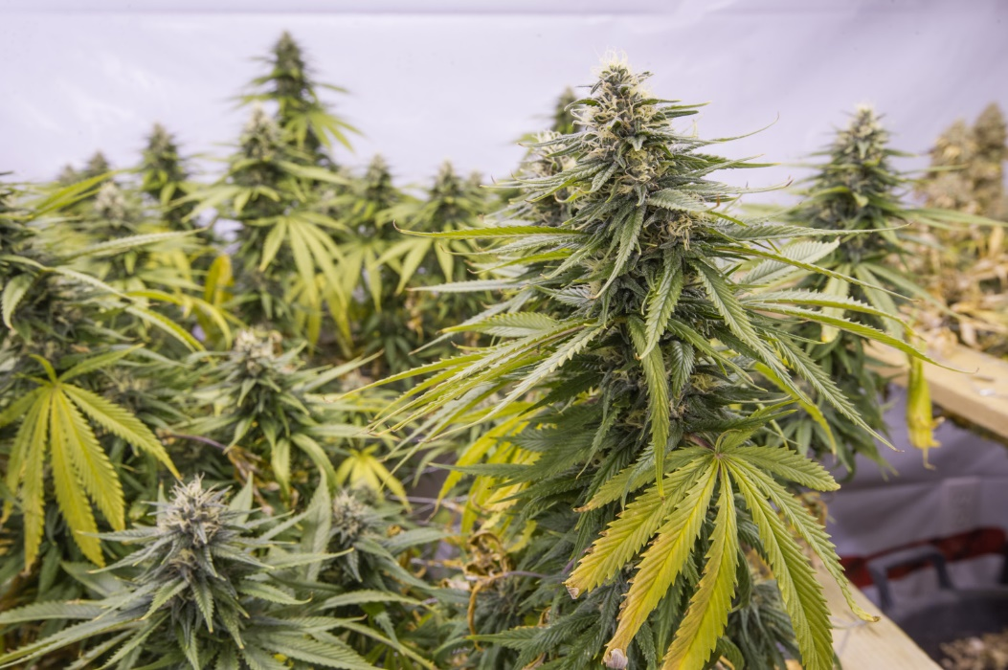
Across the Country…
4 states legalized the recreational, adult use of marijuana
2012:
Washington
Colorado
2014:
Oregon
Alaska
Washington D.C.*

Slide 9
Economic forecast - Marijuana
Legal marijuana grew 74% in 2014 to $2.7B up from $1.5B in 2013.* Arcview Market Research report
Colorado - $699M total combined sales
Taxes - $63M Revenue (36% from recreational)
Licensing - $13M Revenue
2.85M edible retail products sold
Washington – estimated to increase by $252M in 2015*
AMR estimates $10.8B in national sales by 2019*

Slide 10
Economic forecast - Hemp
Hemp – estimated $500M market for hemp products
Renewable energy source?
Medical treatment
Higher rate of return per acre than any other crop except Tobacco. (Congressional Research Service Report for Congress 2013)
22 states have passed pro-hemp legislation.

Slide 11
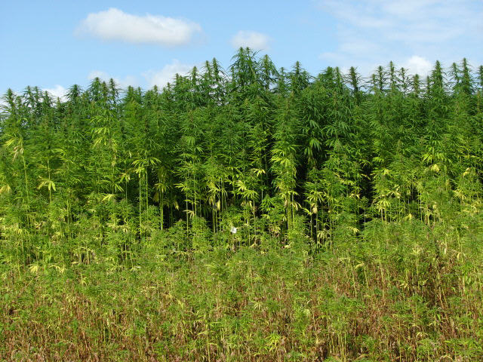
Across the Country…
13 states authorizing commercial hemp programs:
California
Colorado
Indiana
Kentucky
Maine
Montana
North Dakota
Oregon
South Carolina
Tennessee
Vermont
Virginia
West Virginia

Slide 12
Across the Country…
7 states establish industrial hemp programs that are limited to agricultural or academic research programs:
Delaware
Hawaii
Illinois
Michigan
Nebraska
New York
Utah

Slide 13
Marijuana - Research Steps
1. Submit your study proposal to the Food and Drug Administration for a thorough review of its "scientific validity and ethical soundness."
2. Submit your proposal to a separate Public Health Service (PHS) board, which performs pretty much the exact same review as the FDA.
3 Get a marijuana permit from the Drug Enforcement Administration.
4. Finally, obtain a quantity of medical marijuana via the Drug Supply Program run by the National Institute on Drug Abuse (NIDA), which maintains a monopoly on medical marijuana grown for research in the U.S.
June 22, 2015 – Obama administration removed Step 2 – PHS review.

Slide 14
HHS Patent – “Cannabinoids as antioxidents & neuroprotectants”
Awarded October 2003, filed by National Institute of Health
“This new found property makes cannabinoids useful in the treatment and prophylaxis of wide variety of oxidation associated diseases, such as ischemic, age-related, inflammatory and autoimmune diseases. The cannabinoids are found to have particular application as neuroprotectants, for example in limiting neurological damage following ischemic insults, such as stroke and trauma, or in the treatment of neurodegenerative diseases, such as Alzheimer’s disease, Parkinson’s disease and HIV dementia.”

Slide 15
NIH grants license to KannaLife to study CBD
2010 - NIH granted KannaLife exclusivity to develop a treatment for Hepatic Encephalopathy, a disease of the liver and brain that stems from cirrhosis.
August 2014 - NIH granted the company an additional license on their previous patent to study CTE.
KannaLife is the only company with licenses on the US-government held patent on
cannabinoids. NIH owns
patent, but KannaLife
has exclusive rights to develop
drugs with it.

Slide 16
Changes?
New President, 2016
Republican controlled Congress, 2015
New U.S. Attorney General Loretta Lynch
New U.S. Deputy Attorney General Sally Yates
Nebraska and Oklahoma's suit against Colorado alleging federal preemption
Ever-Shifting federal enforcement priorities on tribal land

Slide 17
House Tribal DRAFT Legislation
Draft attempts to provide clarity for tribes wishing to produce, purchase and possess marijuana but concerned that participating in the marijuana industry might put their federal funding at risk.
This bill attempts to alleviate that concern by prohibiting federal agencies from considering the tribe’s participation in the marijuana industry when:
Allocating federal funds, benefits, grants, contracts, or other agreement with the United States, determining compliance or evaluating eligibility for federal funding.

Slide 18
House Tribal DRAFT Legislation
National Indian Cannabis Coalition (www.niccdc.org) is providing input on the draft legislation.
Include IHS
Allow tribes to participate in Hemp initiatives
Include tribes engaged in processing and selling cannabis

Slide 19
Federal Tribal Legislation
Keeping out Illegal Drugs Act of 2016 - Senator Lankford (R-OK)
“A bill to prevent Indian tribes and tribal organizations that cultivate, manufacture, or distribute marijuana on Indian land from receiving Federal funds.”
NICC Position – “In a time where both Congress and the Administration are deferring to individual State decisions on marijuana legalization, this bill would eliminate the opportunity for Tribes to evaluate and make an individual determination regarding the legalization or prohibition of marijuana on their Indian lands.”

Slide 20
HR 2029 - Military Construction and Veterans Affairs and Related Agencies Appropriations Act of 2015
Section 246: “None of the funds appropriated or otherwise made available to the Department of Veterans Affairs in this Act may be used in a manner that would— (1) interfere with the ability of a veteran to participate in a State-approved medicinal marijuana program; (2) deny any services from the Department to a veteran who is participating in such a program; or (3) limit or interfere with the ability of a health care provider of the Department to make appropriate recommendations, fill out forms, or take steps to comply with such a program.”
NICC recommending a similar provision be included in this bill providing the same direction to the Indian Health Service.

Slide 21
Indian Health Service Position
IHS Findings issued in June 6, 2011 -“Federal law specifically prohibits the use of marijuana under all but very controlled, investigational circumstances”
Chief Medical Officer recommends:
“I recommend that all IHS, Tribal, and Urban programs fully adhere and comply with Federal law by not prescribing, recommending, possessing, cultivating, processing, manufacturing, or distributing marijuana for medical or other purposes.”

Slide 22
Indian Health Service Position
But – HHS Sec. Burwell Sec. Burwell reported to tribal advisory committee “...that HHS funding would not adversely be impacted if a Tribe operated a medical grow or dispensary on Tribal lands as long as federal funding is not used.” (Sept 2015)

Slide 23
Washington-Tribal Marijuana Compacts
HB 2000 – All marijuana “compacts” to address any marijuana-related issue that involves both state and tribal interests or otherwise has an impact on tribal-state relations.
Compact provisions –
Allows tribe to buy and sell to State licensees
Protects tribal territory by requiring the State withhold issuing a license to any applicant without express permission of Tribe.
Tribal tax must be at least 100% of the State tax (WA = 37% plus sales tax up to 9.5%)
Medical marijuana is exempt from tax

Slide 24
Oregon
July 1, 2015 – personal possession and use is permitted
Liquor Control Commission is tasked with implementation.
Temporary regs adopted 10/22/15
License applications will be accepted starting January, 2016
Alaska has historically allowed possession in small quantities
Rules adopted November 2015
March 2016 – regulation effective date
Alaska

Slide 25
Logistics:
Insurance –
Lloyds of London determines it will no longer support insuring marijuana operations of any kind until the drug is formally recognized by the U.S. government as legal.
Banking issues – will a bank accept the money?
Fourth Corner Credit Union v. Federal Reserve Bank of Kansas City, Civil Action No. 1:15-cv-01633, (D.Colo. 2015)

Slide 26
Logistics: Gaming & Cannabis
Bank Secrecy Act requires all financial institutions to file Suspicious Activity Reports (“SAR’s”) on businesses they suspect to be engaged in potentially illegal activity. Under the new guidelines, financial institutions must continue to file the following SAR’s on marijuana businesses. These are:
• Marijuana Limited SAR – on businesses that appear to be operating legally and not engaging in activities that will interest federal prosecutors as detailed in the Cole 2.0.
• Marijuana Priority SAR – on businesses that appear to be in violation of state law or interfering with federal enforcement priorities.
• Marijuana Termination SAR – where a financial relationship with a marijuana-related business is terminated due to suspected violations.

Slide 27
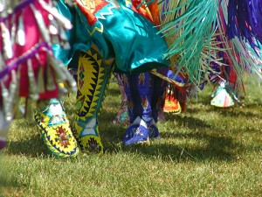

Slide 28
Current Tribal Marijuana Activity
Suquamish Tribe and Squaxin Island Tribe sign Marijuana Compacts under HB 2000.
Passamaquoddy Tribe inks deal for marijuana operation.
Other tribes exploring legalization.
Omaha
St. Croix Chippewa - WI
….but
Alturas Rancheria, Pit River Rancheria marijuana raided by federal and state law enforcement
Pinoleville Rancheria marijuana raids by State law enforcement
Flandreau Santee Sioux burned its plants following discussions with DOJ

Slide 30
Menominee Raid - Warrant
Issues identified in Warrant –
Appeared to be a non-tribal entity and employees operating facility
Non-Wisconsin citizens operating grow
Jurisdictional authority
Public Health and Safety issues
Plants tested positive for Marijuana, Hashish, THC and Hash Oil
Cannabis farm located in State without any legalized marijuana
Menominee has filed Complaint for Declaratory Judgment

Slide 31
Why Indian Country?
Sovereignty as a tool -
Less bureaucracy in licensing
Lower tax rates
Access to land for grow operations – streamlined zoning and permitting processes
Blank slate for growing and processing standards.
Reasonable regulation
Tribes know how to regulate and how to work with feds
Foreign trade zones?
Banking solution?
Medical research?

Slide 32
Questions?
Lael Echo-Hawk
e. lechohawk@gsblaw.com
p. 206.495.1505
www.smokesignalsindianlaw.com
Twitter: @laeleh
Facebook: SmokeSignals IndianLaw
Website: www.niccdc.org

