Slide 1
Colville Health Services Colville Tribal Services Lake Roosevelt community Health Centers Colville Service Unit
Northwest Portland Area Indian Health Board
Quarterly Board Meeting
October 28, 2015 at Mission, Oregon

Slide 2
Colville health services
Presented by:
Alison Ball, PhD Health & Human Services Director
Colleen F. Cawston, MPA CEO Colville Service Unit
Ali Desautel, BA CEO Lake Roosevelt Health Center

Slide 3
Colville health services
Comprised of three primary entities
Colville Tribal Health Services
Colville Service Unit
Lake Roosevelt Community Health Centers

Slide 4
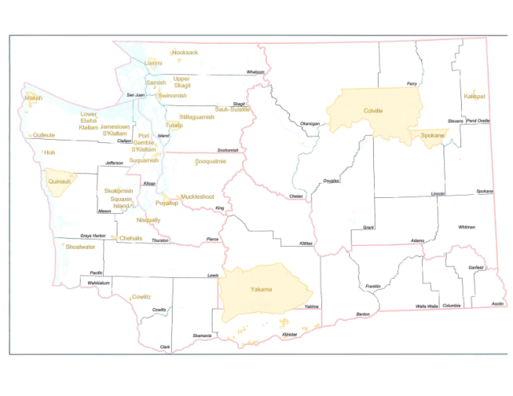
Colville Indian Reservation 1.4 million acres 2 state counties 4 tribal districts
Where are we?

Slide 5
Colville Tribal & Family Health Services
Leadership: The Courage to Shape a Better Future
Building Capacity: What we do, We do well
Collaboration: Leveraging Collective Genius
Accountability: If it is to be, it’s up to me

Slide 6
Lake Roosevelt community Health Centers
Funding sources
Partnerships
Services
Forecasting the future

Slide 7
Indian Health Service Colville Service Unit
EMERGENCY CLINIC RELOCATION
Due to the poor air quality of the Nespelem
The Nespelem clinic will be relocated to the Keller clinic for August 24th & 25th
Call the Keller clinic at 509-634-7300
Clinic hours of operation will be 9 am – 3 pm
Patients who can make it to the Omak clinic easier can also go there.
For emergency situations during this closure follow the Contract Health Service “After Hours Policy”.
Respectfully, Colleen F. Cawston, MPA
Chief Executive Officer
509-634-2933

Slide 8
Colville Service Unit
Renew and Strengthen our Partnerships with Tribes & Urban Indian Health Organizations
Improve the Indian Health Services
Improve Quality & Access to Care for Patients
Be Transparent, Accountable, Fair and Inclusive

Slide 9
Emergency Governmental Hours Operations effective August 31, 2015
With the current fire emergency the Colville Tribes, Bureau of Indian Affairs, & Indian Health Services are modifying the government hours of operation to be from 10 am to 5 pm

Slide 10
Indian Health Service Colville Service Unit
AIR QUALITY RECOMMENDATIONS
With the compromised air quality as a result of the fires here are some recommendations
Limit activity outside in the smoke
Where a mask while outside to limit exposure to air particle and smoke
Where a mask indoors if your environment has visible lingering smoke
Keep windows closed
Have a fan on moderate speed to circulate the air
Do not use Central Air, if you do then change the filter often
Respectfully, Colleen F. Cawston, MPA
Chief Executive Officer
509-634-2933

Slide 11
Thank you
lim’limpt’
lim limtx
qeciyew’yew

