Slide 1
Medical Marijuana and
IHS Funding
Jim Roberts, Policy Analyst
NPAIHB Quarterly Board Meeting
October 24, 2015
Acknowledgement: I want to thank Lael Echo-Hawk, Attorney, Garvey Schubert Barer, for providing slides used in this presentation.

Slide 2
Purpose of Presentation
Several Tribal leaders and Board delegates have requested presentation on:
  What is the impact on Indian Health Service (IHS) and other federal funding if a Tribe legalizes marijuana
  Could medical marijuana be allowed in IHS facilities if a state has legalized it for medical use?
  What are the potential Tribal implications where states have legalized
  Discuss potential issues from a non-legal basis with follow up at a future Quarterly Board Meeting

Slide 3
My Disclaimer:
I am not an attorney and by no means should this be considered a legal analysis.
The fact that I am doing this presentation should not be construed that I am an “expert” about the use [medical or otherwise] of marijuana by any means

Slide 4
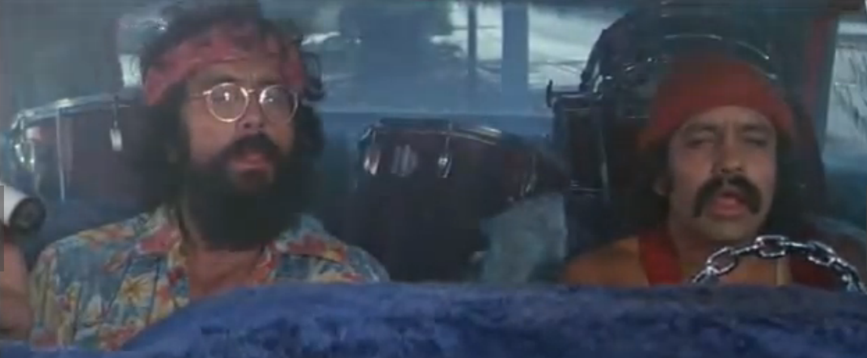
Are you ready to begin?

Slide 5
States that have Legalized Marijuana

Slide 6
Across the Country…
Four states have legalized recreational use of marijuana
23 states, plus WA D.C., recognize and permit the medical use of cannabis
  1996: California
  1998: Alaska, Oregon, Washington
  1999: Maine
  2000: Colorado, Hawaii, Nevada
  2004: Montana
  2006: Rhode Island
  2007: New Mexico, Vermont
  2008: Michigan
  2010: Arizona, New Jersey
  2011: Delaware, Washington, D.C.
  2012: Connecticut, Massachusetts
  2013: New Hampshire, Illinois
  2014: Maryland, Minnesota, New York
Source: This slide courtesy of Lael Echo-Hawk, Attorney, Garvey Schubert Barer

Slide 7
Economic forecast - Marijuana
Legal marijuana grew 74% last year to $2.7B up from $1.5B in 2013.* Arcview Market Research report
Colorado - $699M total combined sales
  Taxes - $63M Revenue (36% from recreational)
  Licensing - $13M Revenue
  2.85M edible retail products sold
Washington – estimated to increase by $252M in 2015*
Source: This slide courtesy of Lael Echo-Hawk, Attorney, Garvey Schubert Barer

Slide 8
Legalization of Marijuana pose several implications for Tribes
Prohibit marijuana
Legalize marijuana:
  Medical
  Recreational
  Both
All would require regulatory framework to develop Tribal laws, regulations, law enforcement, and courts systems
Resources will be required
Could there be a potential impact on federal funding?

Slide 9
What Tribes must consider:
What must Tribes consider when deciding whether to legalize, decriminalize or prohibit marijuana in Indian Country?
Government Issues –
  Affect on other Federal Programs: 638 funding provided by IHS, BIA, HUD, ANA, etc.
  Status of legality in your state – external politics
Potential revenue source
Cost of implementation
Sales, Taxation, Licensing, Regulating & Enforcement
Source: This slide courtesy of Lael Echo-Hawk, Attorney, Garvey Schubert Barer

Slide 10
DOJ Policy Statement regarding marijuana
December 11, 2014 DOJ issues Policy Statement Regarding Marijuana Issues in Indian Country (memo is dated Oct. 11, 2014)
Following release invoked sensationalized press and media frenzy that may or may not have been accurate
The DOJ Policy Statement “does not” legalize or condone marijuana in Indian Country
The DOJ Policy Statement is supportive of Tribal Sovereignty to prohibit or legalize marijuana and encourages consultation
The DOJ Policy Statement updates previous guidance regarding federal marijuana enforcement in states that had legalized marijuana – “Cole Memorandum”, Aug. 29, 2013

Slide 11
What is the impact of HHS funding if a Tribe legalizes marijuana?
This question has been posed by the HHS Secretary’s Tribal Advisory Committee (STAC) to Sec. Sylvia Burwell (STAC letter June 30, 2015)
  “Would HHS funding be jeopardized if a Tribe operated a marijuana grow or dispensary on its lands?”
  “Would HHS funding be forfeited or at risk if a Tribe regulated a third party grow or dispensary on its lands?”
  There are other important questions posed in STAC letter (refer to it)
Sec. Burwell responded to STAC at September 15-16, 2015 meeting
Sec. Burwell reported “...that HHS funding would not adversely be impacted if a Tribe operated a medical grow or dispensary on Tribal lands as long as federal funding is not used.”

Slide 12
Can medical marijuana be “allowed” in an IHS or Tribally-operated facility?
Defining “allowed” means smoked, consumed, prescribed, or other related medical use
Medical marijuana in Indian health programs is complicated; it is not as simple that a state has legalized medical marijuana to allow it in an Indian health program
It will likely require approval from IHS and may need to be included in AFA language?
Federal funding will likely not be allowed to used?
This issue is implicated by the following:
  1970 Controlled Substance Abuse Act
  DOJ Policy Statement Regarding Marijuana Issues in Indian Country
  June 6, 2011, IHS Dear Tribal Leader Letter, “IHS Findings Medical Use of Marijuana”, Dr. Susan Karol, Chief Medical Officer

Slide 13
Controlled Substances Abuse Act of 1970 (CSA)
The CSA establishes federal regulatory system designed to combat recreational drug abuse by making it unlawful to manufacture, distribute, dispense, or possess any controlled substance
The CSA reflects the federal government’s view that marijuana is a drug with “no currently accepted medical use”
Incongruity between federal and state law regarding medical marijuana use
Accordingly, the manufacture, distribution, or possession of marijuana is a federal criminal offense

Slide 14
CSA Schedule I Substances
Schedule I substances are those that have the following findings:
  The drug or other substance has a high potential for abuse.
  The drug or other substance has no currently accepted medical use in treatment in the United States.
  There is a lack of accepted safety for use of the drug or other substance under medical supervision.

Slide 15
DOJ Policy Statement Regarding Marijuana Issues in Indian Country
Prior to the 2014 Tribal Policy Statement, in 2013 DOJ had issued a “Guidance Regarding Marijuana Enforcement” (Cole Memo) in response to legalization of production, processing, sale and possession of marijuana.
Cole Memo articulated the enforcement priorities that had previously and would continue to guide DOJ enforcement of federal marijuana laws, regardless of state law.
Those priorities were restated in the 2014 DOJ Tribal Policy Statement
The 2014 DOJ Tribal Policy Statement clarifies that the federal enforcement priorities from the Cole Memo will also apply to enforcement in Indian Country

Slide 16
DOJ Policy Statement: “Priorities” to focus “investigative and prosecutorial resources”
DOJ 2014 Tribal Policy Statement includes eight priorities:
  Preventing the distribution of marijuana to minors;
  Preventing revenue from the sale of marijuana from going to criminal enterprises, gangs, and cartels;
  Preventing the diversion of marijuana from states where it is legal under state law in some form to other states;
  Preventing state-authorized marijuana activity from being used as a cover or pretext for the trafficking of other illegal drugs or other illegal activity;
  Preventing violence and the use of firearms in the cultivation and distribution of marijuana;
  Preventing drugged driving and the exacerbation of other adverse public health consequences associated with marijuana use;
  Preventing the growing of marijuana on public lands and the attendant public safety and environmental dangers posed by marijuana production on public lands; and
  Preventing marijuana possession or use on federal property.

Slide 17
Indian Health Service Findings Medical Use of Marijuana
IHS Findings issued in June 6, 2011 DTLL
“Federal law specifically prohibits the use of marijuana under al but very controlled, investigational circumstances”
Chief Medical Officer recommends:
    “I recommend that all IHS, Tribal, and Urban programs fully adhere and comply with Federal law by not prescribing, recommending, possessing, cultivating, processing, manufacturing, or distributing marijuana for medical or other purposes.”

Slide 18
Key Points of “IHS Findings Medical Use of Marijuana”
The CSA lists marijuana as a Schedule I controlled substance that requires a special DEA registration for the investigational use and manufacture of the drug.
The CSA continues to classify marijuana as a Schedule I controlled substance that has no medical benefit
The IHS Manual “has provisions for investigational drugs, but not for Schedule I controlled substance as a matter of Agency policy.”
IHS will not use or approve Schedule I controlled substances
A 1981 HHS ruling, prohibits reimbursement of unapproved drugs by the FDA, and the FDA considers marijuana as an unapproved drug and is ineffective through the “Drug Efficacy Study Implementation”
Annual Funding Agreements require Tribal entities meet all applicable laws and the CSA is applicable to marijuana
Not meeting federal statutes and regulations put providers outside their scope of employment and as a consequence FTCA coverage would not apply

Slide 19
Considerations for medical marijuana in Indian health programs
DOJ Policy Statement priority number eight, “preventing marijuana possession or use on federal property” needs to be addressed
Marijuana will need to be reclassified from a Schedule I substance under the Controlled Substances Act
If marijuana can be reclassified than it would need to meet requirements under the Drug Efficacy Study Implementation and meet FDA approval
If marijuana can be reclassified and be approved by the FDA, than the IHS position on Medical Use of Marijuana could be retracted
There may be tribal government considerations on the legalization of medical marijuana
If all these considerations are met, than it may be possible to allow medical marijuana in an Indian health program?

Slide 20
Federal Action regarding medical marijuana
Legislation to reclassify Marijuana as a Schedule I substance or remove it from the CSA
FY 2014 Omnibus bill: Section 538. None of the funds made available in this Act to the Department of Justice may be used, with respect to the States of [….], to prevent such States from implementing their own State laws that authorize the use, distribution, possession, or cultivation of medical marijuana. Emphasis added.
The Veterans Administration has issued a directive that allows veterans to use consume marijuana at facilities located in states that have legalized medical marijuana
The VA may not prescribe marijuana in those states but veterans who are qualified patients are allowed to consume marijuana they have already obtained

Slide 21
Current Tribal Marijuana Activity
Suquamish Tribe and Squaxin Island Tribe sign Marijuana Compacts under HB 2000
Flandreau Santee Sioux announce marijuana resort. State AG has asked them to re-think.
Passamaquoddy Tribe inks deal for marijuana operation.
Other tribes exploring legalization.
….but
Alturas Rancheria, Pit River Rancheria marijuana raided by federal and state law enforcement
Pinoleville Rancheria
marijuana raids by State
law enforcement.
Source: This slide courtesy of Lael Echo-Hawk, Attorney, Garvey Schubert Barer

Slide 22
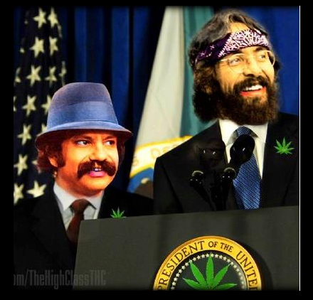
The End!

