Slide 1
Cowlitz Indian Tribe
Health and Human Services

Slide 2
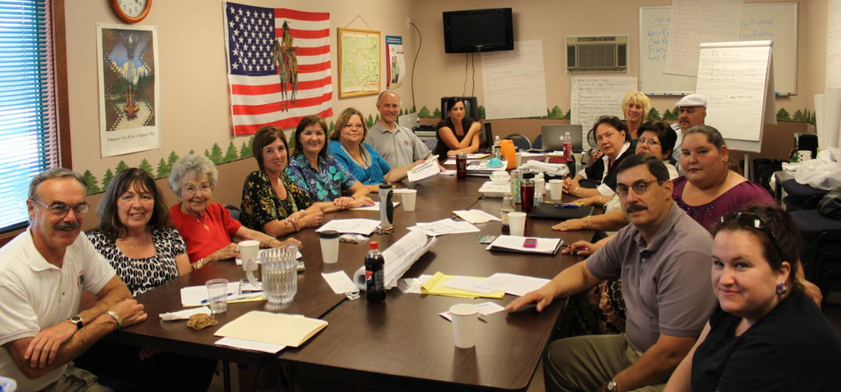
HHS Administration
Policy and Budgeting Set by Tribal Council and Health Board.
Bill Iyall, Chairman, Cowlitz Indian Tribe
Cassy Reck, Health Board Chair
Jim Sherrill, HHS Director
Steve Kutz, Deputy HHS Director
Cowlitz Compacted for Title V
Self Governance in 2011.
Previously, Title I

Slide 3
Cowlitz HHS Programs
 | Longview | Seattle | Vancouver | Toledo
Medical Clinic | 2004 New facility 2011 | - | - | -
Mental Health – Outpatient | 2005 | 2010 | 2010 | -
Adult Alcohol/CD - Outpatient | 2003 | - | 2006 | -
Youth Alcohol/CD – Outpatient | 2008 | 2012 | - | -
Contract Health Services | 2002 | CHSDA Counties Include: | Clark, Cowlitz, Columbia (OR), Wahkiakum, | Skamania, Lewis, Thurston, Pierce, King, Kittitas
Indian Child Welfare | 2009 | Children and Family services | All Washington State
Sexual Assault Advocacy | 2005 | - | 2006 | -
Domestic Violence Advocacy | 2007 | - | 2007 | -
Vocational Rehabilitation | 2004 |  | 2006
Elders Program | 2002 | - | - | 2002
I H S
Non-IHS

Slide 4
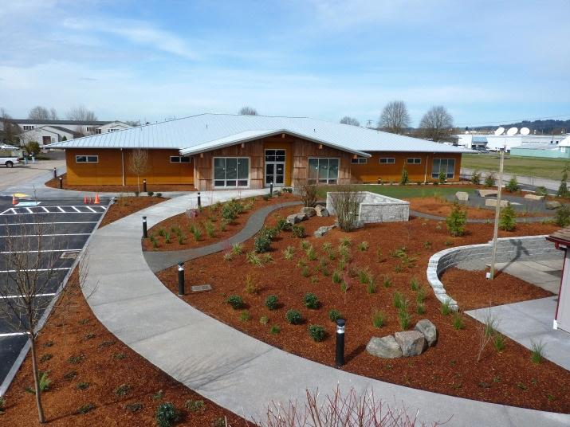
Medical Clinic
Redesigned CHS Dollars
Primary Care, Behavioral Health
Opened Clinic in Longview,
2004 with One Nurse Practitioner
Current Providers:
1 FTE Physician
.3 FTE Physician
.3 FTE Nurse Practitioner
2 FTE MH Therapists
2 FTE Psychiatric Nurse Practitioners
.1 FTE Registered Dietician
1 FTE CHR (new position at Cowlitz).

Slide 5
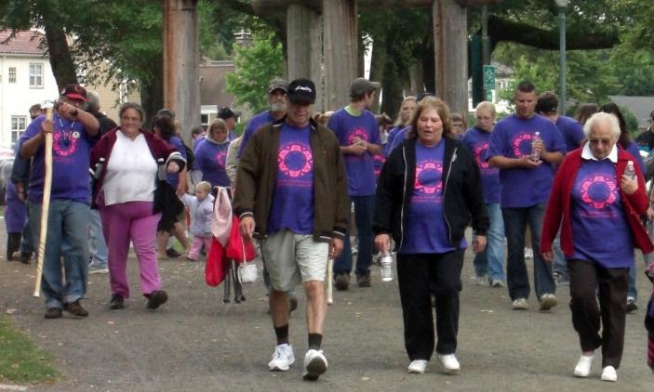
Medical Clinic
New facility opened September, 2011.
Construction funded by Tribal, IHS/SAP, and HUD dollars
See all enrolled AI/AN, descendants, some family and employees with billable resource.
300 + Primary Care Visits per month.
50 + Behavioral Health Visits
About 50% of patients from 150+ tribes.
Ongoing implementation of EHR.

Slide 6
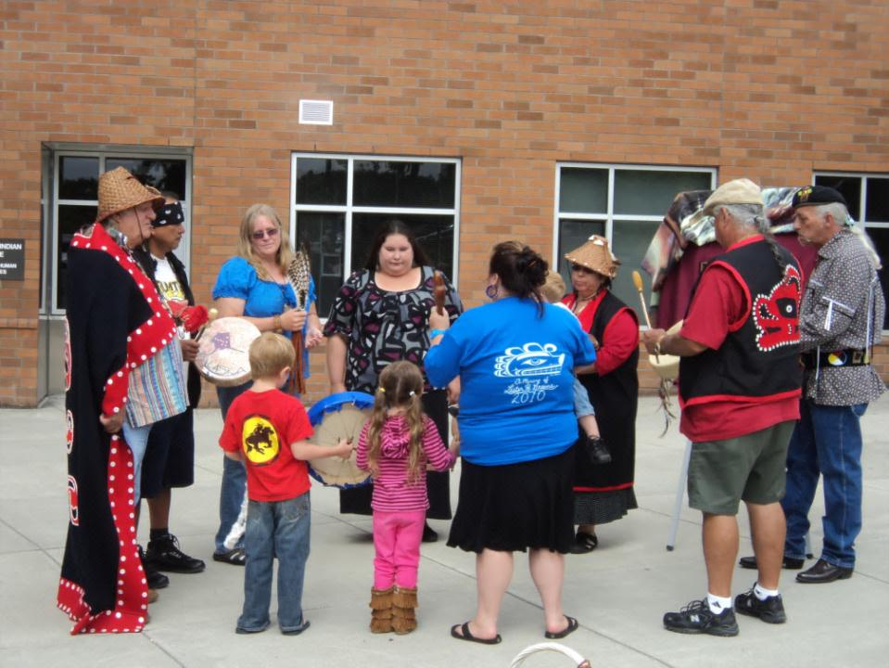
Mental Health
Started with .5 FTE Psych Nurse in Longview, 2006.
Hired 1 FTE Psych Nurse in Longview 2008.
Added 1 FTE Psych Nurse in Vancouver, 2009.
Added Youth and Family Therapy in Seattle, 2010.
Currently recruiting for 2 FTE therapists and psych nurse for Longview.

Slide 7
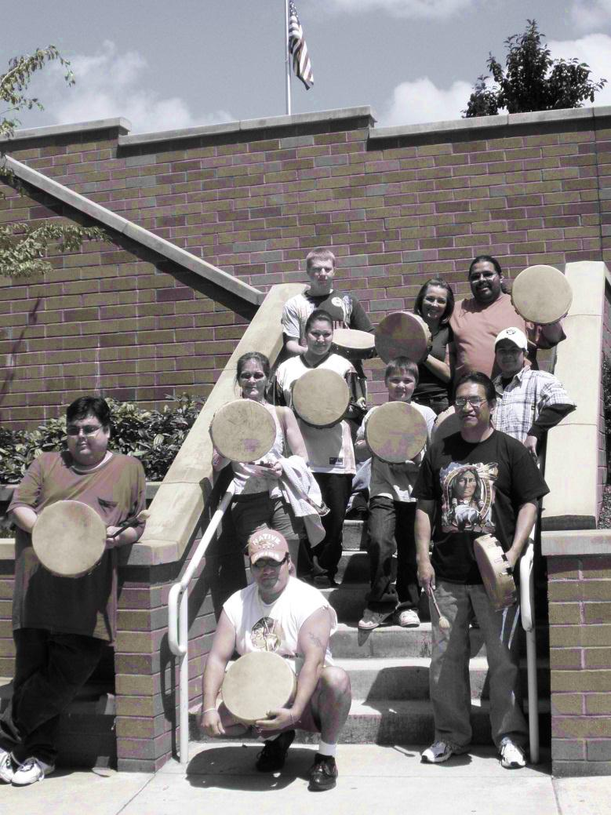
Mental Health
Longview and Vancouver Psych Nurses provide medication management and therapy.
Seattle therapists work with local school districts to provide services for AI/AN youth and families.
Seattle therapists conduct several hundred visits per/month.
Mental Health Programs are also utilizing EHR.

Slide 8
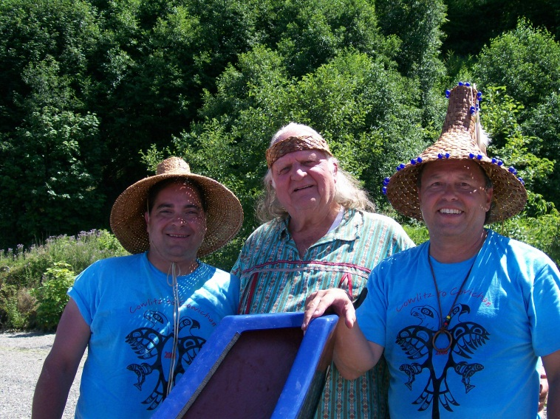
Adult Alcohol/CD – Outpatient
Began 2004 with 1 counselor in Longview
Total of 8 adult groups in Longview and Vancouver
WA State Certified
CARF Accredited
Funded by billing revenues

Slide 9
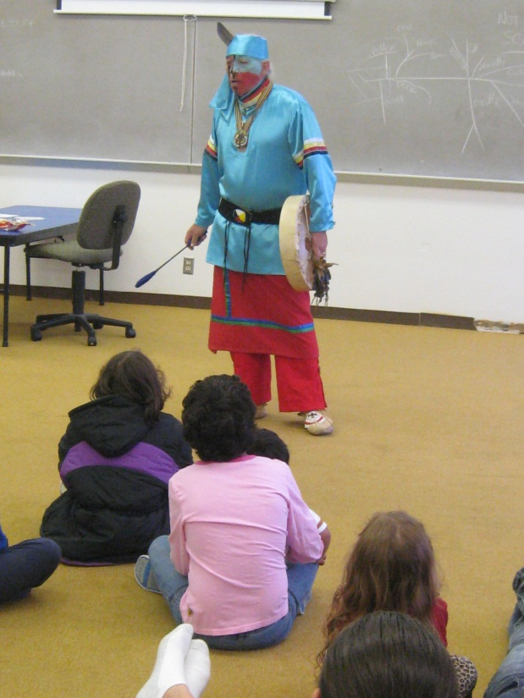
Youth Alcohol/CD – Outpatient
Began summer, 2007, in Longview.
Currently, youth served are
primarily non-Native.
Working on MOU with School Districts in King County to provide services to AI/AN youth in coordination with current mental health program.
Considering adding program in Vancouver, WA.
Funded by billing revenues.
CARF Accredited.

Slide 10
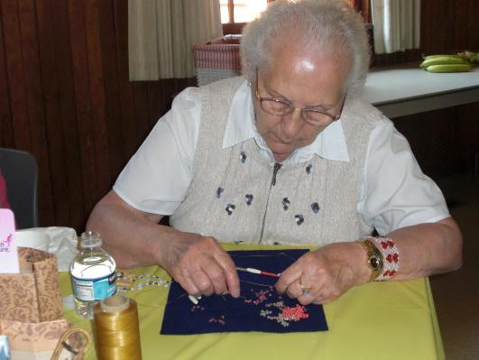
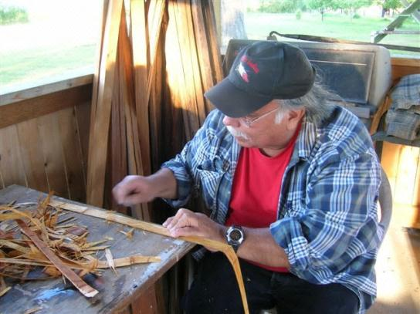
Elders Program
Provides Congregate and Home Delivered Meals to AI/AN in Lewis and Cowlitz Counties.
Provides Transportation, Caregiver Support, Cultural Activities, Trips and More.
Considering alternatives for Home and Community Based Services as allowed by IHCIA.
Funded through federal Agency on Aging.

Slide 11
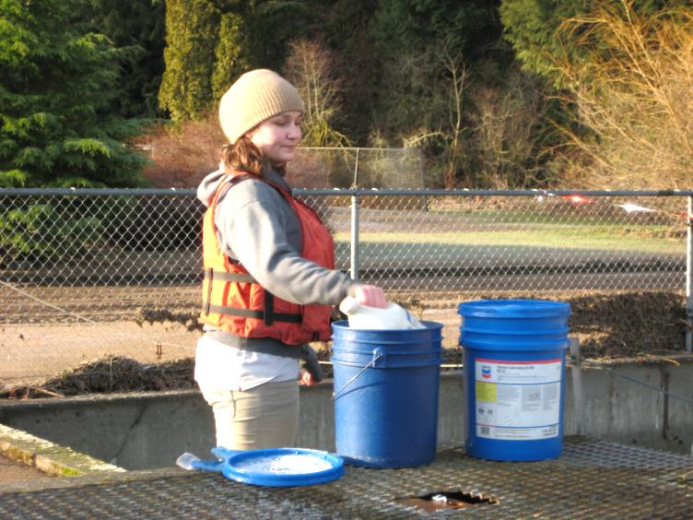
Vocational Rehabilitation
Provides Job Preparedness and Search Support for enrolled members of federally and state recognized tribes from, Clark, Skamania, Cowlitz, Wahkiakum, and Lewis Counties.
Individuals must have a documented disability.
(Physical, Mental, Substance, Etc.)
Helps dozens of AI/AN annually to attain and maintain sustainable employment.
CARF Accredited. Only Tribally-operated program in the country with this distinction.
Funded through the Department of Education, Rehabilitation Services Administration.

Slide 12
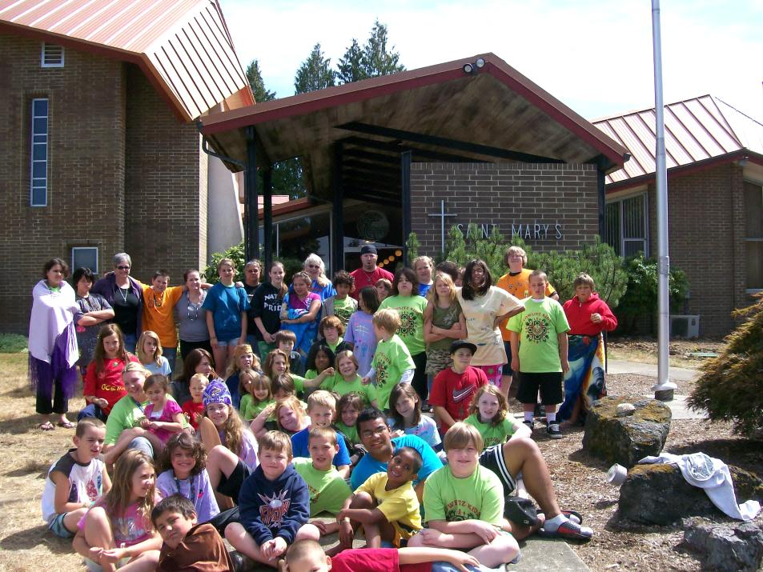
Indian Child welfare
Staff one ICW Social Worker to manage cases across the state.
Case load ranges between 15-30 at any given time.
Funded by WA DSHS Contract.
Kids Camp, 2010

Slide 13
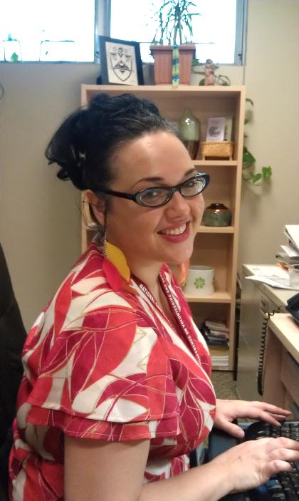
Contract health services
Serves Cowlitz Indian Tribal Members in the CHSDA.
CHSDA includes: Clark, Cowlitz, Skamania, Wahkiakum, Columbia (OR), Lewis, Thurston, Pierce, King, Kittitas.
Tribe has over 3700 members (About 1800 in CHSDA)
No Reservation.
Following WA counties have 300+ members: Clark, Cowlitz, Thurston, Pierce, King.
Tribal Members must utilize any I/T/U within 60 miles of their home for primary care in order to be eligible.

Slide 14
Advocacy services “Pathways to Healing” Program
Provides advocacy services for self-identified AI/AN who have been affected by sexual assault, domestic violence, dating violence or stalking.
Serves Clark, Cowlitz, and South Lewis Counties.
Services may include: legal advocacy, education, transitional housing, clothing, transportation, other financial aid, etc.
Programs are funded through Washington State’s Office of Crime Victims Advocacy and the Department of Justice.

Slide 15
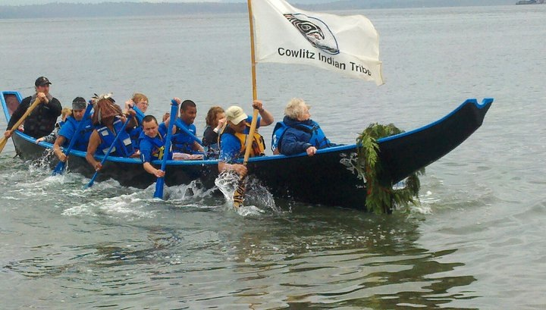
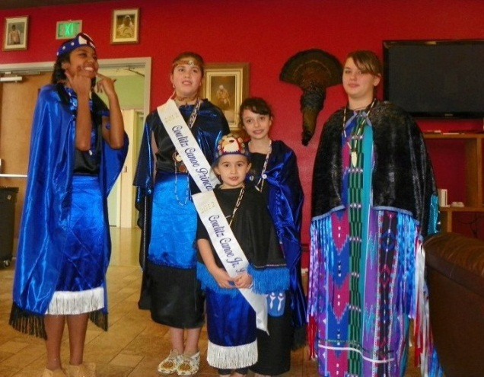
Support for cultural Activities
Canoe Family

Slide 16
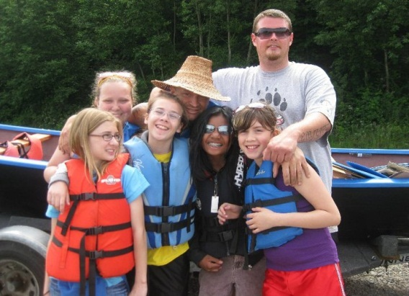
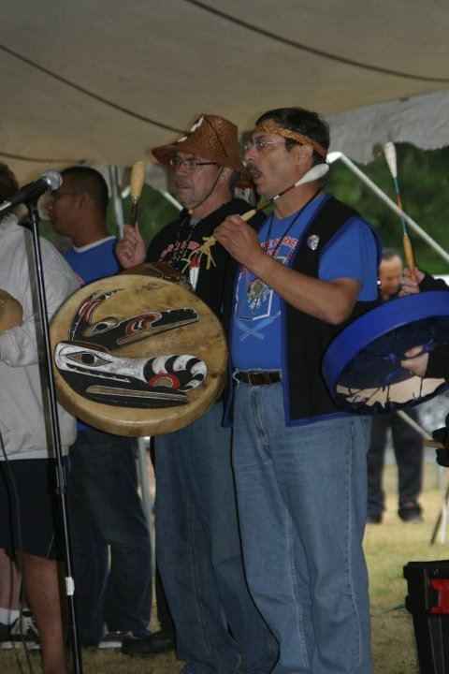
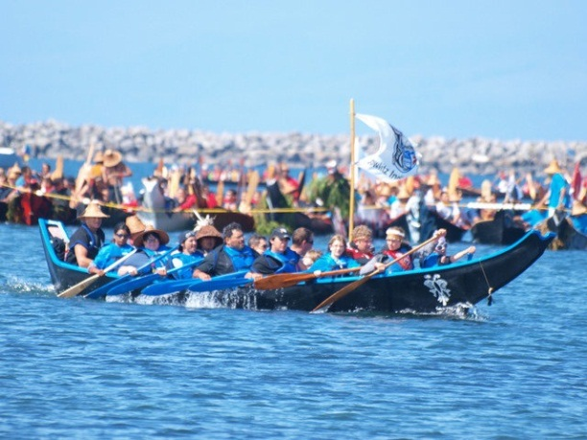
Support for cultural Activities
Canoe Family

Slide 17
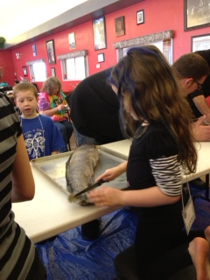
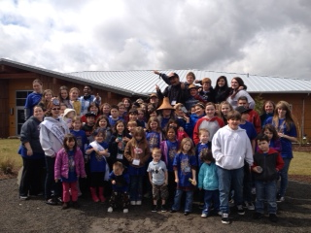
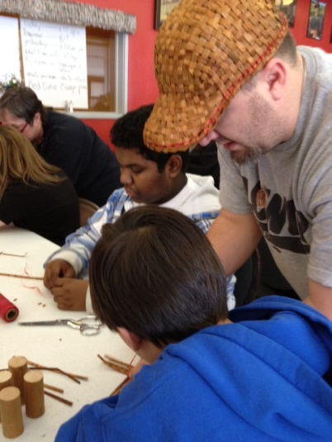
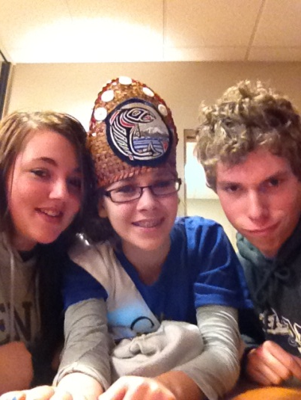
Support for Youth Programs

Slide 18
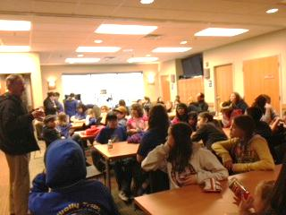
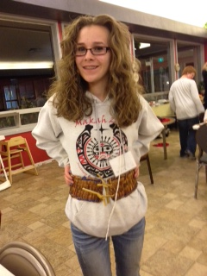
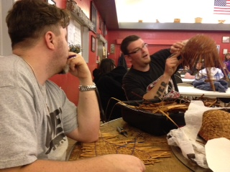
Support for Youth Programs

