Slide 1
Project Red Talon
Preventing STDs and HIV among Tribes in
Oregon, Washington, and Idaho.
Northwest Portland Area
Indian Health Board

Slide 2
Presentation: Project Red Talon
NPAIHB & Project Red Talon
STD/HIV Rates - Impacts for Youth
STD/HIV Testing
Hot Topics in Prevention

Slide 3
Northwest Portland Area Indian Health Board
Established in 1972, the Board is a non-profit tribal organization serving the 43 federally recognized
tribes of Oregon, Washington, and Idaho.
Indian Leadership for Indian Health

Slide 4
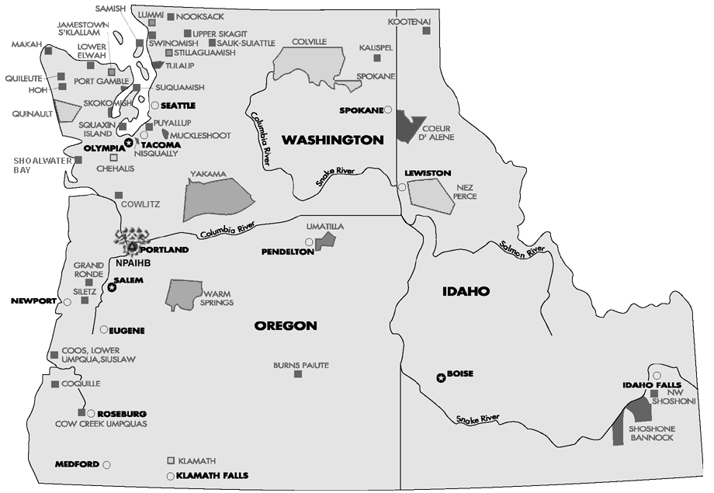
MISSION:
To assist Northwest tribes
to improve the health status and quality of life of member tribes and
Indian people in their delivery of culturally appropriate and
holistic health care.

Slide 5
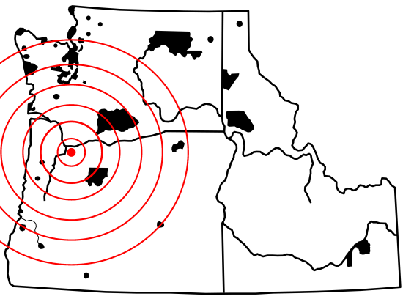
NPAIHB: Functional Areas
Health Promotion & Disease Prevention
Legislative & Policy Analysis
Training & Technical Assistance
Surveillance & Research
Northwest Tribal Epidemiology Center

Slide 6
NW Tribal EpiCenter
Western Tribal Diabetes Program
Toddler Obesity and Tooth Caries Prevention Project
Northwest Tribal Registry Project
Northwest Tribal Cancer Navigator Program
Northwest Tribal Dental Support Center
Northwest Fetal Alcohol Syndrome Project
Project Red Talon: STDs & HIV/AIDS
Immunization Project
CARS: Child Safety Seat Project
Over 20 yrs !

Slide 7




Project Red Talon: Four Objectives
Increase Capacity to Prevent STDs
Increase Awareness about STDs
Improve AI/AN Representation
Improve Testing & Treatment

Slide 8


Slide 9
Sexually Transmitted Infections
Chlamydia
Gonorrhea
Syphilis
Crabs
Trichomoniasis
Bacterial Vaginosis
Herpes
Hepatitis
HIV/AIDS
Human Papillomavirus (HPV)

Slide 10
STD: Transmission
Skin-to-Skin Contact
Sexual Fluids
Ingest Fecal Material

Slide 11
STD: Transmission
Skin-to-Skin Contact
Sexual Fluids
Ingest Fecal Material

Slide 12
STD: Transmission
Skin-to-Skin Contact
Sexual Fluids
Ingest Fecal Material

Slide 13

STD: Transmission
Skin-to-Skin Contact
Sexual Fluids
Ingest Fecal Material

Slide 14


Slide 15
STD/HIV Rates
Numbers Game

Slide 16
Cases per 100,000

Slide 17
Cases per 100,000

Slide 18
Chlamydia Rates per 100,000, by Ethnicity
United States – 1996-2004

Slide 19
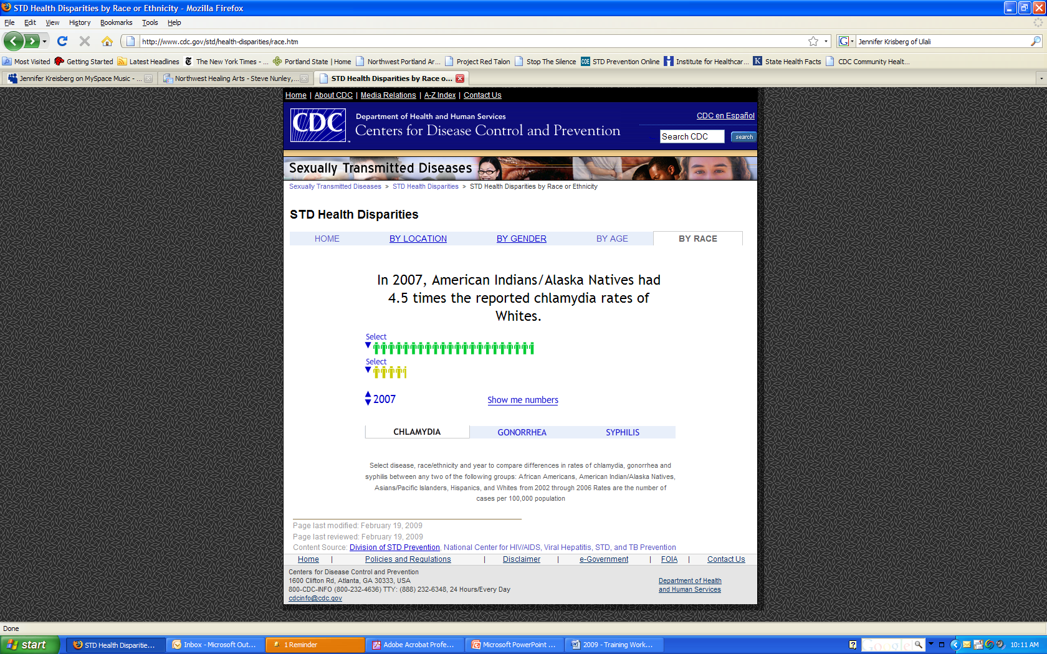

Slide 21
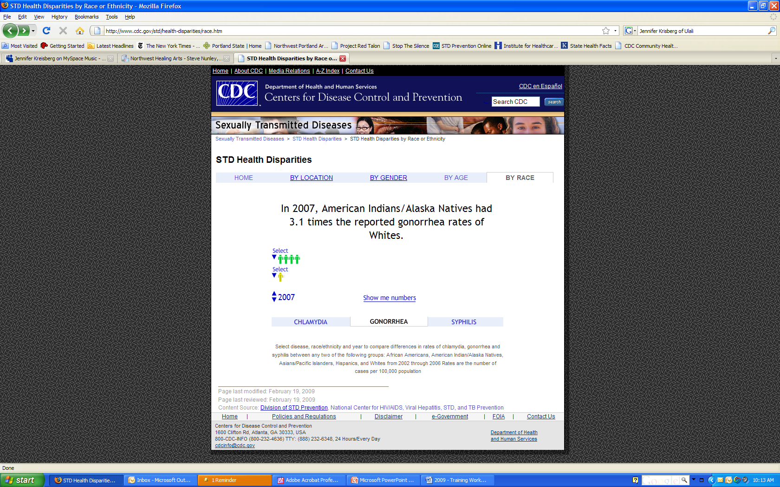

Slide 22
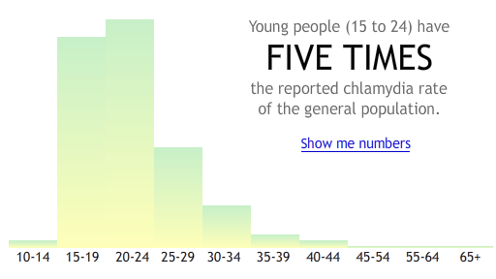

Slide 24

1 out of 4 sexually active teens will get a STD this year.

Slide 26

1 in 10 sexually active teens has chlamydia right now.

Slide 27
Compared by ethnicity, American Indians and Alaska Natives ranked 3rd in their rate of HIV/AIDS diagnoses in 2005.

Slide 28
New AI/AN HIV Diagnoses - 2005

Slide 29
New AI/AN HIV Diagnoses - 2005

Slide 30
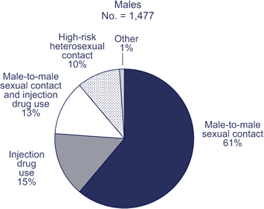
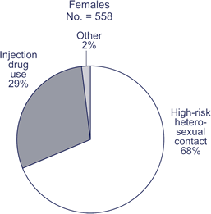
Transmission categories for AI/AN adults and adolescents living with HIV/AIDS, 2005

Slide 31
STD/HIV Impacts for Native Youth
Health Impacts
Increased Risk for HIV

Slide 32
Are STDs Serious?
Yes. STDs are the most preventable cause of infertility in the U.S.
Without treatment, chlamydia and gonorrhea can cause permanent damage to the reproductive organs.

Slide 33

Copyright © 2001-2004 Campaign for Our Children

Slide 34
Most Infections are Silent!
Most STDs do not produce noticeable signs or symptoms.
75% of women and 50% of men with chlamydia have no signs or symptoms.

Slide 35
NW Rates: Youth Impact
In the Northwest, over 800 Native youths age 10-24 years were diagnosed with chlamydia in 2005.

Slide 36
NW Rates: Youth Impact
40% = PID (N=320) Pain and permanent scaring in the uterus and fallopian tubes.
20% = Infertility (N = 64) AI/AN girls not able to have children.

Slide 37
Increased Risk for HIV!
Having an STD increases our chances of getting HIV 2-5 times if exposed.

Slide 38
Two U.S. teens are infected with HIV every hour of every day.

Slide 39
Importance of
STD Testing
CDC-Recommended STD/HIV Testing Guidelines

Slide 40
HPV Vaccine
The HPV vaccine is recommended routinely for all 11 and 12 year-old girls. (Tested in girls 9 through 26)
Vaccine: Three doses over 6 months
Gardasil®: Protects against 4 HPV types: Responsible for 70% of cervical cancer and nearly all genital warts.

Slide 41
Chlamydia and Gonorrhea
The CDC recommends that all sexually active women age 25 years or younger be screened annually for chlamydia.
Test: Urine test, vaginal swab…
Treatment: Antibiotics cure infection.

Slide 42
HIV
HIV testing is recommended for everyone - regardless of age, gender, or risk.
Test: Blood, urine, oral fluid – results take 20 min to one week.
Treatment: No cure, many treatments.

Slide 43
Hot Topics in Prevention
What’s New?

Slide 44
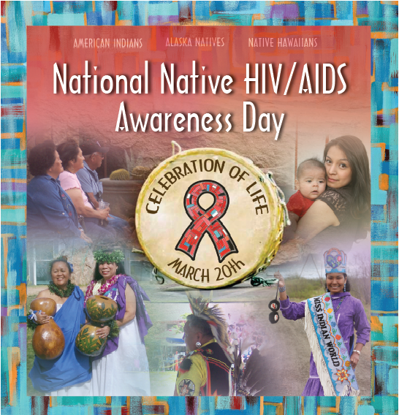

Slide 45
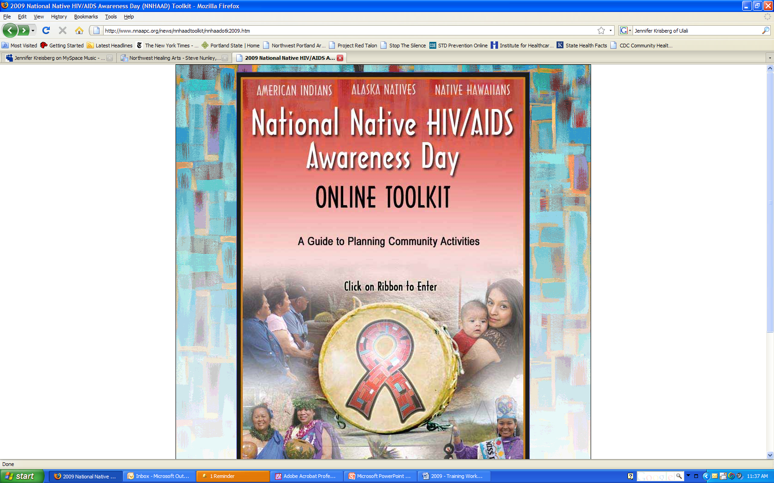
www.nnaapc.org

Slide 46
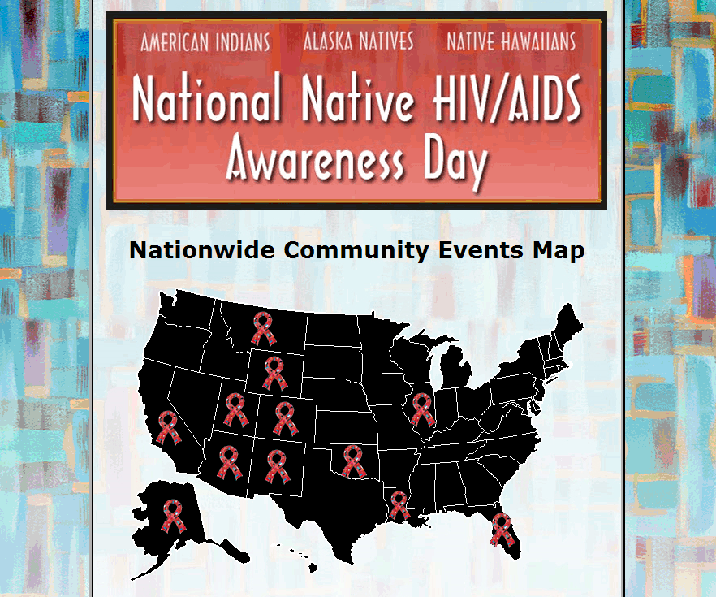

Slide 47


Slide 48
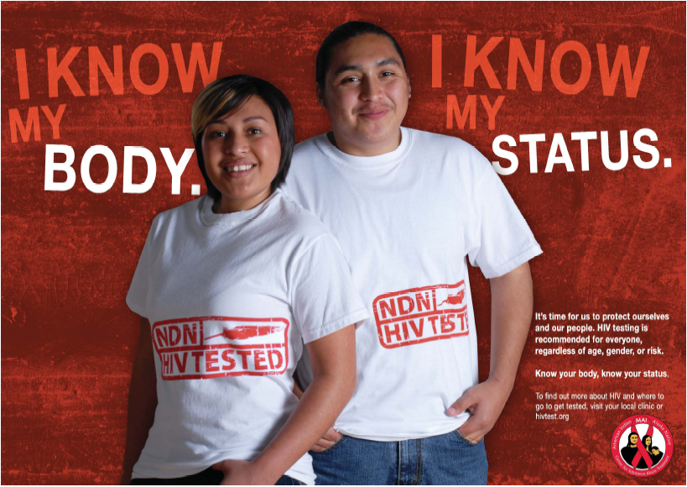

Slide 49
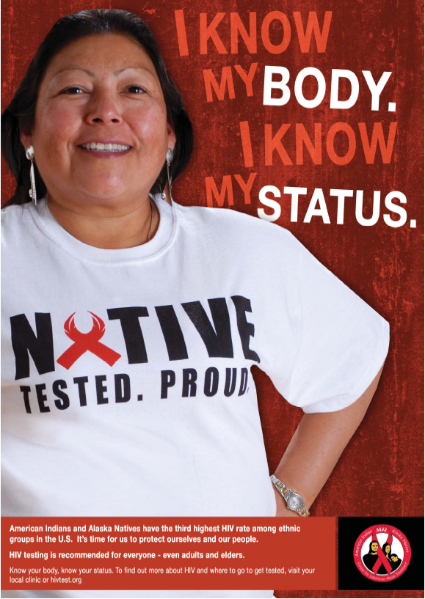

Slide 50
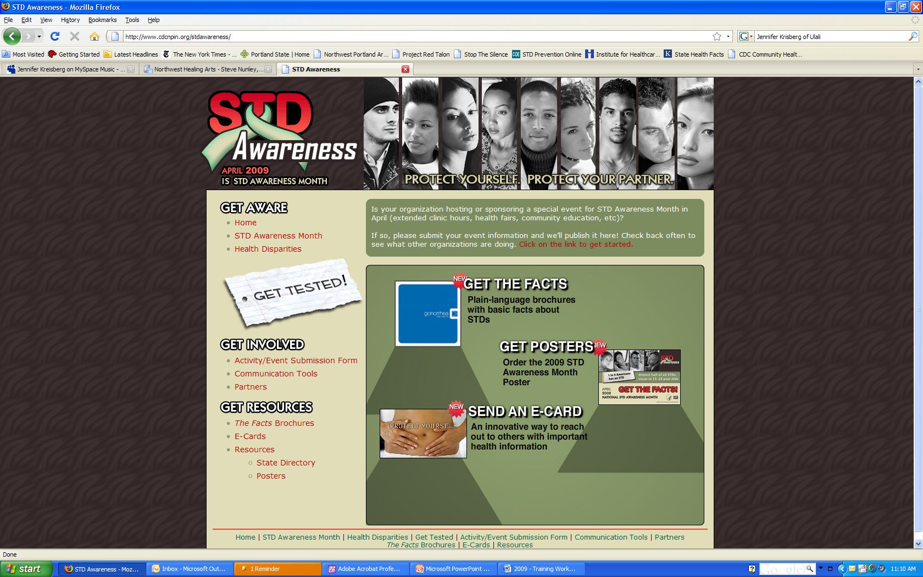
www.cdcnpin.org/stdawareness

Slide 52




Slide 53
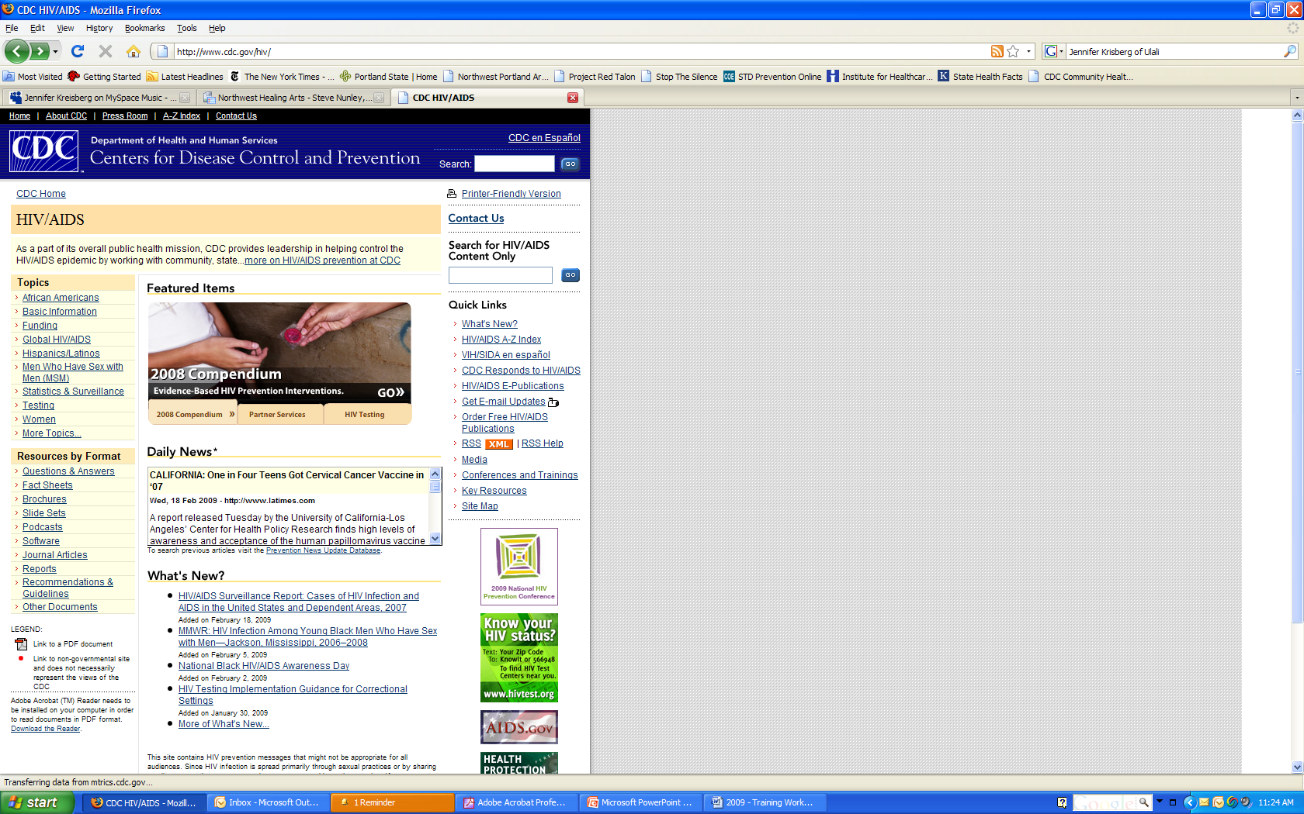
www.cdc.gov/hiv

Slide 54



Slide 55
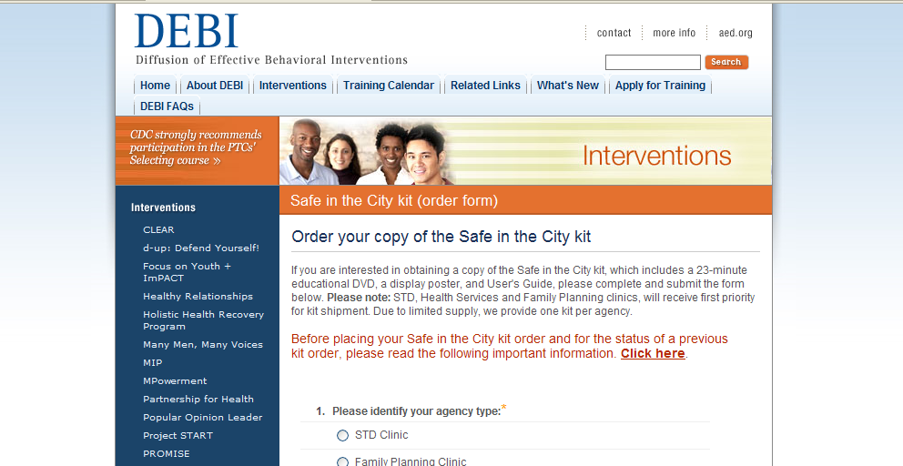
www.effectiveinterventions.org

Slide 56
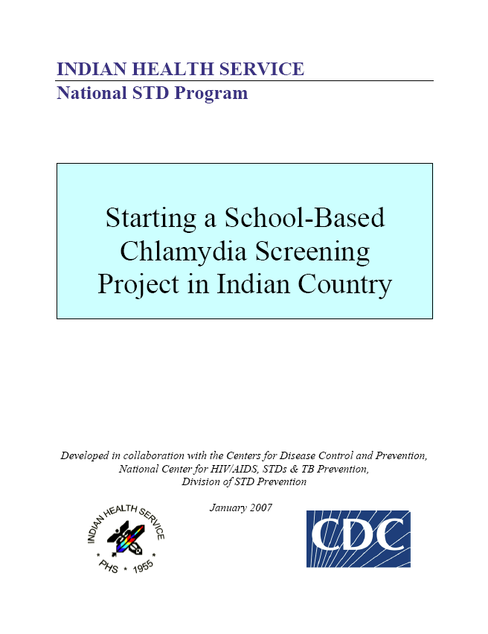

Slide 57
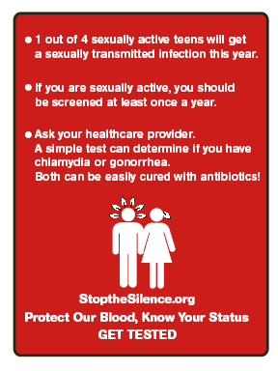


Slide 58


Slide 59
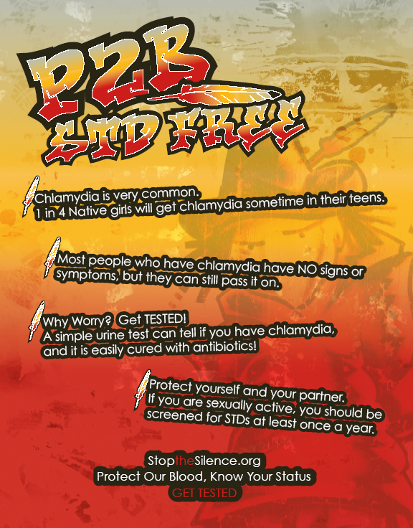

Slide 60
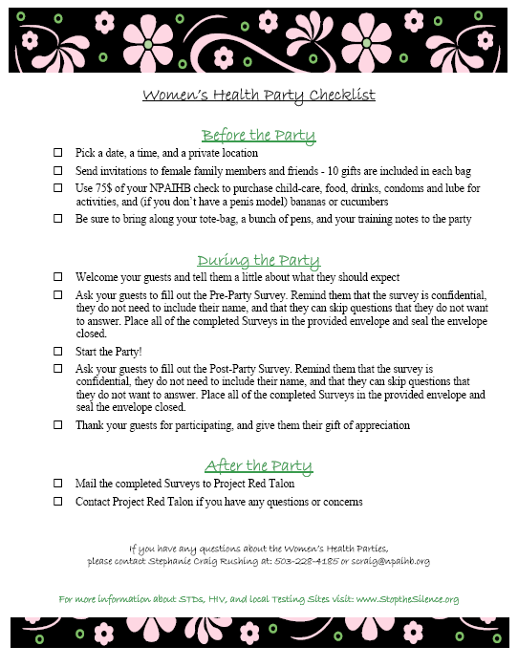

Peer Education Programs
July 27th-31st 2009
Great Wolf Lodge
High School Students

Slide 61
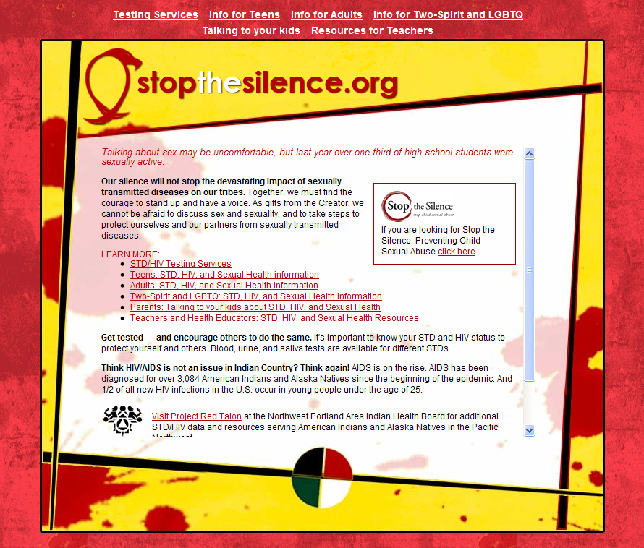



Slide 62

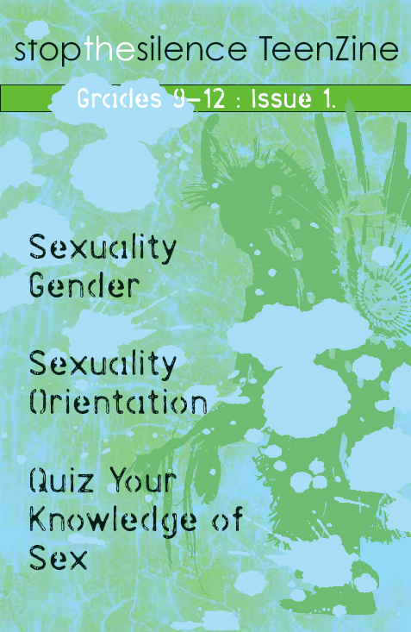
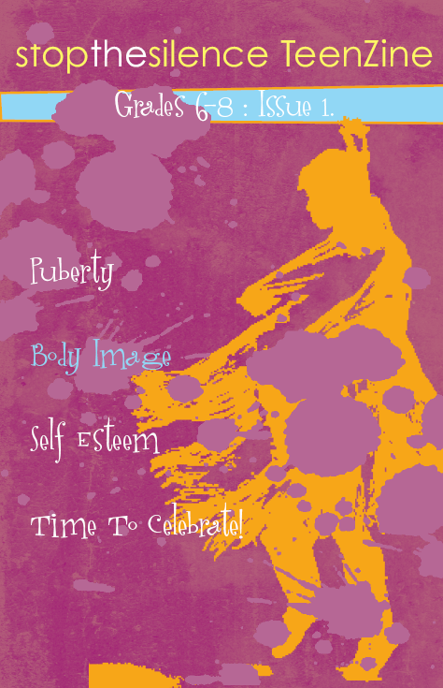
5. Red Talon STD/HIV Coalition
Community Awareness:
Media Campaign
  Teen Posters
  Teen Zines
  Parent PSAs
  Parent Fact Sheet
  www.StoptheSilence.org
Notes:
In September 2005, Project Red Talon received $50,000 from the Library of Medicine to develop a native-specific HIV Media Campaign for our NW Tribes. Working with G&G Advertising, a Native-run social marketing company, Project Red Talon worked with members of the Red Talon Coalition to produce a variety of posters, PSAs, and teen outreach materials.
• Teen Posters
• Teen STD/HIV Magazines
o Three issues for younger teens
A Teacher’s Guide for: Issue #1
o Three issues for older teens
A Teacher’s Guide for: Issue #1
• Adult PSA’s for placement in Tribal papers
• Adult Tip-Sheet for talking to teens about sex and STDs
• Website for both teens and adults: http://www.StoptheSilence.org
• Logo for placement on shirts and other promotional materials

Slide 63
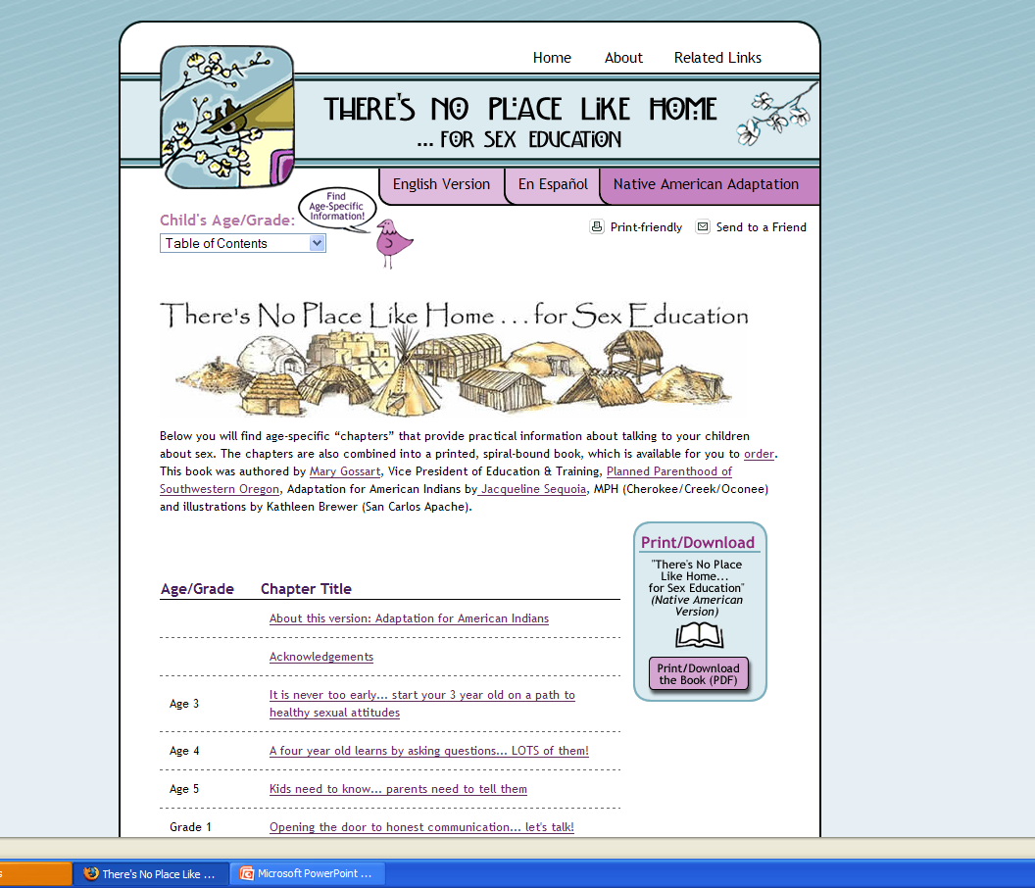
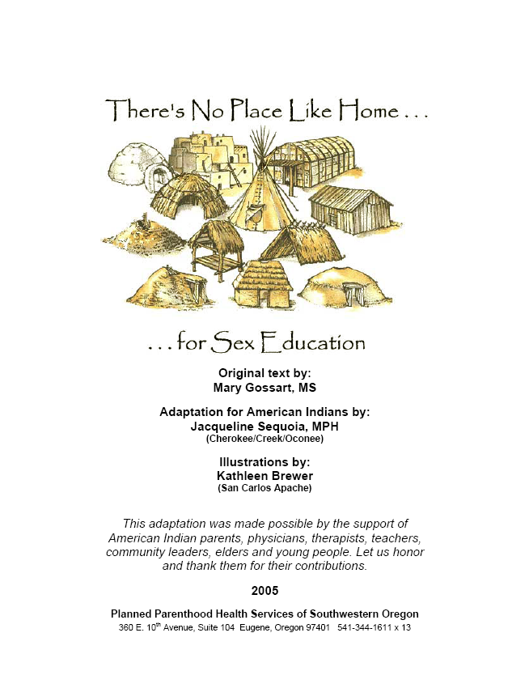
www.no placelike home.org/native american

Slide 64
Questions?

Slide 65
Northwest Portland Area Indian Health Board
Stephanie Craig Rushing, MPH
Director – Project Red Talon
scraig@npaihb.org
Lisa Griggs
Administrative Assistant, Blackfeet
lgriggs@npaihb.org
NPAIHB: www.npaihb.org
PRT: http://www.npaihb.org/epicenter/
project/project_red_talon/
Stop the Silence: www.stopthesilence.org
Indian Leadership for Indian Health

