Slide 1
Western Tribal Diabetes Project
Kerri Lopez
Project Director

Slide 2
Staff & Funding
Staff
  Kerri Lopez, Director
  Don Head, Project Specialist
  Katrina Ramsey, Project Specialist
  Monika McGuire, Project Assistant
5% set-aside SDPI funding
National Contract
  DMS training sessions
  Special projects
  Program evaluation tools

Slide 3
Diabetes register as a tool
In RPMS (or EHR), a list of patients you want to track
Patients are never added automatically – you get to do this
  Pulls information about diabetes care from clinic database
Can be used for
  case management (making sure individuals get care)
  care management (looking at groups of patients together)

Slide 4

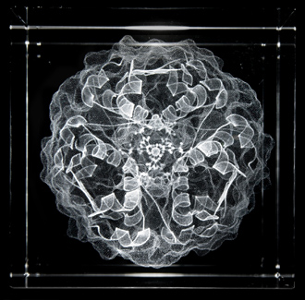
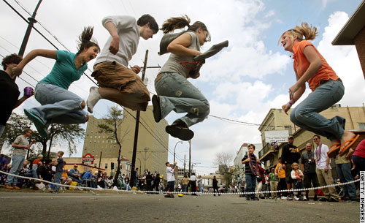
Diabetes (a refresher)
+
=
Glucose
Insulin
Energy
The body does not produce enough insulin ~ or cannot use the insulin it makes
Glucose (sugar) builds up in the blood and overflows into urine

Slide 5

Diabetes (a refresher)
The body loses its main source of fuel even though the blood contains large amounts of glucose
(like being thirsty in the middle of the ocean)

Slide 6

Type 1 diabetes
Only 5%- 10% of diabetes is Type 1
Autoimmune disease that attacks the cells that produce insulin
  Body does not produce insulin
  Need to take insulin every day to survive
Typically diagnosed in children and young adults
Comes on relatively suddenly
Notes:
Type 1 diabetes mellitus—formerly known as insulin-dependent diabetes (IDDM), childhood diabetes or also known as juvenile diabetes, is characterized by loss of the insulin-producing beta cells of the islets of Langerhans of the pancreas leading to a deficiency of insulin. It should be noted that there is no known preventative measure that can be taken against type 1 diabetes. Most people affected by type 1 diabetes are otherwise healthy and of a healthy weight when onset occurs. Diet and exercise cannot reverse or prevent type 1 diabetes. Sensitivity and responsiveness to insulin are usually normal, especially in the early stages. This type comprises up to 10% of total cases in North America and Europe, though this varies by geographical location. This type of diabetes can affect children or adults but was traditionally termed "juvenile diabetes" because it represents a majority of cases of diabetes affecting children.

Slide 7
Diagnostic criteria for Type 2 DM
Three possible plasma blood tests
A1c is not recommended in the diagnosis of diabetes
Plasma blood tests | Values
Casual plasma glucose (Casual is defined as any time of day without regard to time of last meal.) | >200 mg/dl plus symptoms of diabetes: -- Polyuria (urination) -- Polydypsia (thirst) -- Unexplained weight loss
Fasting plasma glucose (Fasting is defined as no caloric intake for at least eight hours.) | >126 mg/dl
Two-hour plasma glucose | >200 mg/dl during a 75 g oral glucose tolerance test (OGTT)
IHS Standards of Care for Adults with Type 2 Diabetes

Slide 8
DIABETES RISK FACTORS
OBESITY/OVERWEIGHT
GENETICS/FAMILY HISTORY
ETHNICITY
GESTATIONAL DIABETES
IMPAIRED GLUCOSE TOLERANCE/PRE-DIABETES
SMOKING

Slide 9
DIABETES RISK FACTORS
Cost of diabetes in the United States, 2002
Total (direct and indirect): $132 billion
Direct medical costs: $92 billion
Indirect costs: $40 billion (disability, work loss, premature mortality)
These data are based on a study conducted by the Lewin Group, Inc., for the American Diabetes Association and are 2002 estimates of both the direct costs (cost of medical care and services) and indirect costs (costs of short-term and permanent disability and of premature death) attributable to diabetes. This study uses a specific cost-of-disease methodology to estimate the health care costs that are due to diabetes.

Slide 10
AMERICAN INDIANS/ALASKA NATIVES AND DIABETES
  American Indians and Alaska Natives are 2.4 times as likely to have diabetes as non-Hispanic whites - 3.3 million AI/AN 2007
  16.3 percent of American Indians and Alaska Natives aged 20 years or older who received care from the Indian Health Service (IHS) in 2007 had diagnosed diabetes
  Annual cost 13,243
    6,178 diagnosed cases 2007 Portland Area
(National Diabetes Information Clearinghouse)

Slide 11
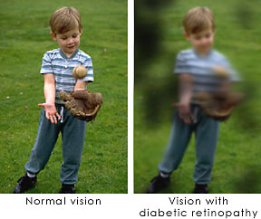
Diabetes complications
Diabetic retinopathy
Neuropathy
Cardiovascular disease
Amputation
Renal (kidney) failure
Notes:
Symptoms: none -- or pain, tingling, or numbness in the hands, arms, feet, and legs
Highest rates of neuropathy are among people who have had diabetes for at least 25 years

Slide 12
Neuropathy
A family of nerve disorders caused by diabetes
Can develop throughout the body, including the digestive tract, heart, and sex organs
About 60 to 70 percent of people with diabetes have some form of neuropathy
Appears to be more common in people who
  have problems controlling their blood glucose
  have high levels of blood fat and blood pressure
  are overweight
Notes:
Symptoms: none -- or pain, tingling, or numbness in the hands, arms, feet, and legs
Highest rates of neuropathy are among people who have had diabetes for at least 25 years

Slide 13
What You Can Do To Reduce Complications
Use your diabetes audit to target lifestyle interventions:
  BMI
  Tobacco Use
  Blood Sugar Control
  Diabetes Education
GPRA reports

Slide 14
Good news!
Diabetes is preventable!
You can screen for it!
The disease process can even be (partly) reversed!
Healthy eating and regular activity are key

Slide 15
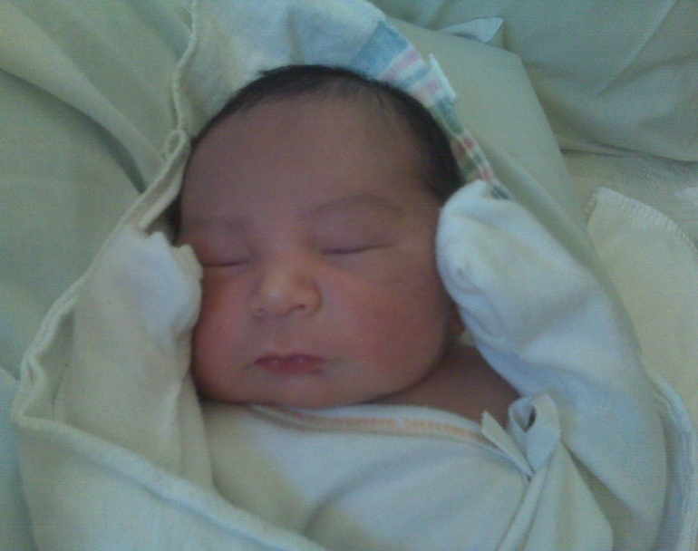
Test every year if you are an adult who has …
A BMI of 25 or higher
  Height (in.) / weight (lbs.) / weight x 703
Hypertension
HDL <40 mg/dl for men or <50 for women
Triglycerides 150 mg/dl or higher
A history of gestational diabetes
Given birth to a baby weighing 9 lbs or more
Were born to a mother with gestational diabetes, weighed 9 lbs or more, or 5.5 lbs or less
Polycystic ovarian syndrome
A close relative with Type 2 diabetes

Slide 16
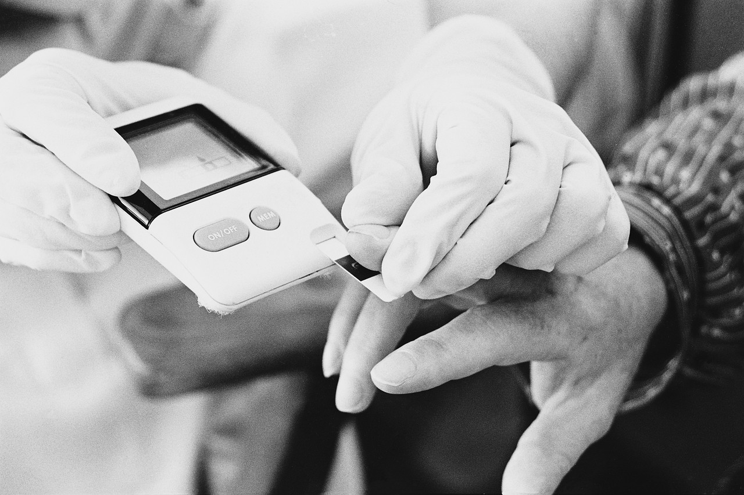
Test every 3 years if you are …
Over 35 years old

Slide 17
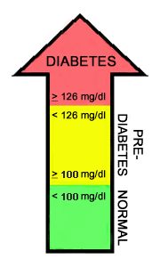
Pre-diabetes
Impaired Glucose Tolerance (IGT) – Oral Glucose Tolerance Test | 2-hr plasma glucose 140-199 mg/dl
Impaired Fasting Glucose (IFG) – 8-hour fasting plasma glucose | FPG 100-125 mg/dl
Blood glucose levels that are higher than normal but not yet high enough to be diagnosed as diabetes
Some long-term damage to the body, especially the heart and circulatory system, may already be occurring during pre-diabetes
Notes:
Fasting plasma glucose test
People with pre-diabetes can expect to benefit from much of the same advice for good nutrition and physical activity.
Pre-diabetes, also called impaired glucose tolerance (IGT) or impaired fasting glucose (IFG), is a condition in which your blood glucose (blood sugar) levels are higher than normal but not high enough for a diagnosis of diabetes. Having pre-diabetes puts you at higher risk for developing type 2 diabetes. If you have pre-diabetes, you are also at increased risk for developing heart disease.
There are two different tests your doctor can use to determine whether you have pre-diabetes: the fasting plasma glucose test (FPG) or the oral glucose tolerance test (OGTT). The blood glucose levels measured after these tests determine whether you have a normal metabolism, or whether you have pre-diabetes or diabetes. If your blood glucose level is abnormal following the FPG, you have impaired fasting glucose (IFG); if your blood glucose level is abnormal following the OGTT, you have impaired glucose tolerance (IGT).

Slide 18

IHS recommended care for individuals with prediabetes and metabolic syndrome
Goal 1: Prevent type 2 diabetes
  Nutrition counseling
  Exercise guidelines
  Medication
  Depression screening and treatment
Goal 2: Reduce risk of cardiovascular disease

Slide 19
PRE-DIABETES RISK FACTORS
FAMILY HISTORY
HIGH BLOOD PRESSURE
HIGH TRIGLYCERIDE LEVELS
GESTATIONAL DIABETES
GIVING BIRTH TO A BABY MORE THAN 9 POUNDS
OBESITY and OVERWEIGHT

Slide 20
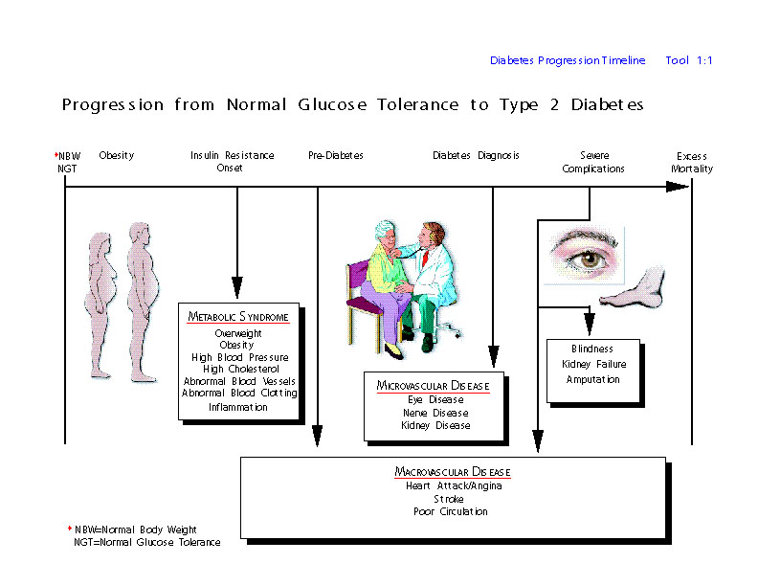

Slide 21
How did we get here?
  Adoption of a “westernized” high fat diet
McDee’s vs. Subway (portion size)
Access to quality foods, fresh fruits, and vegetables. Rural communities have no supermarkets, higher price…Commodities; often high in fat and calories.
Less reliance on hunting and farming as occupations…sedentary occupations. ~
Technological advances in society has hurt us all.
Access to facilities, consistent care.
  Travel time, few wellness centers, new providers
Sense of Hopelessness/Depression ~
  I’ve got diabetes…OK

Slide 22
Portland Area overweight rates have
remained consistently elevated and above
the national IHS rates. These overweight
rates (83%) are considerably higher than
the current US average (66%).
*2003-2004 National Health and Nutrition Examination Survey, percentage of U.S. adults either overweight or obese.

Slide 23
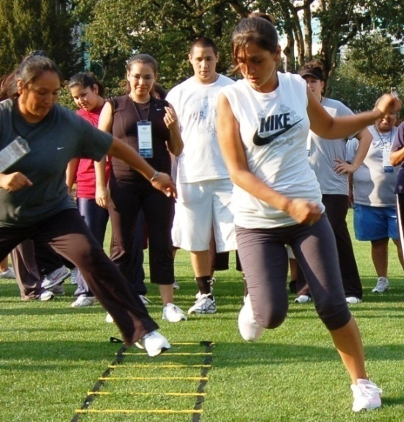
Audit Results for Patients with Diabetes Portland Area 2004-2008

Slide 24
HSR Portland Area

Slide 25
Audit Results for Patients with Diabetes Portland Area 2004-2008

Slide 26
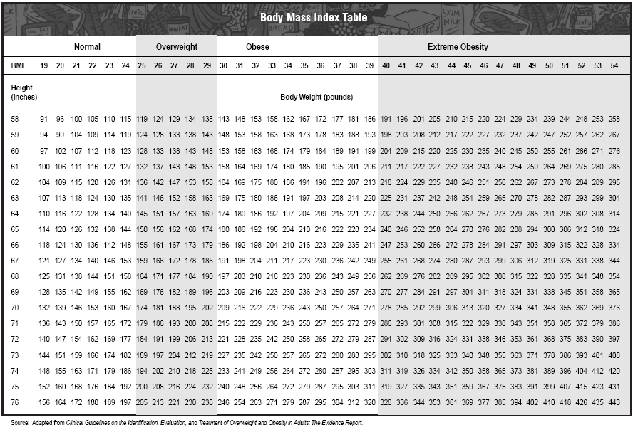

Slide 27
Diabetes Prevention Study
  Middle-aged people with pre-diabetes
  171 Native Americans
  Overweight
  Motivational counseling
  Reducing fat and saturated fat
  Moderate weight loss
  Increased physical activity (walking)
Notes:
Does treating the metabolic syndrome make a difference? Finnish Diabetes Prevention Study
This slide describes the Finnish Diabetes Prevention Study, which looked at 522 middle-aged overweight men and women with glucose intolerance. Subjects were randomized to two groups. The intervention group had individualized counseling.
Reference:
Tuomilehto J, Lindstrom J, Eriksson JG, Valle TT, Hamalainen H, Ilanne-Parikka P, Keinanen-Kiukaanniemi S, Laakso M, Louheranta A, Rastas M, Salminen V, Uusitupa M. Prevention of type 2 diabetes mellitus by changes in lifestyle among subjects with impaired glucose tolerance. N Engl J Med 2001;344:1343-1350.

Slide 28
Diabetes Prevention Study
Risk of diabetes reduced by 58% with a 7% weight loss
Wow!!

Slide 29
Obesity - PREMATURE DEATH
The risk of death rises with increasing weight.
  Obesity can cut up to 20 years off
  a person's life.

Slide 30

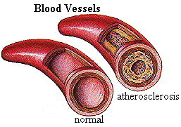
Obesity - HEART DISEASE
Heart disease is increased .
High blood pressure is twice as common.
High cholesterol is increased.

Slide 31
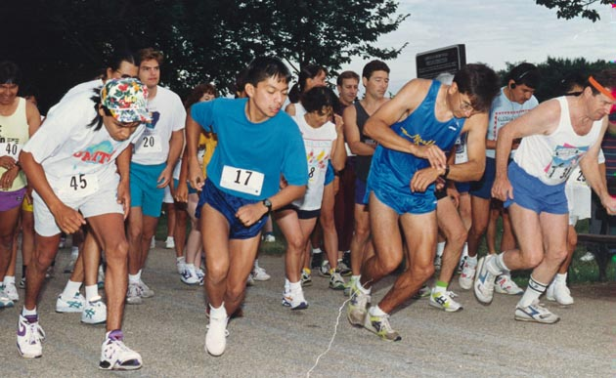

Obesity - DIABETES
11 to 18 pounds increases diabetes risk by 100%.
Over 80% of people with diabetes are overweight or obese.

Slide 32
Obesity - CANCER
Increased risk of cancer.
  Lining of the uterus
  Colon
  Gall bladder
  Prostate
  Kidney
Women can double their risk of postmenopausal breast cancer.
C

Slide 33
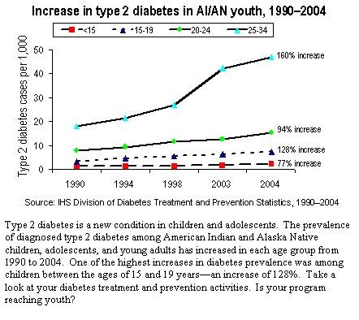

Slide 34


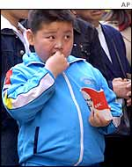

What About The Kids?

Slide 35

What About The Kids?
1 in 3 are overweight
1 in 6 are obese
+ 400% obesity since 1975
Obesity rates much higher in Native kids

Slide 36
What About The Kids?
School PE budgets slashed
Most kids don’t walk to school
Most kids are not in after-school sports
Electronic babysitting
Working moms=fast food dinners
Family R&R is usually inactive

Slide 37
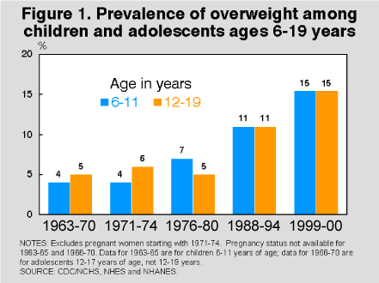

Slide 38
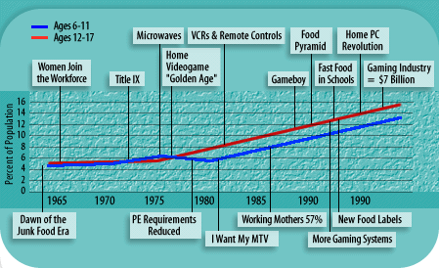
Overweight Kids in Society

Slide 39
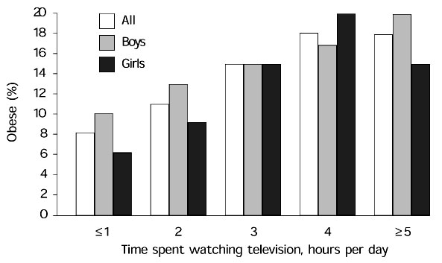
TV & Obesity
43%
Teens
Watch
>2hr
TV
day

Slide 40
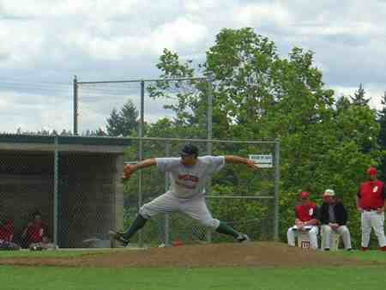
TV & Obesity
Most kids ages 2-18 watch a total of > 5 hours/day of electronic media
1 in 4 kids get no school PE at all
Teen obesity may aggravate eating disorders and emotional problems.

Slide 41
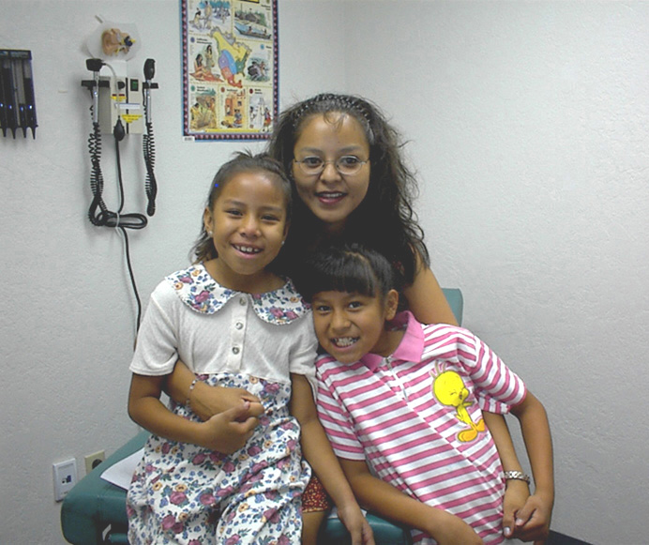
Obesity - CHILDREN AND ADOLESCENTS
Increased risk for:
  high cholesterol & blood pressure
  heart disease & diabetes
  asthma
  joint problems
  adult obesity
  Children perceive their own social discrimination because of obesity

Slide 42
Metabolic Syndrome in Kids
Nearly 1 million U.S. teenagers
  “…almost three out of every 10 is like a ticking time bomb for heart disease because they have metabolic syndrome.”
  Michael Weitzman MD
  Director of the American Academy
  of Pediatrics' Center for Child Health Research

Slide 43
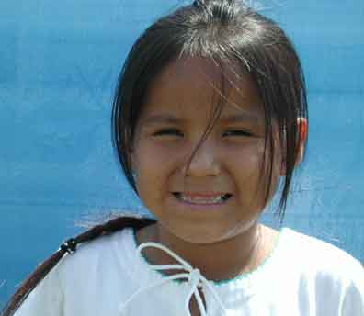
Overweight in American Indian Kids
  200-300% more common than non-Natives.
  4 in 10 Native kids are overweight or obese.

Slide 44
The Future ?
“…these children are at very high risk for serious problems later on, and if we don't change their status,
…these are going to be people with diabetes in their twenties or thirties and their first heart attack in their forties."
        CDC director
        Dr. Julie Gerberding.

Slide 45
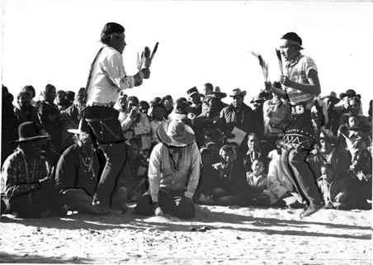
Getting A Grip On Obesity
What’s The Problem?
What’s It Got To Do With Me?
What Can I Do About It?

Slide 46
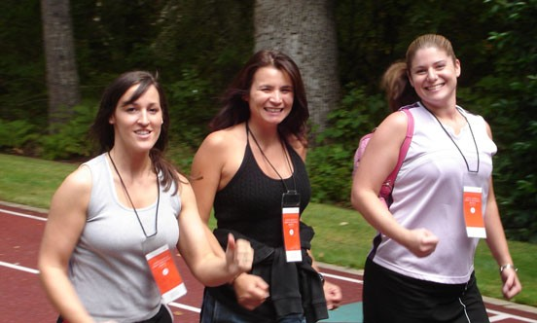
What You Can Do
Walking at least ½ hour for most days of the week can reduce risk of developing diabetes.

Slide 47
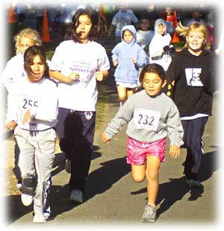
What You Can Do
Weight loss is the key.
Drastic weight reductions & severe diets are not needed to reduce risk and improve health.

Slide 48

What You Can Do
Keeping kids fit is not rocket science.
Smaller food portions. Healthier food choices.
Make ‘em walk.
Chores of activity.
Limit all TV/PC/electronic media to one hr/day.
Active family rec activities.
Lead by example.

Slide 49
What You Can Do
Diabetes, metabolic syndrome, heart disease and stroke risks can all be improved by these small reductions in body weight.

Slide 50
What We Can Do
Tips for balancing energy everyday
Good food that’s good for you
Ways to get the family moving
Ways to wean the screen
How to maintain a healthy weight

Slide 51
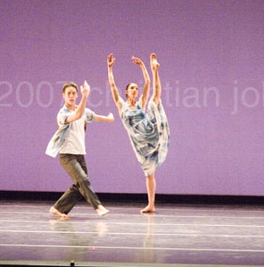
Ten tips
Choose to move
Cut down on screen time
Steer clear of sugary drinks
Limit Fast Food
Respect your appetite
Don’t use food as a reward
Eat Breakfast
Choose more fruits and vegetables
Make fitness a family project
Stay Positive

Slide 52
IHS Best Practices
Youth and type 2 Diabetes
School Health and Diabetes
http://www.ihs.gov/MedicalPrograms/Diabetes/resources/bestpractices_2006.asp

Slide 53
Body Works
7 steps to success for teens
“Train the trainer model”
www.womenshealth.gov/bodyworks

Slide 54
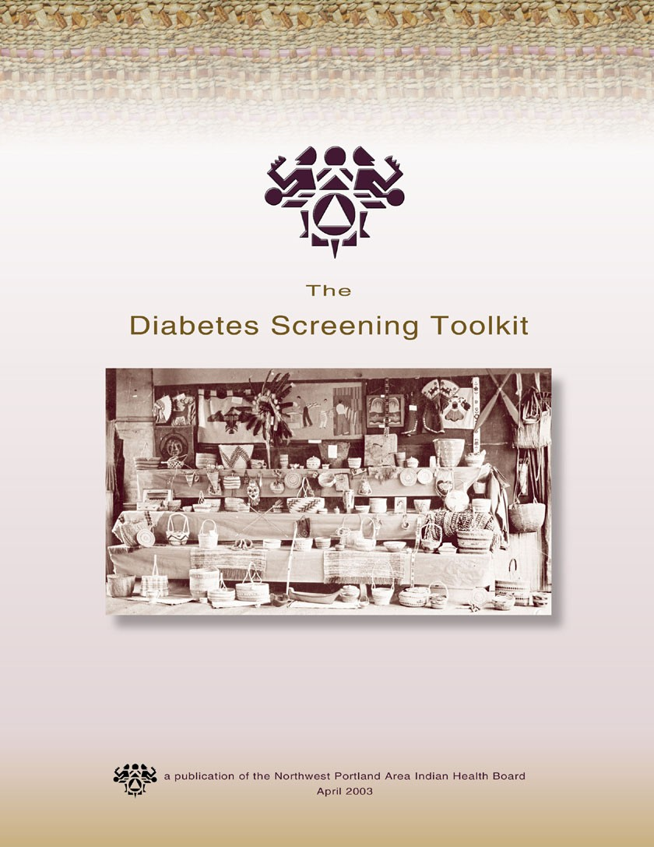
Tribal Partnerships At Work
Diabetes
Screening
Toolkit
Coquille
Quinault
Cow Creek
Coeur d’Alene
NPAIHB
IHS

Slide 55
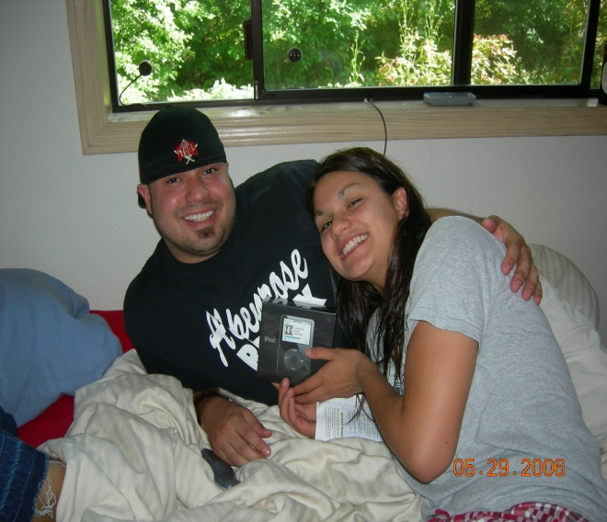
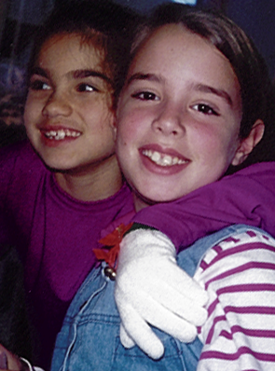
Diabetes Screening Toolkit
Develop a diabetes screening resource that is currently not available for American Indian and Alaska Native communities to identify target populations for prevention initiatives.

Slide 56

Diabetes Screening Toolkit
Address a priority identified by nearly all Portland Area diabetes programs
Serve as standardized tool for community-based diabetes screening activities
Assist diabetes programs with planning effective screening activities
Stimulate prevention projects

Slide 57
Screening Justification
Higher diabetes prevalence rates
Recognition of pre-diabetes and metabolic syndrome
Consideration of complications
Intervention can prevent and decrease complications and/or the disease itself

Slide 58

Why Screen?
Enhance health status of individuals
Decrease complications risk
Decrease death from the disease
Increase overall well-being of families and communities

Slide 59
New youth screening
Coming soon
Guidelines for screening for childhood obesity
Guidelines for screening for childhood high blood pressure
Guidelines for screening for childhood high cholesterol
Healthy lifestyle geared for youth

Slide 60
WTDP Tools and Resources
Short cut and reference manual
Health Status Report
Tribal diabetes comparison report
Tribal diabetes trends report
NW Diabetes Aggregate Report
Diabetes Screening Toolkit

Slide 61
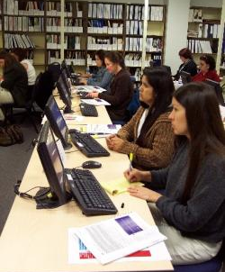
Formal training
Ten sessions held since October 1, 2007
  100 trained
  Ceu accredidation
  Typically 14-20 students
Attended by diabetes coordinators, assistants, and clinicians
Primarily new employees, but some come for “refresher”

Slide 62
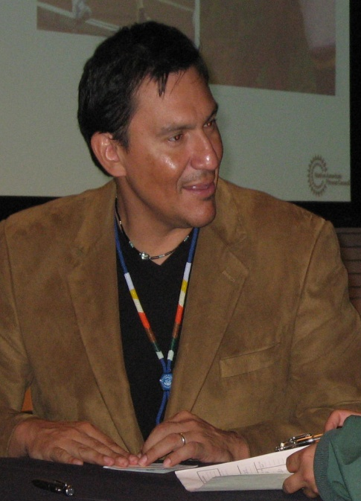
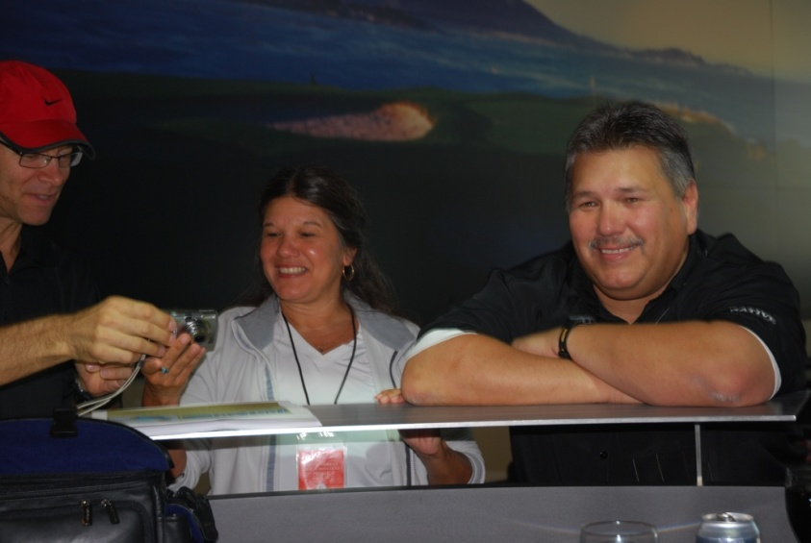
Other trainings
Nike Native Fitness
  150 participants
  77 programs
  18 states
Motivational Interviewing
  25 particpants
  18 tribal programs
Risky Business (3)
  45 participants
Partnerships
  PAO IHS
  National
  OIT
  IHS Clinical support center

Slide 63
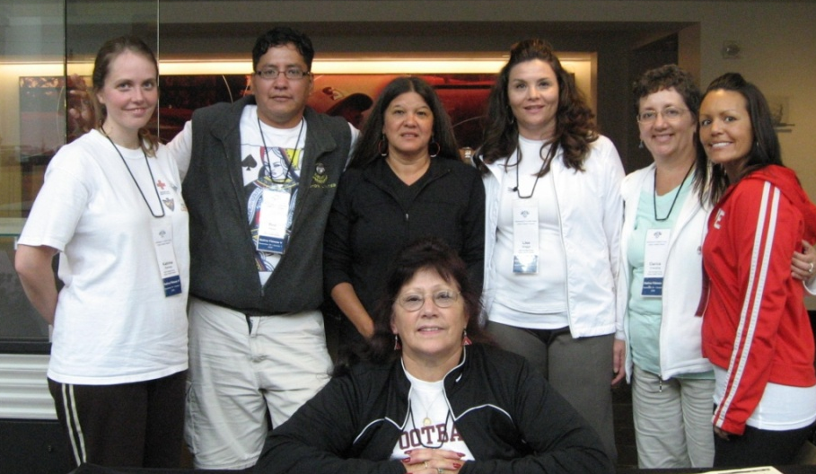
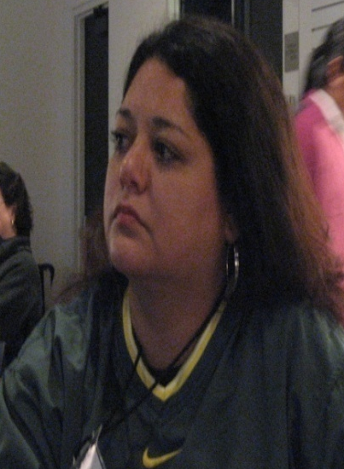
Future directions
Continue current activities
Effective model
  Translate to other areas
  Measurable markers
  Data survey
Obstacles
  Data as good as data entry
  Staff turnover
  New Technology – EHR, iCare, Visual DMS
Opportunities in other chronic disease case management & monitoring areas
  CVD, Cancer of particular interest

Slide 64
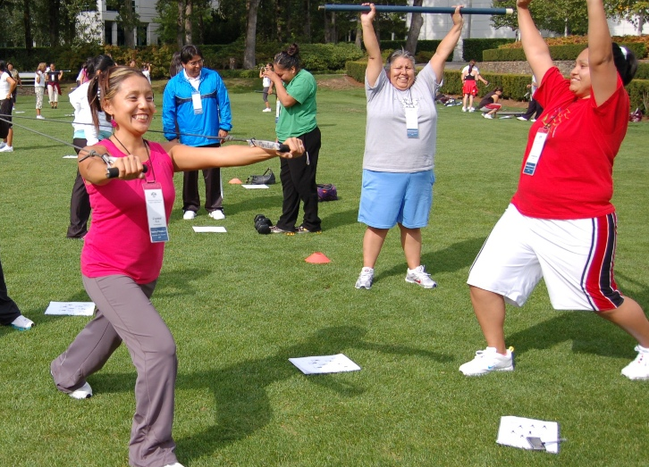
Northwest Tribes Meet the Challenge
10,000 STEPS
Youth screening in schools
Aerobics/Water
Aerobics Video
Mile Moccasin Club
Yoga
Fitness centers/personal trainers
Golf tournaments
Community Gardens
Biggest Loser
Health Fairs
Walk to Smithsonian
Cooking classes/healthy eating
Pre-diabetes Screening
Just Move It
Youth and Adult Diabetes Camps
Tribal Diabetes Conferences
Lifestyle Intervention Classes

