Slide 1
CHILDHOOD IMMUNIZATIONS
Thomas Weiser, MD, MPH
Medical Epidemiologist
Portland Area Indian Health Service
Northwest Portland Area Indian Health Board

Slide 2
Before vaccines, parents in the United States could expect that every year:
Polio would paralyze 10,000 children.
Rubella (German measles) would cause birth defects and mental retardation in as many as 20,000 newborns.
Measles would infect about 4 million children, killing 3,000.
Diphtheria would be one of the most common causes of death in school-aged children.
A bacterium called Haemophilus influenzae type b (Hib) would cause meningitis in 15,000 children, leaving many with permanent brain damage.
Pertussis (whooping cough) would kill thousands of infants.

Slide 3
Immunization Schedules
More complex
More shots
More protection
More controversy

Slide 4
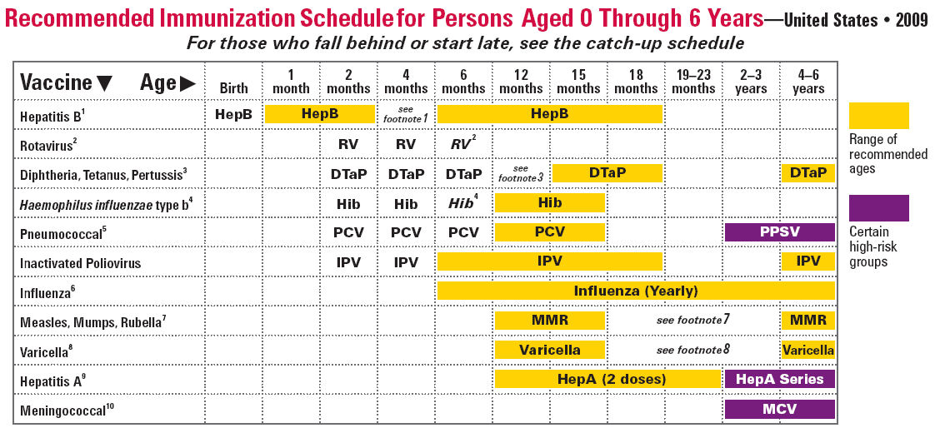
2009 Immunization Schedule

Slide 5
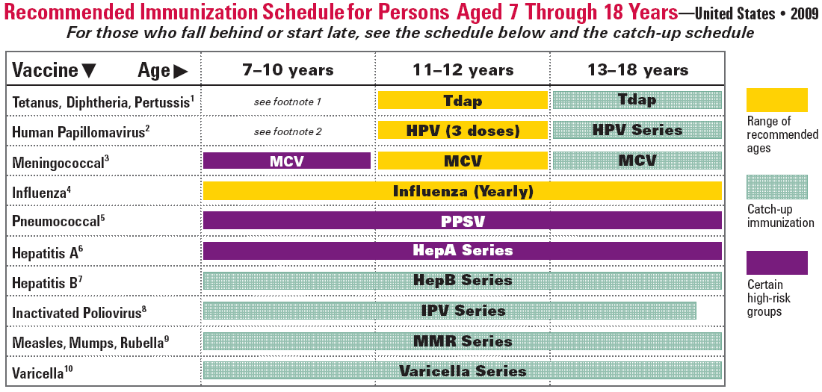
2009 Immunization Schedule

Slide 6
Recent New Immunizations
Varicella - 1995
Pneumococcal- 2000
Meningococcal- 2005
Hepatitis A- 2006
Rotavirus- 2006 (RotaTeq), 2008 (Rotarix)
Tdap- 2006 (for adolescents)
Human Papilloma Virus- 2007
Influenza- 2008 (for children 6 months-18 yrs)

Slide 7
Concerns About Safety
Autism- most recent studies have concluded that there is no link between MMR or thimerosol and autism
http://www.chop.edu/vaccine/fact_from_fear/vaccine_shell.html
Chronic Illness- studies have found no link between immunizations and multiple sclerosis, ADHD, diabetes, inflammatory bowel disease or SIDS

Slide 8
What do people say?
What do people in your community say about immunizations?
What do providers tell their patients?
Take 5-7 minutes to discuss in small groups

Slide 9
