Slide 1
Special Diabetes Program for Indians
KLAMATH TRIBES COMMUNITY-DIRECTED
DIABETES MANAGEMENT GRANT PROGRAM
Jessie Hecocta; Diabetes Program Coordinator
Klamath Tribal Health & Family Services
3949 South 6th Street
Klamath Falls, Oregon 97603
(541) 882-1487 Ext.237
jessie.hecocta@klm.portland.ihs.gov

Slide 2
Oral Health Care
Diabetes Management Program
IHS Standards of Care:
Inspection of gums/teeth at diagnosis, then at every diabetes visit.
Dental exam by dental professional at diagnosis, then every 6-12 months.
Dental Diabetes Program:
Began in FY 2012
Establish priorities for dental treatment and oral health education for people with diabetes.
Conduct annual dental examinations and cleanings.
Restoring caries in all people with diabetes.
Provide recalls to maintain periodontal and dental health.
Barriers to key measures
Cancellation or no-shows-leaving open appointments, takes up provider time.
Transportation issue-clinic service rurally located.
Rural service areas-patient population living in outlying areas. Sprague, Beatty and Bly.
Unable to identify the use of outside provider care: oral health.

Slide 3
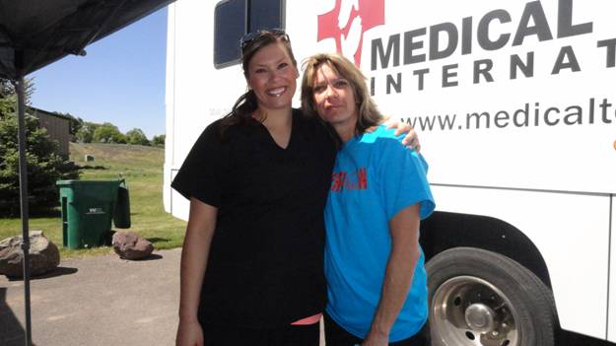
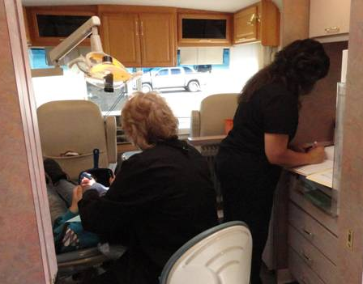
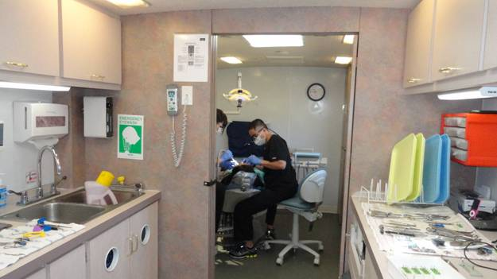
Mobile dental van
Dental Diabetes Program:
Began in FY 2013-current
Investigated and organized collaboration between the Klamath Tribes’ Dental Diabetes Program and Medical Teams International.
Diabetes Management Program budgeted $1,000.00 per rental date(s).
Community Outreach:
Provide mobile dental services within (2) communities, twice a year.
We have provided every service from fluoride treatment-to-extraction.
We have billed several insurance companies: Oregon Medicaid Dental, OHP Advantage Dental Plan, INC., Blue Cross Blue Shield of Oregon, Guardian Dental.
Medical Teams International:
Bend, Oregon
Cost is $1,000.00; budget also for supplies $200.00.
Includes: driver/dental assistant and their wage, come fully equipped with supplies.
Has two operatories, a sterilization room, x-ray capabilities and a bathroom.

Slide 4
Medical Teams International
Debbie Stumbaugh
Manager of the Mobile Dental Clinic
(541) 977-4367
dstumbaugh@medicalteams.org
3347 NE Zamia Ave, Redmond, OR 97756
http://www.medicalteams.org/about-us/what-we-do/mobile-dental-program
END SLIDE

