Slide 1
A multi-media health resource for
Native teens & young adults with content
about the topics that matter most to them.
Notes:
We R Native

Slide 2
Notes:
We Have a Website: www.weRnative.org
(Theory-based, offering culturally-appropriate health information - with tools for behavior change & positive youth development.)
Text Messaging Service: Text NATIVE to 24587
… and a Facebook page, YouTube channel, and Twitter feed.

Slide 3
Notes:
The website is funded by the President’s National HIV/AIDS Strategy and the Indian Health Service’s National HIV/AIDS Program, and run by the Northwest Portland Area Indian Health Board.
The site focuses on health and social issues important to Native youth.
Native youth, elders, and topical experts from throughout the U.S. have contributed to the site… as authors of blogs, directors of videos, graphic design artists, and more.

Slide 4
Notes:
The website includes an “Ask Auntie” section, where you can submit your own questions, search other people’s questions, and view Auntie’s responses.

Slide 5
Examples…
Dear Auntie, how do I explain being Native to someone who has only heard bad stuff on the news?
http://youtu.be/rQjkLUabTG8

Slide 6
Examples…
Dear Auntie, I think I might be gay but I’m not sure. When do most people know for sure?
http://youtu.be/mWeMhmrBU1I

Slide 7
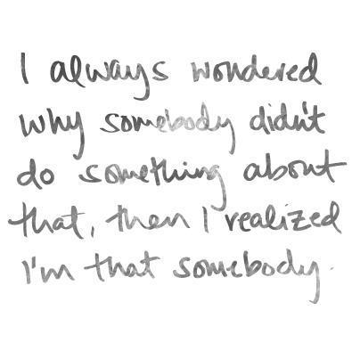
Notes:
To help youth take a more active role in their own health and wellbeing…

Slide 8
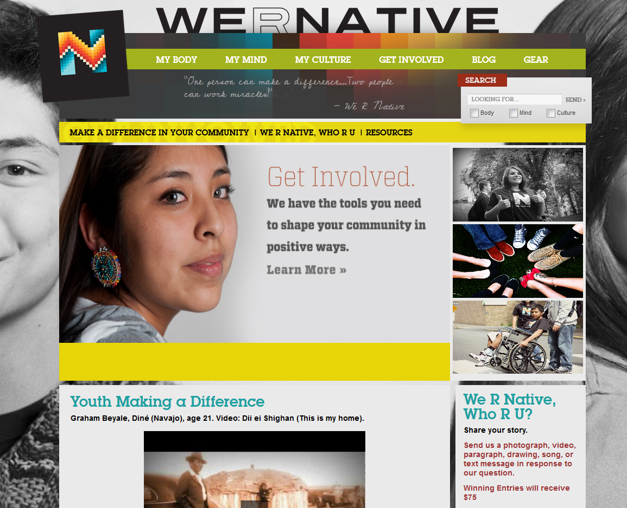
Notes:
The “Get Involved” section of the website focuses on:
Community Service Projects (and mini grants up to $475)
A Monthly “We R Native, Who R You?” Contest ($75, $50, and $25 prizes)
And showcases Native teens and young adults doing great things in their communities.

Slide 9
Community Service Grants
Shoshone-Bannock Tribes
Fort Hall Indian Reservation
Fort Hall, ID
Notes:
Here are some examples of what people have done with their community service grants…

Slide 10
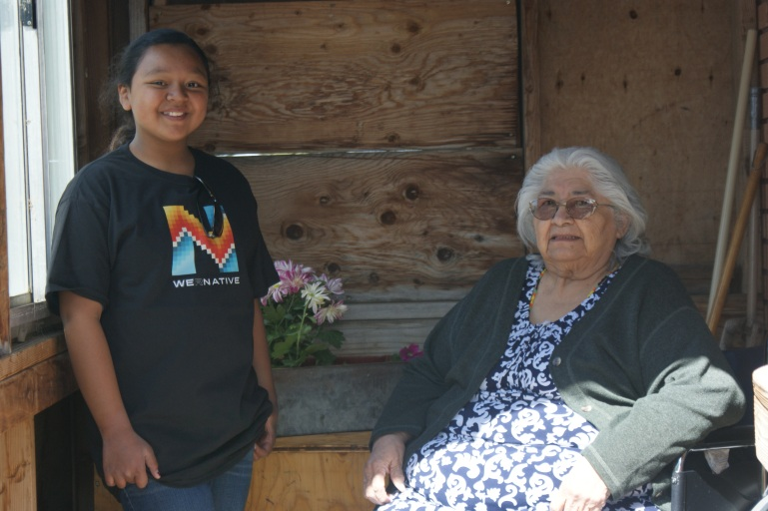
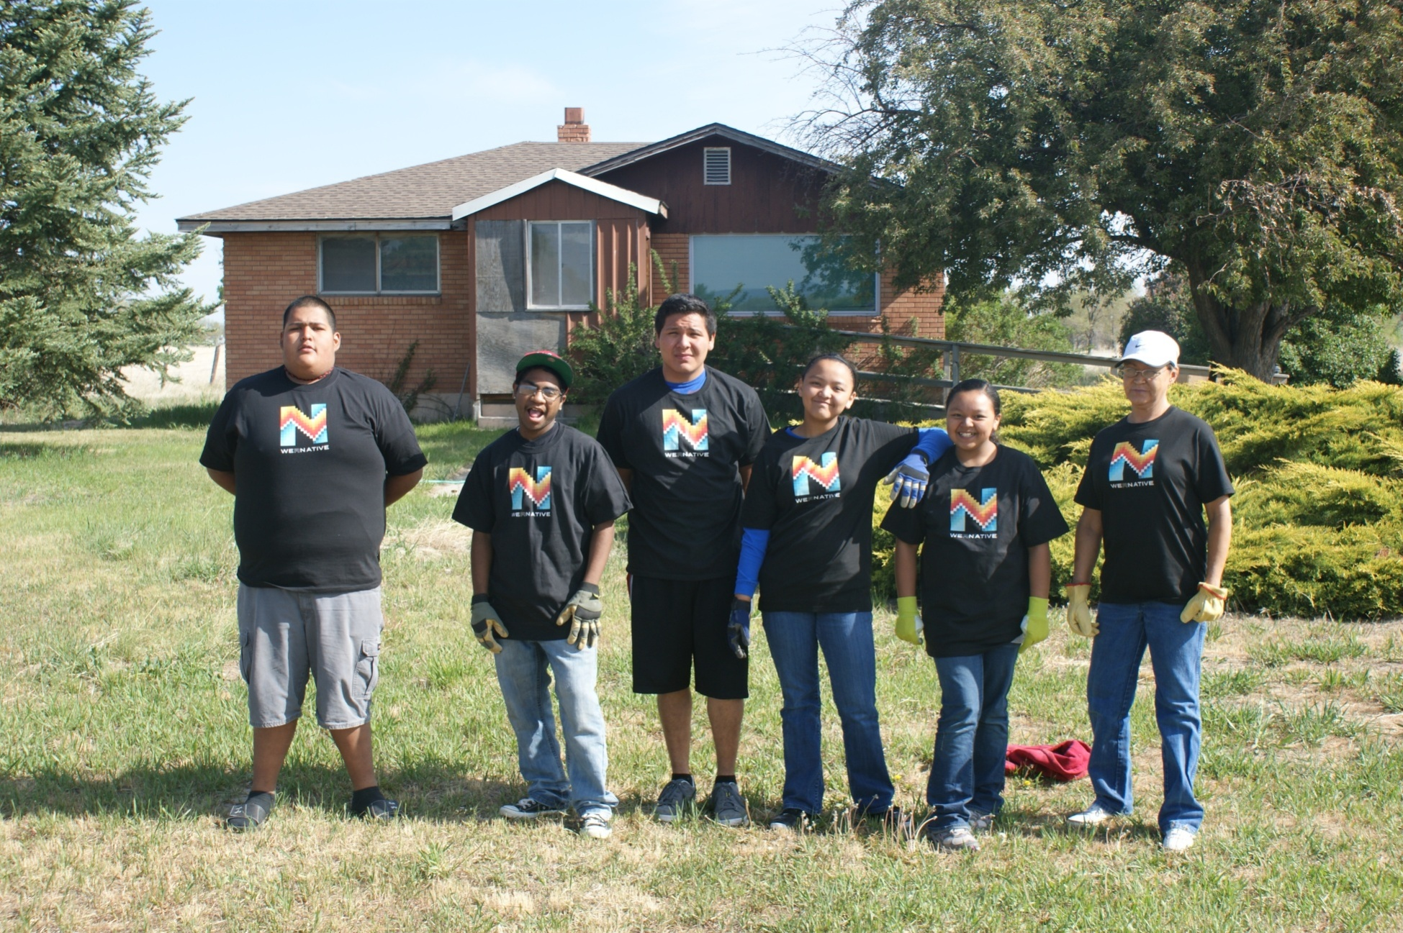
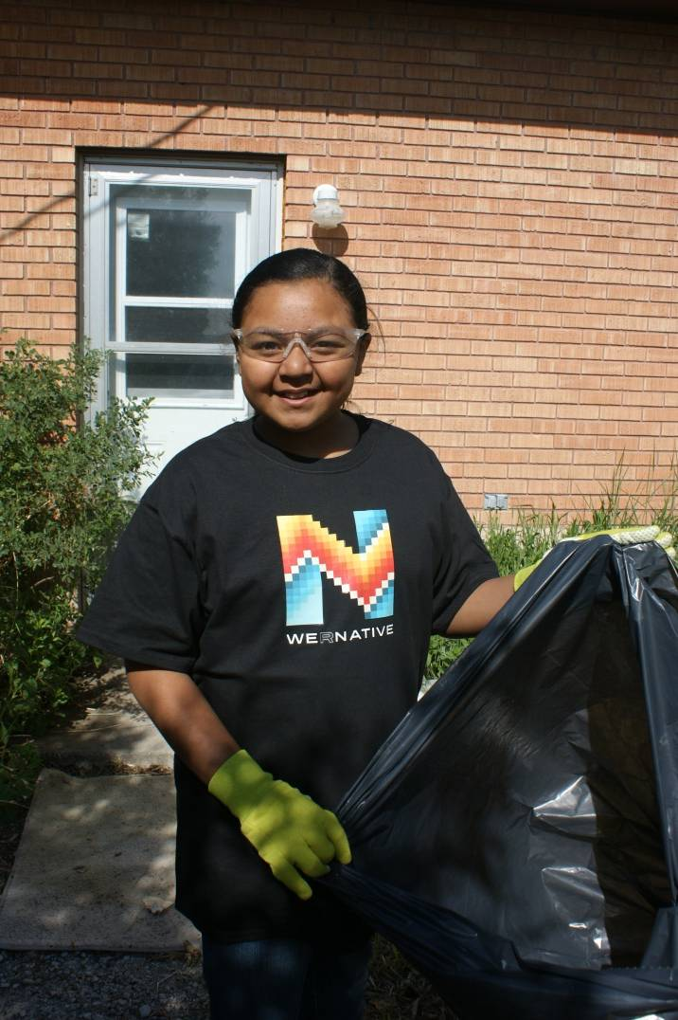
Notes:
Students from the Shoshone Bannock Healthy Empowered Youth (HEY) program offered yard clean-up services to elders in their community.
Students borrowed lawn mowers, rakes, and a trailer, and spent the day mowing and planting flowers at two elder’s homes. Afterwards they shared a meal with the homeowner, and asked them about their life.

Slide 11
Community Service Grants
Northern Diné Youth Committee
Navajo Nation
Shiprock, NM

Slide 12
Notes:
To celebrate National STD Awareness Month in April, the Northern Diné Youth Committee hosted an all-day Get Yourself Tested (GYT) event.
The event was open to the public, and included a 5K run/1 mile walk, a dodgeball tournament, food, and special performances by DJ Smash and Digital Divide. To help folks get tested, the youth committee partnered with Navajo AIDS Network to offer free, confidential STD/HIV testing to those who attended.

Slide 14
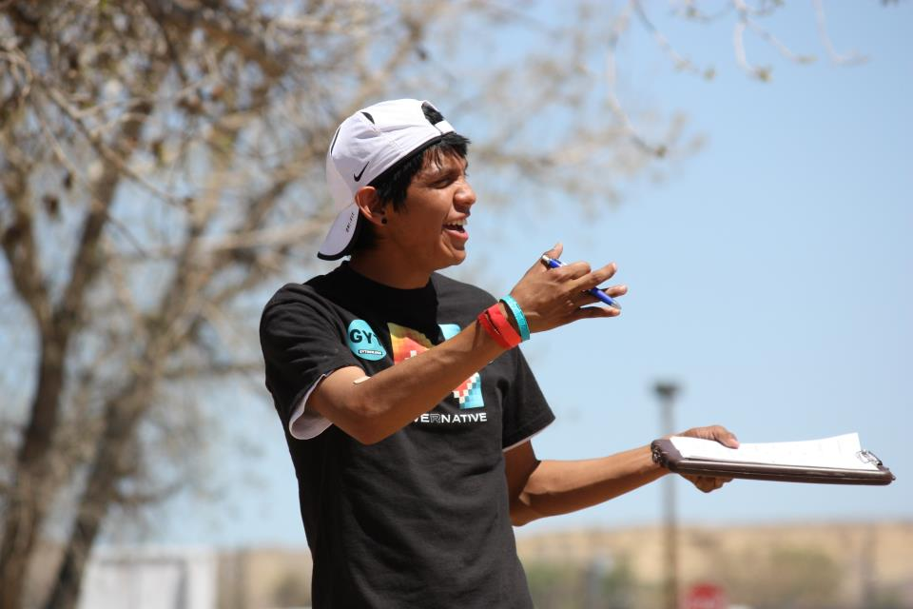
http://www.youtube.com/watch?v=hW_57M5YTxA
Notes:
They had around 100 people come to their event… food, music, and games. 100% Native youth powered!
Video is by Graham Beyale - mover and shaker in this youth group. Made it for We R Native’s We R Native. Who R You? Video Contest.

Slide 15
We R Native, Who Y You?
Monthly Contests
Send a photograph, video, paragraph, drawing, song, or text message in response to the question.
Winners : $75 – 1st, $50 – 2nd, and $25 – 3rd
Notes:
Every month the site also features a new contest.

Slide 16
Notes:
This is We R Native’s facebook page….
These are photos from a recent We R Native, Who R You? photography contest.

Slide 17
Notes:
To join the Text Messaging Service, text the word NATIVE to 24587
Over 900 people have signed up for the service.

Slide 18
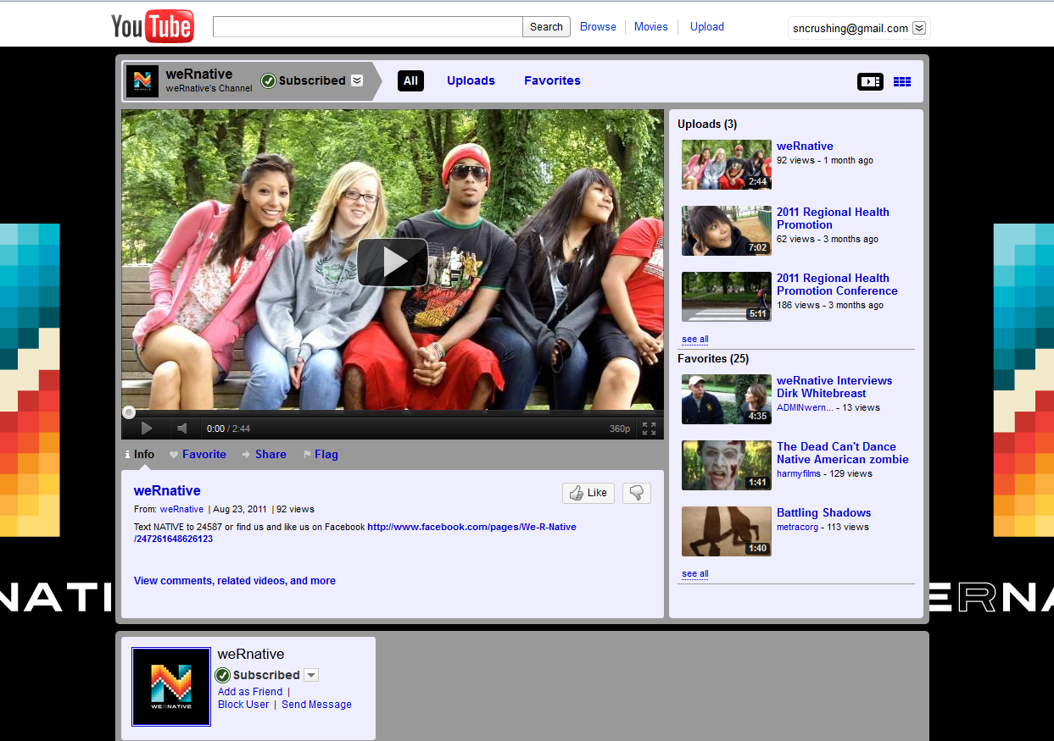
Notes:
Watch videos on our YouTube channel.

Slide 19
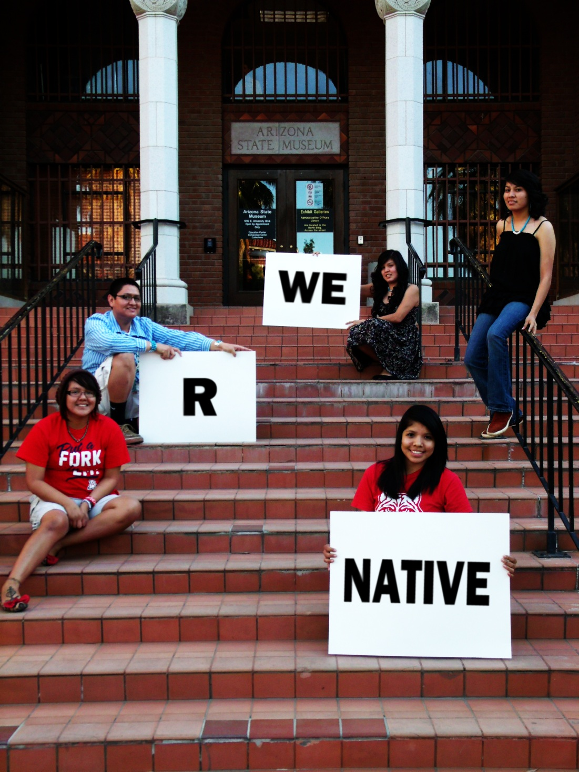
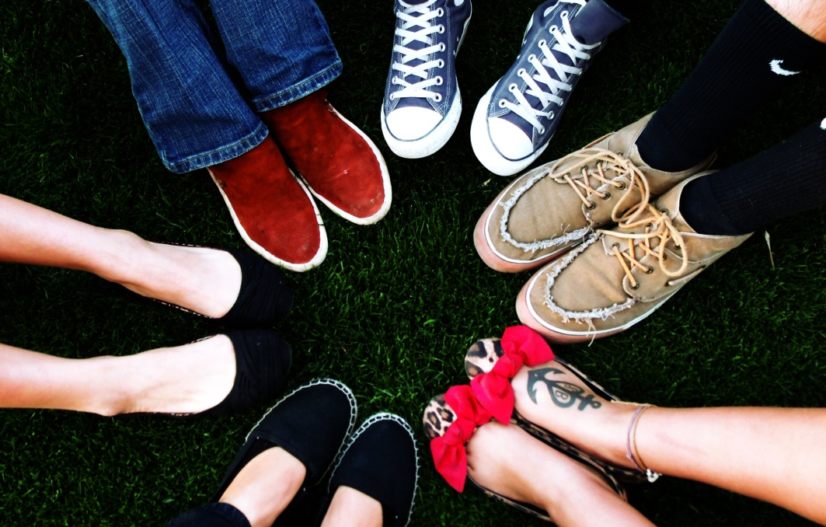
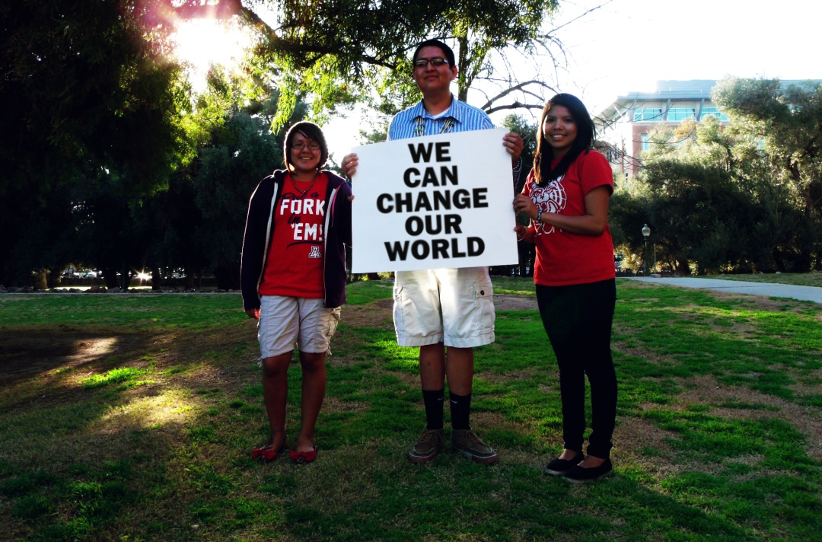
Notes:
Small amount but can accomplish great things! Also feel like it’s important to reflect the positive things youth are doing back to young people.
We believe at We R Native that Native youth can change our world…

