Slide 1
Public Health and Traditional “Emergency Responders”: A Cross-Cultural Communication
Susan Allan, MD, JD, MPH
Director, Associate Professor

Slide 2
NWCPHP Region
Mission:
The Northwest Center for Public Health Practice (NWCPHP) promotes excellence in public health practice by linking academia and the practice community.
Regional Network Steering Committee

Slide 3
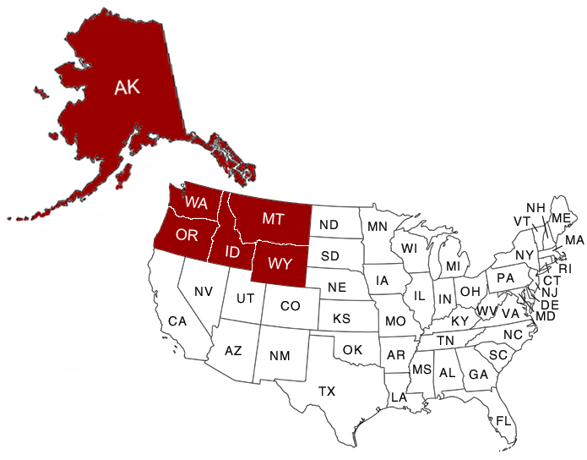
NWCPHP Region
Training, research and evaluation for state, local, and tribal public health in Alaska, Idaho, Montana, Oregon, Washington, and Wyoming.
www.nwcphp.org
Notes:
As part of the University of Washington School of Public Health, the NWCPHP provides training, research and evaluation for state, local, and tribal public health in six Pacific Northwest states (Alaska, Idaho, Montana, Oregon, Washington, and Wyoming).
3

Slide 4
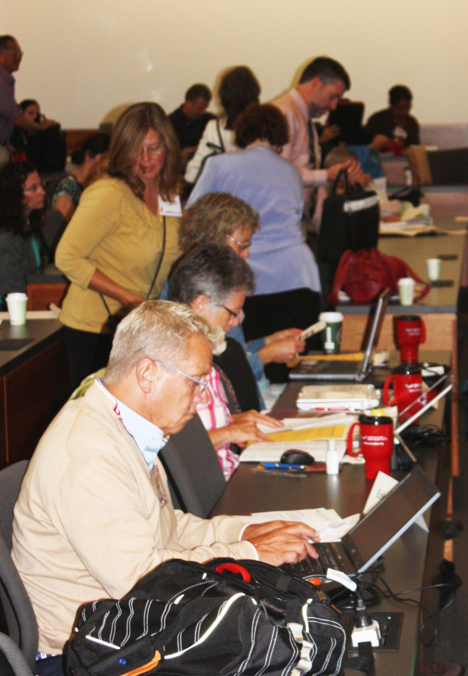
NWCPHP Region
Training
Online courses
In-person trainings
Exercises
Monthly Webinars
Leadership Institute
Summer Institute
Notes:
4

Slide 5
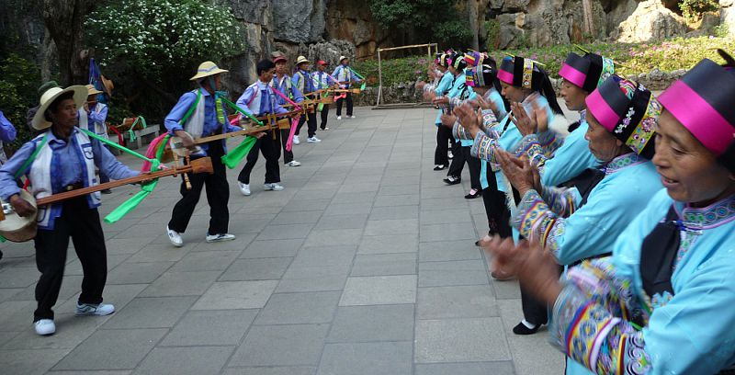
Practice-Based Research Developing evidence for public health practices.
Preparedness & Emergency Response Communications
Climate Change
Limited English Proficiency populations
Notes:
5

Slide 6
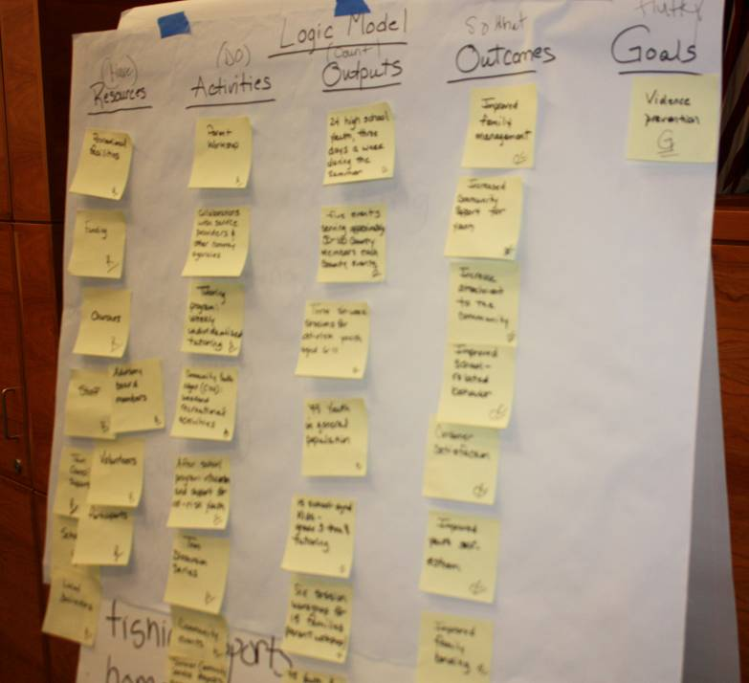
NWCPHP Region
Evaluation
Public Health Programs
Public Health Training Needs Assessments
Public Health Trainings
Notes:
6

Slide 7
“Cross Cultural Communication”
Nothing new for you!
My education – the hard way
Differences:
How we look
How we think
How we talk
Hints and reminders

Slide 8
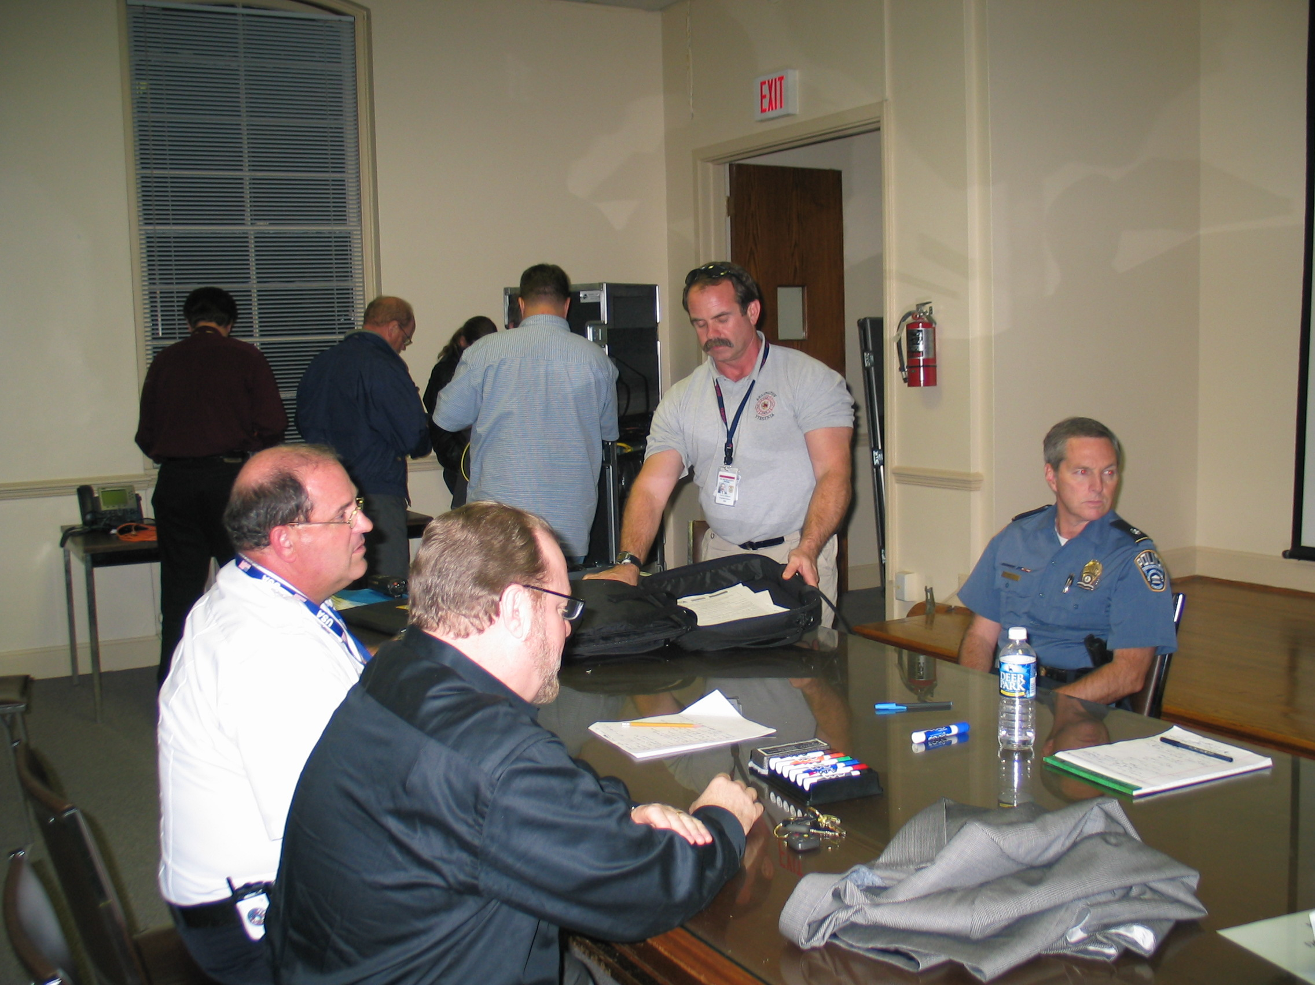

Slide 9
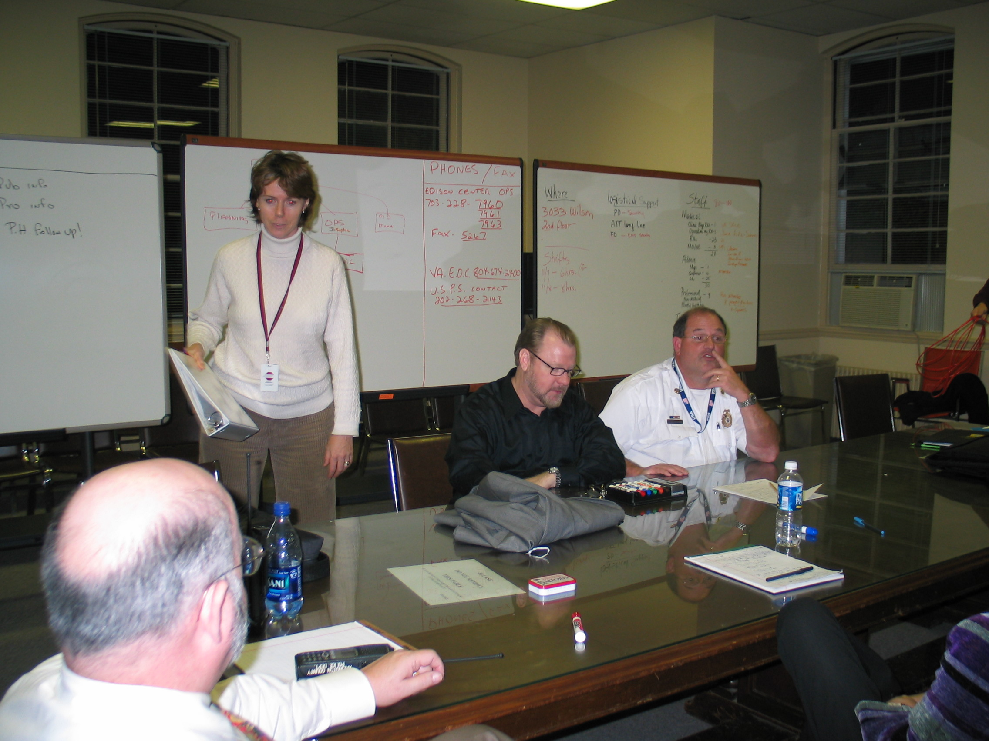

Slide 10
Arlington, Virginia September 11,2001

Slide 12
October 2001 – Anthrax Letters

Slide 17
Difference: How we look

Slide 18
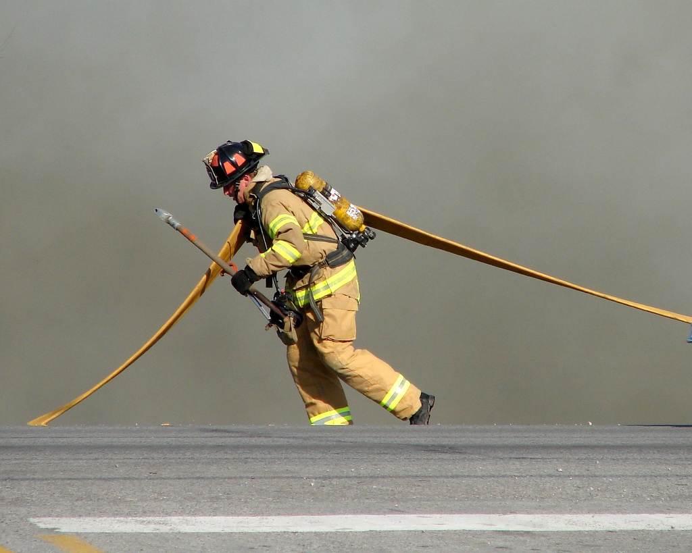

Slide 19
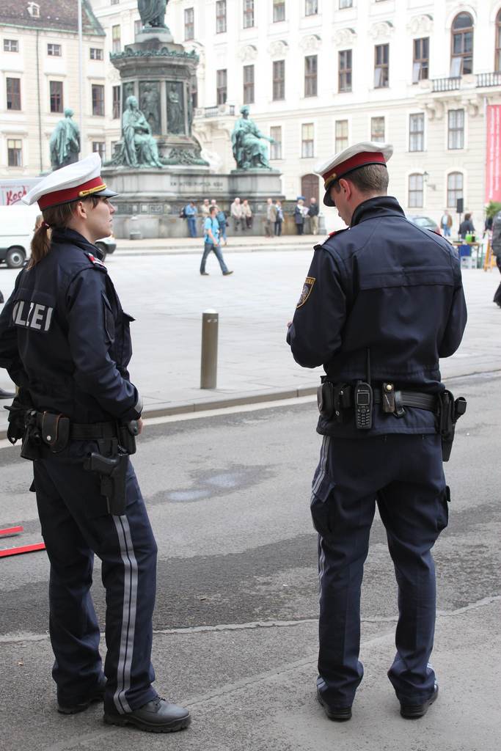

Slide 20
Difference: How we think

Slide 21
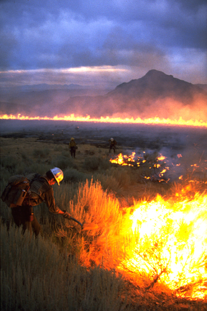
Wildfires

Slide 22
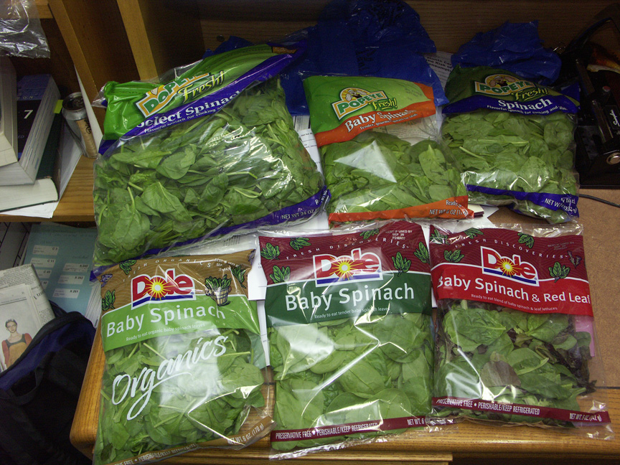
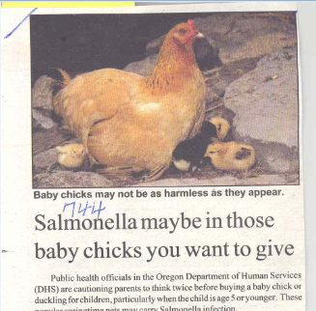
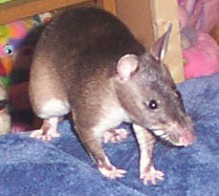

Slide 23
Meningitis Incident
“Why don’t you just treat everybody?”
“I’ll go to the lab and ask them to speed up the results”
Bio test vs chem

Slide 24
Tricky Concepts
Timeframes
Location of the emergency
Authority
ICS
Everyday protocols vs emergency protocols

Slide 25
Difference: How we Talk

Slide 26
Tricky Terms
Alphabet soup
Specialized jargon
Words that don’t seem like jargon
“Case”
“Aerosol”

Slide 27
Tips for Cross Cultural Communication www.culturosity.com
Slow Down.
Separate Questions.
Check Meanings.
Avoid Slang.
Maintain Etiquette.
Assume good will (SMA)

Slide 28
Advice following the massive SARS event in Toronto (2003)
“Take every opportunity to correct misinformation.”
Frank Ryder, Chief Superintendent,
Ontario Provincial Police

Slide 29
Links
Home page www.nwcphp.org
20th Anniversary – Timeline www.nwcphp.org/20th/index_html
Training www.nwcphp.org/training

