Slide 1
7th Annual Tribal Emergency Preparedness Conference 2010
Psychological First Aid:
Applications with American Indians
September 29, 2010
Grand Mound, WA

Slide 2
Randal Beaton, PhD, EMT Research Professor Schools of Nursing and Public Health University of Washington Faculty, Northwest Center for Public Health Practice

Slide 3
Funding Support
NIOSH Occupational Health Nurse Training Grant
2 T42 OHO 08433-06
(B. de Castro, Director of OHN Program)
HRSA Advanced Nurse Education Training grant #1 D09HP08334-04-00-
Disaster & Environmental Health Nursing
(R. Beaton, PI)

Slide 4
Special Thanks
Jason Madrano, Caddo
Linda Frizzell, E. Cherokee & Lakota
June Strickland, Echota Cherokee
Ticey Casey, Siletz and NPAIHB
Joe Finkbonner, Lummi and NPAIHB
Jay LaPlante, Blackfeet
Iris Heavy-Runner Pretty Paint, Blackfeet
National Child Traumatic Stress Network

Slide 5
Learner Objectives
To identify the intervention principals & core actions of Psychological First Aid.
To examine strengths and vulnerabilities of American Indians in the aftermath of a community wide disaster or public health emergency.
To propose and analyze culturally competent applications of Psychological First Aid for American Indian tribes and tribal members.

Slide 6
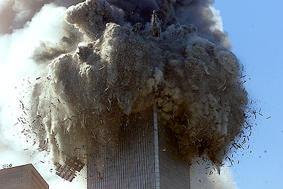
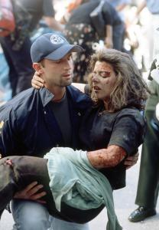
Psychological First Aid (PFA)
National Child Traumatic Stress Network
www.NCTSN.org
National Center for PTSD
www.ncptsd.va.gov

Slide 7
What is Psychological First Aid?
}
An evidence-informed psychosocial intervention designed to assist children, adolescents, adults, and families (and tribal members) in the immediate aftermath of disaster .
American Red Cross
Medical Reserve Corps
Community Emergency Response Teams (CERT)
Among others
This approach to disaster survivors’ mental health has been adopted by:

Slide 8
Basics of Psychological First Aid
Who is it for?
Individuals experiencing acute stress reactions or who appear to be at risk for significant impairment (Distressed survivors.)
Disaster response workers or others who are trained to provide early assistance. May include public health, emergency management personnel and tribal members.
Who is it delivered by?
When is it intended
to be delivered?
Immediate aftermath – usually within the first week
Where can it be delivered?
A broad range of emergency settings, in either single or multiple sessions (shelters, community out-reach)

Slide 9
How Do We Know How to Respond Following Disasters?

Slide 10
Some Basics of Psychological First Aid
Early mental health intervention such as PFA needs to be part of any disaster response
Expect a normal recovery
Assumes survivors are competent
Recognize survivor strengths
Promotes resilience
Modular components
Can be tailored

Slide 11
Cautionary Tales
The vast majority (80%+) of disaster and trauma survivors either recovers naturally (within days, weeks or a few months) or is significantly resilient such that they never develop PTSD or other mental disorders.
Some early mental health interventions designed for trauma survivors can potentially make matters worse. “First, do no harm”
Issues of timing and cultural considerations

Slide 12
Critical Incident Stress Debriefing Outcomes
Some studies have found that for a small minority (~10%) of trauma survivors Critical Incident Stress Debriefing (CISD) intervention- a type of group “agenda therapy”- is itself distressing and may potentially interfere with normal recovery.
This iatrogenic effect may be due to one inherent feature of CISD– “re-experiencing the traumatic event”– too soon (Miller-Burke and Fass, 1999)
CISD may be appropriate for some occupational cultures– such as the fire service– but may be inappropriate for others.

Slide 13
Cultural Considerations- Early interventions can be harmful
Study of psychoeducational interventions for Burundian civil war survivors (Yeoman et al, 2010).
Burundi, a small nonindustrial African nation, suffered a civil war in which over 300,000 individuals– mostly non military citizens- were killed.
Psychoeducational intervention included information about PTSD including commonly experienced trauma symptoms.
Outcome: The group that received the psychoeducational intervention actually reported less of a reduction in trauma symptoms.

Slide 14
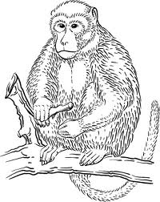
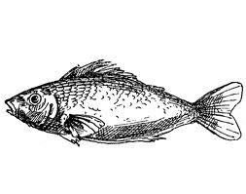
Good intentions are not enough
Ancient Chinese Fable Quoted in Marsella and Chrisopher (2004)
A monkey and a fish were caught in a terrible flood and were being swept downstream by torrents of water and debris.
The monkey spied a branch from an overhanging tree and pulled himself to safety from the flood waters.
Then, wanting to help his friend the fish, he reached into the water and pulled the fish from the water onto the branch…
monkey
fish

Slide 15
Good intentions are not enough
Moral of the story Good intentions are not enough. If you wish to help the fish, you must understand the culture.
monkey
fish

Slide 16
Five Empirically-Supported Early Intervention Principles

Slide 17
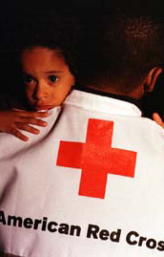
Promotion of Psychological Sense of Safety
“Safety First”
Reduces biological aspects of traumatic stress reactions
Positively affects thoughts that inhibit recovery
Notes:
Bring to a safe place
Make it clear that it is safe
Educate about how to make environment safe
Inform the media to convey safety and resilience rather than imminent threat.
Encourage individuals to limit exposure to news media overall
“Grounding techniques” such as reality reminders
Instruction in discriminating context in the face of trauma and loss triggers
Imaginal exposure and real-world, in-vivo exposure

Slide 18
Promotion of Calming
Reduces anxiety, high arousal, numbing, or strong emotions
Supports better:
Sleep
Eating
Decision-making
Performance of life tasks
May reduce the probability of long-term psychological difficulties
Notes:
Help people directly solve concerns
Give information on whether loved ones are safe
Inform if further danger is impending
Large-scale community education about:
Common post-trauma reactions
Anxiety management techniques
Signs of more severe dysfunction
Limiting media exposure
Breathing retraining
Deep muscle relaxation
“Normalization” of stress reactions
Therapeutic grounding

Slide 19
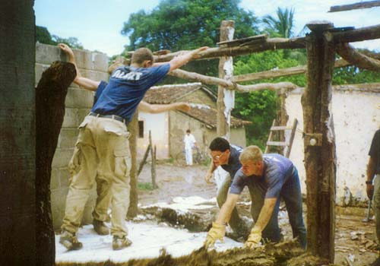
Promotion of Self-Efficacy
Encourage disaster survivors to play an active role in their own recovery
Increases people’s beliefs about their capabilities
Increases self-control of thought, emotions, and behavior
Notes:
Provide people with resources
Involve survivors in decision-making
Promote community activities such as:
Meetings
Rallies
Collaboration with local leaders and healers
Collective healing and mourning rituals
Religious activities
Remind individuals of their efficacy
Help to “recalibrate” expectations and goals
Teach individuals to problem-solve and set achievable goals
Encourage active coping

Slide 20
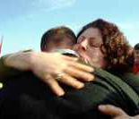
Promotion of Connectedness
Related to better emotional well-being and recovery
Provides opportunities for:
Information about resources
Practical problem-solving
Emotional understanding
Sharing of experiences
Normalization of
reactions and experiences
Sharing of ways of coping
Notes:
Identify those who:
Lack strong support
Are likely to be more socially isolated
Have a support system providing undermining messages
Help individuals to link with loved ones
Increase the quantity, quality, and frequency of supportive transactions
Address potential negative social influences
Train people how to access support
Provide formalized support
Address discordance among
family members

Slide 21
Instilling Hope
Favorable outcomes
are associated with:
Optimism
Positive expectancy
A feeling of confidence in life and/or self
Strong faith-based beliefs
Notes:
Help people:
Link with resources
Share their experience and hope
Memorialize and make meaning
Accept that their lives and their environment may have changed
Rebuild local economies
Identify and build strengths
Normalize responses
Encourage positive coping behaviors
Manage extreme avoidance behavior
Manage self-defeating self statements

Slide 22
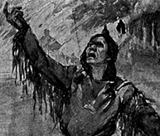
Historical Trauma– Soul Wound
Historical Trauma of American Indians which has occurred over a span of 500 years resulting in collective emotional injury over life spans & across generations (Yellow Horse Brave Heart & DeBruyn, 1998)
Included genocide, place loss, “ethnic cleansing” and forced acculturation resulting in unresolved grief and anger (Whitbeck et al, 2004)
A vulnerability and risk factor for PTSD

Slide 23
Other Risk Factors for Trauma Outcomes for American Indians and Tribes
There are a variety of proximal stressors and traumatic events to which many American Indian tribes and tribal members are routinely exposed including:
These are also risk factors for adverse trauma outcomes.
Poverty
lack of resources
social injustice
mental or physical health problems
substance use disorders
cultural disruption

Slide 24
Ethnoracial Trauma Research with American Indians
Some research findings suggest that American Indians may have higher rates of PTSD than whites and the highest cumulative burden of past trauma (compared to whites, Latinos and Asians)
But study samples may not be representative of tribal members.

Slide 25
Ethnoracial research (cont.)
One recent published study (Stephens et al, 2010) found higher rates of PTSD and prior “trauma burden” in American Indian (n=81) survivors of traumatic injuries. But few of these Harborview Medical Center trauma patients resided on tribal lands and most were mixed white and American Indians.
History or current PTSD and prior trauma exposures are considered risk factors for the onset and progression of PTSD to a novel traumatic event.
Provides an additional rationale for the provision of culturally competent PFA in the aftermath of a disaster for American Indians.

Slide 26
Trauma Prevention
Epidemiological studies of PTSD in children and adults also provide a rationale for trauma prevention
Research has shown that prior traumatic events– for example in children who lived in New York city nearby the Twin Towers on 9/11– increased the likelihood of PTSD in the aftermath of the terrorist attacks. (Hooven et al, 2005)
Thus, efforts to reduce traumatic outcomes following a disaster should include efforts to prevent traumatic events in children—such as child abuse and neglect– and in adults– such as suicide and domestic violence. (Beaton et al, 2009)

Slide 27
{
}
Differences between
American Indian and Outside culture-
many are strengths
“In the Face of Disaster” (Mandano and Strickland)
Children granted same degree of respect as adults.
Harmony with the environment and nature
Generosity and sharing; contributions to the group
Present-oriented (time); not future (implications for preparedness and prevent efforts)– may be less likely to dwell of past events or negative outcomes in the future. Also may mean less likely to prepare for future unknown events such as disasters.

Slide 28
NWTEMC
Northwest Tribal Emergency Management Council:
Building Systems
Through Partnerships

Slide 29
American Indian Values and Culture ---differences (cont.)– Respect for elders
respect
wisdom
storytelling
oral traditions
spiritual harmony

Slide 30
US (non-Indian) Generation gap–
{
}
“Want my Advice? Um, Not Really.”
82% of 18-29 y.o.’s and 79% of those 30-79 believe there is a generation gap (Pew Research Center Poll)– major difference in the point of view of younger and older people today.
Differences in perspective, work ethnic and technology
Twenty-something quote: “If I want to learn how to tie a tie, change a diaper, mix a drink or cook a lobster I… log onto YouTube and find a video”– “I don’t call mom and dad.”

Slide 31
American Indian culture and philosophy– differences (c0ntinued)
Respect for traditional lifestyle and teachings
Healing (balance) vs. curing (fighting) e.g., herbal medicine vs. chemotherapy
Centrality of spiritual beliefs and faith– “The Whites talk of mind, body and spirit. For us everything is spiritual from the time we get up until we go to bed.” (Annie Kahn, Navajo healer– quoted in Peate and Mullins, 2008)

Slide 32
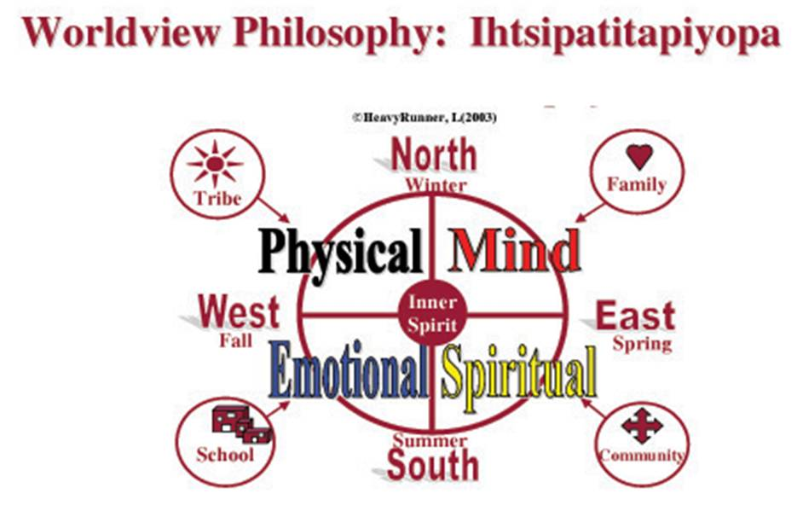
Iris HeavyRunner PrettyPaint’s Worldview Philosophy(2003)©
Lens through which we learn to nurture, protect and dream
Used with permission of Iris HeavyRunner Pretty Paint

Slide 33
Stories and other tribal resources as well as some empirical data are now available to guide suggestions for coping with trauma in American Indians.
Importance of tribal cultural traditions in building community resilience
Importance of ceremony and ritual - the drums, the colors
Importance of tribal connectedness and cohesion through song, dance
Importance of native art as therapy

Slide 34
Skokomish Tribe

Slide 35
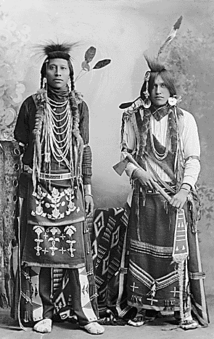
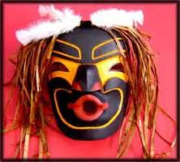
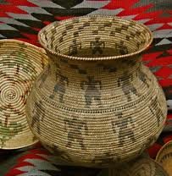
Baskets, beads and other examples of NW tribal art

Slide 36
Importance of Nature in American Indian Culture and Coping
Wild Tiger lilies
Johnson Ridge and Scorpion Mountain- Central Cascades.

Slide 37
Sacred Places
Siletz Medicine Rock

Slide 38
Importance of nature and resources
Siletz hatchery

Slide 39
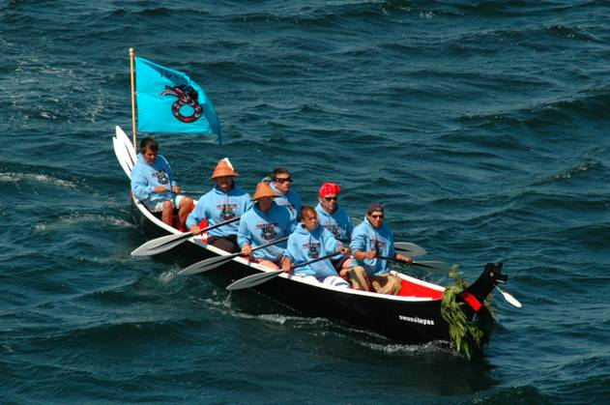
The Journey 2010
Puget Sound canoe journeys promote tribal cohesion & sense of community
cohesion
community

Slide 40
Integrating PFA with American Indian Tribal Traditions and Culture
Disclaimer- Over 500 recognized tribes in North America with a multitude of beliefs, cultures and traditions
Even among the NW tribes there are many, many differences as well as similarities
Will attempt to identify and incorporate areas of tribal similarity, though some examples may be specific to a particular tribe.

Slide 41
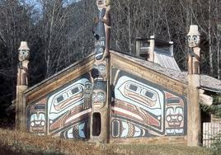
PFA Principle: Safety- American Indian Application
Identify a location on tribal land likely to be safe and secure following a disaster
This may be the longhouse or other facility on the tribal land such as the tribal health clinic

Slide 42
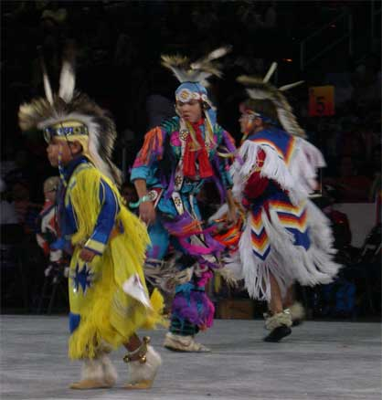
PFA Principle: Calming American Indian Applications
Prayer, song, dance and other renewal celebrations can reduce physiological arousal and promote calming
Some tribes embrace meditation
Sweat lodge
These calming rituals can be led by the tribal spiritual leader

Slide 43
Northwest Tribal Dance

Slide 44
PFA Principle: Promotion of Individual and Tribal Self-Efficacy
This may run counter to some tribal beliefs that the tribe and family are paramount
Not necessarily mutually exclusive, each piece of the web must play its part.
Perhaps the tribe or family can empower and direct individual tribal members to take action to prepare and to respond to the emergency at hand “for the good of the tribe”

Slide 45
PFA Principle: Connectedness– Application to American Indians
This is a real strength of most tribes
There is an emotional understanding and sharing of resources amongst tribal members
There are common coping strategies that can be relied upon and which connect members of the tribe such as storytelling

Slide 46
PFA Principle: Instilling Hope- Application to American Indians
Most tribes and tribal members have strong shared spiritual beliefs and faith
The tribal spiritual leader or elder may be consulted to guide the tribe through challenging times and to instill hope

Slide 47
Psychological First Aid: Core Actions and Applications with American Indians

Slide 48
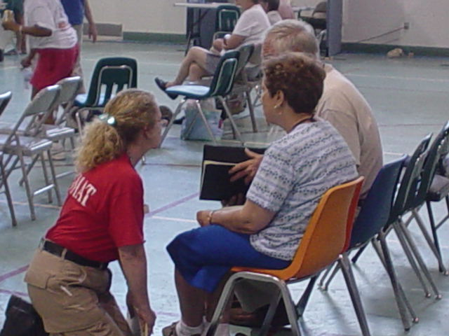
Contact and Engagement
1
Establish a connection with survivors
in a non-intrusive, compassionate manner.
Introduce self and describe role
Ask for permission to talk
Explain objective
Ask about immediate needs

Slide 49
PFA Core Action: Contact and Engagement: Application to American Indians
1
Ideally, PFA is provided by a known elder or other tribal member who respects the tribal member in distress and is trusted
Never intrude on another personal space without permission

Slide 50
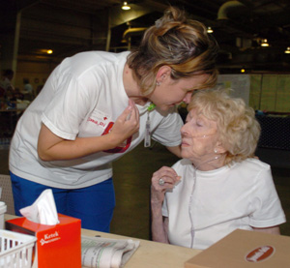
2
Safety and Comfort
Enhance immediate and ongoing safety, and
provide physical and emotional comfort.
“Are you cold– do you need a blanket?”

Slide 51
PFA Core Action: Safety and comfort– Application to American Indians
2
Caring for the immediate safety and comfort of tribal members is basic tenet of Indian way
May be some special needs in a disaster including care of the injured or evacuation to a safe locale.

Slide 52
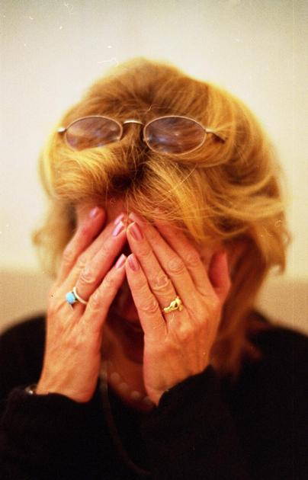
3
Stabilization
Calm and orient emotionally
overwhelmed/distraught survivors.

Slide 53
PFA Core Action: Stabilization
Application to American Indians
3
Some tribal members may be emotionally overwhelmed in the immediate aftermath of a disaster
Service to others is the Indian Way
Listen, really listen
And talk softly

Slide 54
4
Information Gathering: Current Needs and Concerns
Identify immediate needs and concerns, and gather additional information, and tailor PFA interventions.
Nature and severity of experiences
Death of a loved one (or family pet)
Concerns about the post-disaster circumstances and threat
Separation from or concerns about the safety of loved ones
Physical illness, mental health conditions, and need for medications
Losses incurred as a result of the disaster
Extreme feelings of guilt or shame
Thoughts about causing harm to self or others
Immediate developmental impact
Availability of social support
Prior alcohol or drug use
Prior exposure to trauma and death of loved ones

Slide 55
PFA Core Action: Information Gathering
Application to American Indians
4
Tribal member in distress likely known to tribal PFA counselor
Need to consider importance of invasive questioning vs respect for privacy of tribal members
Privacy and confidentiality are especially important to maintain in small tribal communities; must be preserved to avoid rumors and gossip

Slide 56
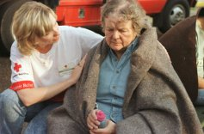
5
Practical Assistance
Offer practical help to survivors in addressing immediate needs and concerns.
Identify the most immediate need(s)
Clarify the needs
Discuss an action plan
Act to address the needs

Slide 57
PFA Core Action: Practical Assistance
Application to American Indians
5
Practical help needed by tribal disaster survivors may be food and shelter
It is the Indian way to Always Greet others with an honor song and give them your “best food, best blankets, best places to rest.”
It is also possible that some tribes and tribal members may need assistance to apply for disaster relief

Slide 58
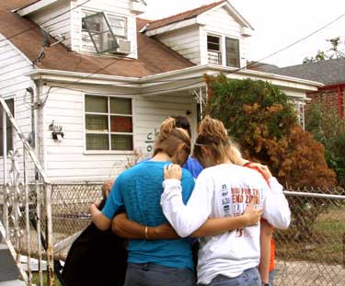
6
Connection with Social Support
Help establish brief or ongoing contacts with primary support persons or other sources of support, including family members, friends, and community helping resources.

Slide 59
PFA Core Action: Connection with Social Support
Application to American Indians
6
Efforts to re-connect those who have been separated from their tribe and/or family are paramount.
This is probably the single most important core action of PFA for American Indians (and non-Indians)

Slide 60
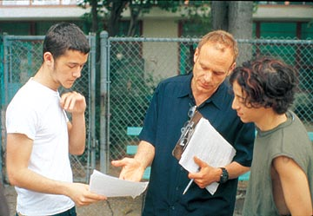
7
Information on Coping
Provide information about stress reactions and coping to reduce distress and promote adaptive functioning.
What is currently known about the unfolding event
What is being done to assist them
Available services
Post-disaster reactions and how
to manage them
Self-care and family care
Coping
Alcohol & substance abuse

Slide 61
PFA Core Action: Connection with Social Support
Application to American Indians
7
Most tribal members will want an update on any unfolding disaster
Most acute emotional and behavioral reactions in tribal members in the aftermath of a disaster are normal and will abate with time.
Important to reassure survivors and, to the degree possible to “normalize” their trauma symptoms in the immediate aftermath such as fear, disorientation and vivid recollections of the event and nightmares.

Slide 62
8
Linkage with Collaborative Services
Links survivors with available services needed at the time or in the future.
Provide direct link to additional needed services
What counseling services are available to your tribal members?

Slide 63
PFA Core Action: Linkage with Collaborative Services and Agencies
Application to American Indians
8
Though tribes may be able to provide many or even most of the needs of members in the aftermath of a disaster, some non-tribal services or agencies may supplement these services:
Local and state departments of health
Local, county and state and federal emergency management organizations

Slide 64
Possible Indications of a Need for a Referral in both American Indian and Non-Indian Populations
An acute medical or serious mental health problem
Threat of harm to self or others
Concerns related to the use of alcohol or drugs
Cases involving domestic, child, or elder abuse
Ongoing difficulties with coping (4 weeks or more after the disaster)
Significant developmental concerns about children or adolescents
When the survivor asks for a referral
Medication evaluation?

Slide 65
Preventative Approaches
An ounce of prevention is worth a ton of cure.
Strategies that can prevent a crisis or emergency or mitigation strategies that minimize the impact of a disaster are the most important in terms of avoiding the harmful short-term and long-term mental health impacts of trauma

Slide 66
Preventive Approaches to Foster Individual & Community Resilience
Survival and Red Cross Training– learn CRP and basic survival skills
Join a community emergency response team such as CERT or Medical Reserve Corp
UW CERT webpage site: http://www.washington.edu/admin/business/oem/cert/

Slide 67
Local Community
Emergency Response Teams

Slide 68
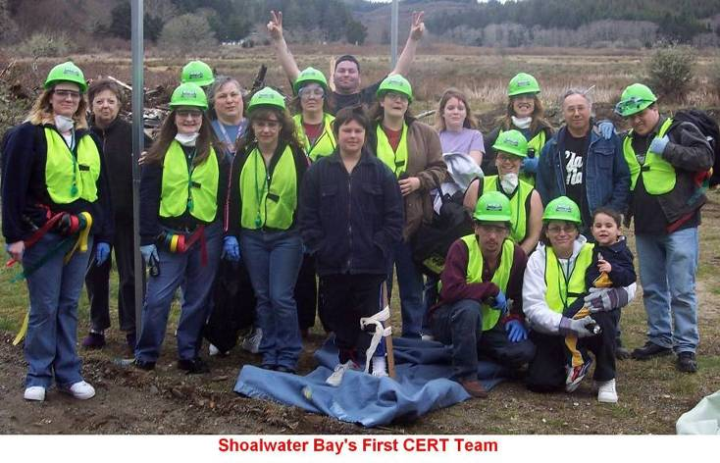
Shoalwater Bay Tribe CERT Training
Three trainings
60 team members

Slide 69
Mental health impacts of disasters
Important to recognize the multiple impacts of disasters include not only the traumatic events but also:
Hardships– stemming from loss of residence, loss of community and loss of employment
Grief and loss– loss of loved ones and/or pets who may have died in the disaster.
For many individuals the disaster impacts may not manifest for months following the disaster. In non-Indian culture individuals do not seek counseling for at least 6 months- 1 year.

Slide 70
Mental health impacts of disasters (continued)
There are many manifestations of the mental health impacts of disasters in addition to PTSD
Depression is perhaps the most common mental health problem encountered following a disaster
Anger and “acting out” are also common post disaster stress pathways with an increased risk of domestic violence as well as child and elder abuse
Another common mental health impact is an increase in alcohol and substance abuse disorders

Slide 71
Post Traumatic Growth
Trauma therapists and researchers have began to note that some individuals– both adults and children-- not only bounce back but grow stronger
So called post traumatic growth is marked by increases in self-esteem and compassion, a greater appreciation of the importance of relationships and a deeper sense of spirituality.
Trauma survivors may “put things into perspective”, appreciate each day and feel they can handle even major challenges.
It is important to note that some traumatic events may be so severe that growth is impossible and that not all survivors experience post traumatic

Slide 72
Mental health component of Disaster Response
Long after a disaster survivor’s wound has healed
Long after a disaster survivor’s bone fracture has mended,
He or she will remember how they were treated by disaster personnel.
They will remember if were they were treated in a kind, humane and considerate fashion
Survivors will remember if the disaster personnel treated them and their family with respect and compassion and if they helped the survivors and their families in their struggle to regain hope, purpose and meaning following a disaster

Slide 73
In Summary American Indian Tribes and Coping with Trauma and Disaster
NW American Indian tribes and individuals and members have a number of protective traditions, rituals and ceremonies as well as other cultural sources of resilience
Culturally adapted principles and actions of Psychological First Aid might also leverage these strengths and assist NW American Indian tribes, families and members to cope and even thrive in the aftermath of disasters

