Slide 1
Catastrophic Epidemics in Movies & History: What Can We Learn for Preparedness?
Anthony Marfin
September 28, 2010
7th Annual Tribal Emergency Preparedness Conference
Grand Mound, Washington

Slide 2
Goals
Describe infectious diseases with pandemic potential and those of global concern
Understand the potential for epidemic spread of respiratory viruses and arthropod-borne viruses

Slide 3
Movies About Outbreaks, Epidemics, & Pandemics

Slide 5
What the Movies Get Right
Big epidemics come from:
Respiratory transmission of infectious agents
Aerosol
Large respiratory droplets
Viruses (or virus-like agents) predominate
Person-to-person transmission
Lab mistakes can end up in pandemics

Slide 6
What Movies Get Wrong
Do not show the importance of asymptomatic infection with transmission before illness onset
Too long or too short an incubation period
Simultaneous epidemics & epizootics are uncommon
Transmission through infectious bodily fluids (sweat, saliva, ??) unlikely to cause big epidemic
Nothing suddenly goes to airborne transmission
Bacteria kills millions over years not minutes or days
Vector-borne diseases essentially ignored
Most likely pandemic clinical syndromes are not ZLI or VLI

Slide 7
History of Outbreaks, Epidemics, & Pandemics

Slide 8
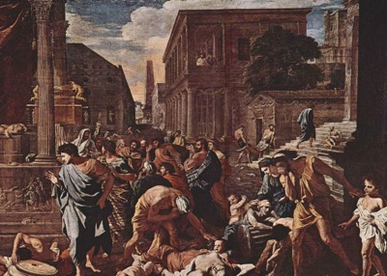
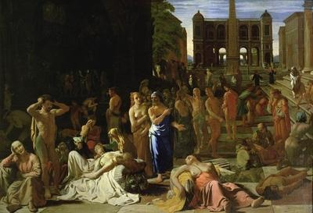
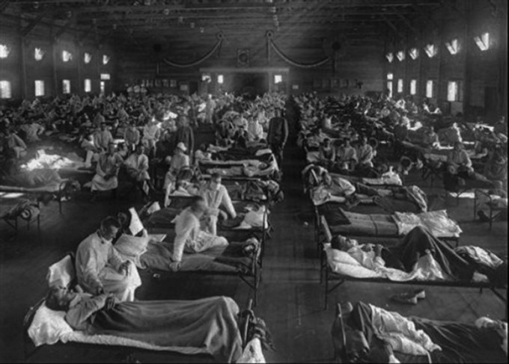
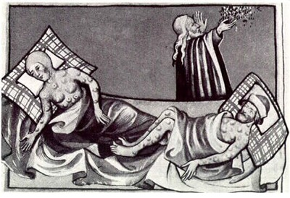
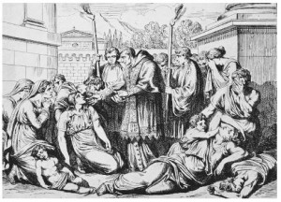
Plague of Athens
Plague of Justinian
1918 Flu Pandemic
Antonine Plague
Black Death

Slide 9
Historical Epi/Pandemics
Antonine Plague (165AD). ~5K/day die/Rome. Kills 5M/15 yrs. Agent: Smallpox (measles?)
Plague of Justinian (541AD). ~10K/day die/Constantinople. Kills 100M/50 yrs. Agent: Plague
Black Death (1348). Kills 25M/4 yrs/W Europe. Agent: Plague
H1N1 Influenza Pandemic (1918). Kills 50-100M/2.5 yrs worldwide. Agent: H1N1 Influenza virus
Louse-borne typhus (“Epidemic typhus”)(1918) Kills 3M/5 yrs./Russia. Agent: Rickettsia prowazekii
AIDS (1981) Kills 25M/30 yrs worldwide with greatest mortality in Africa. Agent: Human Immunodeficiency Virus

Slide 10
Timelines of Great Epidemics
Multiple editors & contributors
Minimal peer review but LOTS of peer pressure
27 “great” epidemics from 430BC – 2009:
2009 H1N1 Influenza Pandemic not included (yet?)
Width: |  | Range:300 ~ 930
Height: |  | Range:300 ~ 450

Slide 11
Transmission Modes for 27 “Great” Epidemics from 430 BC - 2002
* STI/BB – Sexually transmitted infection / blood-borne pathogen

Slide 12
Transmission Modes for 27 “Great” Epidemics from 430 BC - 2002
Smallpox
Measles
Influenza
SARS

Slide 13
Transmission Modes for 27 “Great” Epidemics from 430 BC - 2002
Plague
Yellow Fever

Slide 14
Transmission Modes for 27 “Great” Epidemics from 430 BC - 2002
Cholera
Polio

Slide 15
Transmission Modes for 27 “Great” Epidemics from 430 BC - 2002
AIDS

Slide 16
Limited Number of Agents
Plague (Yersinia pestis)(vector-borne)
Smallpox (respiratory)
Measles (respiratory)
Influenza (respiratory)
Epidemic typhus (Rickettsia prowazekii)(vector-borne)
HIV (sexually-transmitted)
Cholera (water-borne)
Malaria (?)(vector-borne)

Slide 17
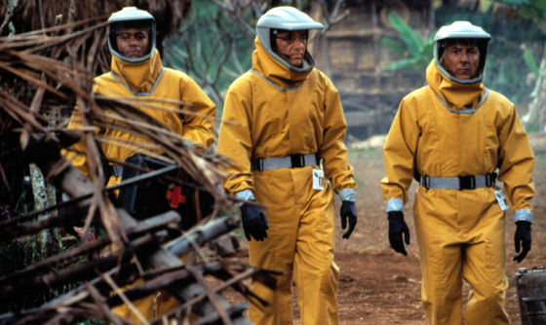
Potential Emerging Infectious Diseases
MDR / XDR tuberculosis
Antibiotic-resistant bacteria from livestock
MDR Gram negative bacilli
Simian hemorrhagic fever viruses
Simian retroviruses (HIV- & HTLV-like)
Simian malaria
Arboviruses
Avian influenza viruses (e.g., H5N1)
TFX- & TPX-associated infections

Slide 18
Potential Emerging Infectious Diseases
MDR / XDR tuberculosis
Antibiotic-resistant bacteria from livestock
MDR Gram negative bacilli
Simian hemorrhagic fever viruses
Simian retroviruses (HIV- & HTLV-like)
Simian malaria
Arboviruses
Avian influenza viruses (e.g., H5N1)
TFX- & TPX-associated infections

Slide 19
Biggest Potential Epi/Pandemic Threats (Naturally Occurring)
Avian influenza (H5N1)
Arthropod-borne viruses (arboviruses)

Slide 20
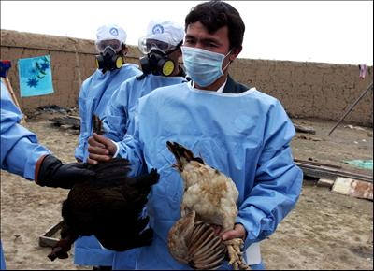
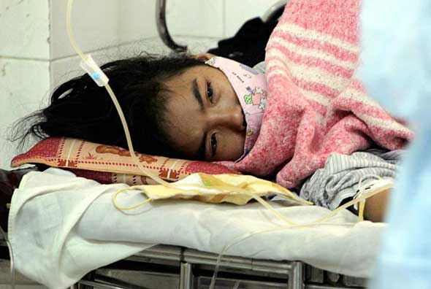
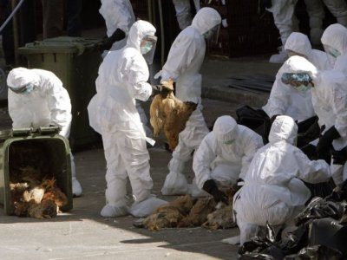
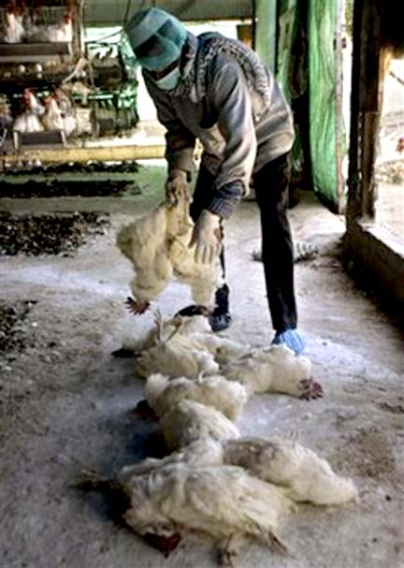
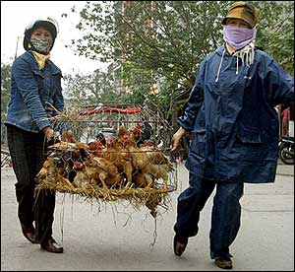
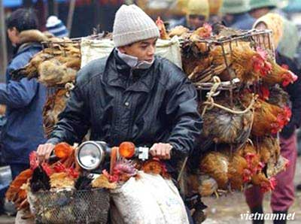
Pandemic flu planning is not over

Slide 21
Avian Influenza (H5N1) Cases, Worldwide, 2003-2010*
* Through August 31, 2010 (WHO)

Slide 22
Avian Influenza (H5N1) Cases, Worldwide, 2003-2010*
Egypt
Indonesia
Vietnam
* Through August 31, 2010 (WHO)

Slide 23
Influenza viruses are constantly changing through mutation and recombination (“gene swapping”)

Slide 24
Gene Segment Reassortment
Influenza virus co-infection
of swine or human

Slide 25
Is the Risk For Avian Influenza Increasing?
Possibly!
2009 H1N1 → more influenza infections worldwide
Greater opportunity for recombination? Yes
Has recombination with H5N1 been documented in humans? No
Dual influenza A infections in humans documented (pandemic H1N1 & seasonal H1N1 and pandemic H1N1 & H3N2)
“Rumors” of persons co-infected with H5N1 & pandemic H1N1
Reassortment of mammal (swine) H3N2 and avian H5 influenza viruses documented in China

Slide 26
Arboviral Diseases with Pandemic Potential

Slide 27
“Human-to-Human” Arboviruses*
Humans → high concentrations of virus (high viremia)
Can infect mosquitoes
Unlike WNV, we can transmit to others
Viremic humans travel while asymptomatic
Humans go into endemic/enzootic areas
Urban growth or ag development in developing nations
Tourism
Range of Ae aegypti & Ae. albopictus expanding
Each virus can establish local transmission
* Or, simian-to-human

Slide 28
Arboviruses (Human-to-Human)
Currently, increased activity & global movement for:
Rift Valley Fever virus (Phlebovirus)
Dengue virus (Flavivirus)
Yellow fever virus (Flavivirus)
Chikungunya virus (Alphavirus)
O’nyong-nyong / Igbo Ora

Slide 29
Rift Valley Fever Virus
Disease of East Africa (Egypt, Sudan, Kenya)
2000 – 1st time out of Africa (Saudi Peninsula)
2010 – Large epidemic & enzootic in So Africa
Last major epidemic 1974 (20,000 cases)
Multiple forms of transmission
Mosquito-borne (multiple mosquito species)
Consuming contaminated animal products
Airborne transmission
Extremely sensitive to climate
Global climate change effect?

Slide 30
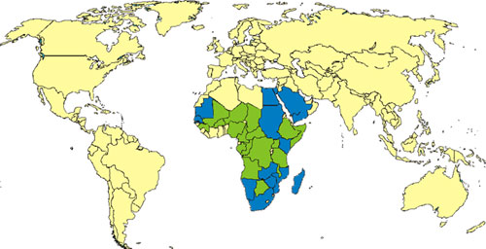
Distribution of RVF, Worldwide (2009)
Epidemic transmission
Sporadic transmission

Slide 31
Possible Sources of Introduction
Infected vectors
Viremic animals
Viremic people
Contaminated animal meat & tissues
Contaminated raw milk & dairy products

Slide 32
Dengue & Yellow Fever

Slide 33
Dengue
Common in travelers to Caribbean, C. America, & Asia (3-8% travelers with fever)
2009, more cases worldwide
Est. 50M infections / year (WHO)
Urban transmission worldwide (big cities)
Reported in 100 countries
Local transmission shown in Texas, Florida, & France (sustained?)
Thousands of cases in India now
On average, 1 case infects 3 cases
R₀ same as flu

Slide 34
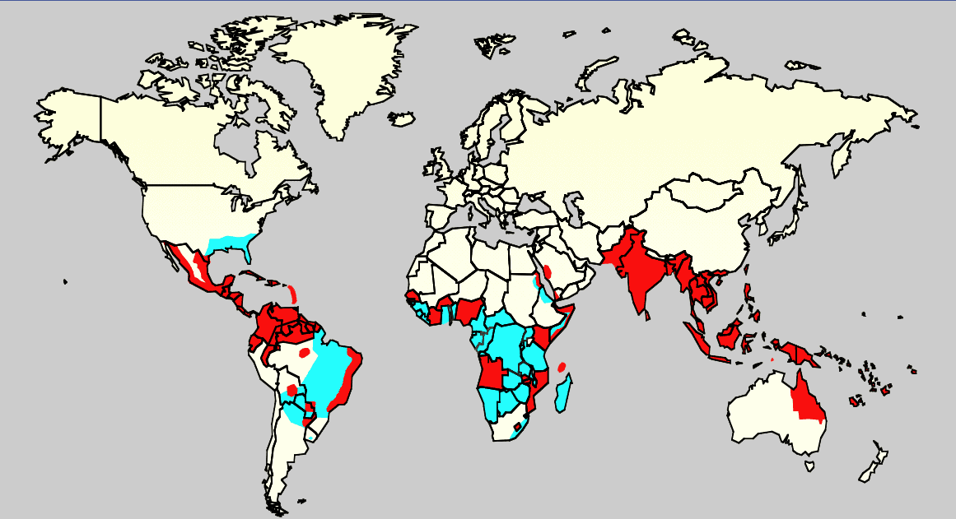
Distribution of dengue epidemics and Aedes aegypti in 2006
Dengue epidemics & Ae aegypti
Ae. aegypti

Slide 35
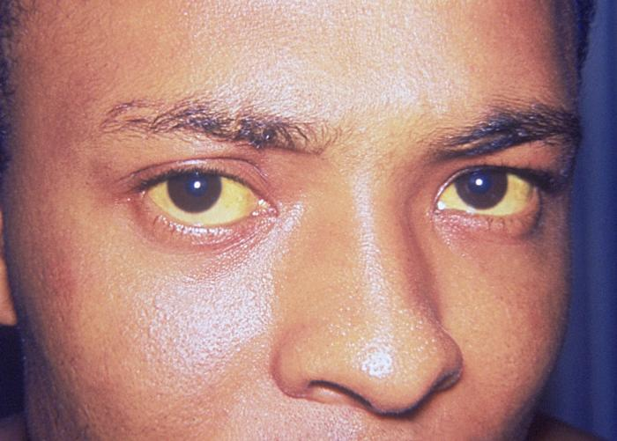
Yellow Fever
Original hemorrhagic fever (CFR up to 50%)
Massive U.S. outbreaks, 1693-1905
1793: 10% of Philadelphia’s population dies
Up to 150,000 die / year in US
Currently, expanding range in So America
Where dengue occurs, yellow fever can occur

Slide 38
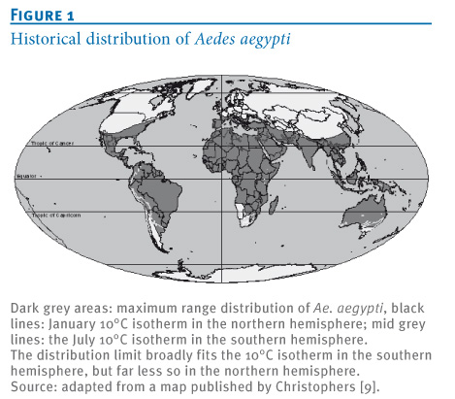

Slide 39
Distribution of dengue epidemics and Aedes aegypti in 2006
Dengue epidemics & Ae aegypti
Ae. aegypti

Slide 40
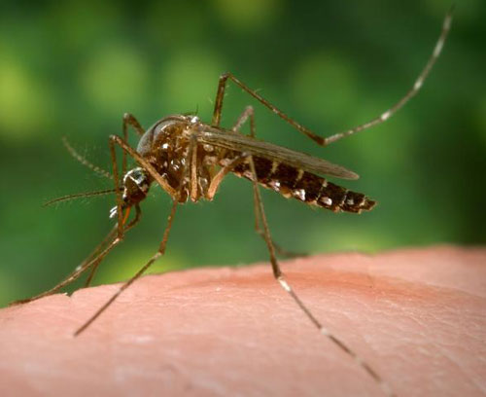
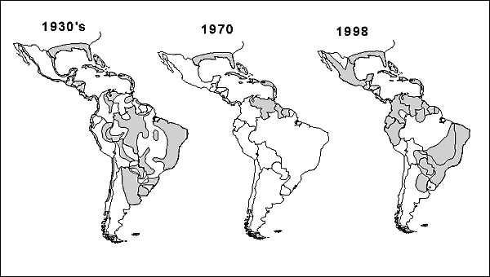
Geographic distribution of Ae aegypti in the Americas, 1930s, 1970, & 1998

Slide 41
2009 National Resource Defense Fund Fever Pitch: Mosquito-Borne Dengue Fever Threat Spreading in the Americas
28 states at risk for introduction of dengue
Population: 174 million people
Dengue introduction risk limited because Aedes aegypti, not currently in mid-latitude regions. Shifting climates will likely change that.

Slide 42
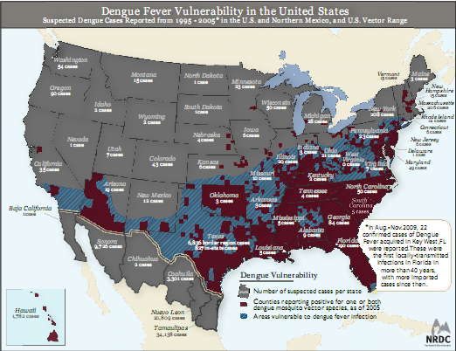

Slide 43
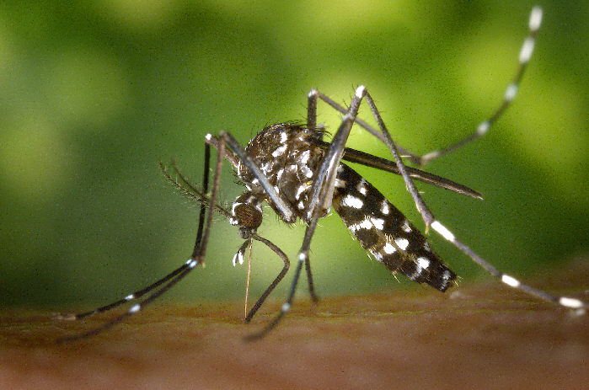
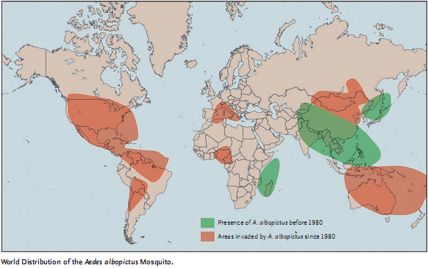

Slide 44
Chikungunya

Slide 45
Chikungunya (Togaviridae)
Alphavirus (Semliki Forest Complex)
Urban transmission: Aedes aegypti & Ae albopictus
Weeks to years of severe, debilitating joint swelling & pain
Worldwide outbreaks start in 2005
Mutation increases virus amplification in Ae albopictus?
2005-07: Outbreaks in Indian Ocean, India, & Italy
‘06: > 1,000 imported cases to US, UK, Canada, & France
Travelers VFR returning from India

Slide 46
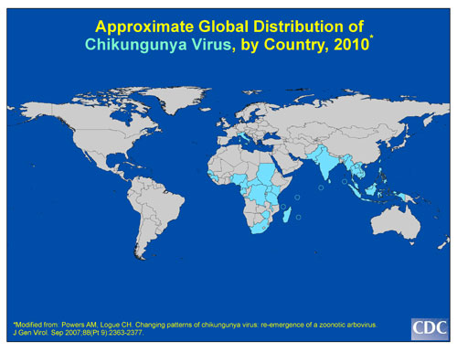

Slide 48
Why is CHIK Virus a Threat
Large, explosive outbreaks with ↑ impact on healthcare system
Lamu Island (Kenya), ‘04 – 75% attack rate (13.5K ill)
Median time in bed: 7d (range 1-90d)
Comoros Islands, ‘05-’06 – 63% attack rate (> 200K ill)
80% in bed, median time: 6d (range 1-30d)
India, 2006 – 1.3M persons ill
Potential for sustained local transmission following return of viremic travelers (Italy 2007)
Ae aegypti & Ae albopictus both play major roles

Slide 49
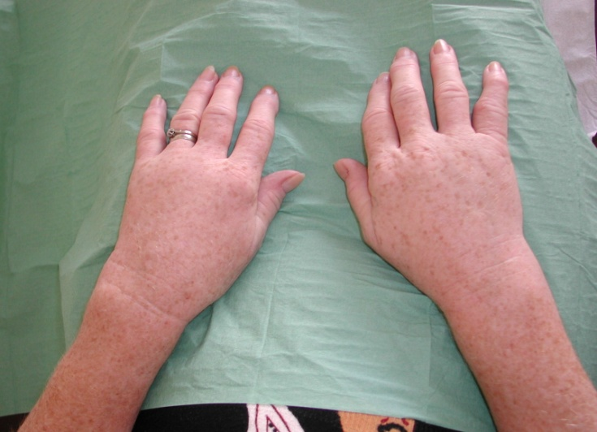
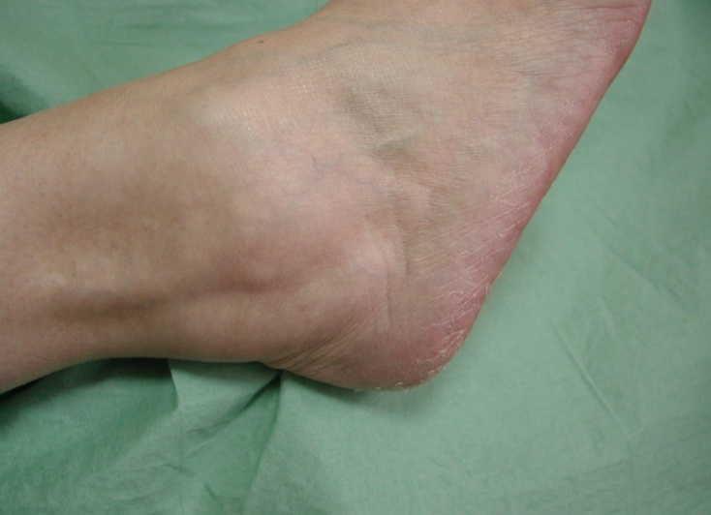
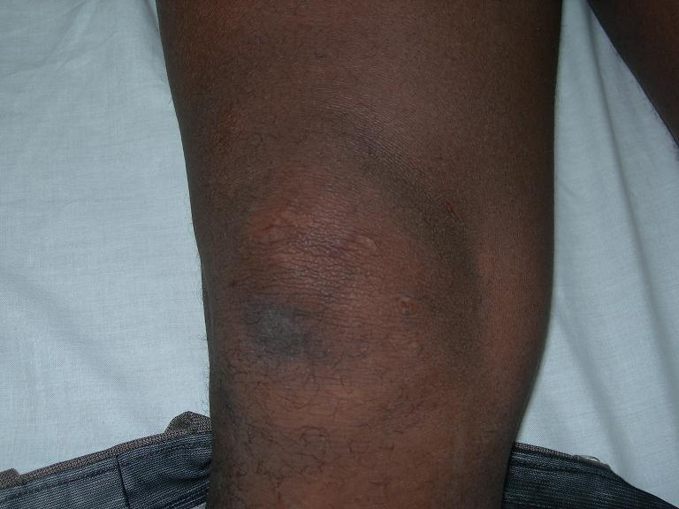
Fever-Rash Syndrome
a
Fever, arthritis, rash
Encephalitis & death rare (0.1%)
Mutation cause higher morbidity?
Travel to areas with ongoing transmission OR sustained local transmission of CHIK noted
b
c

Slide 50
Summary
Greatest risk for a significant epidemic/pandemic:
Avian influenza
Other respiratory viral pathogens (e.g., SARS)
Aedes aegypti- or Aedes albopictus-borne arboviruses
No evidence that risk is decreasing
Epidemic history has been repeating itself for more than 2000 years

Slide 51
Thank you. Questions?

