Slide 2
Objectives
Help Tribal emergency mangers form state wide tribal organizations help foster stronger relationships with Federal, State, Local emergency management stakeholders.
Notes:
The ITERC was formed to bring all the tribal emergency management personnel in the State of Nevada together into an organization that would represent them at the local, state and federal level.

Slide 3
Overview of the Inter Tribal Emergency Response Commission (ITERC) and its programs
Overview of grant opportunities and the grant process that we have used to obtain grant funding
Notes:
The ITERC was formed to bring all the tribal emergency management personnel in the State of Nevada together into an organization that would represent them at the local, state and federal level.

Slide 4
Understand the unique emergency management challenges that face Tribal jurisdictions and how the ITERC has been able to work with or through these challenges.
Identify barriers that caused or created mistrust between the tribes and local, state and federal stakeholders.
Notes:
The ITERC was formed to bring all the tribal emergency management personnel in the State of Nevada together into an organization that would represent them at the local, state and federal level.

Slide 5
History
There are 27 Tribes in the State of Nevada
These tribes are the second largest land owners in the state second only to the BLM
Many tribal lands cross county and state lines , presenting a need for inter-jurisdictional communications and intelligence sharing between tribes and local, state and federal agencies

Slide 6
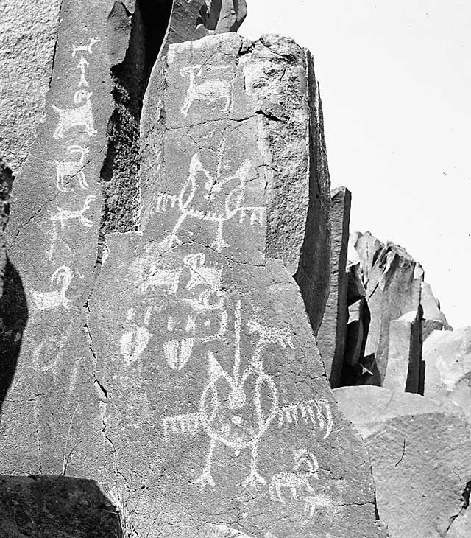
The Washoe tribe inhabited the Sierra Nevada Mountain Range that forms the border between present day Nevada and California.
The Paiute tribe lived in northern and southern Nevada.
The northeastern region was occupied by the Shoshone.

Slide 7
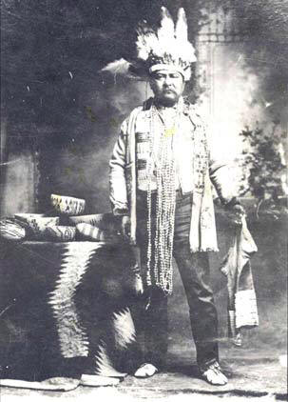
Only three of the twenty seven tribes have full time emergency management, homeland security coordinators.
The other twenty four tribes have struggled with adding these duties to other already existing full time positions such as Environmental Directors, Natural Resource Directors to one tribe who has tasked the TERO and Safety Officer with these duties.
We were at a huge disadvantage from the beginning.

Slide 8
In 2002 when funding came down from the Federal government tribes were considered local governments and tribes had to request funding from the states.
Lack of experience in letting contracts between the states and tribes created the first obstacle.
Second, lack of funded personnel to perform emergency management, homeland security functions and being able to be an active participant in this process was and still is an obstacle.

Slide 9
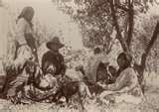
ITERC
The ITERC consist of one representative from each of the 27 tribes
The bylaws of the ITERC allow for no more than twenty one voting members.
Each member is appointed either by the Tribal Chairman or by resolution.
The ITERC’s mission is governed by SARA Title III and the Emergency Preparedness and Community Right –To- Know Act of 1986

Slide 10
materials related funding pursuant to Public Law 99-499 and Title I of Public Law 93-633Providing management and oversight of hazardous
Obtaining, administering and providing grants to Tribal Emergency Response Committees to implement these acts and enhance public safety on Tribal Lands.
Carrying out tasks as assigned to the ITERC by acts of the United States Congress.

Slide 11
In addition to the lack of personnel to address the practical application of the needed scope of work, the tribes were at a disadvantage to apply for current as well as future grants.
NIMS and its mandatory implementation for future funding brought forward the severe consequences on tribes not being NIMS compliant.
The creation of the ITERC was Nevada’s way of addressing these critical issues.

Slide 12
Promoting state-wide Tribal compliance with Homeland Security Presidential Directive -5, and the National Incident Management System.
ITERC Officers
Chairman
Co-Chairman
Sergeant at Arms
Secretary
Treasurer
Notes:
Identify these positions as the Executive Board

Slide 13
Development of ITERC
The ITERC started out as the Emergency Managers group, with five tribes participating.
I saw the potential of all of the tribes working together and started to contact each and every tribe in Nevada in an attempt to create a statewide organization.
The first full year of the ITERC as an organization had fourteen active members
Notes:
Identify these positions as the Executive Board

Slide 14
The Indian Health Board of Nevada was a 501 C 3 non-profit corporation which would allow the ITERC to receive grants as a non profit organization.
The ITERC began looking for funding to support its mission and to hire a full time Director to promote and protect the ITERC interests.
The ITERC applied for and received its first grant in October 2009.
Notes:
Identify these positions as the Executive Board

Slide 15
We Contacted the tribes not actively participating
We were able to pull all the tribes in and the ITERC began writing its by-laws and Mission Statement.
The ITERC was officially created and legally recognized in May of 2009.
In August of 2009 the ITERC was moved from under the Inter Tribal Council of Nevada, to the Indian Health Board of Nevada
Notes:
Identify these positions as the Executive Board

Slide 16
The grant was an interoperability gap analysis grant for $279,000 from Nevada State Homeland Security Program.
The ITERC received it’s second grant from the Nevada Division of Emergency Management in the amount of $55,000 to support the ITERC’s newly created Emergency Manager, Homeland Security Director.
ITERC received it’s third grant award from Region IX Homeland Security.
Notes:
Identify these positions as the Executive Board

Slide 17
This grant was in support of the overall functions of the ITERC in the amount of $50,000.
On Friday March 26th the ITERC received it fourth grant from Nevada State Homeland Security Program. This grant was in support of a statewide tribal NIMS compliance program in the amount of $160,000
The ITERC has become not only a tribal emergency management organization, but has evolved into a political organization also
Notes:
Identify these positions as the Executive Board

Slide 18
Current ITERC Programs
The ITERC is currently working with one of Nevada’s Senators to address issues of inequality in grant funding.
We are reaching out to other states such as California, Oregon, Washington, Arizona and Oklahoma to help them create statewide tribal organizations.
Locating grants for future funding is critical.
Notes:
Identify these positions as the Executive Board

Slide 19
Creation of a national ITERC consisting of one member from every participating state.
Introduce legislation that adds state recognized ITERC’s into agencies that can apply for EMPG and Homeland Security grant funding.
Notes:
Identify these positions as the Executive Board

Slide 20
Nevada Tribal Type III All Hazards Incident Management Team
Building a Team to respond to and protect Nevada Tribal Members, our Lands and our Culture.

Slide 21
Flooding that affected one of Nevada’s Tribes 2007

Slide 22
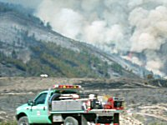
Fire, Flood, Earthquakes, Whether related events. Type III All Hazards Incident Management Team type Events.
Nevada’s Tribal IMT team is just a phone call away for any tribe not only Nevada’s but also Washington, Oregon, Montana and Idaho.
If you have or are developing a team we hope to train with your team(s) or offer our assistance.

Slide 23
All Hazards IMT Type III Team

