Slide 1
NWTEMC Annual Conference Maximizing Interoperable Communications: how to determine which strategies yield the highest benefit
~ Laura Kingman ~
Washington State Patrol/SIEC
September 29, 2010

Slide 2
SIEC
The problem: Our first responders cannot always talk to each other in crisis situations.
Interoperability ensures emergency responders can talk and share data:
- on demand
- as needed
- as authorized
Notes:
If you can, hire a full-time outreach person who has a strong background in marketing, public relations, legislative affairs and technology.
Planning is very important. The Outreach and Public Affairs plan as approved by the SIEC is reprinted in it’s entirety in Appendix F of our SCIP.
Messaging is also very important.
Having key messages and helping others understand how and when to use them. Your stakeholders are you ambassadors.
Reiterating the basics is what helps them sink in.

Slide 3
SIEC
Interoperability is essential for large disasters and for incidents that can happen in any community on any day
Interoperability is essential:
across all levels of government
across all agency boundaries
Notes:
Any community/Any day: School shootings, fires (urban and rural), hazmat incident, chemical spill and/or fire, flooding, crime, earthquakes, volcanoes, and tsunamis.
All levels of government: Federal, state, tribal, county, city, and municipalities.
Emergency responder agencies/teams: Law Enforcement, Fire and Emergency Medical Response, Utilities, transportation and transit agencies, schools, Red Cross, hospitals, ambulance companies, hazmat, ecology, public health, public works, ports, marine services, bomb squads, tactical teams, volunteer organizations, telephone companies, and amateur radio operators.

Slide 4
SIEC
Outreach is the key to success:
The SIEC’s approach empowers and assists emergency responder agencies to work together at the local level to develop interoperability from the ground up (rather than state down).
Notes:
We learned after 9/11 that governance, protocols and planning are even more important than money and technology. Significant progress can be made in lieu of both.

Slide 5
Notes:
Homeland Security’s SAFECOM Continuum illustrates the five areas of concentration. Much can be done to establish governance, protocols and planning. Then when money for equipment becomes available you are ready.

Slide 6
SIEC
TOGETHER – Seven Steps to Achieve Interoperability
Works off the Business Case Scenario from software development
Helps policymakers understand
Keeps policymakers and key stakeholders engaged and supportive
Tribes/Agencies move right on the Continuum
Notes:
Policymakers are any elected/appointed officials – they can help by bringing the right people together, establishing protocols, supporting training and cooperation. No technical experience is needed to make significant progress.

Slide 7
7 Steps
Notes:
Handout

Slide 8
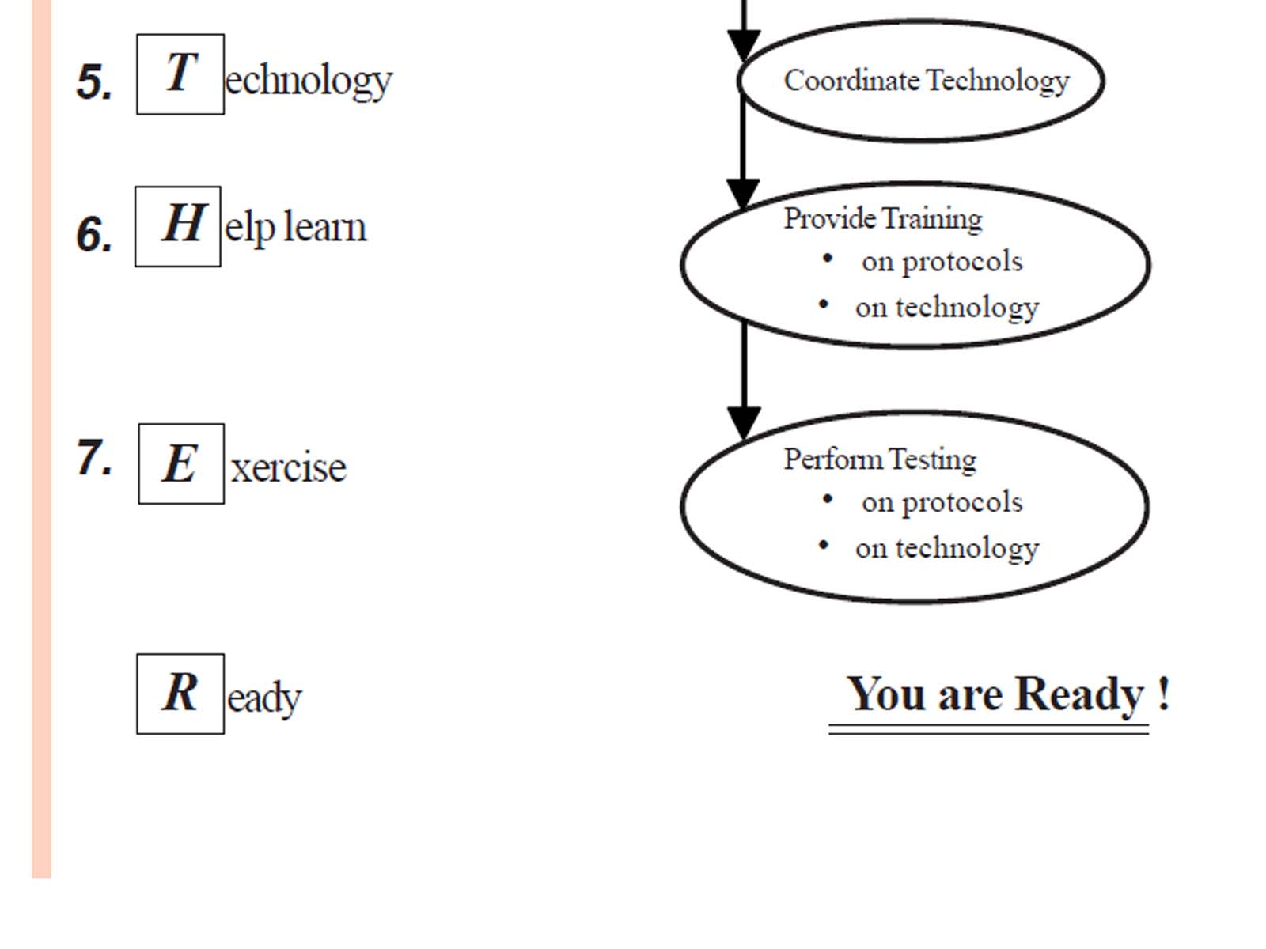
7 Steps
…TOGETHER
Notes:
Handout

Slide 9
Planning
Without an outreach plan, you risk:
Trying to do everything
Priorities getting lost
Getting taken off task by anyone with a loud voice and a “good idea”
A solid outreach plan is your road map to success

Slide 10
Planning
Plan your internal and external communications (rather than react) :
To raise awareness
To generate a positive image of what you are trying to accomplish
To communicate specific messages
To educate and provide information
To provoke thought and reinforce opinions
To alter behavior
Notes:
With a clear, well-thought-out strategically-driven outreach plan, target audiences will know what your message is, what further information they need, how they will benefit from listening to you, and how to get additional information.

Slide 11
Creative Brief
Bring together a small group to answer:
What is the assignment? (Develop a strategic outreach plan for XYZ Tribe)
What do you want this plan to accomplish? (Heighten awareness about interoperability – what does our tribe need?)
Who is your target audience? (Describe each group separately with as much detail as possible – Adults 25-45, household income range; good voters; male skew; live in x area; education level)
Notes:
Advertising firms do this for every product. Your “product” is no different. (Examples are given in parenthesis). Answer these questions before you write your first communications plan.

Slide 12
Creative Brief
What does the target audience think now? (Do this for each target audience. You can use a quote, “I have no idea what my tribe is doing to prepare for emergencies.”)
What do you want them to think? (What do you want to happen when the plan is complete?)
What are the main messages you plan to communicate?
Why should the target audience believe this? (What supporting information do you have?)
Notes:
Advertising firms do this for every product. Your “product” is no different. (Examples are given in parenthesis). Answer these questions before you write your first communications plan.

Slide 13
Creative Brief
Is there anything else that is important? (This is bare your soul time)
Decision/input Timeline
Date Due
Notes:
Being really honest will pay dividends.

Slide 14
Outreach Plan
Goal – This is the thing you want to do. (Could be to increase awareness or gain support)
Objectives – These are broad ideas of how you will achieve your goal and measure your success – objectives must be quantifiable and specific. Use beginning words like: develop, position, build, determine, help, assist…
Notes:
Change is bad until it succeeds.
Great Outreach plans have established parts. You must define each part. – use the information from the Creative Brief to create your plan.

Slide 15
Outreach Plan
Target Audience – use your descriptions from your Creative Brief. Address primary, secondary audiences and influencers.
Key message – be concise! (not more than three)
Strategies – These are a little more specific than objectives. Use words like utilize, produce, concentrate…
Notes:
SIEC Key Messages –
Our emergency responders cannot always talk to each other in crisis situations.
We can solve this problem with a collaborative approach, saving time, money and most importantly – lives.
This is an investment in public safety.

Slide 16
Outreach Plan
Tactics – be very specific. These are actual actions that will achieve your goal. These are assignable tasks and deliverables.
Budgets – be realistic
Timelines – start at the end of your planning cycle and plan backward. Be realistic about how much time you’ll need – review and adjust as needed.
Notes:
Once the plan is complete, review and adjust as needed. Your Outreach Plan is designed to be a living, fluid document.
Enjoy your success!

Slide 17
SIEC
Questions?
Interoperability is an investment in Public Safety and Emergency Preparedness
www.siec.wa.gov
Laura Kingman
Washington State Patrol
360-507-3881
Laura.Kingman@wsp.wa.gov

