Slide 1
Impact of Pandemic H1N1 on American Indians and Alaska Natives: Federal, State and Tribal Collaborative Responses
Thomas Weiser, MD, MPH
Medical Epidemiologist, Portland Area Indian Health Service
Northwest Tribal Epicenter

Slide 2
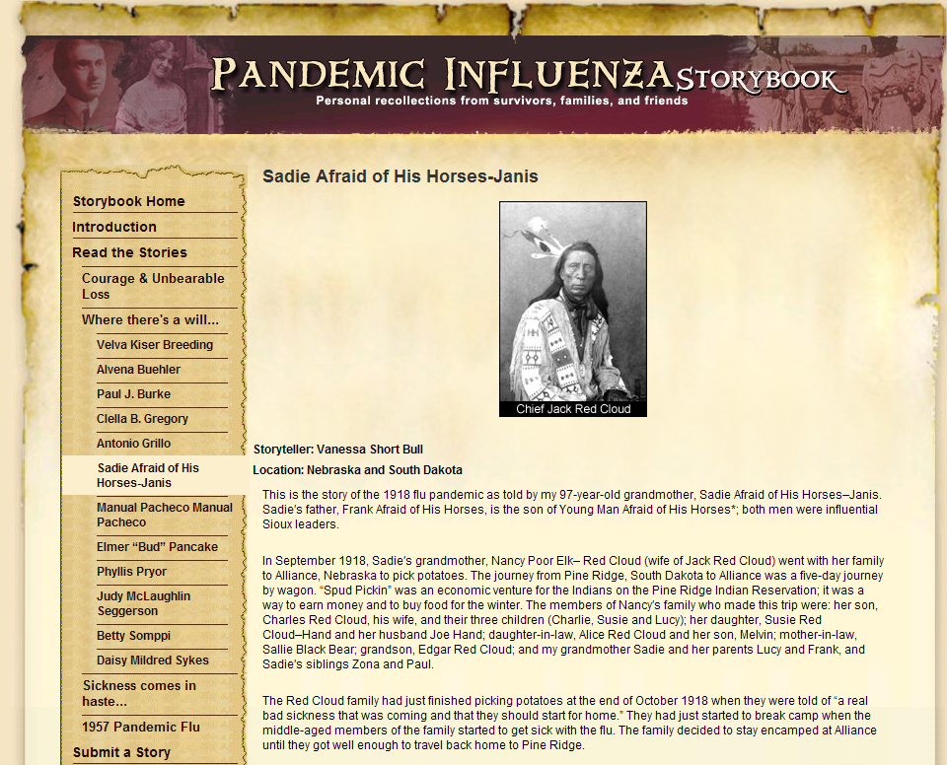
http://www.flu.gov/storybook/stories/will/will_shortbull/index.html

Slide 3
Increased Pneumonia and Influenza Impact Among AI/AN
Condition | Year(s) | Ratio: AI/AN vs. Comparison Group | Comparison group
Pneumonia and influenza mortality—all ages | 2002–2004 | 1.5 | US all races
Pneumonia and influenza mortality— infants | 2000–2001 | 4.0 | US whites
Groom, et al. AJPH 2009, Vol. 99, Suppl 2

Slide 4
Examples of Mortality, Disability and Risk Factors Among AI/AN
Condition | Year(s) | Ratio: (AI/AN vs. Comparison Group) | Comparison group
Diabetes mortality—all ages | 2002–2004 | 2.9 | US all races
Prevalence of 3+ chronic disease risk factors—adults | 2001–2002 | 1.2–6.9 | Blacks, Hispanics, and Asians
Prevalence of disability in older AI/AN | 2003–2005 | 1.1–2.5 | Whites, Blacks, Asians, Hispanics
Prevalence of disability in older AI/AN | 2000 | 1.3–1.6 | US whites
Prevalence of end-stage renal disease—all ages* | 2006 | 1.7 | US whites
Groom, et al. AJPH 2009, Vol. 99, Suppl 2

Slide 5
Why AI/AN are Different From other Minorities
Federal Relationship
The relationship between the Tribes and the United States is one of a government-to-government.
Treaties ratified by the U.S. with Indian Nations did not create tribal governments, but rather was a means by which the U.S. recognized those governments as sovereign entities.
While the U.S. federal government deals with Tribes in a manner similar to states for certain purposes, Tribes are domestic sovereign nations that are different than states or local counties.
Notes:
Of 800+ treaties, the U.S. Senate ratified approximately 372 treaties.
Statement by the President on the Reauthorization of the Indian Health Care Improvement Act…”Our responsibility to provide health services to American Indians and Alaska Natives derives from the nation-to-nation relationship between the federal and tribal governments.”

Slide 6
Federally Recognized Tribes
Over 564 federally recognized Tribes
Numerous other Tribes not federally recognized
IHS 2009: 2.4 million people were enrolled in federally recognized Tribes across Indian country

Slide 7
Federally Recognized Tribes
Over 564 federally recognized Tribes
Numerous other Tribes not federally recognized
IHS 2009: 2.4 million people were enrolled in federally recognized Tribes across Indian country

Slide 8
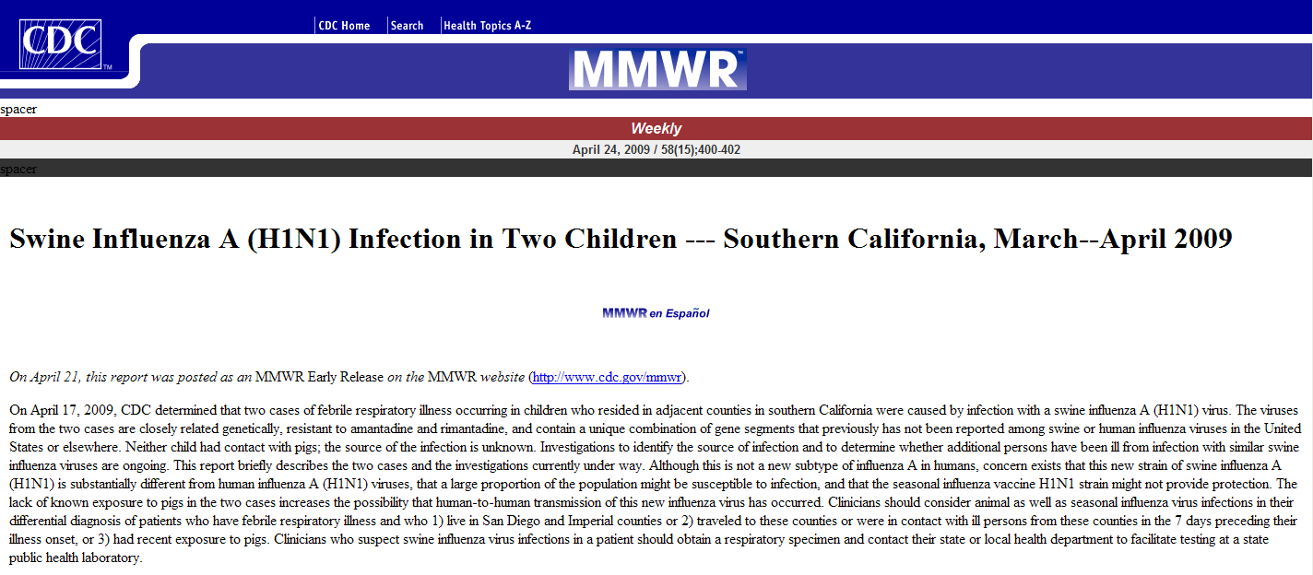

Slide 9
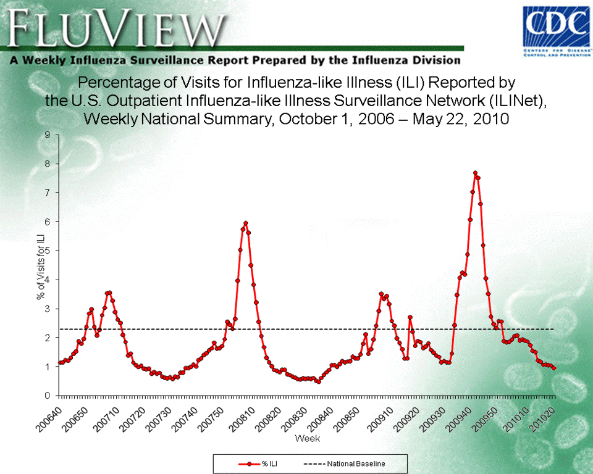

Slide 11
Reflect for a Moment
What resources did you turn to?
What plans did you have in place?
How did the Pandemic we were dealt fit with the Pandemic for which we planned?

Slide 12
Four Pillars of the Federal Response Plan
Surveillance
Community Mitigation
Vaccination
Communication

Slide 13
Indian Health Service Response to H1N1 Pandemic
National level EOC coordinated efforts with each Area
Identified national resources and made these available- PPE, antivirals and, when available, H1N1 vaccine for Health Care Personnel (HCP)
Weekly calls with Area leaders
Division of Epidemiology and Disease Prevention (DEDP, Albuquerque) developed automated ILI surveillance from RPMS, assisted with outbreak investigation

Slide 14
IHS H1N1 Surveillance System
4/25: Active surveillance (Sells, AZ)
Syndromic surveillance system conceived same weekend
Support/permission obtained from IHS CMO and Area CMOs
Programming began quickly; multiple modifications

Slide 15
Data Flow IHS H1N1 Surveillance System
Individual patient data stored at facility level in Resource Patient Management System (RPMS)
Electronic data uploaded automatically to Albuquerque nightly
Aggregated and analyzed in SAS

Slide 16
Percent ILI by Week IHS National Data
% ILI
Week

Slide 17
Percent of Visits for ILI,
Week 40
Billings
2.6%
Aberdeen
2.8%
Bemidji
1.3%
Portland
3.8%
California
2.6%
Phoenix
6.2%
Nashville
2.9%
Tucson
1.9%
Navajo
5.2%
Oklahoma
2.1%
Alaska
1.9%
Albuquerque
11%

Slide 18
Portland Area IHS Response
Area level ICS activated- joint team included IHS and NPAIHB
Maintained communication with State departments of health, with Tribes and with other Federal agencies (CDC, HHS)
Developed early version of ILI surveillance system

Slide 19
Portland Area ILI Surveillance
Consulted with IHS DEDP
Required manual query of data system daily by participating sites
Data reported to Portland Area
Labor-intensive, non-sustainable
Replaced by national surveillance system

Slide 20
Portland Area IHS
43 Tribes
~ 150,000 people
Outpatient only
6 Federal facilities
Over 30 Tribal programs
3 Urban clinics
SALISH
JAMESTOWN
S’KLALLAM
MAKAH
LOWER
ELWAH
QUILEUTE
HOH
QUINAULT
SHOALWATER
BAY

Slide 21
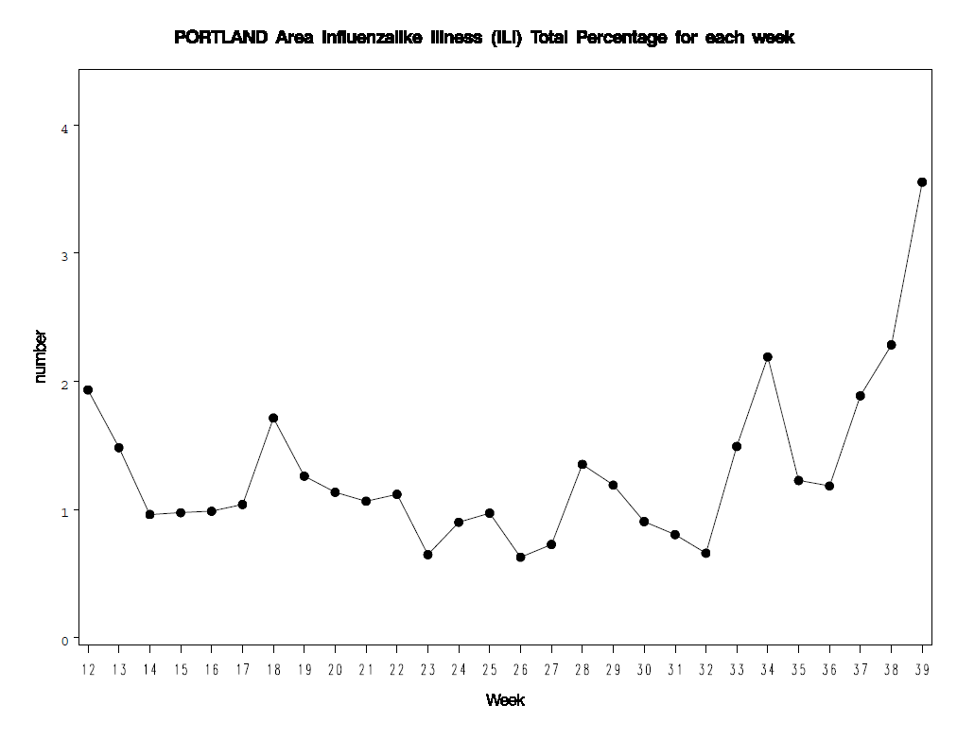
Portland Area Percent ILI Visits
Weekly Totals
13 Tribal sites
6 Federal sites
Percent of Visits
Report Week

Slide 22
Collaborations
Partners:
Council of State and Territorial Epidemiologists (CSTE) Tribal Epi Workgroup
12 State Health Departments (AL, AK, AZ, MI, NM, ND, OK, OR, SD, UT, WA, WY)
CDC, IHS
Tribal Epi-Centers
Study impact of H1N1 on AI/AN
Study released in MMWR, Dec. 11, 2009

Slide 23
Deaths Related to 2009
Pandemic Influenza A (H1N1) Among American Indian/Alaska Natives --- 12 States, 2009
In October, two U.S. states (Arizona and New Mexico) observed a disproportionate number of deaths related to H1N1 among American Indian/Alaska Natives (AI/ANs). These observations, plus incomplete reporting of race/ethnicity at the national level, led to formation of a multidisciplinary workgroup comprised of representatives from 12 state health departments, the Council of State and Territorial Epidemiologists, tribal epidemiology centers, the Indian Health Service, and CDC. The workgroup assessed the burden of H1N1 influenza deaths in the AI/AN population by compiling surveillance data from the states and comparing death rates. The results indicated that, during April 15--November 13, AI/ANs in the 12 participating states had an H1N1 mortality rate four times higher than persons in all other racial/ethnic populations combined.
MMWR. Dec 11, 2009 / 58(48);1341-1344
Notes:
Under the CSTE Tribal Epidemiology Subcommittee during the midst of the H1N1 pandemic, CDC, State, TEC, and IHS officials came together to address an important AI/AN health disparity…. in this case that AI/AN had a mortality rate 4 times higher than other racial groups combined.
In October, two U.S. states (Arizona and New Mexico) observed a disproportionate number of deaths related to H1N1 among American Indian/Alaska Natives (AI/ANs). These observations, plus incomplete reporting of race/ethnicity at the national level, led to formation of a multidisciplinary workgroup comprised of representatives from 12 state health departments, the Council of State and Territorial Epidemiologists, tribal epidemiology centers, the Indian Health Service, and CDC. The workgroup assessed the burden of H1N1 influenza deaths in the AI/AN population by compiling surveillance data from the states and comparing death rates. The results indicated that, during April 15--November 13, AI/ANs in the 12 participating states had an H1N1 mortality rate four times higher than persons in all other racial/ethnic populations combined.

Slide 24
Comparison of the number and rate of deaths related to 2009 pandemic influenza A (H1N1) among American Indian/Alaska Natives (AI/ANs)* and persons in non-AI/AN populations, by age group — 12 states, April 15–November 13, 2009
 |  |  | Rate (Per 100,000 population)
Age group (yrs) | Total deaths | AI/AN deaths | All racial/ethnic populations | AI/AN | Non-AI/AN populations§ | Rate ratio AI/AN to non-AI/AN (95% CI)
0–4 | 18 | 4 | 0.6 | 3.5 | 0.5 | 7.2 (2.4–21.8)
5–24 | 51 | 5 | 0.4 | 1.1 | 0.4 | 2.7 (1.1–6.8)
25–64 | 273 | 26 | 1.2 | 4.2 | 1.1 | 3.7 (2.5–5.6)
≥65 | 84 | 7 | 1.6 | 7.2 | 1.4 | 5.0 (2.3–10.8)
Total | 426 | 42** | 1.0†† | 3.7†† | 0.9†† | 4.0 (2.9–5.6)
* All AI/ANs were non-Hispanic.
§ Includes 19 persons with unknown race/ethnicity.
** AL (one death), AK (two), AZ (16), MI (zero), NM(eight), ND (zero), OK (three), OR (one), SD (four), UT (two), WA (four), and WY (one).
†† Age adjusted to the 2000 U.S. standard population.

Slide 25
Comparison of the number and percentage of deaths related to 2009 pandemic influenza A (H1N1) among AI/AN and non-AI/AN populations with diabetes, asthma, and any high-risk health condition† 12 states, April 15–November 13, 2009
 | AI/AN deaths (n = 42) |  | Deaths in non-AI/AN populations (n =384) |  | Prevalence ratio
Health condition | N | % | N | % | AI/AN % to non-AI/AN % | (95% CI)
Diabetes | 19 | 45.2% | 92 | 24.0% | 1.9 | (1.3–2.8)
Asthma | 13 | 31.0% | 54 | 14.1% | 2.2 | (1.3–3.7)
Any high-risk health condition** | 34 | 81% | 298 | 77.6% | 1.0 | (0.9–1.2)
† CDC defined groups at high risk for influenza available at http://www.cdc.gov/h1n1flu/recommendations.htm
** Including diabetes and asthma.

Slide 26
Other Studies
Hospitalized Patients with 2009 H1N1 Influenza in the United States, April–June 2009, S. Jain et al NEJM 10-8-09
ICU admission or death associated with shortness of breath, pneumonia, delayed antiviral treatment
Critically Ill Patients With 2009 Influenza A(H1N1) Infection in Canada, A. Kumar, et al JAMA 10-12-09
Correlates of severe disease in patients with 2009 pandemic influenza (H1N1) virus infection, R. Zarychanski et al, CMAJ 2-23-10
Severe illness/death associated with First Nations race and delayed antiviral treatment

Slide 27
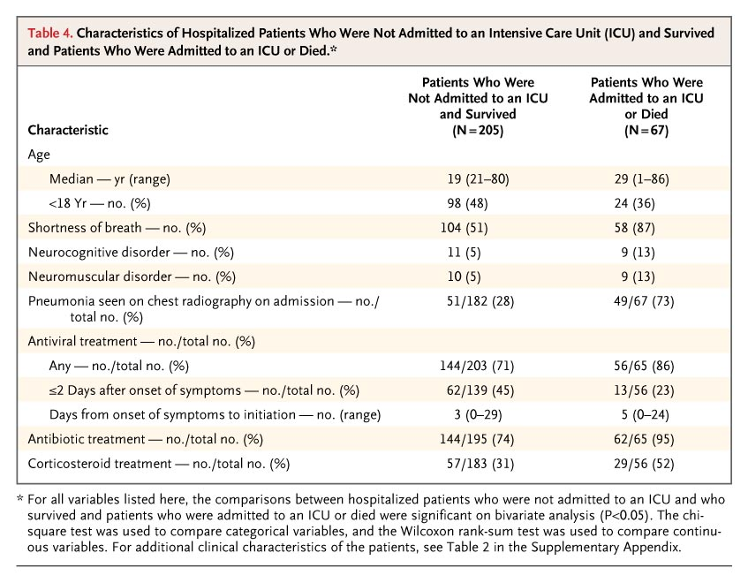
Jain S et al. N Engl J Med 2009;361:1935-1944
Notes:
Table 4. Characteristics of Hospitalized Patients Who Were Not Admitted to an Intensive Care Unit (ICU) and Survived and Patients Who Were Admitted to an ICU or Died.

Slide 28
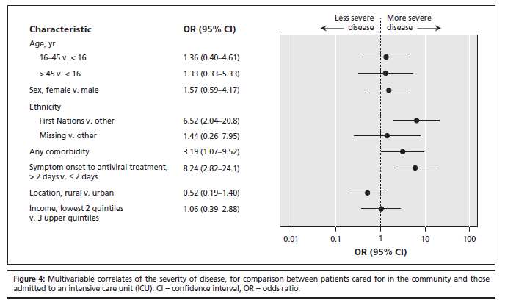
Likelihood of Hospitalization
R. Zarychanski et al, CMAJ 2-23-10

Slide 29
State-Tribal Partnerships
Both Oregon and Washington have Tribal Liaisons
Assist in communicating with Tribes
Work to meet needs regarding supplies (PEP), vaccines and anti-viral medications
Provide a conduit for Tribal and IHS communication with States about issues such as surveillance, outbreak investigation and resource allocation
Notes:
Oregon PHD maintains a position dedicated to tribal preparedness liaison work to facilitate communication with tribes, the Northwest Portland Area Indian Health Board, and agencies working with Urban Indians.
PHD established a Tribal epidemiology liaison position to coordinate efforts to respond to H1N1, other public health issues, and to improve data quality.
Tribes, local health departments, and PHD held weekly conference calls to review unfolding H1N1-related developments and share issues requiring coordinated action.
Tribal representatives and the PHD tribal preparedness coordinator held a separate, weekly conference call to share information and problem solve.
Provided direct allocation of PPE, antiviral medications, and 2009 H1N1 vaccine to tribes.
Provided direct allocation of vaccine to the Native American Rehabilitation Association, an Urban Indian clinic.

Slide 30
State and Tribal Epi-Center Collaboration
New projects in WA and OR to link the Northwest Tribal Registry with hospital and emergency department discharge and communicable disease surveillance systems to correct racial misclassification
Participation in CSTE follow-up study of risk factors for H1N1 hospitalization and mortality among AI/AN

Slide 31
What’s Next
Continue to refine our plans for pandemic influenza
Maintain existing partnerships and forge new collaborations around improving public health data quality and reporting, surveillance and outbreak investigation, immunization and public health communication

Slide 32
Thank You!
Acknowledgments
OR Dept Human Services, Public Health Division
Richard Leman
Cary Palm
WA Dept of Health
Maria Gardipee
John Erickson
Indian Health Service
John Redd
John Hayes

Slide 33
Questions?

